Slide 1
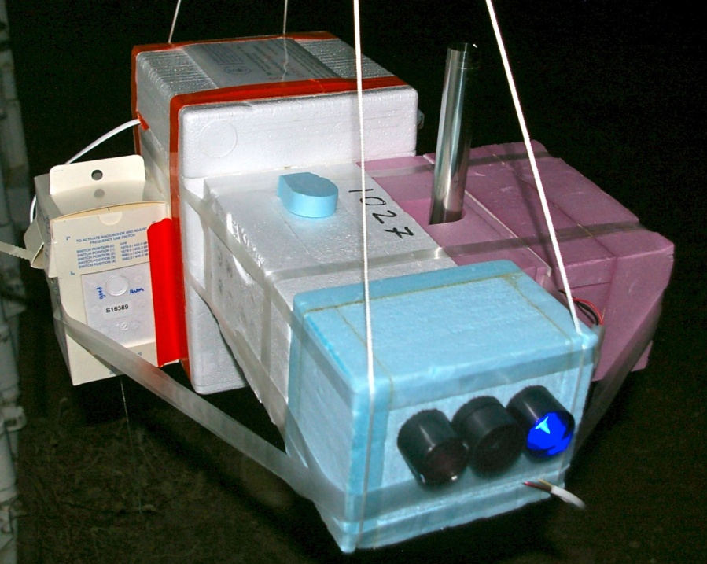
Balloon- borne measurement of Asian tropopause aerosol layer at Lhasa and Kunming during Asian summer monsoon
In the poster, balloon sounding water vapor, ozone, and particle (SWOP) campaign during the ASM will be introduced, including sonde, location and timing.
The Asian tropopause aerosol layer as revealed by satellite is indeed observed by in situ Cobald measurements!
If you have interest in the UTLS in situ measurement within the ASM anticyclone, you can contact me (bjc@mail.iap.ac.cn).
Jianchun Bian (IAP/CAS)

Slide 2
Balloon-borne sondes
Compact Optical Backscatter Aerosol Detector (ETH)
NOAA Frost Point Hygrometer (NOAA GMD)
Cryogenic Frost Point Hygrometer (Vömel-DMT)
Electrochemical Concentration Cell Ozonesonde (DMT)
Radiosonde: P, T, U, winds (u,v) (InterMet)
CFH & FPH measure the water vapor concentration and RHi by detecting the frost point of the air-mass.
COBALD detects cloud particle and aerosol by emitting light at two wavelengths (455nm, 870nm), and receiving the back-scattered signal.

Slide 3
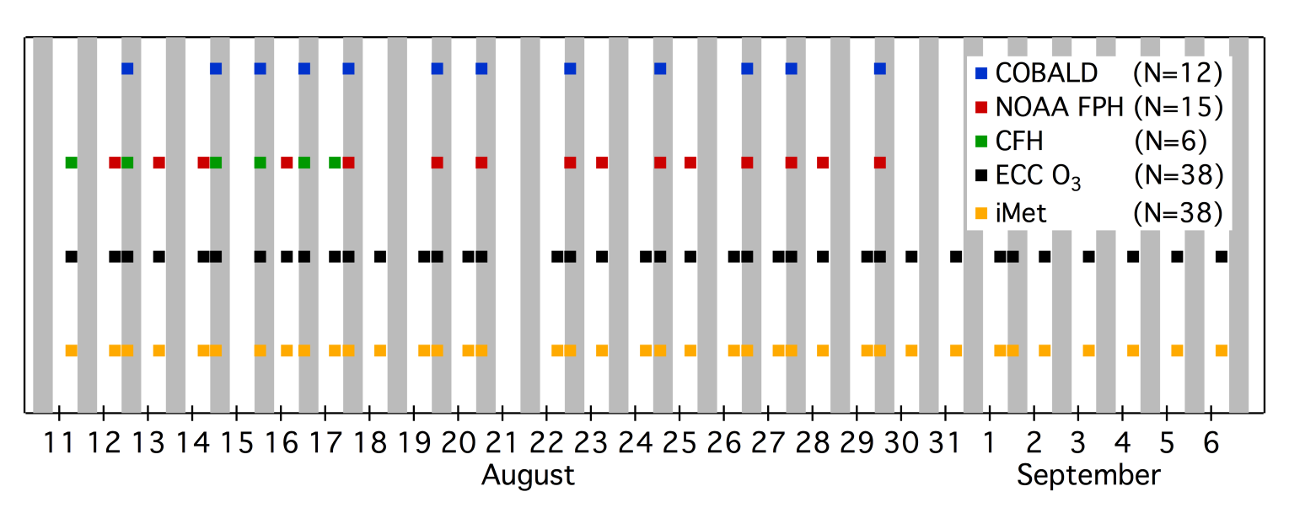
Sounding timing
Kunming, 2012
Kunming
Lhasa 2013
Lhasa

Slide 4
Water vapor Ozone RHi
KM
2009
(11)
LS
2010
(12)
Bian et al. GRL, 2012

Slide 5
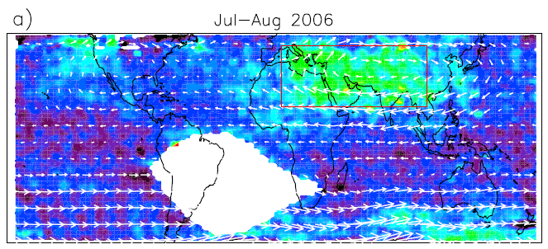
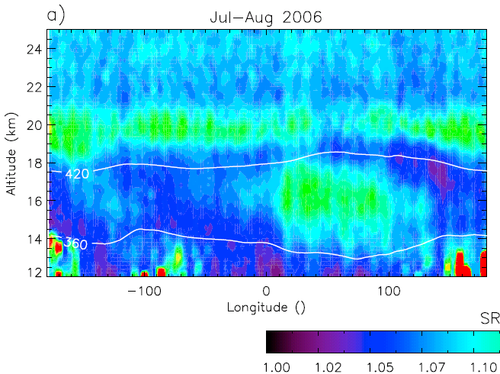
Asian tropopause aerosol layer is indeed observed by in situ measurements !
Vernier et al, GRL, 2011

Slide 6
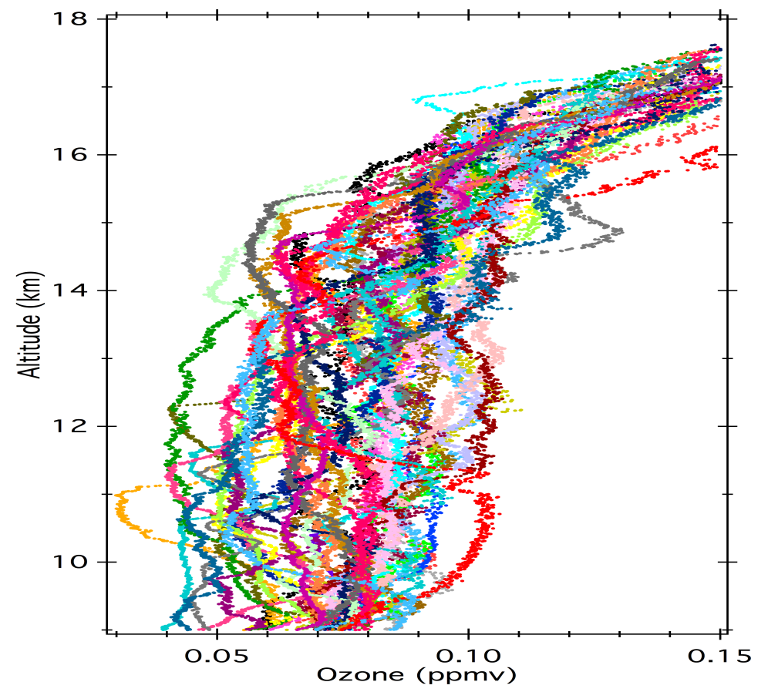
Low-ozone intrusion into the UT
KM 2012
KM 2009
Deep convection signal – Local or faraway
KM 2012 has fewer cases above 14 km – Interannual variation

Slide 7
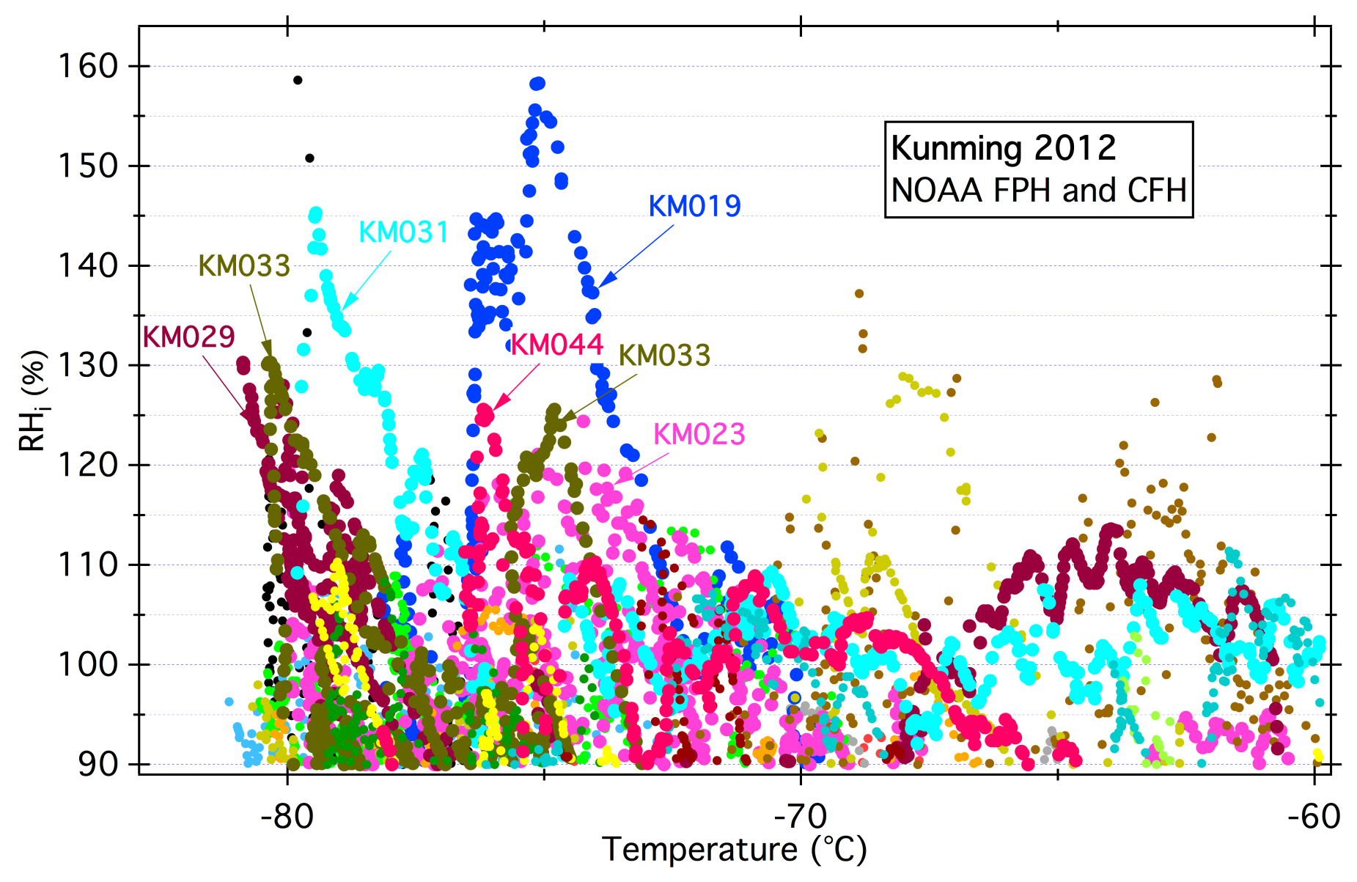
RHi distribution changes with temperature

Slide 8
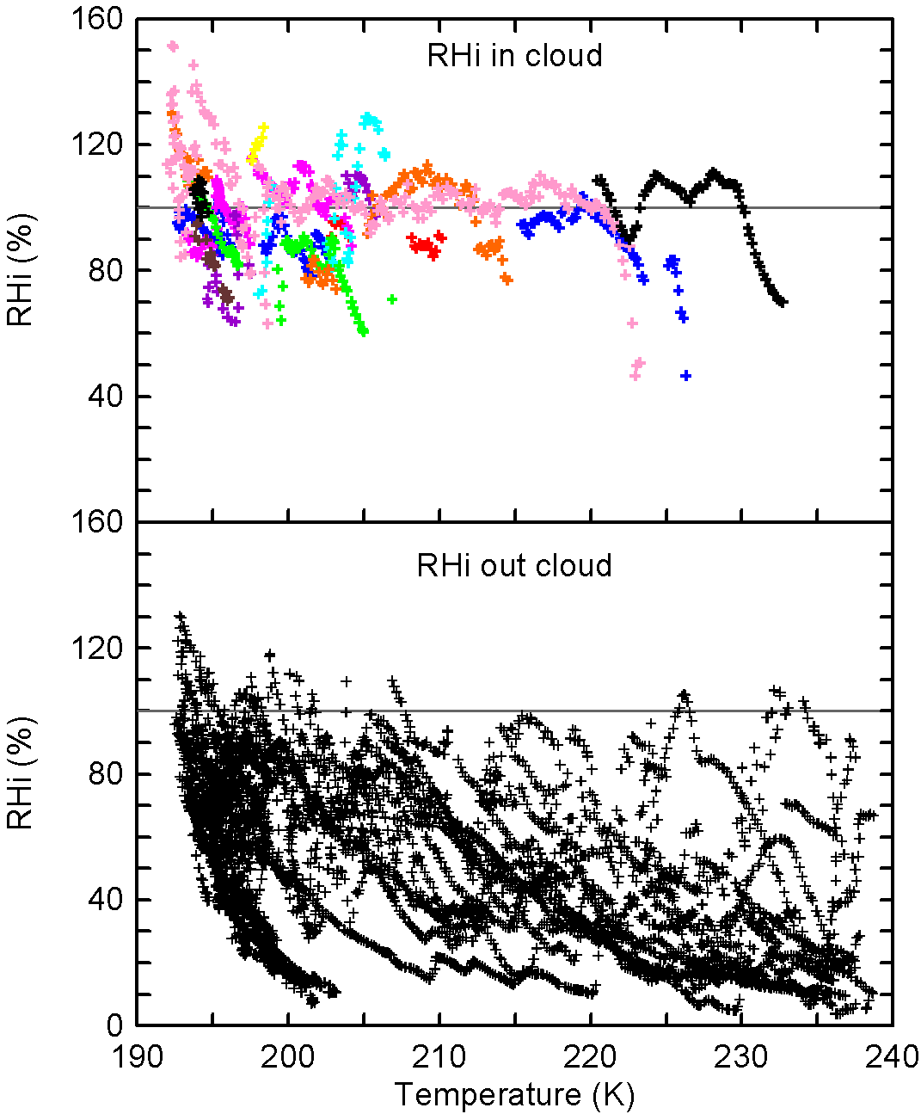
RHi distribution in/out cirrus cloud

Slide 9
Summary
For the first time, in situ observing H₂O, O₃ and particle in the UTLS were conducted during the ASM.
Some specific features in the ASM UTLS are revealed: super-saturation, low ozone intrusion to the UT, aerosol layer, RHi structure in and out cirrus layer.
Further analysis (model and satellite data) should be done to understand the underlying micro-physical and dynamical processes.

