Slide 1






Aerosol
Climate Change Initiative
Stratospheric activities
around the Aerosol_CCI project
C. Bingen, C. Robert, A. Bourrassa & Aerosol_CCI Team
F. Vanhellemont, N. Mateshvili, D. Fussen & AerGom Team
SPARC - SSiRC Workshop • 28-30.10.2013 • Atlanta, Georgia, USA
Notes:
Page Titre

Slide 2
Aerosol_CCI
Generalities
Framework
Climate Change Initiative = ESA response to GCOS requirements :
Development of improved data records for the main Essential Climate Variables
Valorisation of ESA archives
MAIN OBJECTIVES
Identify and understand differences, strengths, weaknesses of existing algorithms
Consolidate and improve existing algorithms
Integrate major European EO teams / focus on ENVISAT and European sensors:
{ ATSR-2, AATSR, MERIS, SCIAMACHY, OMI, GOME, AVHRR, GOMOS }
Important involvement of User community (AEROCOM, MetNo, NILU, MPI-Chem)
Phase I (3 years) currently ending; proposal has been introduced for Phase 2 (3 years)
Notes:
MOTIVATION: large uncretainty in terms of climate impact (IPCC)
Reasons for disagreement between satellite products: : 1) ill-posed retrieval problem 2)different information content (spectral, angular, polarization) 3)different assumptions 4)different sampling

Slide 3














Aerosol_CCI
Teams involved
Universität
Bremen
Earth’s
Observation
User and
Validation
System
Engineering

Slide 4
Aerosol_CCI
stratospheric aspects (Phase I)
Baseline – stratospheric part : focus on GOMOS
Use a new GOMOS retrieval algorithm (ESA Aergom project) as input for Aerosol_CCI
Improve stratospheric occultation product
Include the longitudinal dependence in the final binned product
Produce a aerosol records for year 2008 using the GOMOS instrument.
AOD + extinctions with error at 550 nm, PSC flags, Angstrom exponent
Monthly binned product: 2.5° lat. x 10° lon. x 1 km
Validation by NILU (CALIPSO) and MPI-Chem (EMAC CCM)
Option : Multi-sensor stratospheric aerosol data sets: GOMOS+OSIRIS
Investigate the problem of data merging
Propose a data merging algorithm: OSIRIS + GOMOS (AERGOM)
In collaboration with U. Saskatchewan (Canada)

Slide 5
GOMOS products
Official vs AerGom
 | Official GOMOS processor | AerGom
Spectral inversion | SPA NO₂, NO₃: DOAS O₃, aerosols: LM fit Aerosol spectral model: rather strange quadratic polynomial | SPA, SPB1 (outside O2 band) NO₂, NO₃, O₃, aerosols: simultaneous LM fit Aerosol spectral model: more physical parameterization using a polynomial in inverse wavelength
Spatial inversion | All species separately, discarding covariances from the spectral inversion Tikhonov altitude regularization (one for aerosols) | All species together, using the entire spectral retrieval covariance matrix Tikhonov altitude regularization for each species

Slide 6
GOMOS products
Official vs AerGom
Official product (v5)
AerGom product
Blue: 400 nm
Green: 500 nm
Red: 600 nm
Notes:
AerGom: differences and improvements over the official product (see presentation by Filip for Claus)
_> too much smoothing at 500nm, no regularzation at other wavelengths

Slide 7
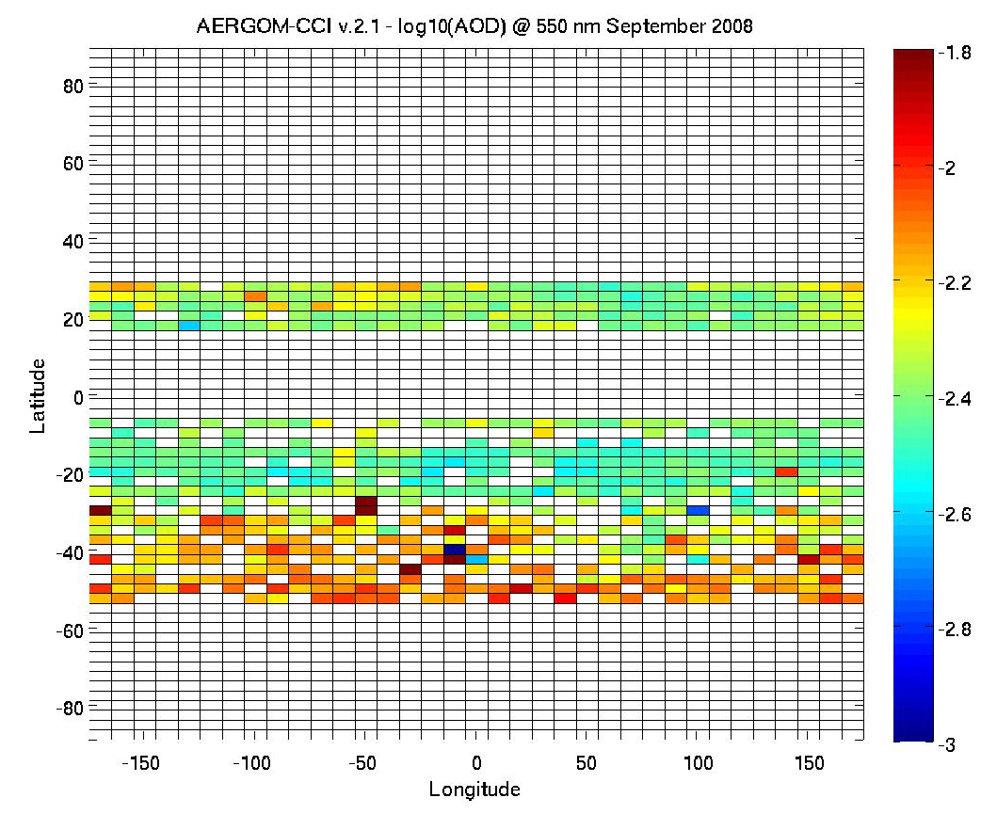
Aerosol_CCI
Latest version: Product detail
AOD product at 550 nm
Notes:
Seasonal and zonal averaged extinction

Slide 8
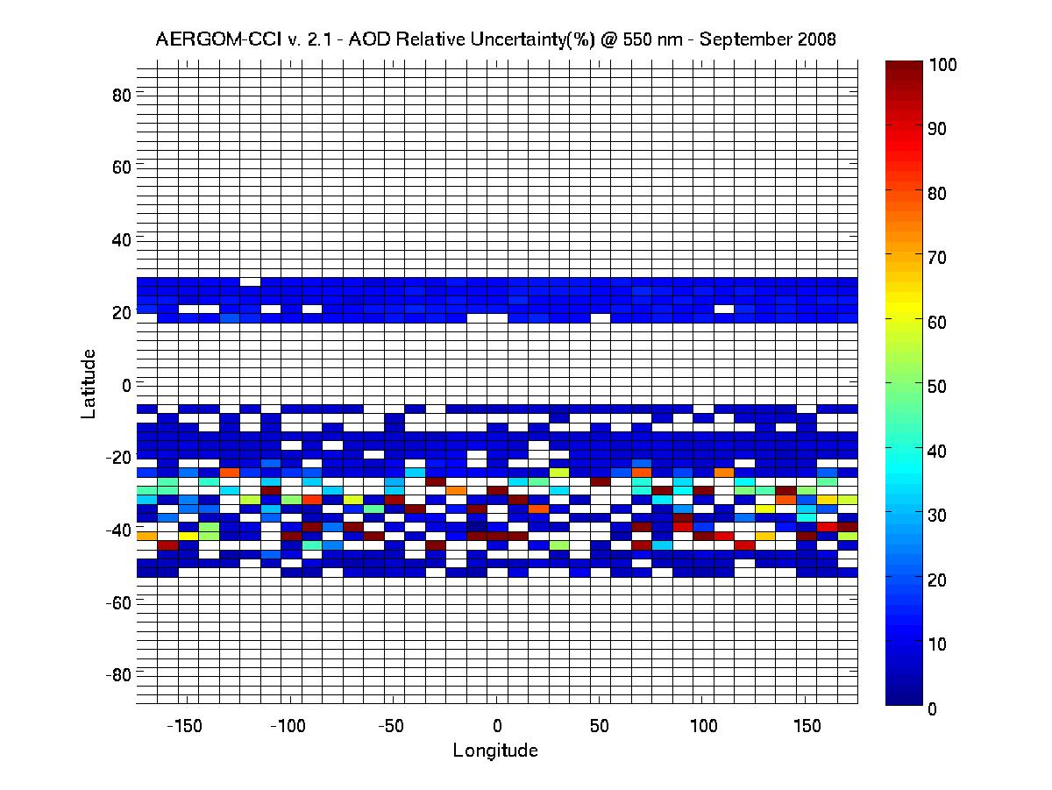
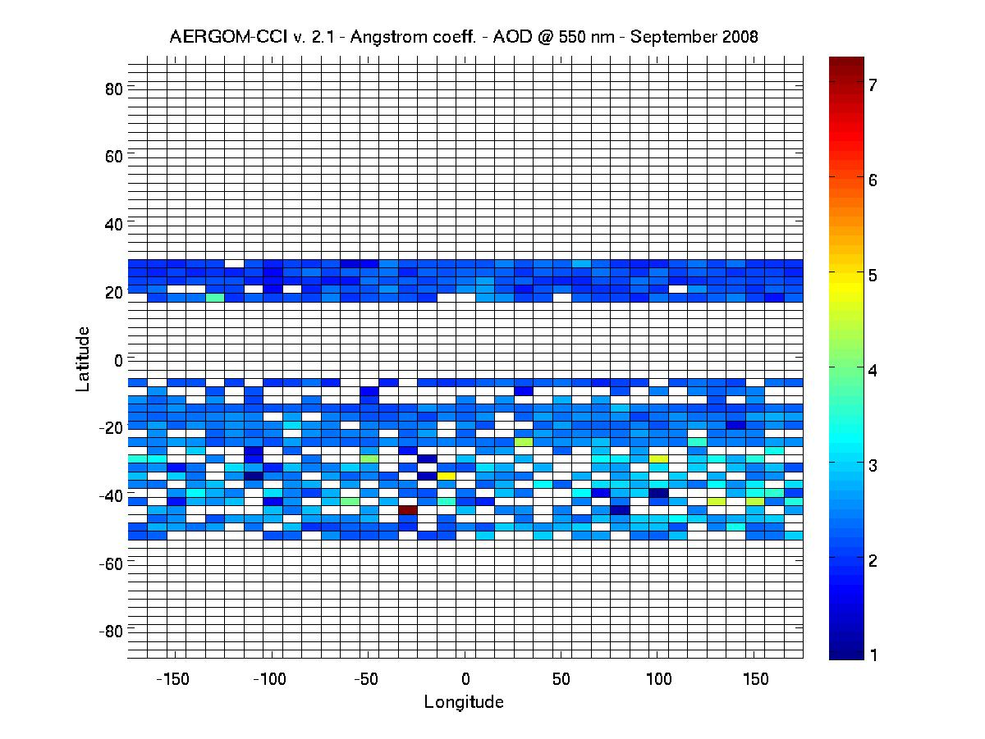
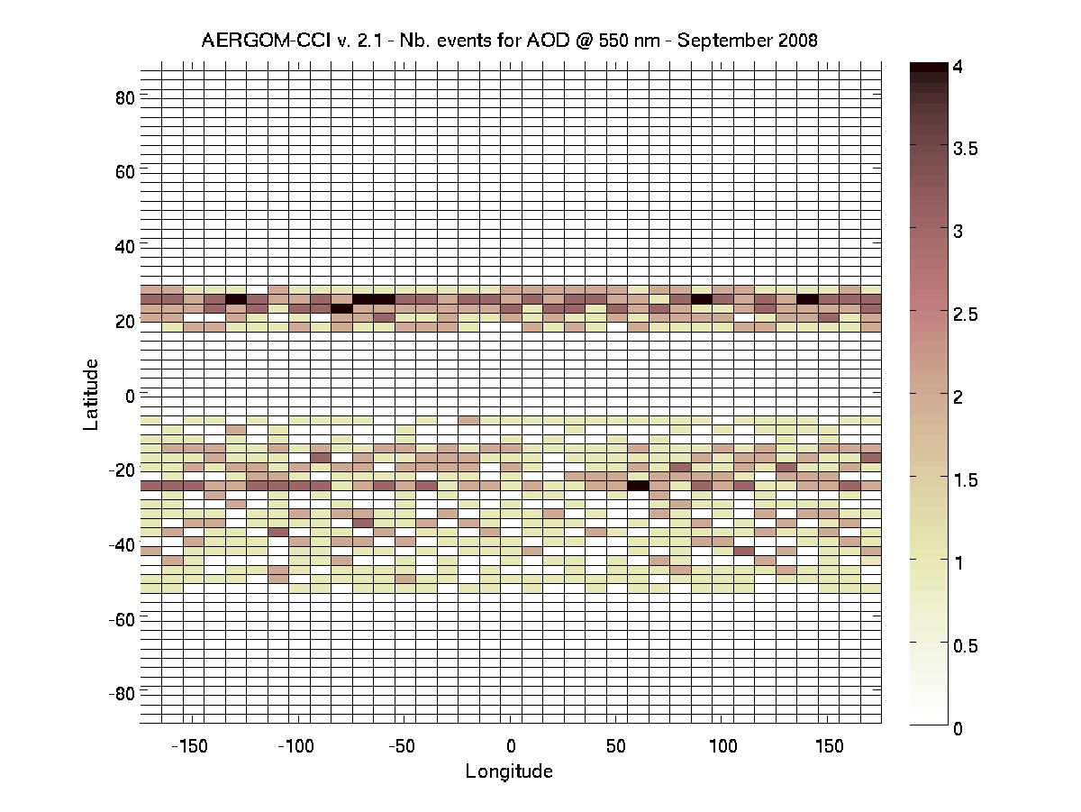
Aerosol_CCI
Latest version: Product detail
Notes:
Seasonal and zonal averaged extinction

Slide 9
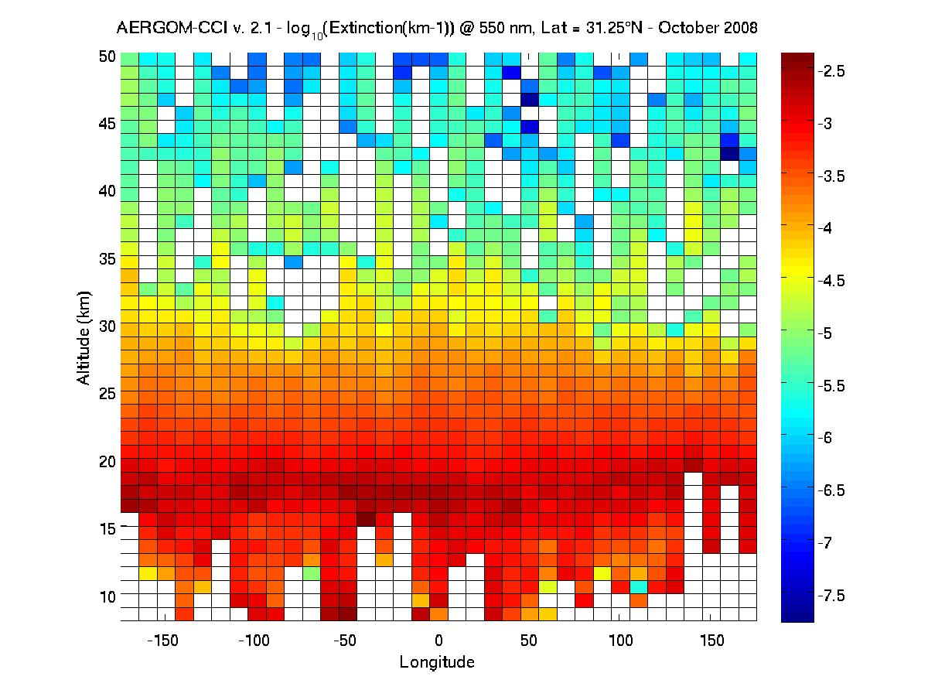
Aerosol_CCI
Latest version: Product detail
Extinction product at 550 nm
Notes:
Seasonal and zonal averaged extinction

Slide 10
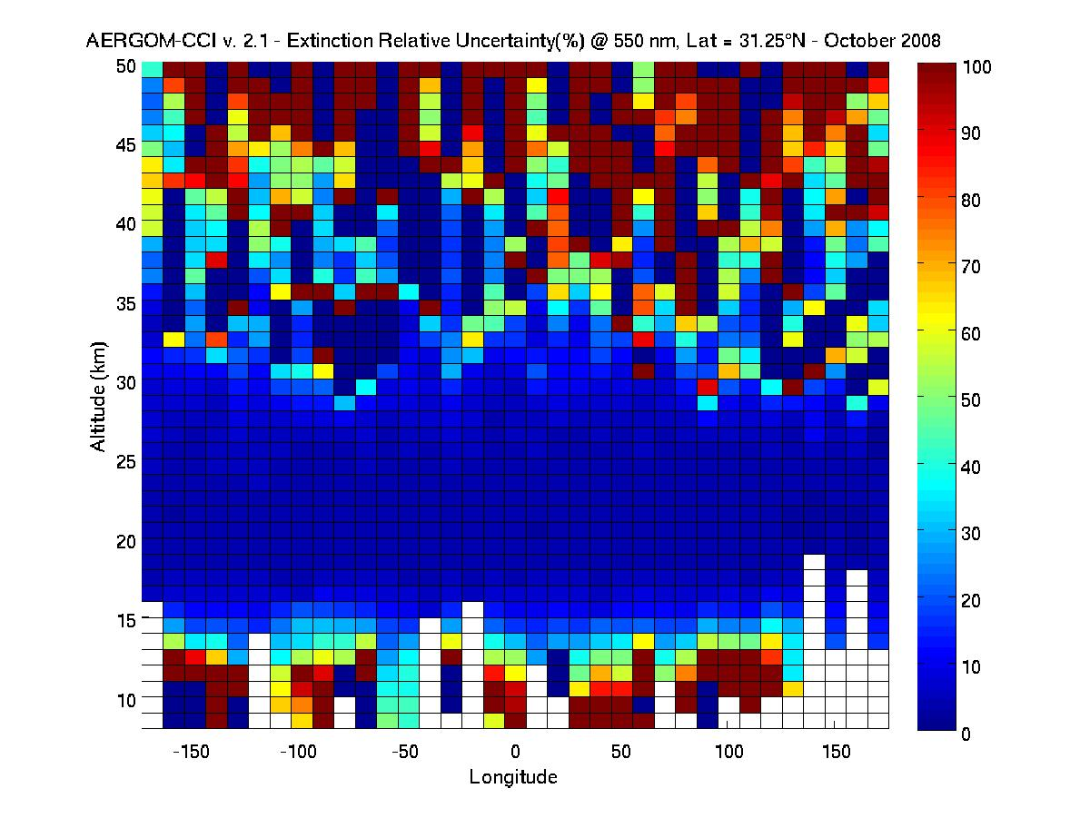
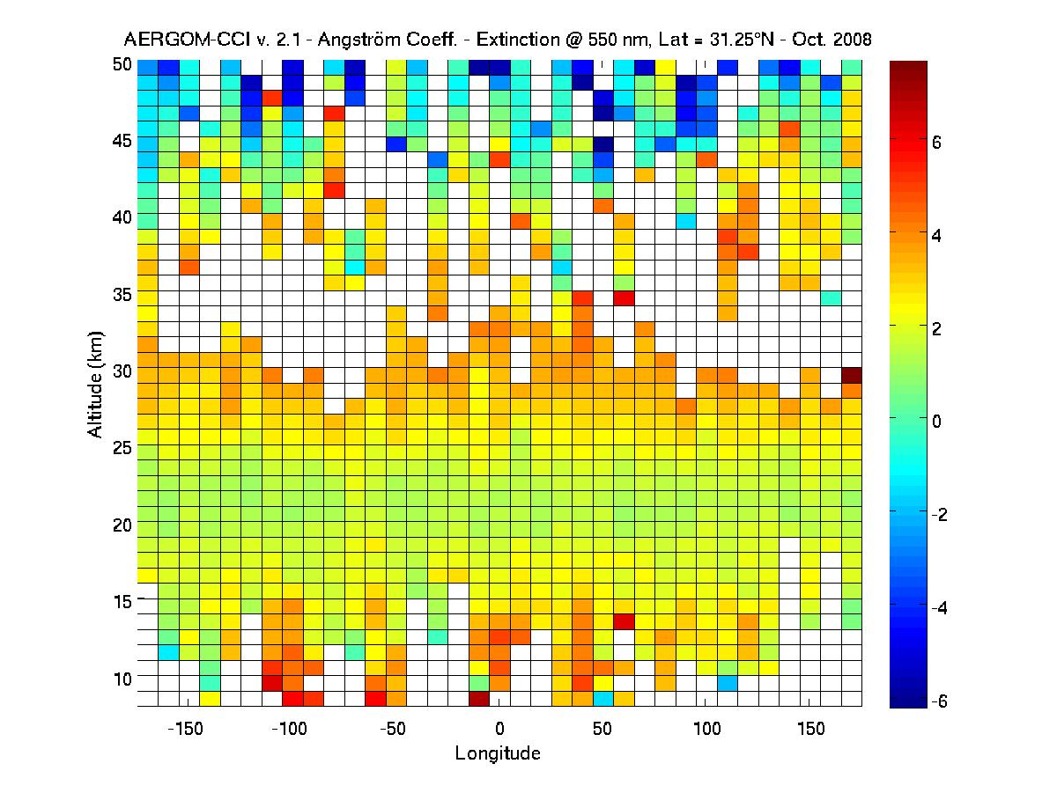
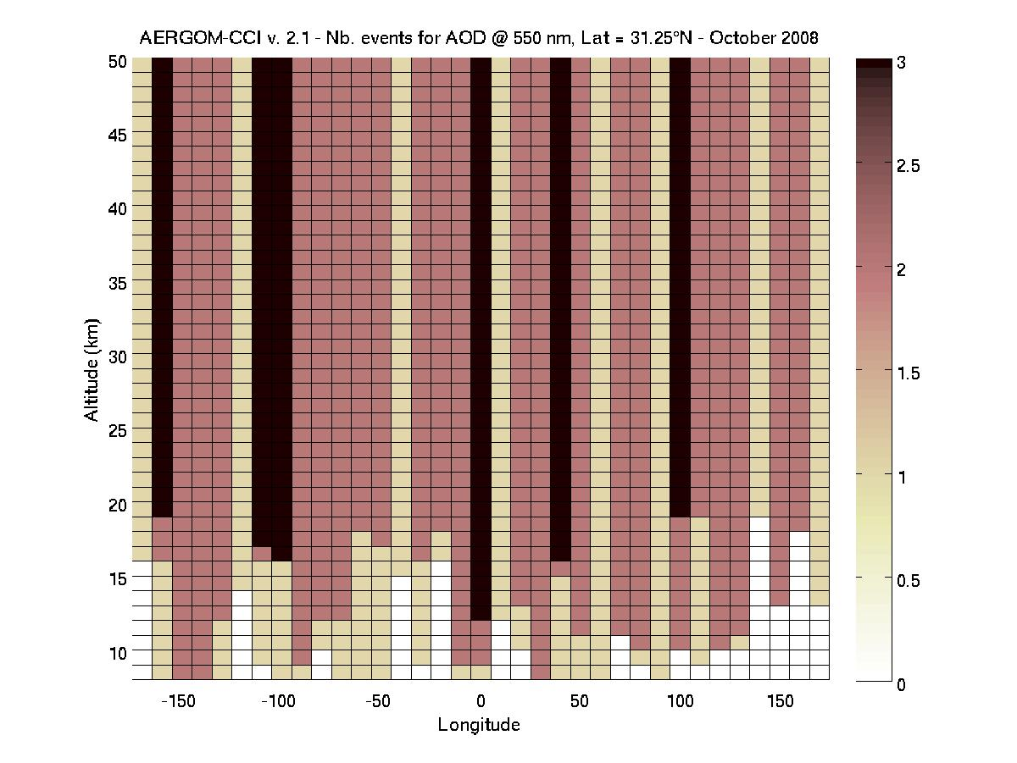
Aerosol_CCI
Latest version: Product detail
Notes:
Seasonal and zonal averaged extinction

Slide 11
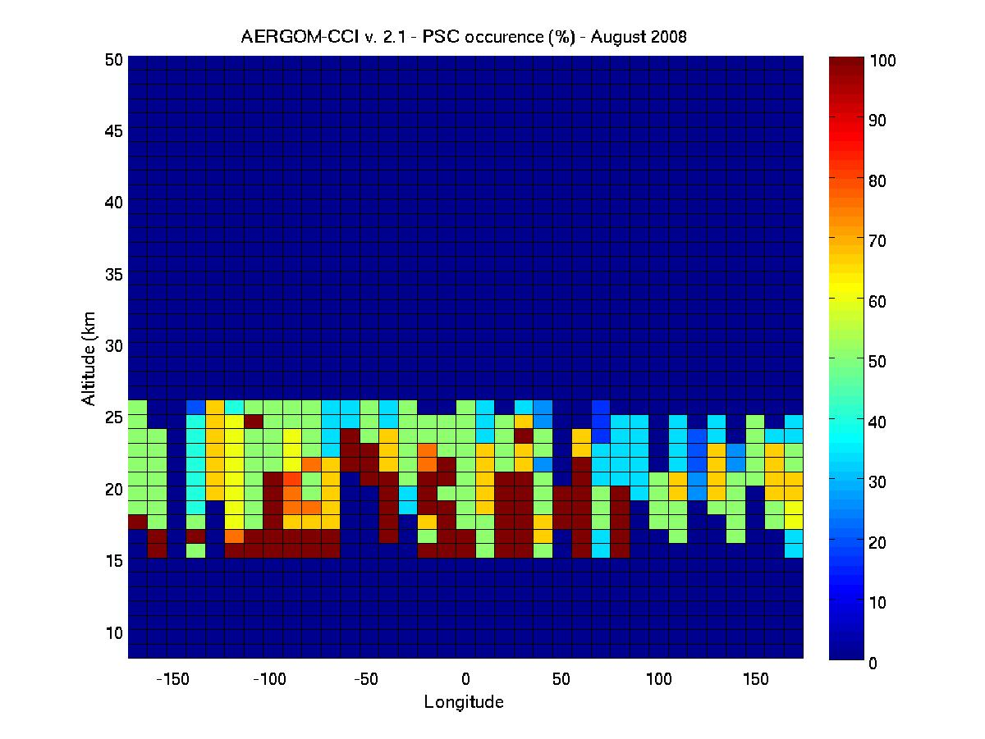
Aerosol_CCI
Latest version: Product detail
PSC occurrence
From the Options Proposal Revision 2: Part selected in March 2012 Volume I:
Inter-comparisons will be carried out between both data sets, and possibly using other independent data sources (historical satellite data sets or in situ). As an initial task, the focus will be to determine how to proceed with the inter-comparisons to minimize the effect of discrepancies between respective geo-locations, measurement times and spectral differences of both measurement sets. Possible gaps will be indentified in both data sets, and differences in extinction values and uncertainties will be analyzed to better understand the strengths and weaknesses of both data sets.
Notes:
Why did we choose year 2003 compared with 2008 for the baseline?
In 2003, there were more data with GOMOS (prior to a system failure which decreased the daily measurements from ~400 to ~280 on average)
Possibility to compare with SAGE II and SAGE III instruments, which can act as reference

Slide 12
Aerosol_CCI
Data merging
Multi-sensor stratospheric extinction dataset : AerGom + OSIRIS
Assessment of both datasets with respect with one another
Development of a merging strategy
Production of one year dataset (2003)
Current way of working:
Individual binning of both extinction datasets
Fit of Mie particles through the combined Aergom-OSIRIS binned dataset
Separate retrieval for liquid aerosols and ice particles
Reconstruction of the extinction using the particle size distribution
From the Options Proposal Revision 2: Part selected in March 2012 Volume I:
Inter-comparisons will be carried out between both data sets, and possibly using other independent data sources (historical satellite data sets or in situ). As an initial task, the focus will be to determine how to proceed with the inter-comparisons to minimize the effect of discrepancies between respective geo-locations, measurement times and spectral differences of both measurement sets. Possible gaps will be indentified in both data sets, and differences in extinction values and uncertainties will be analyzed to better understand the strengths and weaknesses of both data sets.
Notes:
Why did we choose year 2003 compared with 2008 for the baseline?
In 2003, there were more data with GOMOS (prior to a system failure which decreased the daily measurements from ~400 to ~280 on average)
Possibility to compare with SAGE II and SAGE III instruments, which can act as reference

Slide 13
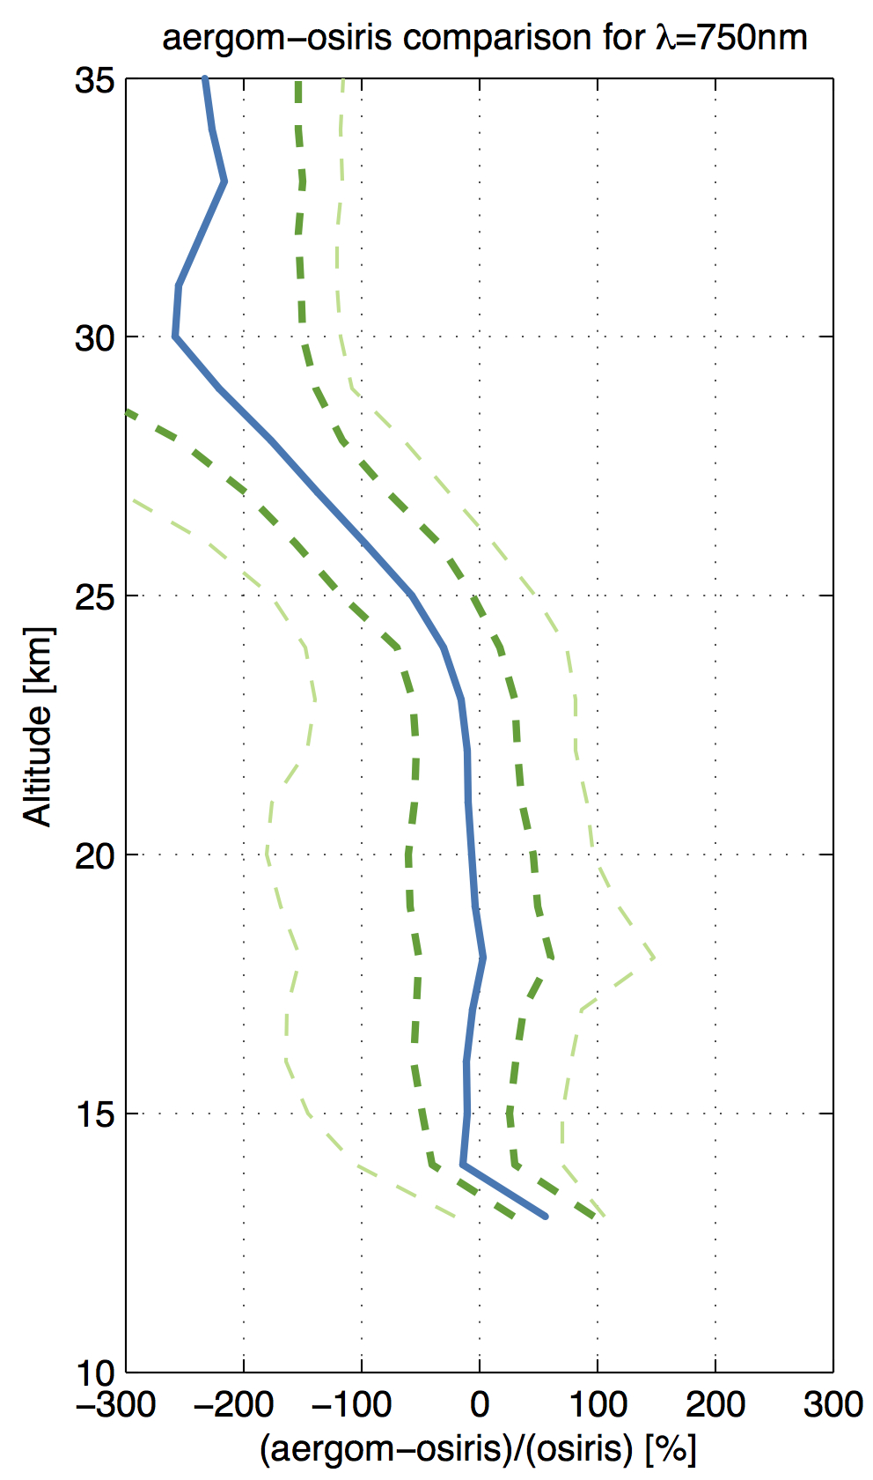
Aerosol_CCI
Data merging
Intercomparison AerGom - OSIRIS
Good agreement between both datasets up to 24 km
Bias increases at higher altitude
Star filtering : removal if
SZA > 117°
Star magnitude < 2.6
Star temperature > 5000 K
Coincidence criteria :
Δt = ±6h
Δr = ± 500 km
P50
P25
P75
P10
P90
From the Options Proposal Revision 2: Part selected in March 2012 Volume I:
Inter-comparisons will be carried out between both data sets, and possibly using other independent data sources (historical satellite data sets or in situ). As an initial task, the focus will be to determine how to proceed with the inter-comparisons to minimize the effect of discrepancies between respective geo-locations, measurement times and spectral differences of both measurement sets. Possible gaps will be indentified in both data sets, and differences in extinction values and uncertainties will be analyzed to better understand the strengths and weaknesses of both data sets.
Notes:
Why did we choose year 2003 compared with 2008 for the baseline?
In 2003, there were more data with GOMOS (prior to a system failure which decreased the daily measurements from ~400 to ~280 on average)
Possibility to compare with SAGE II and SAGE III instruments, which can act as reference

Slide 14
Data merging
Derivation of the merged extinction: liquid aerosol
March 2003
[100°E,110°E]
[50°S, 40°S]
AerGom
Aerosol_CCI

Slide 15
Data merging
Derivation of the merged extinction: liquid aerosol and ice occurence
January 2003
[170°W,160°W]
[20°S, 10°S]
AerGom
Aerosol_CCI

Slide 16
Data merging
Effect of the bias between AerGom and OSIRIS
March 2003
[140°W,130°W]
[60°S, 50°S]
AerGom
Aerosol_CCI

Slide 17
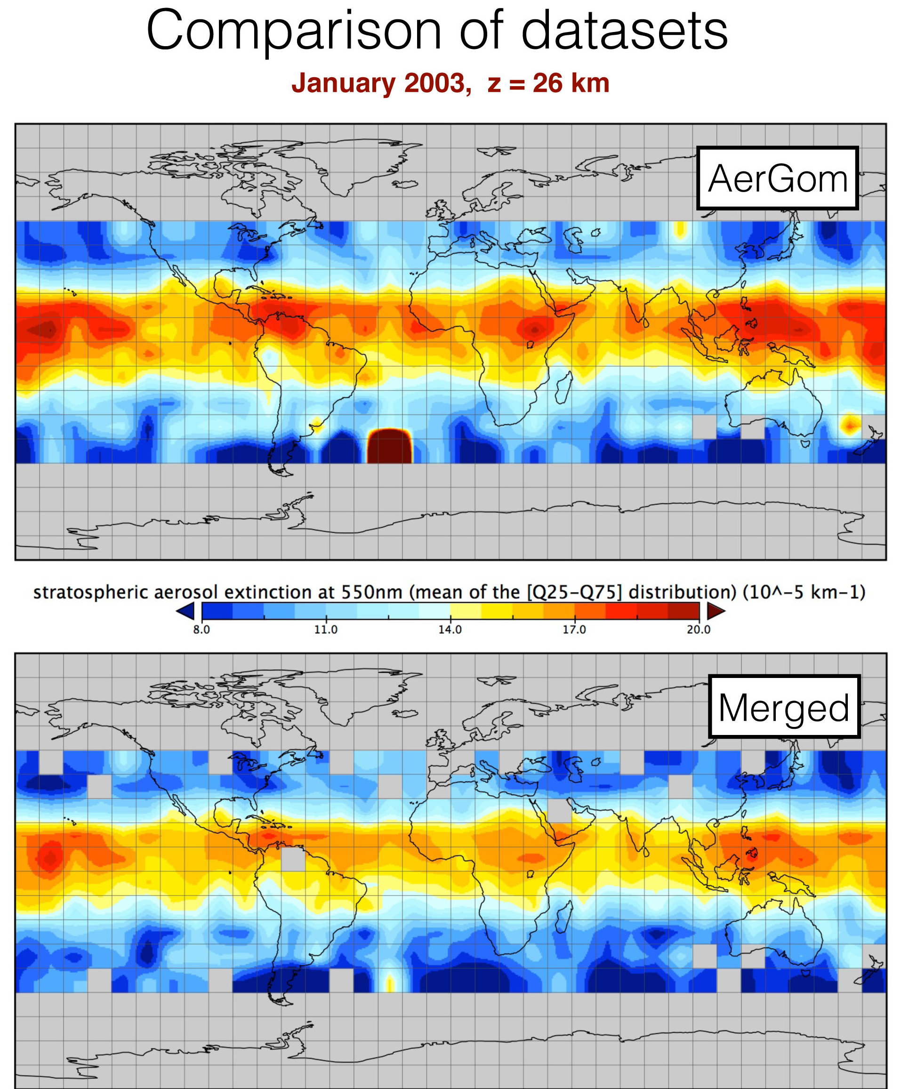
Data Merging
λ = 550 nm
AerGom
Aerosol_CCI

Slide 18
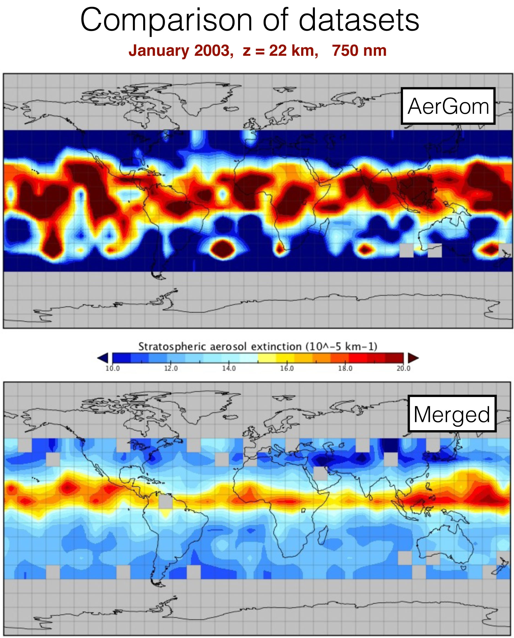
Data Merging
Significant increase of the information content !
AerGom
Aerosol_CCI

Slide 19
Aerosol_CCI
Future work
Baseline project
Long-time series AerGom dataset
Long-time series AerGom - OSIRIS - SAGE II
Further algorithm development
Option : Integration SCIAMACHY with GOMOS stratospheric prod.
Investigation, intercomparisons and improvement of both datasets
Production of SCIAMACHY data records with same specifications as for the baseline
Development of a data merging algorithm for SCIAMACHY and AerGom
Provision of long-time series AerGom-SCIAMACHY
Investigation of the particle size retrieval
Collaboration with the U. of Bremen (Germany)
AerGom
Aerosol_CCI

Slide 20
Aerosol_CCI
Stratospheric Aspects
CONCLUSION
Strong interaction between AerGom and Aerosol_CCI:
Dramatic improvement of AerGom
Development of GOMOS data records for the Climate Modeling Community: AOD, extinction, Angström coefficients and several diagnostic products
All data provided with uncertainty
Development of data merging
Problem of bias between AerGom and OSIRIS
Ongoing work !
Perspectives for Phase 2:
Development long-time series
Algorithm development and improvement
Sensors: GOMOS, GOMOS-OSIRIS-SAGE II, GOMOS-SCIAMACHY

