Slide 1
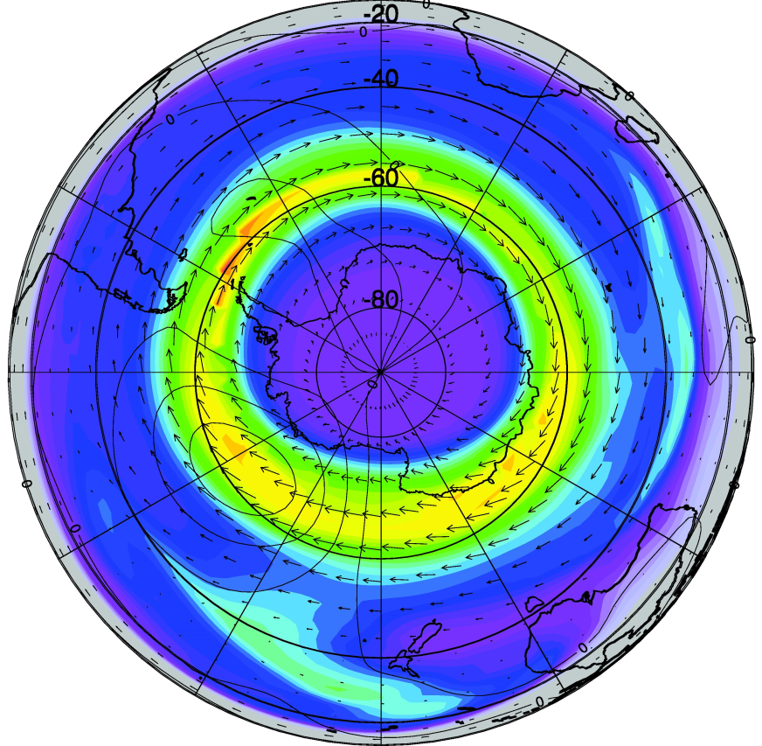
The Global Extent and Variability of the Stratospheric CN Layer: A Three Dimensional Modeling Study
Patrick Campbell, University of Wyoming, Laramie, Wyoming, USA.
Michael Mills, NCAR Earth System Laboratory, Boulder, Colorado, USA.
Terry Deshler, University of Wyoming, Laramie, Wyoming, USA.
SSiRC Workshop
Atlanta, Georgia
October 30, 2013

Slide 2
Stratospheric Condensation Nuclei (CN)
Measurements of CN include the total stratospheric aerosol population above a critical size, which is dependent on the instrumentation. For our balloon-borne instruments, the observed size is r > 3 – 10 nm, dependent on pressure.
The stratospheric aerosol population is dominated for number concentration by the smaller particles, and thus quantifying CN helps describe the small particle tail of the size distribution.
Stratospheric CN are also important because:
They are the initial pathway for removal of sulfate from the stratosphere.
They serve as sites for condensation and nucleation centers for PSCs.
They can be used as a tracer for transport processes.
They are involved in interplay of meteoritic material with H₂SO₄ condensation and removal.
CN layers may be important for specific heterogeneous reactions.

Slide 3
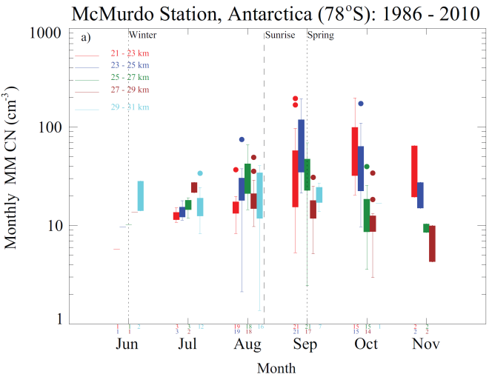
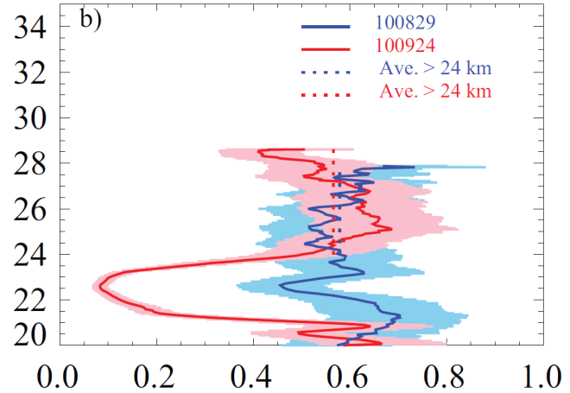
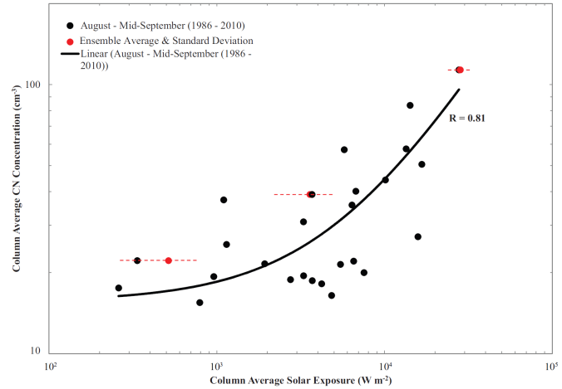
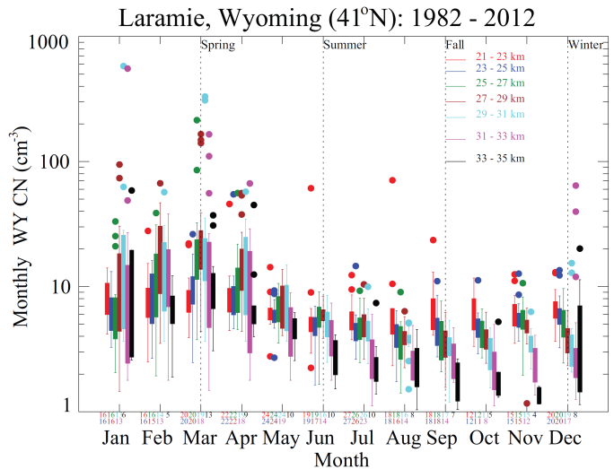
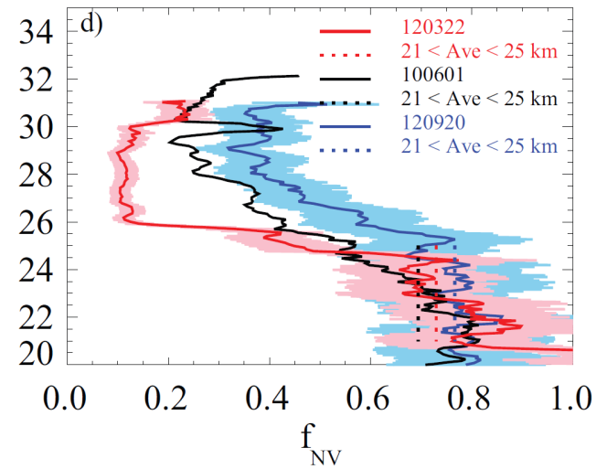
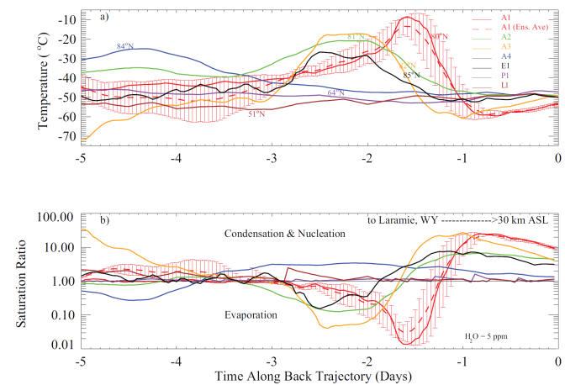
Stratospheric CN Measurements Campbell and Deshler [2013], JGR, under revision.
Seasonality
Volatility
Formation
10 – 20 → > 100 cm⁻³ (21 – 27 km)
< 0.1
1 – 10 → > 20 cm⁻³ (25 – 31 km)
< 0.1
Seasonal enhancement, the “CN layer”, forms during late winter – early spring.
CN layer is volatile H₂SO₄-H₂O solution; supports binary homogeneous nucleation
CN layer forms locally to Antarctic. Influenced by transport in mid-latitudes
Notes:
Here I show some main results from a climatology of nearly 30 years of stratospheric CN measurements, under revision in Campbell in Deshler (2013). Don’t need to pay too close attention to the details in the plots here, but a seasonal analysis shows an enhancement in CN concentration, or the CN layer, that forms in the winter-spring seasons above the polar regions such as McMurdo Station, Antarctica, as well as a weaker CN layer above the mid-latitude location of Laramie, Wyoming, in the U.S.
Animation…Volatility studies of the CN layer between 2010 – 2012 indicate that the observed CN layer is mainly a volatile sulfuric acid-water solution, formed via binary homogeneous nucleation.
Animation…Analyses on the formation of the CN layers using HYSPLIT modeling compared with long term observations indicate a local formation to the Antarctic, while a transport influences for the mid-latitude CN layer.

Slide 4
Previous Modeling Studies of the Stratospheric CN Layer
The importance of the stratospheric CN layer has prompted modeling studies of its austral spring formation over Antarctica [Zhao et al., 1995; Mills et al., 1999; Mills et al., 2005].
Results from these studies indicated that the source of the austral spring CN layer is:
High altitude photolysis of H₂SO₄ vapor by visible solar radiation [Vaida et al., 2003],
Subsidence of SO₂ from the upper stratosphere and mesosphere, and
Springtime formation of the OH, and SO₂ oxidation leading to a burst in gas phase H₂SO₄ and nucleation of new particles.
A motivation for this study, was to extend such modeling and measurements to provide the first three dimensional perspective of the global extent and variability of the stratospheric CN layer.

Slide 5
NCAR Community Earth System Model, Version 1 (CESM1)
CESM1(WACCM) - CARMA
English et al. [2011]
WACCM: Whole Atmosphere Community Climate Model [Marsh et al., 2013] - “High-Top” Model
CARMA: Community Aerosol and Radiation Model for Atmospheres [Toon et al., 1988] - Sectional aerosol microphysics model. Focused on pure sulfates.
Model run used specified dynamics [SD; Kunz et al., 2011]. Output compared to observations for the 2010 calendar year.
Notes:
From English et al. [2011]
Model description
We have constructed a three-dimensional general circulation model with sulfur chemistry and sectional aerosol microphysics. We use the Whole Atmosphere Community Climate Model (WACCM) (Garcia et al., 2007) coupled with the Community Aerosol and Radiation Model for Atmospheres (CARMA) (Toon et al., 1988). Figure 1 illustrates the processes treated in the coupled model. Model coupling is done by implementing a single column version of CARMA as a WACCM physics package. Results of this coupling for meteoric dust (Bardeen et al., 2008), noctilucent clouds (Bardeen et al., 2010) and black carbon (Mills et al., 2008; Ross et al., 2010) have been published previously. Other versions of the code have been used to simulate sea salt and dust (Fan and Toon, 2010; Su and Toon, 2011). The WACCM state is passed to CARMA one column at a time. CARMA calculates changes to the constituents, and the tendencies are sent back toWACCM where they are used to adjust the model’s state. Each CARMA aerosol size bin is added as a unique WACCM constituent (Bardeen et al., 2008). Although CARMA is capable of interacting radiatively and chemically with WACCM, for these studies the interactions were mainly disabled. This version of WACCM utilizes SAGE II sulfate surface area densities for radiative transfer and ozone heterogeneous chemistry calculations.
WACCM with sulfur chemistry
We useWACCM3 version 3.1.9 tag 9 with 30-min time steps at 4 latitude by 5 longitude horizontal resolution with 66 vertical levels based on hybrid-sigma coordinates, providing 15 vertical levels in the UTLS between 50 and 500 hPa. We use the WACCM mass-conserving finite volume dynamical core based on a flux-form semi-Langrangian transport scheme (Lin and Rood, 1996, 1997). The vertical diffusion algorithm in WACCM handles eddy and molecular diffusion for gases. A 63-species chemistry module is implemented. We utilize WACCM’s standard 56-species chemical package which includes Ox, NOx, HOx, ClOx, and BrOx chemical families along with CH4 and its products and 7 ions (Kinnison et al., 2007), and add 7 sulfur-bearing gases: S, SO, SO2, SO3, HOSO2, H2SO4, and OCS. Their reaction rates and photo-dissociation rates are given in Table 1.
The model includes emissions of carbonyl sulfide (OCS) and sulfur dioxide (SO2), two primary sulfur emissions of importance to the UTLS region. OCS is specified with a constant surface concentration of 510 pptv. SO2 is specified from a two-dimensional monthly mean surface emissions dataset (Lamarque et al., 2010; Smith et al., 2011). The model does not include emissions of dimethylsulfide or volcanic SO2, which are large natural sources of sulfur to the UTLS, but minor contributions to total UTLS aerosol. We compare with data from a period with relatively little volcanic activity. Wet deposition for all constituents (including the aerosol bins from CARMA) is calculated using WACCM’s existing techniques (Barth et al., 2000). All of the aerosol bins are assumed to have a constant 0.3 solubility parameter. WACCM treats dry deposition of gases (Barth et al., 2000), while dry deposition of aerosols is not treated in this model.
CARMA
We use CARMA 2.3 configured for one-dimensional columns using the same vertical grid as WACCM. Split-time stepping is enabled for nucleation and growth routines when sulfuric acid is supersaturated. Nucleation and growth are treated simultaneously in the model. If sulfuric acid gas concentrations become unstable (negative), the CARMA time step is retried with double the number of substeps. On rare occurrences the model reached over 1000 substeps, but typically the model ran with only 1 or 2 substeps. We have found that increasing the number of timesteps past the point at which negative gas amounts were found did not significantly change results. Additionally, we limited nucleation to 40% of the sulfuric acid available. We specify 38 sulfuric acid mass bins ranging from 0.2 nm to 1 micron radius, with mass doubling between bins. The particles are assumed to have spherical shape. Sulfate surface tension is calculated using the constants from Sabinina and Terpugow (1935). Since the bins only carry sulfate, the equivalent sulfate aerosol size (including sulfuric acid and water) is determined by the technique
of Tabazadeh et al. (1997), which calculates weight percent sulfuric acid as a function of temperature and water activity. Weight percent sulfuric acid is assumed to be independent of particle size. We did not include any other types of aerosols. Although other aerosols, such as organics, are known to compose a significant fraction of the sulfate aerosol mass in the UTLS (Froyd et al., 2009; Murphy et al., 2007), sulfates are believed to be the primary source of new particles in this region, and the primary aerosol in the lower and middle stratosphere (Murphy et al., 2007).
Fall velocities are calculated by assuming a Stokes- Cunningham equation with Knudsen number corrections from Fuchs (1964), using the equivalent aerosol size (sulfuric acid plus water). Since WACCM handles advection by winds as well as eddy diffusion, no additional eddy diffusion
of aerosol particles is added by CARMA. However, CARMA treats Brownian diffusion of aerosols, which becomes important above 100 km as the heterosphere is approached, and which is not well treated by algorithms in WACCM. CARMA calculates the effect of coagulation of
particles of equivalent aerosol size using the numerical approach described in Toon et al. (1988). Coagulation coefficients are calculated to include Brownian, convective and gravitational effects. A sticking coefficient of 1 is used, which assumes that all particles stick together upon colliding. A correction for the impact of inter-particle Van der Waals forces on coagulation is included (Chan and Mozurkewich, 2001). Sulfate aerosol growth and evaporation is calculated via sulfuric acid equilibrium vapor pressure over binary solution using the method of Ayers et al. (1980) with a temperature correction by Kulmala (1990) and thermodynamic constants from Giauque (1959). Numerical calculations for fall velocity and growth/evaporation are solved by CARMA using the piecewise parabolic method of Colella and Woodward (1984).

Slide 6
2010 CESM1(WACCM) Output vs. In-situ Observations
Model produces the CN layer above McMurdo.
McMurdo Station, Antarctica (78°S)
Campbell et al. [2013], JGR, under revision.
Notes:
Here are some of the 2010 results…
Pressure vs. CN Concentration above McMurdo ,for both observations and model results for late winter in August in black, and early spring in September in red. WACCM particle concentrations for both r > 10 nm (dashed) and r > 3 nm (dashed-dot) are shown for comparison, since there is some uncertainty as to the observed lower size threshold of CN.
Both the observations and model suggest the start of a layer by late August…the WACCM somewhat overestimates the CN layer by this time compared to observations.
By late September in Spring…the WACCM does a good job at predicting the CN layer and the region of new particle formation. Compared to observations however, the model underestimates the magnitude, is somewhat broader, and is higher in altitude.
Overall the WACCM adequately predicts a CN layer to occur over Antarctica….THUS I then investigate its global extent.
DONE!!

Slide 7
Global Extent of the Stratospheric CN Layer
r > 10 nm (cm⁻³)
r > 3 nm (cm⁻³)
CN Layer = Max (10 – 20 hPa) – Min (20 – 50 hPa)
30°N
Winter - Spring
February
Unconfirmed “fall CN layers”
August
Winter - Spring
15°S
Campbell et al. [2013], JGR, under revision.
Notes:
Here I show a WACCM time series-meridional structure analysis , with latitude on the y-axis, for the CN layer in the mid-stratosphere. I define the CN layer as the difference between the maximum (10 – 20 hPa) and minimum (20 – 50 hPa) concentrations, and only plot where there is an increase in concentration with height.
Animation…Most important results show the indication of a polar CN layer sin both hemispheres that extend to lower latitudes. In regards to late winter early spring, the extent is 30 N and 15S by February and August respectively.
Animation….There are also unconfirmed nucleation events that lead to CN layers confined to the polar regions in fall for both hemispheres (shown here). Additional measurements in the fall in polar regions, as well as further modeling are necessary to confirm or deny these events.
Animation…For the months of maximum CN Layer extent, February and August in NH and SH respectively, I next show a polar view of their monthly averages....

Slide 8
Global Extent of the Stratospheric CN Layer
Polar view of monthly average CN layer (r > 3 nm), 10 hPa wind vectors, and mean (10 – 20 hPa) equatorward meridional wind (black lines).
Overall, the CN layer has a near global extent in both hemispheres, and the correlation with the extent of the equatorward meridional wind indicates the importance of transport to lower latitudes.
Mean (10 – 20 hPa) equatorward wind
r > 3 nm (cm⁻³)
Campbell et al. [2013], JGR, under revision
.
Notes:
Maximum Global Extent of the CN layer…. Overall, the CN layer has a global extent in both hemispheres, is an important result challenging conventional wisdom that predominant stratospheric CN source is the TTL, there are clear differences between the NH and SH.

Slide 9
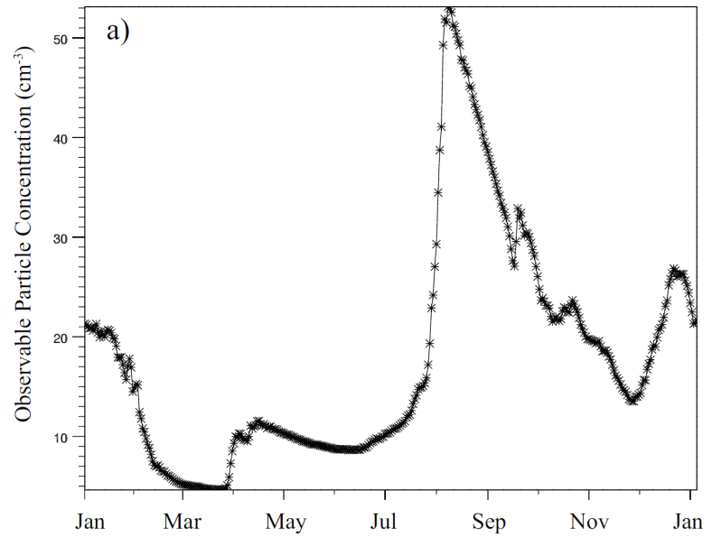
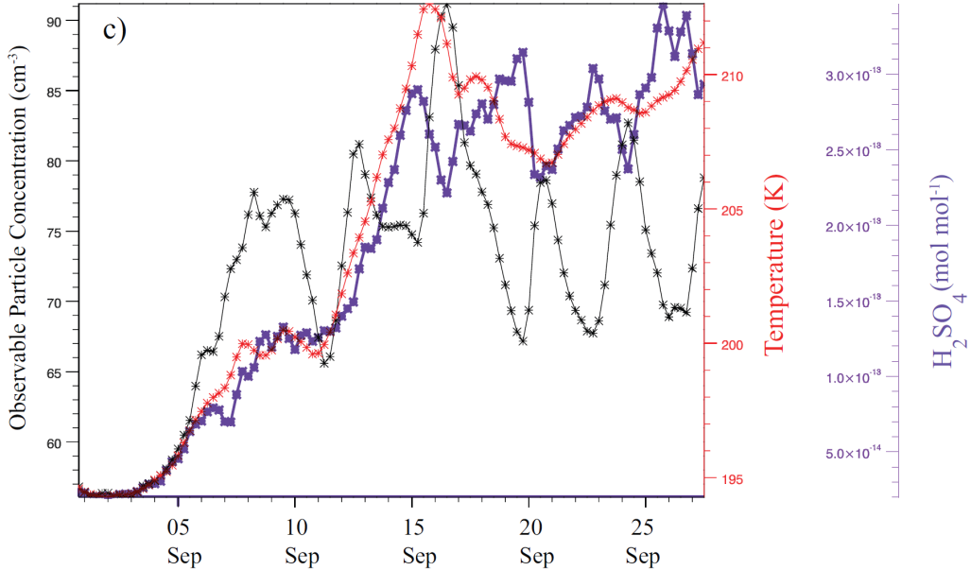
Variability of the Stratospheric CN Layer
Global – 24 hr Ave @ 10 hPa
SH
Global CN (r > 3 nm) concentrations are strongly variable due to winter-spring CN layer formation in both hemispheres.
Local (e.g., McMurdo) CN layer (r > 3 nm) concentrations over Antarctica may oscillate because of:
Sharp temperature increases → Larger partitioning of H₂SO₄ to the vapor phase.
Nucleation/condensation dominating under sufficiently cold enough temperatures →CN number sharply increases.
Nucleation/condensation scavenges H₂SO₄ vapor and then coagulation dominates → CN number sharply decreases.
Under continued H₂SO₄ production or subsequent sharp temperature increases, steps 2 – 3 repeat.
NH
NH
Zonal (78°S) 3 hr Ave @ 15 hPa
+ Solar →
+T
+H₂SO₄
+CN
H₂SO₄ & CN
Peaks ~ 1- 2 days
Campbell et al. [2013], JGR, submitted.
Notes:
During this time above Antartica at 78 S, there is a positive solar trend associated with increasing temperatures, as well as a positive H2SO4 and CN concentration trend. However, the H2SO4 and resulting CN concentration may oscillate because of sharp temperature increases leading to and increase in partitioning of H2SO4 to the vapor phase. In this case the gas phase sulfuric acid mixing ratios were at the equilibrium vapor pressure over sulfuric acid solution droplets, S = 1, and then when the temperature sharply rose, S < 1, droplets evaporate to achieve a new equilibrium, S = 1. Thus there is more H2SO4 in the vapor phase. Thus nucleation/condensation shall dominate under sufficiently cold temperatures and the CN number increases. However, at some point the nucleation/condensation scavenges enough H2SO4 vapor to where these rates slow, a maximum in CN concentration is reached, and then coagulation of the particles dominates. Thus the CN number then decreases. However, under continued production of H2SO4 (positive trend seen here) the H2SO4 vapor will again increase in the face of coagulation, to a point where nucleation/condensation again dominates and the CN number increases again. This could also occur with another sharp temperature increase and larger partitioning of H2SO4 to the vapor phase.

Slide 10
Conclusions
CESM1(WACCM) reproduces a layer of observable particles in the stratosphere, i.e., the stratospheric “CN layer”, in good agreement with observations [Campbell and Deshler, 2013].
CESM1(WACCM) results are unprecedented and important, while extending observations and previous modeling, to show that the stratospheric CN layer originates in the polar regions, and has a maximum extent (r > 3 nm) near 30°N and 15°S in February and August respectively. Questions conventional wisdom of the main source of global stratospheric CN as originating from the TTL [Brock et al., 1995].
The modeled variability suggests that on a global average, the observable CN concentrations in the mid-stratosphere (≈ 10 hPa) are not constant, but change with season due to the formation of the polar CN layer.
The magnitude of the local austral spring CN layer may undergo periodic oscillations, and the positive trend is not necessarily smooth.
Notes:
Previous measurements of the McMurdo CN layer have adequately captured its
formation [Campbell and Deshler, 2013]; however, they cannot be expected to represent
such variability. Thus results here present the benefit of extending such measurements
using models.

Slide 11
Ongoing Work and Suggestions
Running a new version of CESM released in June 2013, CESM1.2, similar to my previous run, but with heterogeneous chemistry feedbacks from CARMA. Use results to possibly quantify a potential CN layer impact on reducing stratospheric ozone depletion over Antarctica > 20 km.
Further CESM modeling (w/meteoritic dust) and CN observations at different times and sizes (r > 1 nm) are needed to confirm fall nucleation events over the polar regions in both hemispheres, and to quantify the impact (if any) of meteoritic particles on stratospheric CN layer formation.

Slide 12
References
Brock, C. A., P. Hamill, J. C. Wilson, H. H. Jonsson, and K. R. Chan (1995), Particle formation in the upper tropical troposphere: a source of nuclei for the stratospheric aerosol, Science, 270, 1650 – 1653.
Campbell, P. C., and T. Deshler (2013), Condensation Nuclei Measurements in the Mid-Latitude (1982 – 2012) and Antarctic (1986 – 2010) Stratosphere between 20 and 35 km, J. Geophys. Res., under revision.
Campbell, P. C., M. Mills, and T. Deshler (2013), The Global Extent and Variability of the Stratospheric CN Layer: A Three-Dimensional Modeling Study, J. Geophys. Res., under revision.
English, J., O. Toon, and M. Mills (2011), Microphysical simulations of new particle formation in the upper troposphere and lower stratosphere, Atmos. Chem. and Phy., 11, 12441–12486.
Kunz, A., Pan, L. L., Konopka, P., Kinnison, D. E. and Tilmes, S. (2011), Chemical and dynamical discontinuity at the extratropical tropopause based on START08 and WACCM analyses, J. Geophys. Res, 116(D24), D24302.
Marsh, D. R., M.J. Mills, D.E. Kinnison, J.-F. Lamarque, N. Calvo, and L. M. Polvani (2013), Climate change from 1850 to 2005 simulated in CESM1(WACCM), Journal of Climate, in press.
Mills, M. J., O. B. Toon, and S. Solomon (1999), A 2D microphysical model of the polar stratospheric CN layer, Geophys. Res. Lett., 26, 8, 1133 – 1136.
Mills, M. J., O. B. Toon, V. Vaida, P. E. Hintze, H. G. Kjaergaard, D. P. Schofield, and T. W. Robinson (2005), Photolysis of sulfuric acid vapor by visible light as a source of the polar stratospheric CN layer, J. Geophys. Res., 110, D08201.
Toon, O. B., Turco, R. P., Westphal, D., Malone, R., and Liu, M. S. (1988), A multidimensional model for aerosols – description of computational analogs, J. Atmos. Sci., 45, 2123–2143, 1988.
Vaida, V., H. G. Kjaergaard, P. E. Hintze, and D. J. Donaldson (2003), Photolysis of sulfuric acid vapor by visible solar radiation, Science, 299, 1566 – 1568.
Zhao, J., O. B. Toon, and R. P. Turco (1995), Origin of condensation nuclei in the springtime polar stratosphere, J. Geophys. Res., 100, 5215 – 5227.

Slide 13
Thank you!

Slide 14
Evolution of the Stratospheric CN Layer over the Antarctic
McMurdo Station, Antarctica (78°S)

Slide 15
Model vs. In situ Discrepancy
McMurdo Station, Antarctica (78°S)

Slide 16
2010 CESM1(WACCM) Output vs. In-situ Observations
Laramie, Wyoming (41°N)

Slide 17
Northern Hemisphere Stratospheric CN Layer and Global Extent

