Slide 1
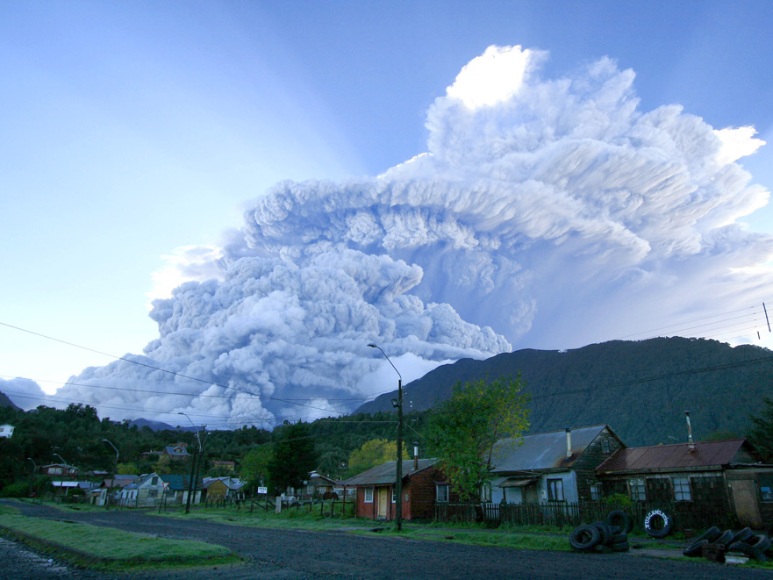

Satellite Measurements of Volcanic SO₂ Emissions into the UTLS
Simon A. Carn¹, Kai Yang^{2,3}, Nickolay A. Krotkov³, and Fred J. Prata⁴
Michigan Technological University, Houghton, MI, USA
University of Maryland, College Park, MD, USA
Laboratory for Atmospheres, NASA Goddard Space Flight Center, Greenbelt, MD, USA
Norwegian Institute for Air Research, Kjeller, Norway

Slide 2
STRATOSPHERE
More Reflected
Solar Flux
Less
Upward
IR Flux
Stratospheric aerosols
(Lifetime ≈ 1-3 years)
backscatter
H₂S
SO₂
absorption
(near IR)
Solar Heating
IR
Heating
emission
→ H₂SO₄
NET HEATING
Heterogeneous → Less
O₃ depletion Solar Heating
IR Cooling
HCl,
BrO, ClO
absorption (IR)
emission
Explosive
forward scatter
CO₂
H₂O
Tropopause
(8-17 km)
Effusive
Enhanced
Diffuse
Flux
Effects
on cirrus
clouds
Gas scavenging?
Ashfall
TROPOSPHERE
Indirect Effects on Clouds
Reduced
Direct
Flux
SO₂ → H₂SO₄
More
Downward
IR Flux
Passive
Less Total
Solar Flux
Tropospheric aerosols
(Lifetime ≈ 1-3 weeks)
NET COOLING
Exsolution
Effects of volcanic emissions on the climate system
Dissolved volatiles
Original slide courtesy of A. Robock
Notes:
This diagram shows the main components of non-explosive and explosive volcanic eruptions, and their effects on shortwave and longwave radiation. Large explosive eruptions are strong, rapid perturbations (may be short or long-lived) to the climate system; passive degassing may be a long-term, weaker perturbation. Example of Pinatubo for an explosive event - 0.5K global average cooling in few years after the eruption. Tropospheric aerosols have shorter lifetimes but their supply (from passive degassing) is more persistent. ALTITUDE OF EMISSIONS IS CRITICAL.

Slide 3
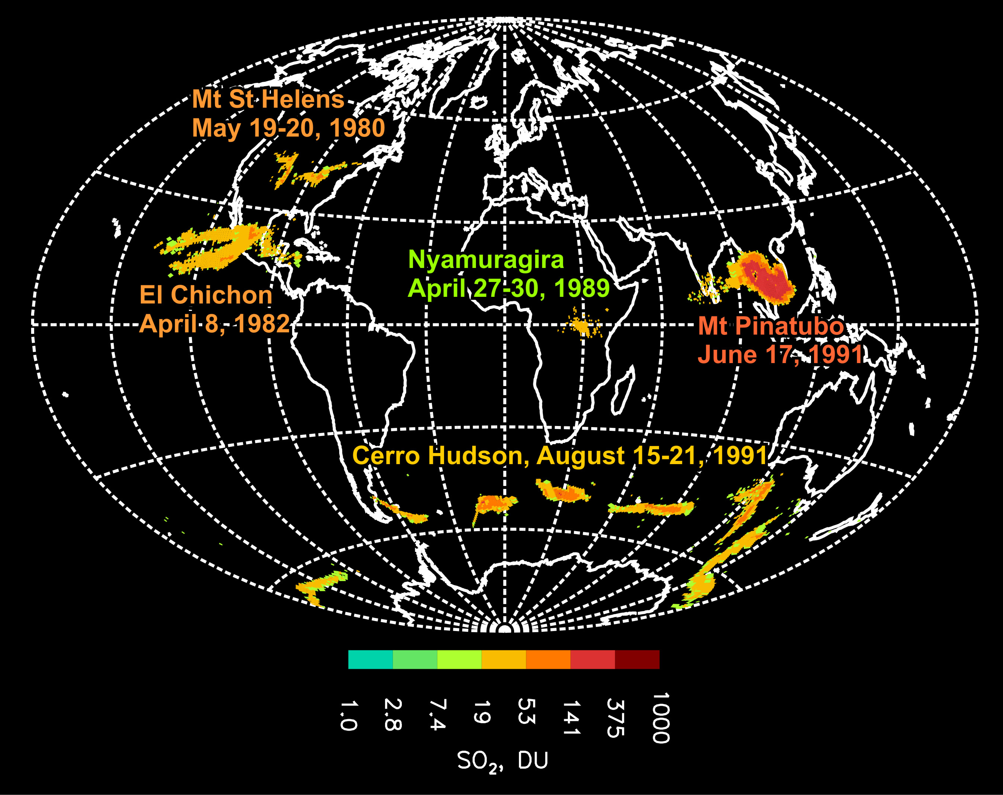
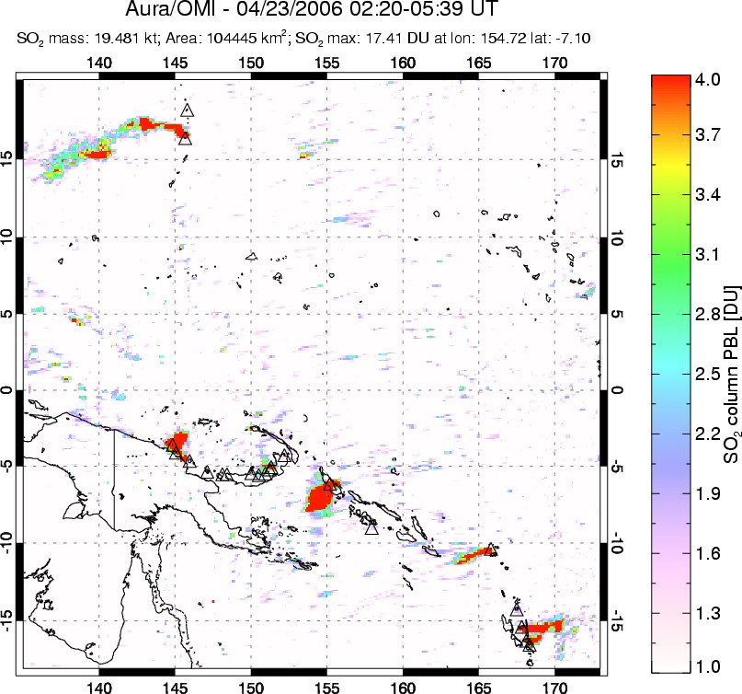

UV satellite remote sensing of volcanic SO₂
SW Pacific
April 23, 2006
1978-2005
Total Ozone Mapping Spectrometer (TOMS)
2004-
Ozone Monitoring Instrument (OMI)
2012-
Suomi NPP/OMPS
Notes:
Satellite perspective is only way to gain a real appreciation of the size of the largest volcanic clouds; track them as they move around the globe (important for aircraft hazards); understand their place in the global Earth system and effects on climate etc. Because of its relatively high SO2 detection limit, TOMS was capable of measuring larger eruptions that reached the upper troposphere or stratosphere (examples in image). Could not measure small eruptions or passive degassing of SO2, which contributes more SO2 to the atmosphere than explosive volcanism on a time-averaged basis. GLOBAL SCALE. First indications of actual quantities of SO2 emitted by volcanoes, leading to more accurate climate change simulations.

Slide 4
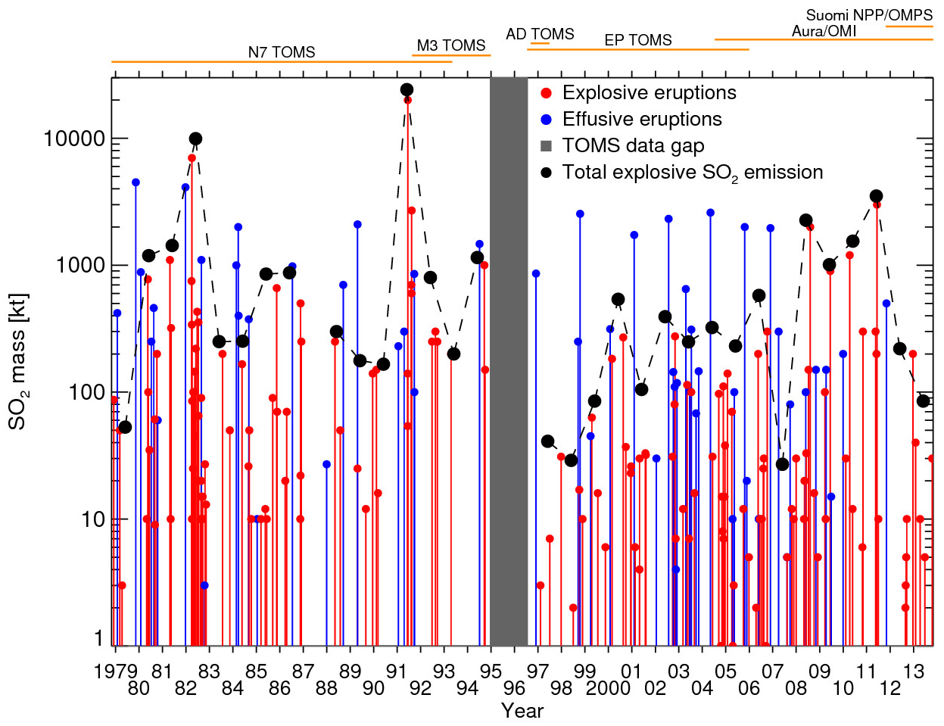
UV satellite volcanic SO₂ emissions inventory (1978 – 2013)
[Bluth et al., 1993; Carn et al., 2003]
Pinatubo
El Chichòn
Nabro
Increase in total explosive volcanic SO₂ emissions from 1997-2011
Notes:
TOMS + OMI SO2 measurements also show increased SO2 emissions since the late 1990s. Increased sensitivity to smaller eruptions with OMI/OMPS post-2004.

Slide 5
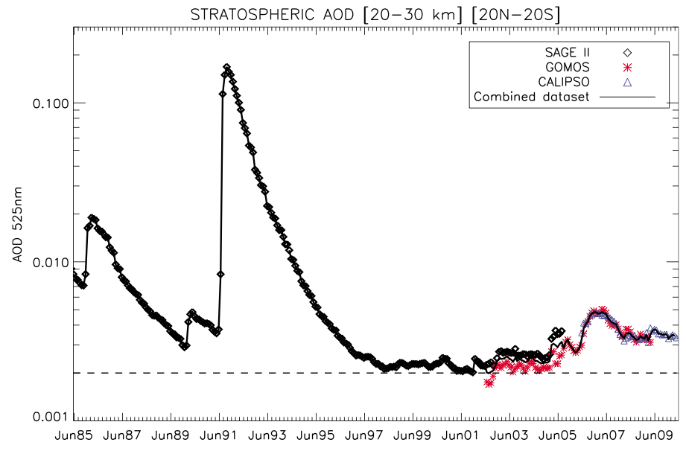
Increase in tropical stratospheric AOD since 2000
Pinatubo
Hofmann et al., GRL, 2009
Ruiz
Increase linked to influence of tropical volcanic eruptions
Vernier et al., GRL, 2011
Solomon et al., Science, 2011
Notes:
Some recent papers have suggested that frequent, moderate-scale tropical volcanic eruptions have lead to increased stratospheric AOD over the last decade, which has slowed the rate of global warming due to the negative aerosol radiative forcing.

Slide 6
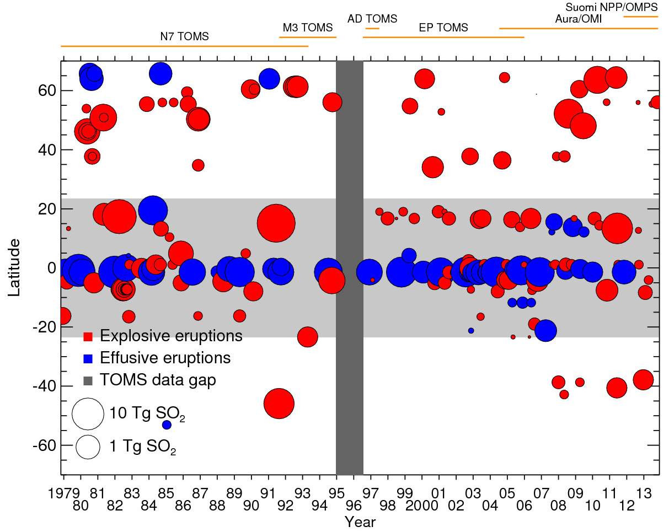
UV satellite volcanic SO₂ emissions inventory (1978 – 2013)
[Bluth et al., 1993; Carn et al., 2003]
El Chichon
Pinatubo
Nabro
TROPICS
Notes:
Frequent eruptions at equatorial latitudes (Galapagos, Virunga, Ecuador, Sulawesi, PNG)

Slide 7
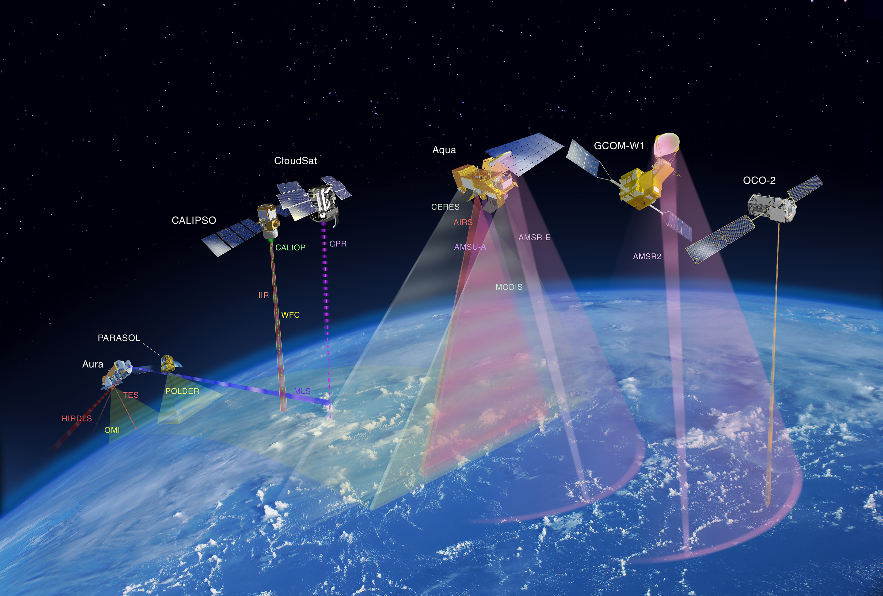

Aura (2004-)
CloudSat (2006-)
Aqua (2002-)
OMI - SO₂, NO₂, BrO
TES - SO₂
MLS - strat. SO₂, HCl
CPR (radar) – precipitation, hydrometeors
MODIS - SO₂, ash, sulfate
AIRS - UTLS SO₂, ash
The A-Train
CALIPSO (2006-)
CALIOP (lidar) - cloud altitude, aerosol phase

Slide 8
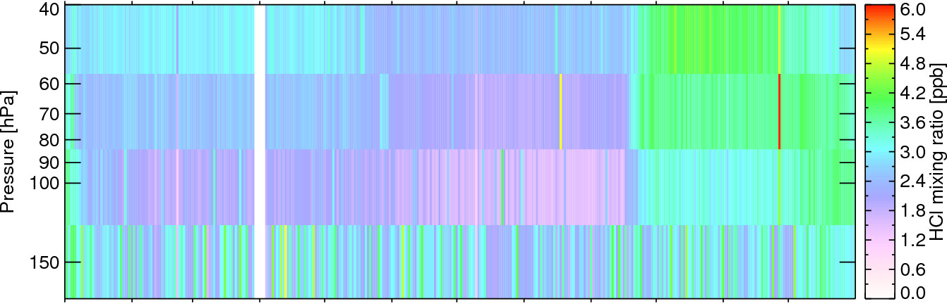
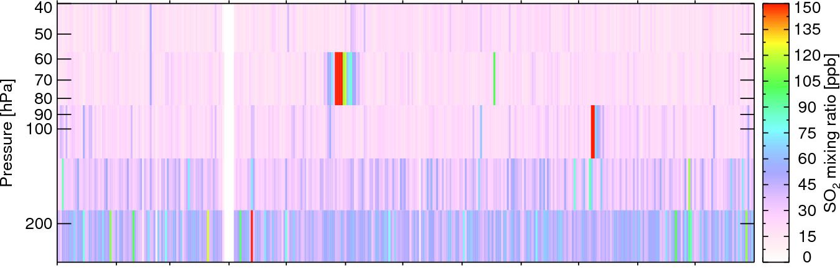
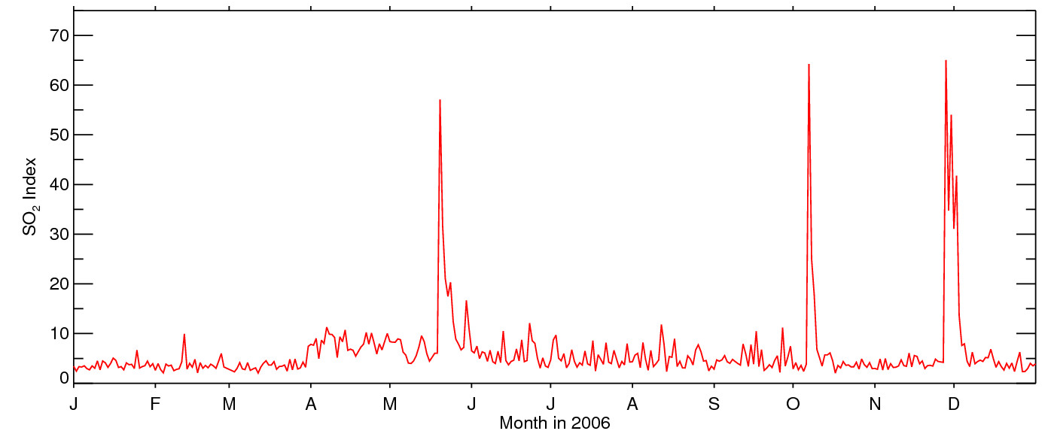
2006
MLS
HCl
MLS
SO₂
Nyamulagira
Rabaul
Soufriere Hills
OMI
SO₂

Slide 9
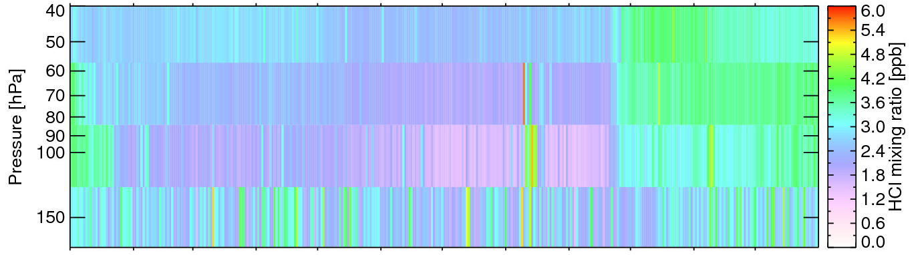
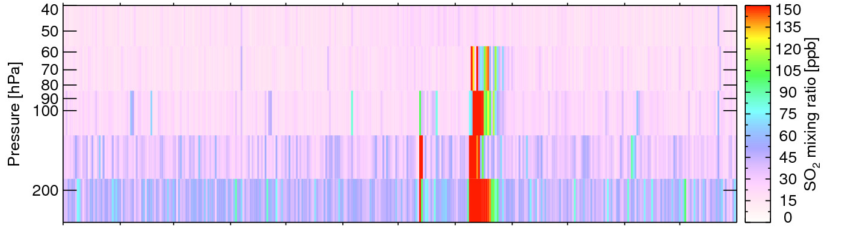
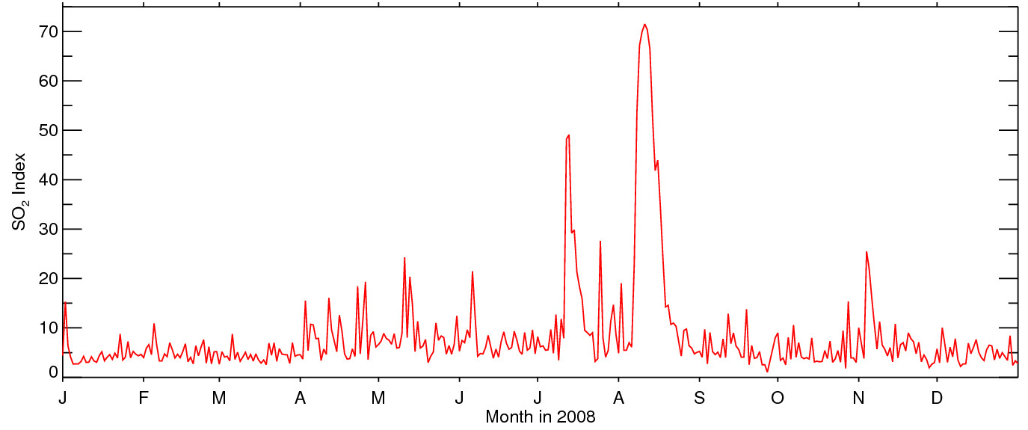
2008
MLS
HCl
MLS
SO₂
Kasatochi
Okmok
OMI
SO₂

Slide 10
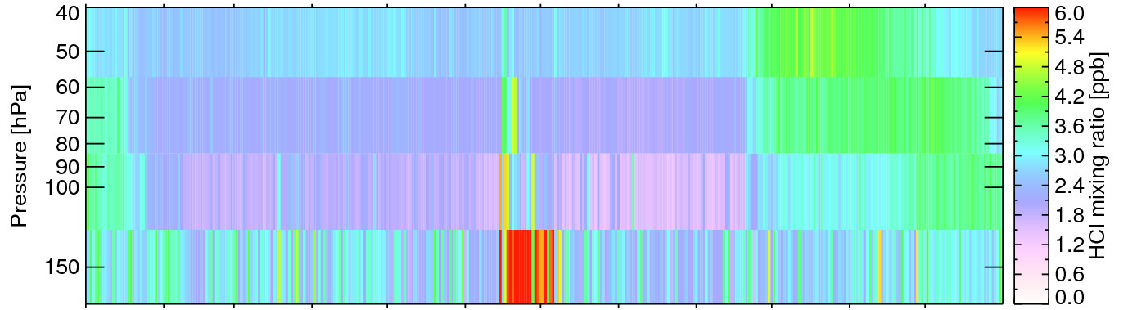
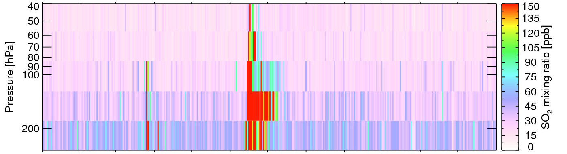
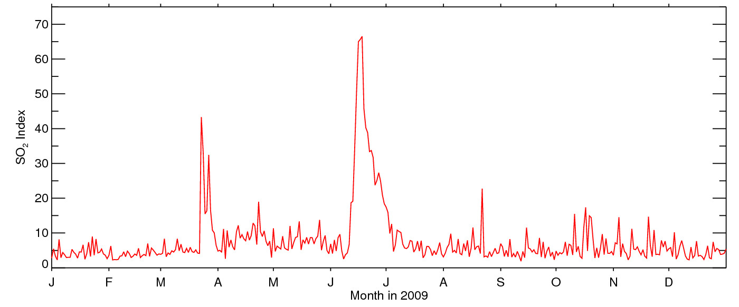
2009
MLS
HCl
MLS
SO₂
Sarychev Peak
Redoubt
OMI
SO₂
Notes:
40 hPa = ~20.4 km altitude

Slide 11
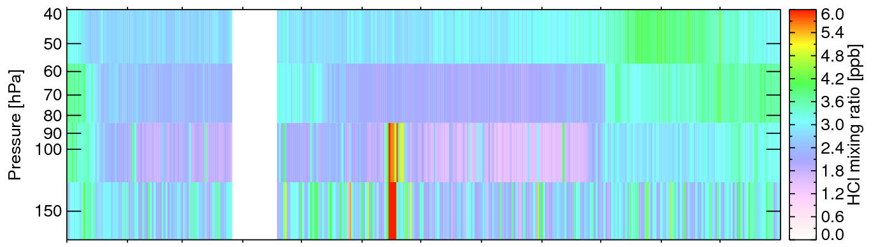
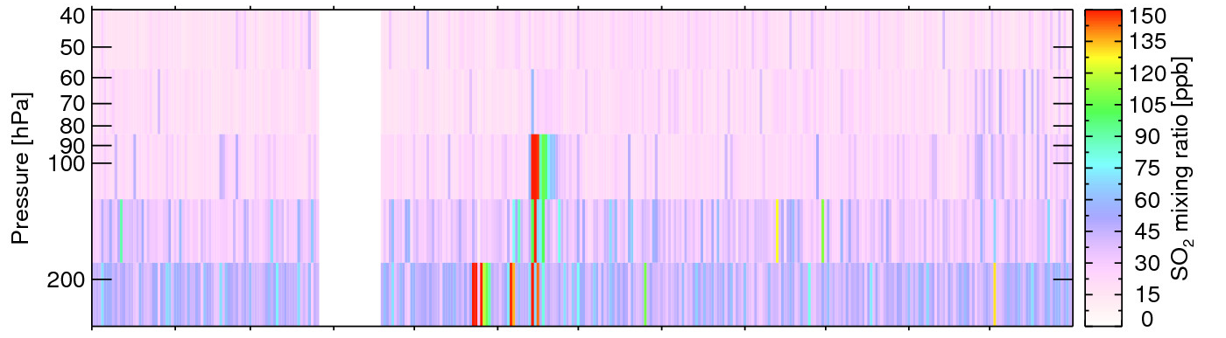
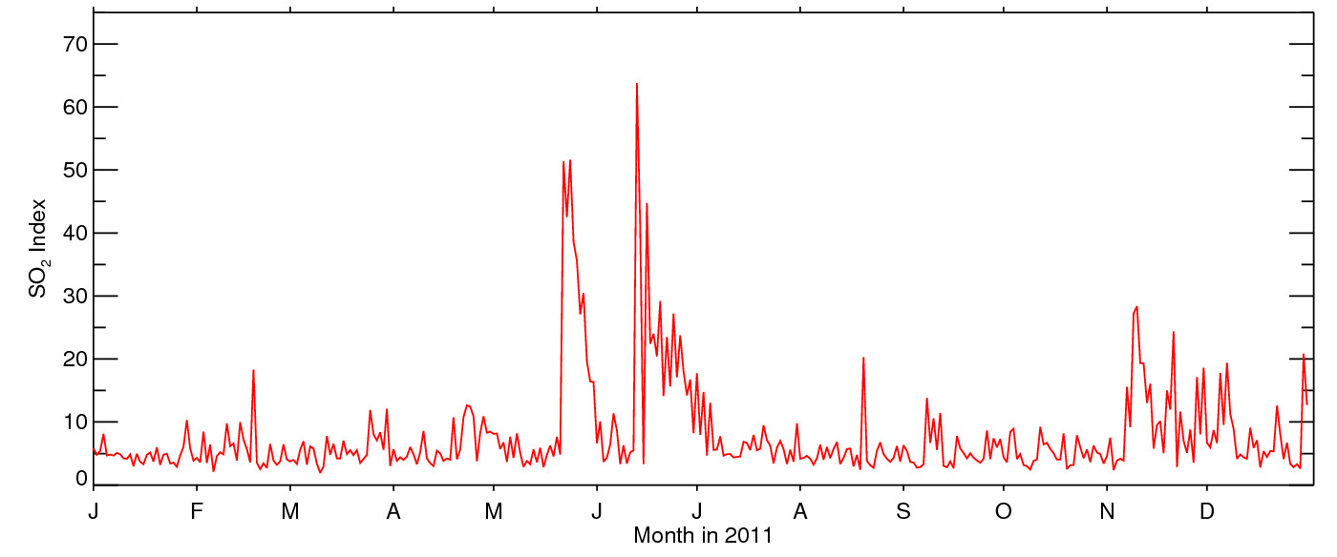
2011
MLS
HCl
MLS
SO₂
Cordon Caulle
Nabro
Grimsvötn
OMI
SO₂
Nyamulagira

Slide 12
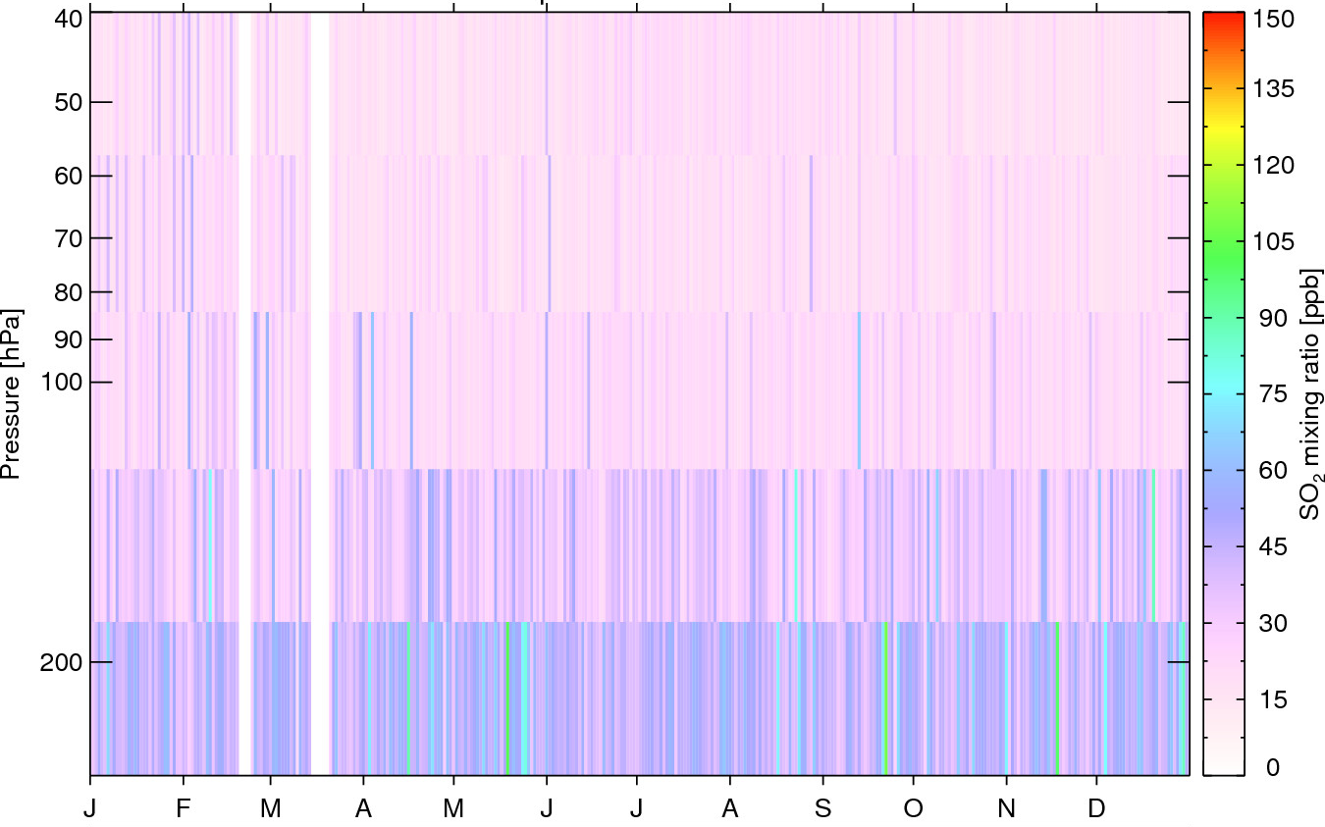
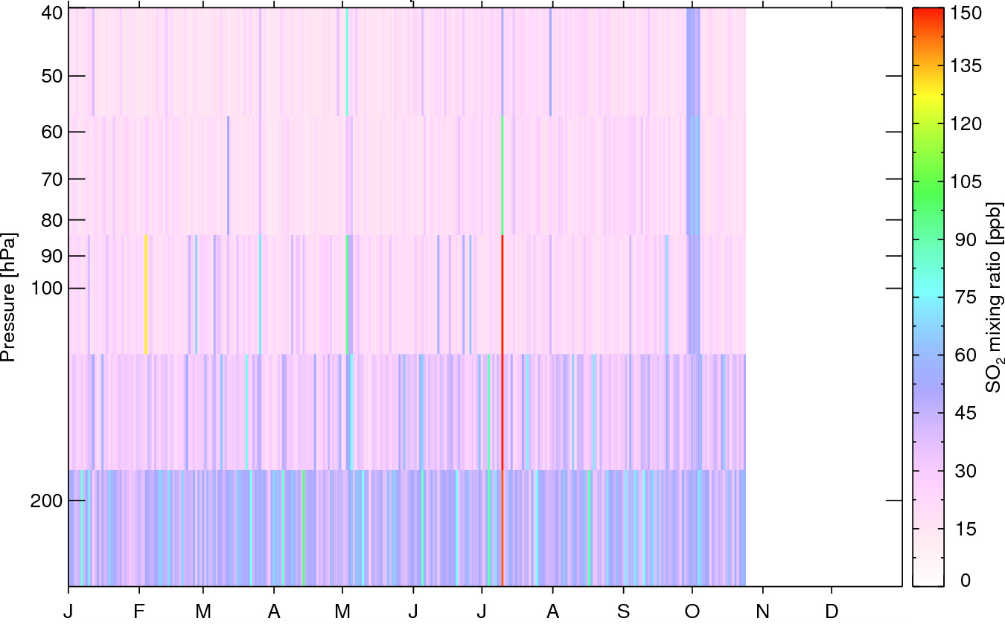
2012
MLS
SO₂
2013
Paluweh
Popocatepetl?

Slide 13
Grimsvötn mammatus (May 2011)
Photos by Jón Ólafur
Fate of volcanic gases in eruption columns
Gas scavenging on ash and hydrometeors

Slide 14
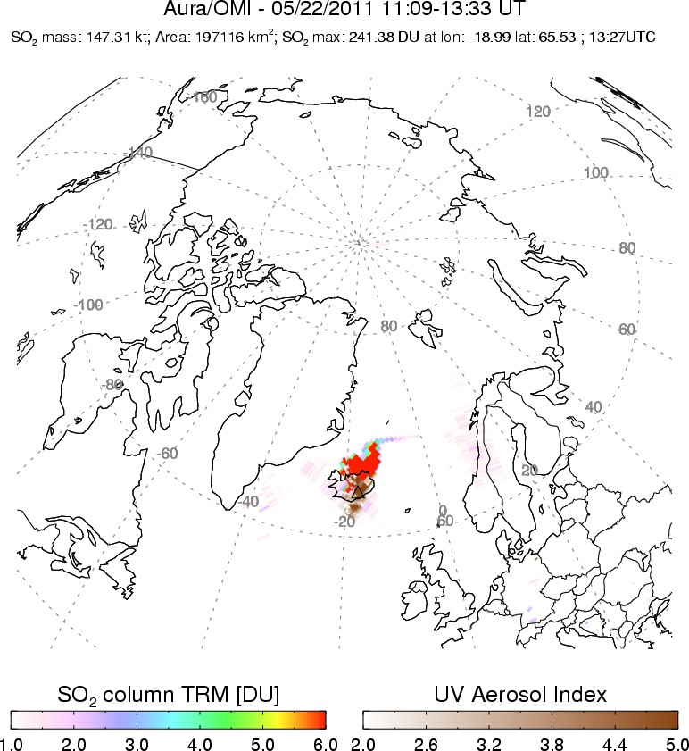
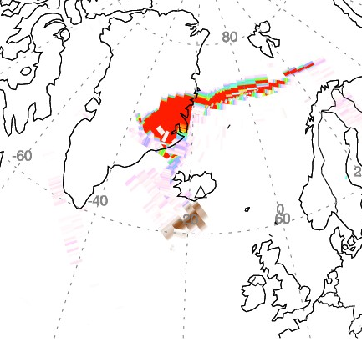
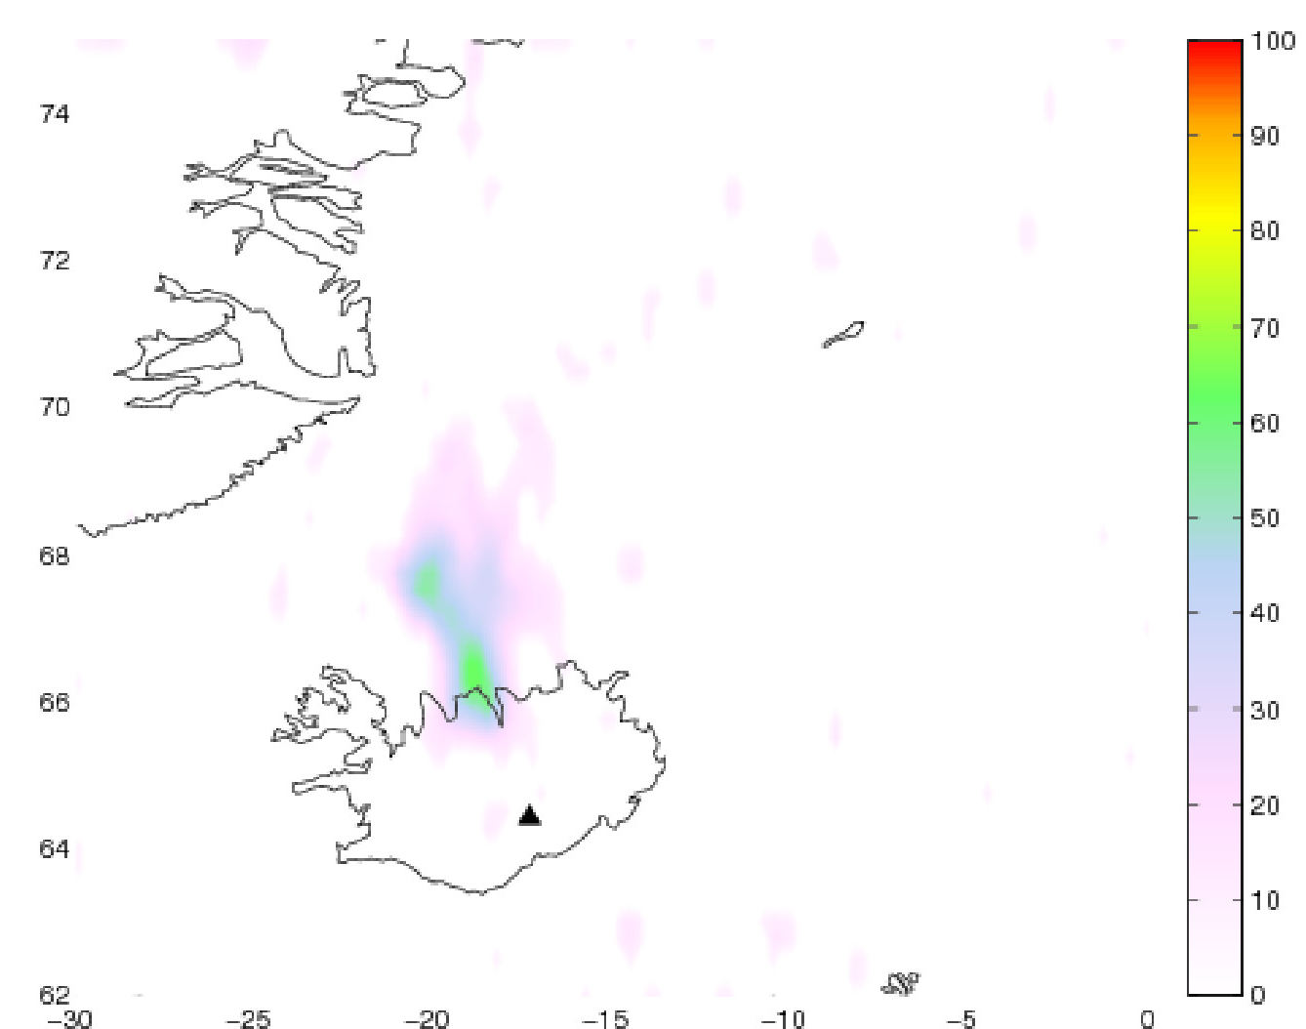
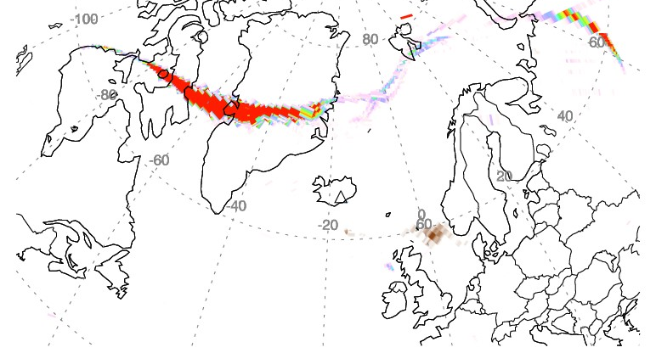
Sulfur budget of the Grimsvötn 2011 eruption
OMI - May 22
May 23
MetOp/IASI – H₂S
May 22
~29 kt H₂S
May 24
L. Clarisse – LATMOS/ULB
H₂S/SO₂ = ~0.1, similar to in-situ Icelandic gas samples
~15 kt S₂?
~120 kt S sequestered on ash
0.6 Tg SO₂ emitted; only 0.3 Tg reached UTLS
38% S scavenged cf. 20% [Textor et al., 2003]
~0.3 Tg SO₂
Sigmarsson et al., GRL, in review
Notes:
S2 = Disulfur (violet gas, produced by heating of sulfur to high T)

Slide 15
Suomi-NPP/OMPS UV Sensors
Limb instrument:
Aerosol and Ozone
profiles above tropopause
NP
Nadir Mapper (NM):
swath similar to OMI
Notes:
OMPS consists of suite and ground processing algorithms. Two sensors, Limb and Nadir, provide Limb Profile, Nadir Total Column, and Nadir Profile Raw Data Records
SDR and EDR algorithms process RDRs into SDR and EDR products
110° nadir cross-track field of view (FOV) and 3 limb FOVs provide required coverage
2.23° limb vertical FOV provides sampling from tropopause to 60 km

Slide 16
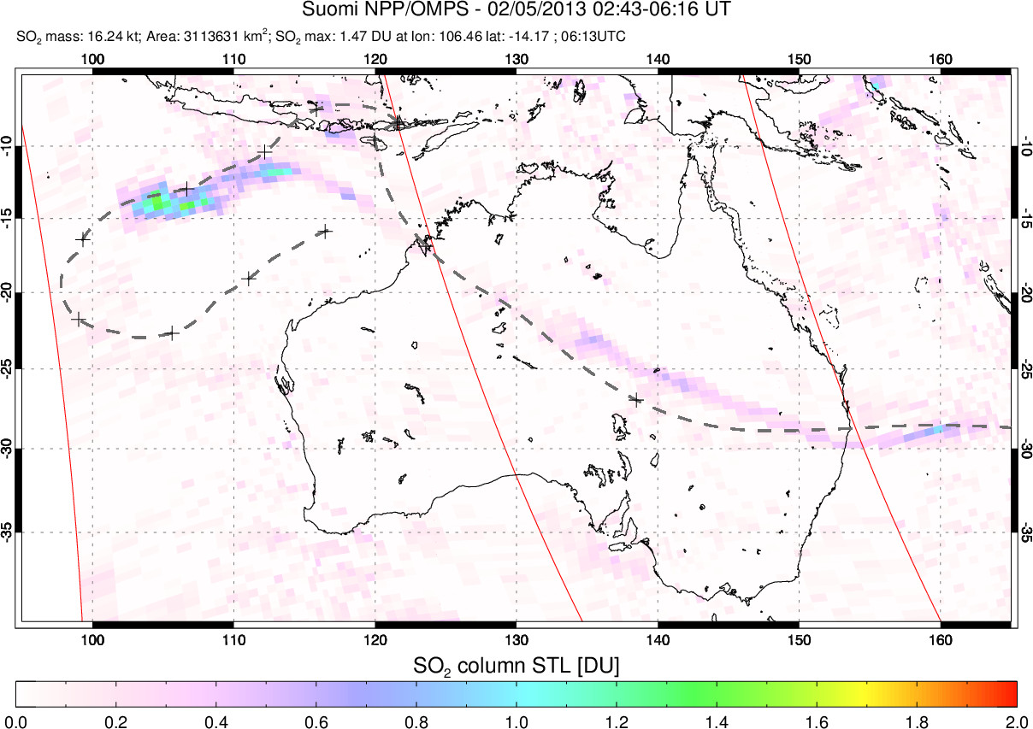
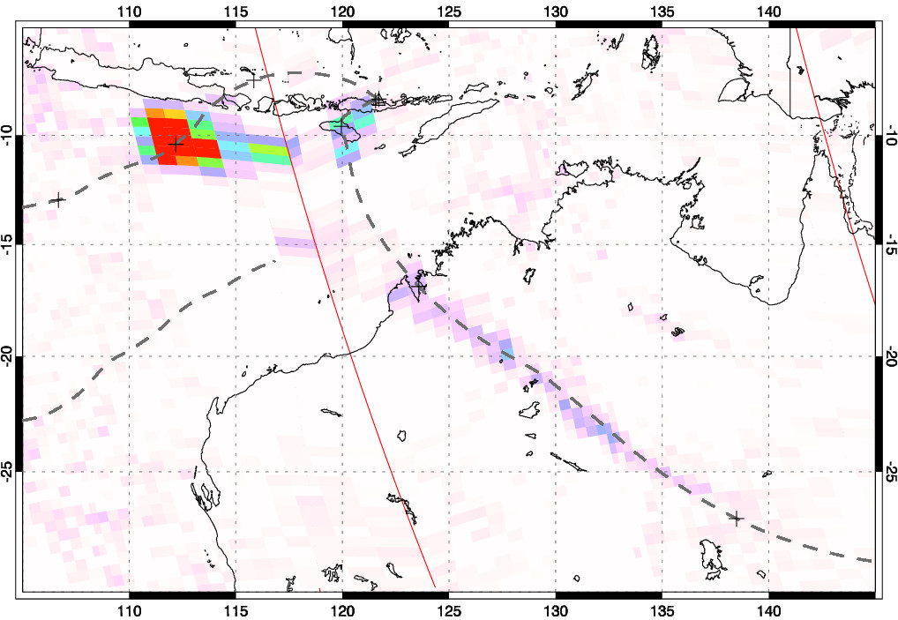
Suomi NPP/OMPS NM SO₂ data for Paluweh (Indonesia)
Feb 4, 2013
Feb 5, 2013
Paluweh
HYSPLIT forward trajectory @ 17 km
HYSPLIT forward trajectory @ 15 km
Reported (ash) plume altitude = ~14 km

Slide 17
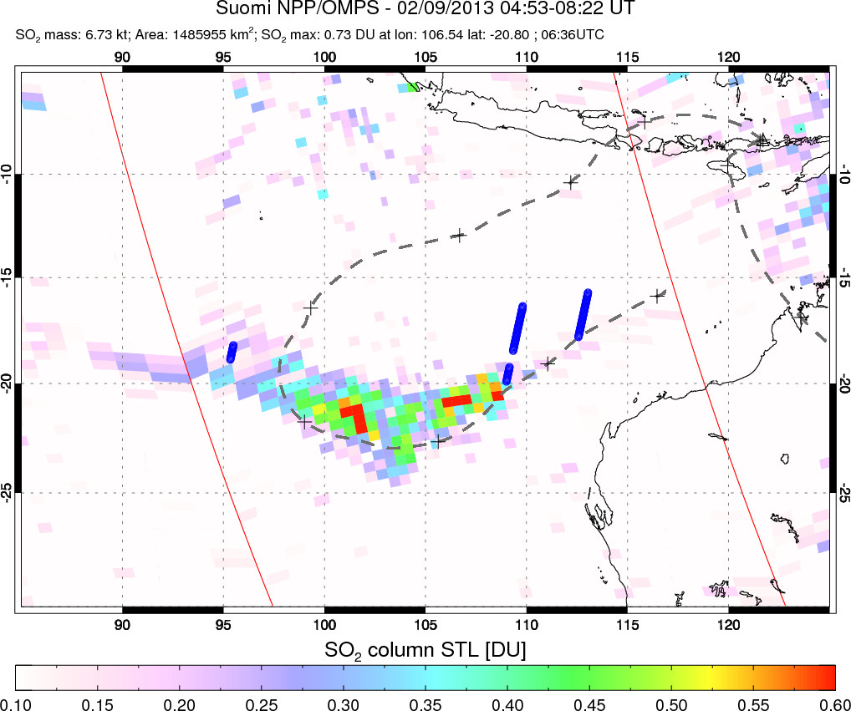
Suomi NPP/OMPS NM data for Paluweh
CALIPSO Vertical Feature Mask
Stratospheric aerosol detection

Slide 18
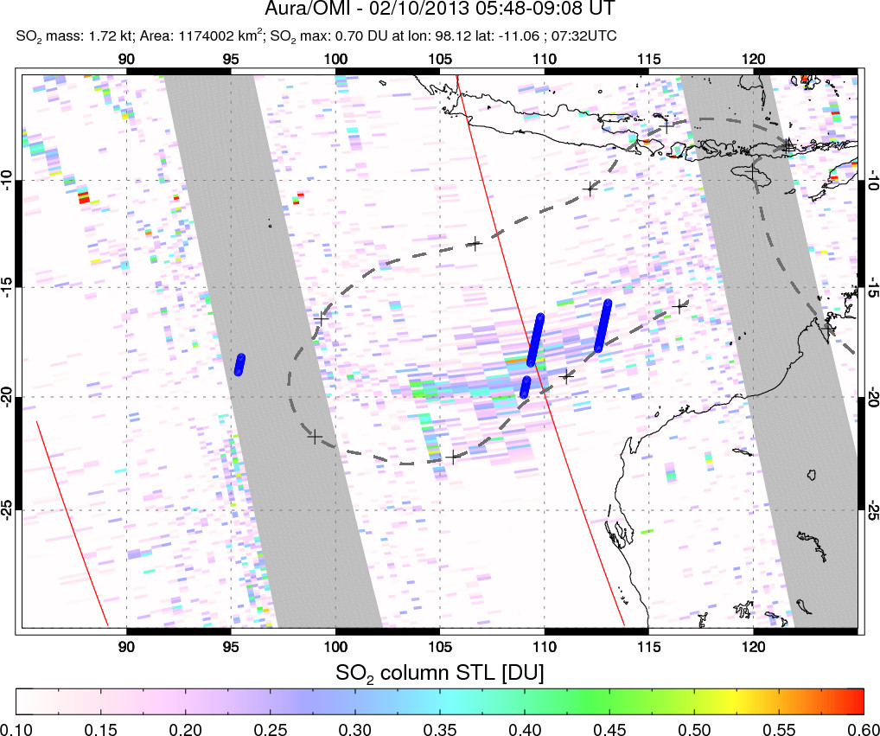
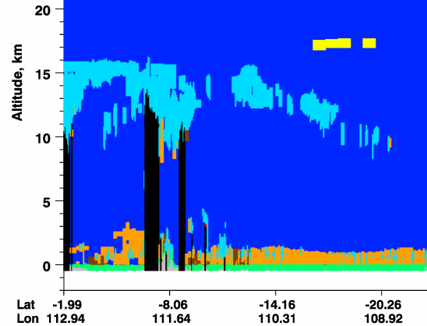
Aura/OMI data for Paluweh
CALIPSO Vertical Feature Mask
Stratospheric aerosol detection
~0.03 Tg SO₂ -> 0.04 Tg H₂SO₄
Only 0.01-0.02 Tg/S year required to explain post-2002 strat. AOD increase [Hoffman et al., 2009]
Notes:
Paluweh produced ~0.03 Tg SO₂, or 0.015 Tg S.
Assuming that all the SO₂ is converted into gaseous H₂SO₄ and further condensed into a 75%‐25% H₂SO₄‐H₂O solution, the total aerosol mass yield would be 0.04 Tg. If even only ~25% of the S reached the stratosphere, this alone is sufficient to account for the 0.01–0.02 Tg S/year required to explain the average aerosol increase of 4–7%/year after 2002 estimated by Hoffman et al. [2009].

Slide 19
Direct retrieval of SO₂ altitude from UV radiances
SO₂ altitude directly retrieved from UV radiances
Validate with CALIPSO, MLS
Reprocessing of entire UV OMI-OMPS data archive planned (NASA MEaSUREs project)
SO₂ altitude retrievals for 2008 Kasatochi eruption
[Yang et al., JGR, 2010]

Slide 20
Summary
Long-term record of volcanic SO₂ emissions based on UV satellite measurements continues (TOMS, OMI, OMPS)
  Increased SO₂ flux from explosive volcanism 1997-2011
  Consistent with observed stratospheric AOD trends
  Less explosive volcanism in 2012-13
  A-Train data (MLS, CALIPSO) provides profile information
New insights into sulfur gas scavenging in eruption columns
  2011 Grimsvötn (Iceland) eruption: 50% of S scavenged
Many small tropical eruptions inject SO₂ to tropopause level
  SO₂ sufficient to sustain long-term increase in stratospheric AOD
  Plume altitudes based on ash clouds may underestimate SO₂ altitude
Direct UV SO₂ altitude retrievals now available
  Reprocessing of all major eruptions planned to develop new altitude-resolved volcanic SO₂ climatology (NASA MEaSUREs)
Acknowledgments: NASA funding (Aura Science Team, Atmospheric Chemistry Modeling and Analysis program, NPP Science Team, MEaSUREs)

Slide 22
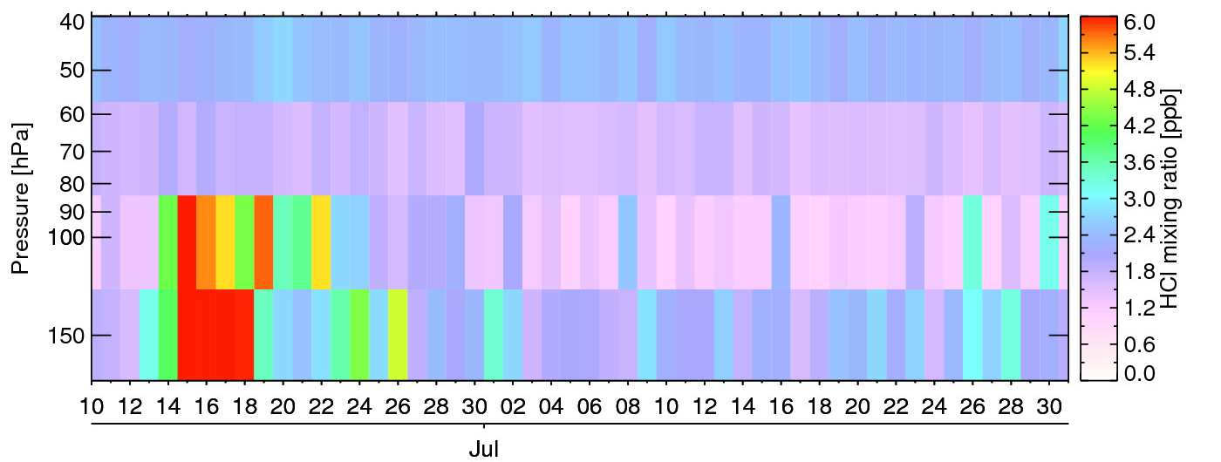
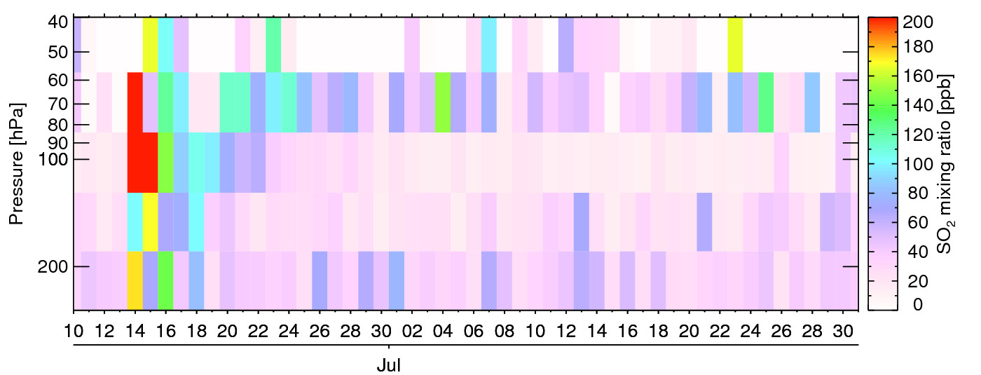
Time-series of maximum MLS SO₂ and HCl
HCl
Direct injection
40
25
68 hPa
46 hPa
Monsoon
SO₂
10
15

Slide 23
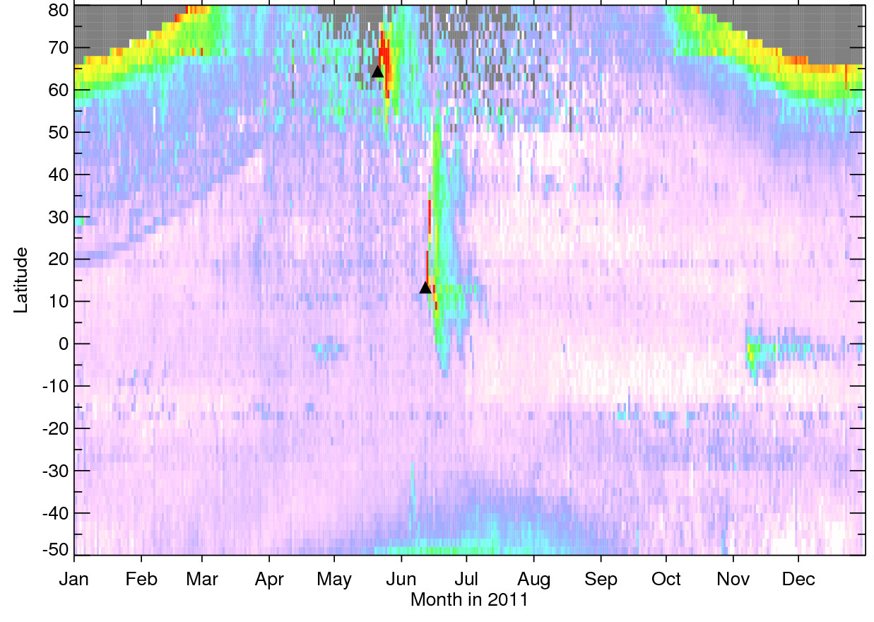
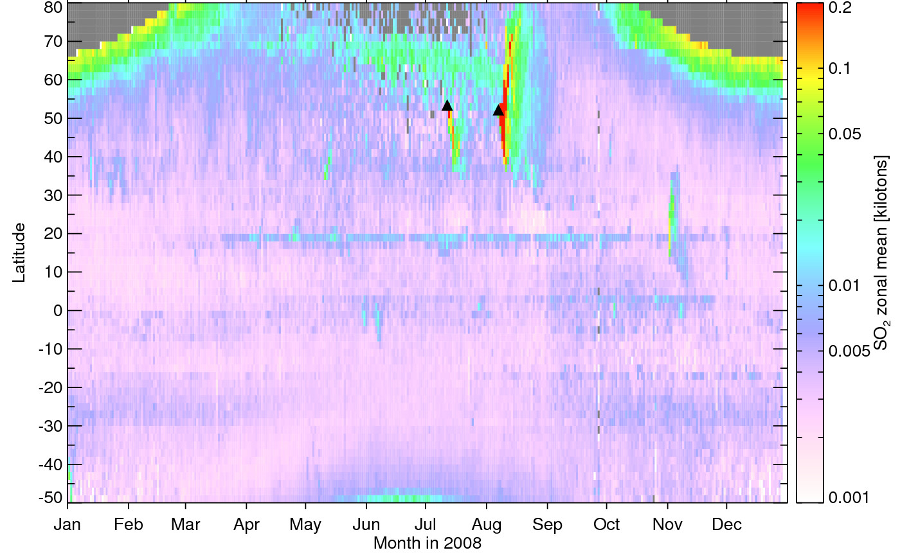
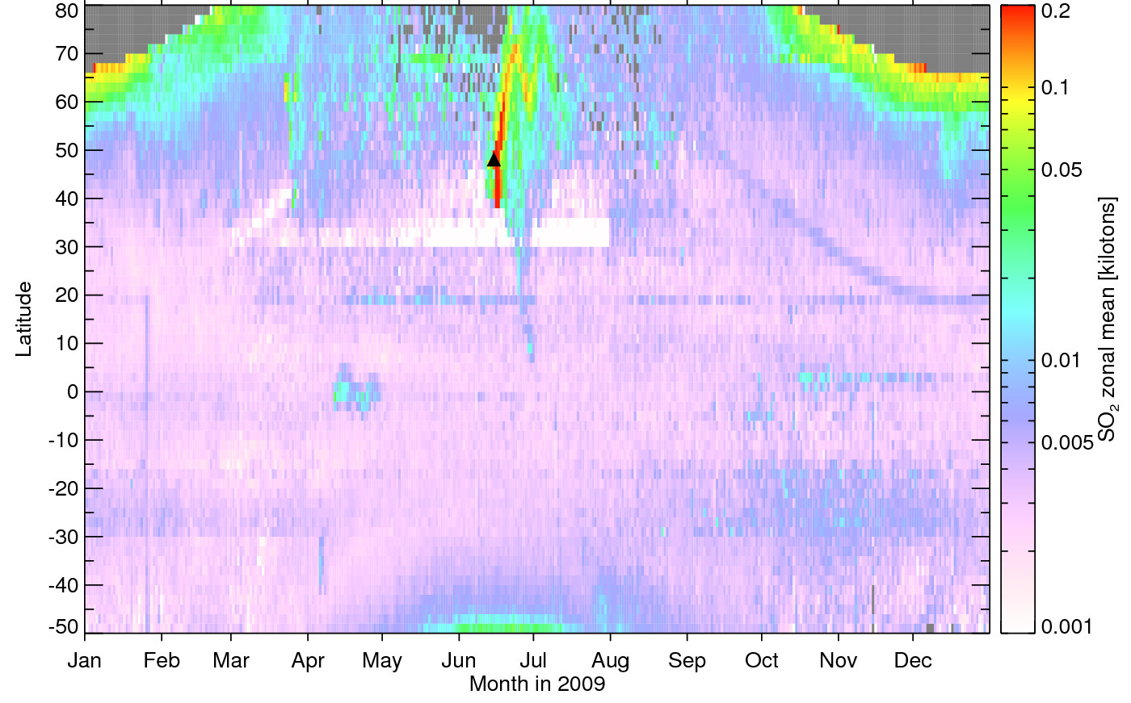
OMI SO₂ zonal means
Noise
Noise
Noise
Noise
Grimsvötn
Okmok
Kasatochi
Nabro
2011
2008
Noise
Noise
Nabro was the largest tropical volcanic SO₂ emission since the 1991 Pinatubo eruption
Sarychev
2009

