Slide 1
Anthropogenic and volcanic contributions to the decadal variations of stratospheric aerosol
Mian Chin, NASA Goddard Space Flight Center
Plus: Thomas Diehl, Qian Tan, Huisheng Bian, John Burrows, Nickolay Krotkov, Jean-Paul Vernier, Zifeng Lu, David Streets, William Reed
Work funded by NASA Aura Program

Slide 2
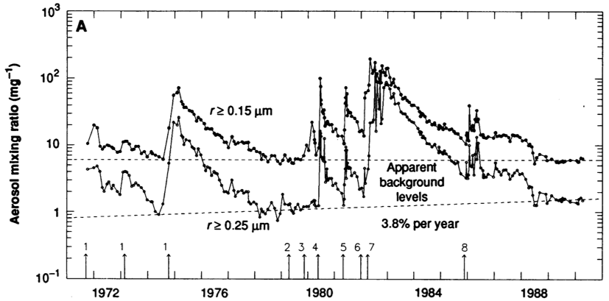
Preface
Hofmann, 1990: Stratospheric background increased by 3.8%/year, likely due to OCS
Chin and Davis, 1995: OCS is not responsible for the increase. Volcanic influences possible.
Hofmann, 2009: Asian anthropogenic emission caused the increase of stratospheric aerosols since 2000
My Aura proposal: Investigating anthropogenic and volcanic contributions

Slide 3
Introduction
The origin and variability of stratospheric aerosol have drawn considerable attention because the change of such aerosol could have long-term climate effects
Recent observations seem to suggest that the stratospheric aerosol has been increasing in the past decade without major volcanic eruptions
  it was suggested that the increase of Asian anthropogenic emission was the cause of such increase (Hofmann et al., 2009)
  But other studies showed that small-to-medium volcanic emission trends in the past decade can explain the stratospheric aerosol changes (Vernier et al., 2011; Neely et al., 2013; Simon Carn’s talk yesterday)

Slide 4
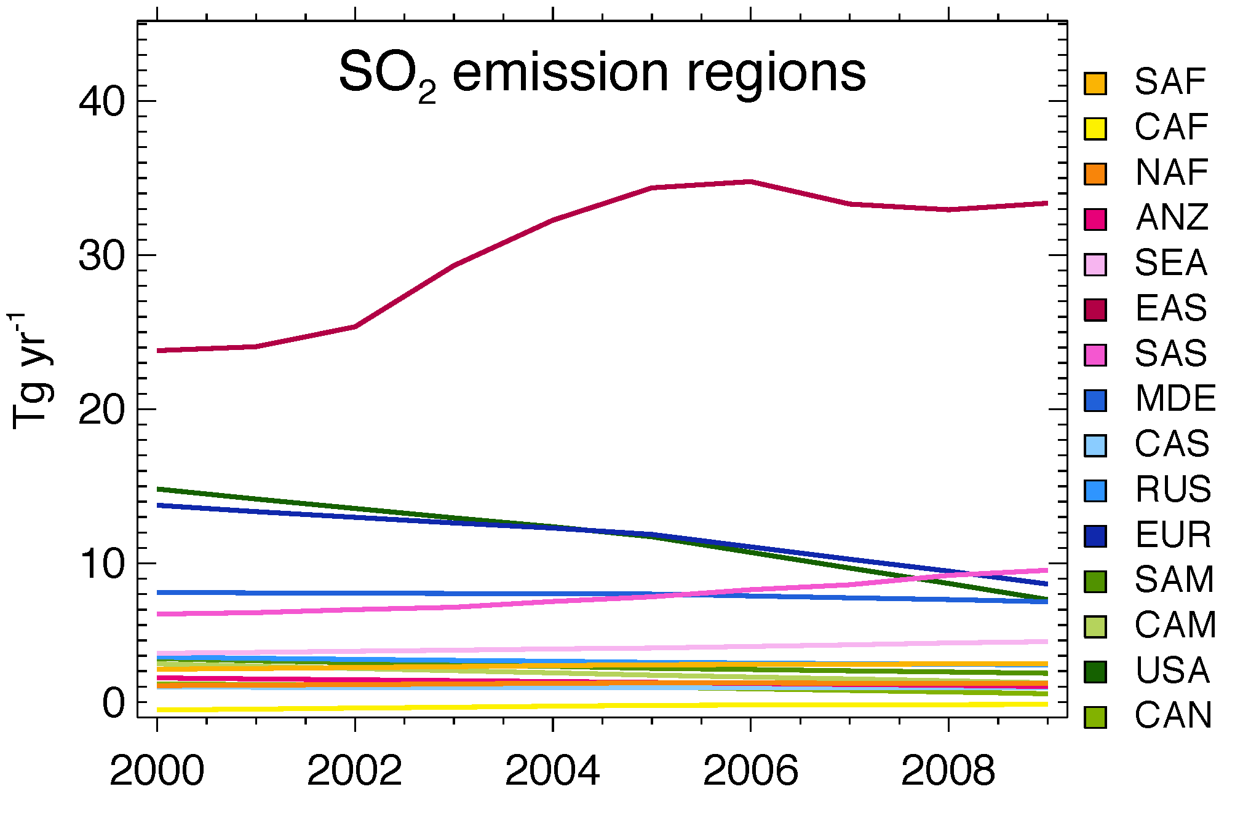
Anthropogenic SO₂ emission, 2000-2009
Anthropogenic SO₂ emissions in East Asia and South Asia have increased significantly in the last decade
In the meantime anthropogenic emission has decreased significantly in US and Europe
The question is: How efficient the transport is to lift Asia surface pollution to the stratosphere to control the stratospheric aerosol trend?
Anthropogenic SO₂ emission
EAS
USA
EUR
SAS
Emission data from: Z. Lu, D. Streets, et al., 2010; Diehl et al., 2012

Slide 5
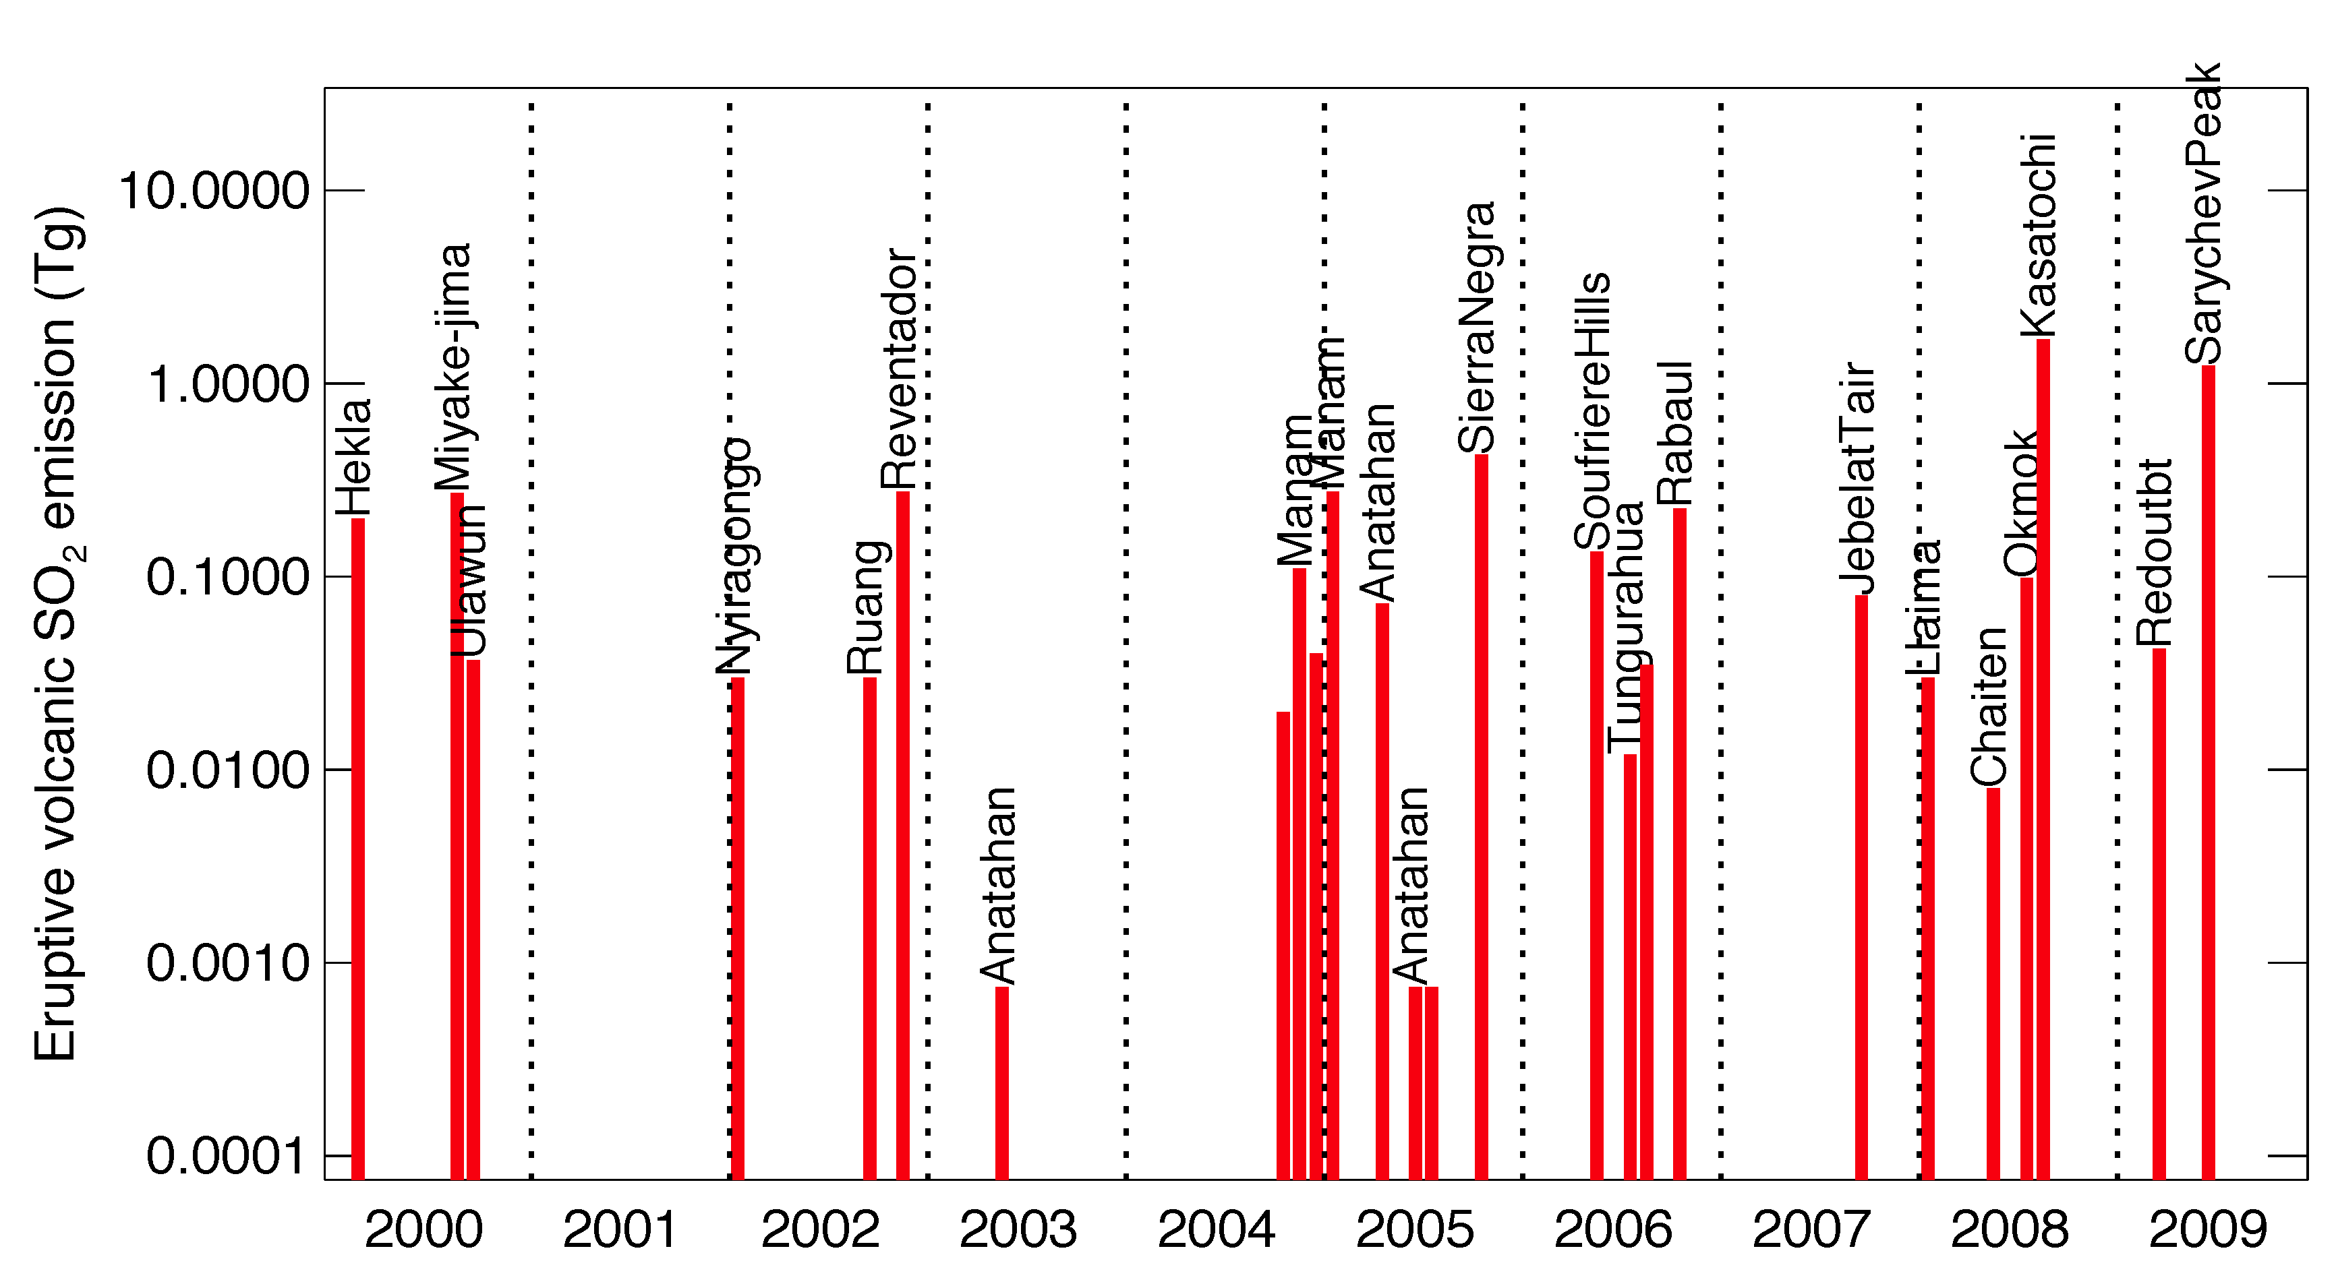
Volcanic emission of SO₂ going to the UTLS, 2000-2009
Volcanic emissions that reach the UTLS seem to have a positive trend as well
And they release SO₂ at high altitudes to have a more direct influence than Asian anthropogenic sources
SO₂ emission from eruptive volcanoes from 2000 to 2009 with injection height above 10 km. Data source: TOMS, OMI, GVP, and in-situ measurements reported in literature (Diehl et al., 2012)

Slide 6
This study
We use a global model GOCART to simulate atmospheric aerosols with a goal to assess the relative contributions of volcanic and anthropogenic emissions to the stratospheric aerosol loading and decadal trend
We compare the model simulations with satellite observations of SO₂ and aerosols in the troposphere and stratosphere from multiple satellite data

Slide 7
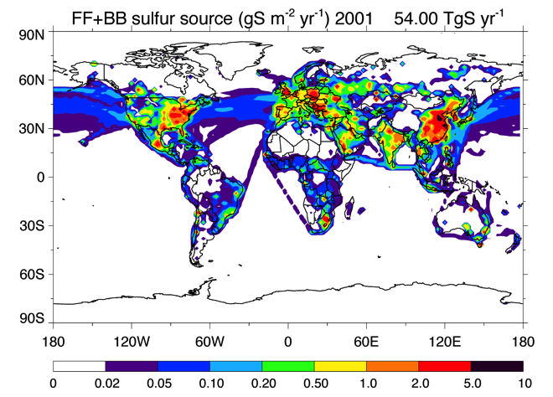
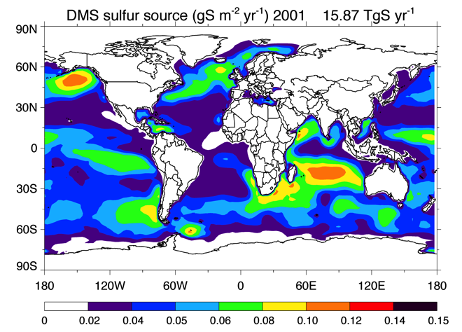
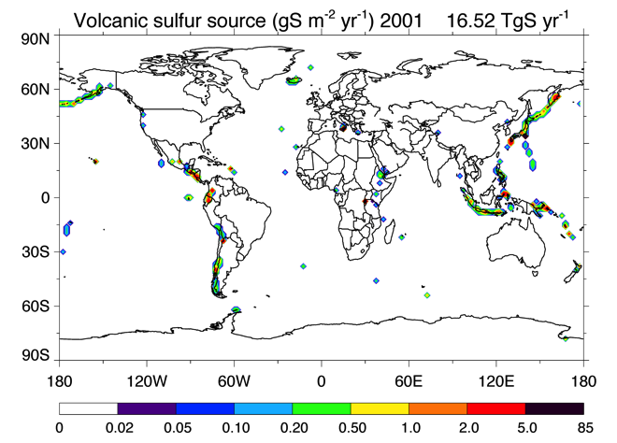
Global SO₂ emissions, 2001
(Note: OCS is not included in the model)

Slide 8
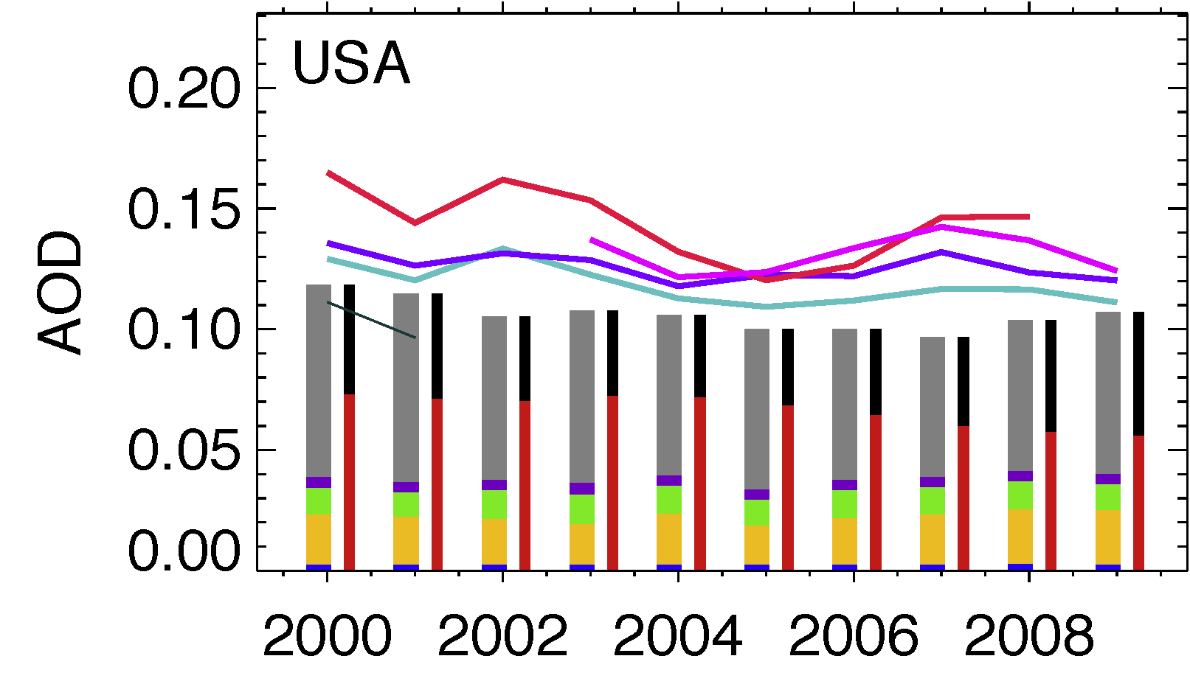
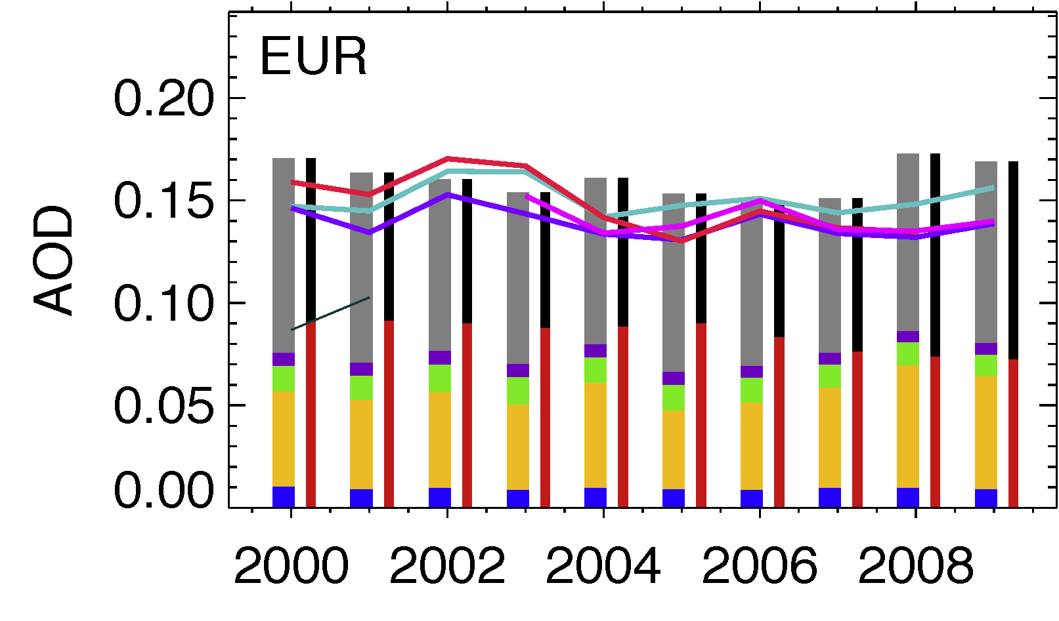
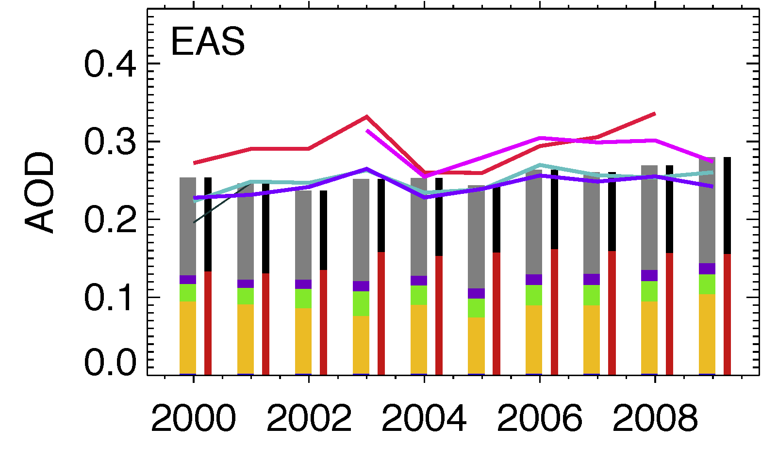
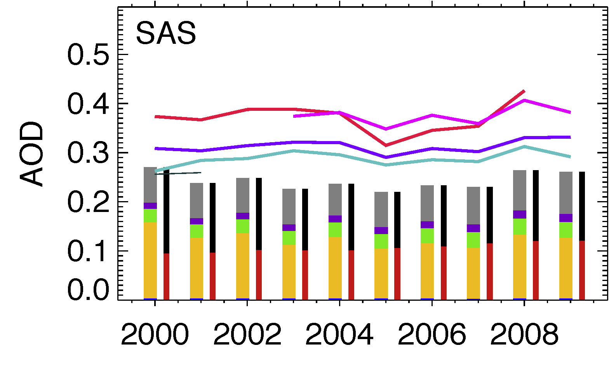
Regional aerosol trends – model and satellite AOD
Even though anthropogenic AOD shows regional decreasing or increasing trends, trends of total AOD is much weaker because of large fraction of other aerosols (e.g., dust)

Slide 9
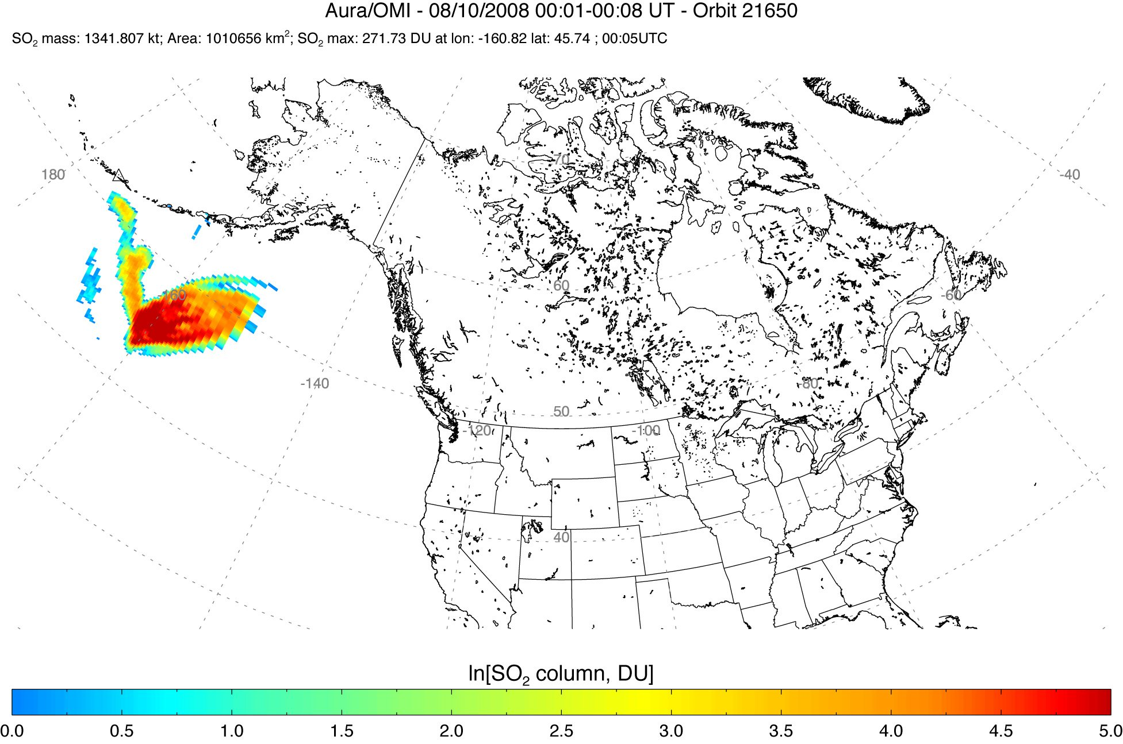
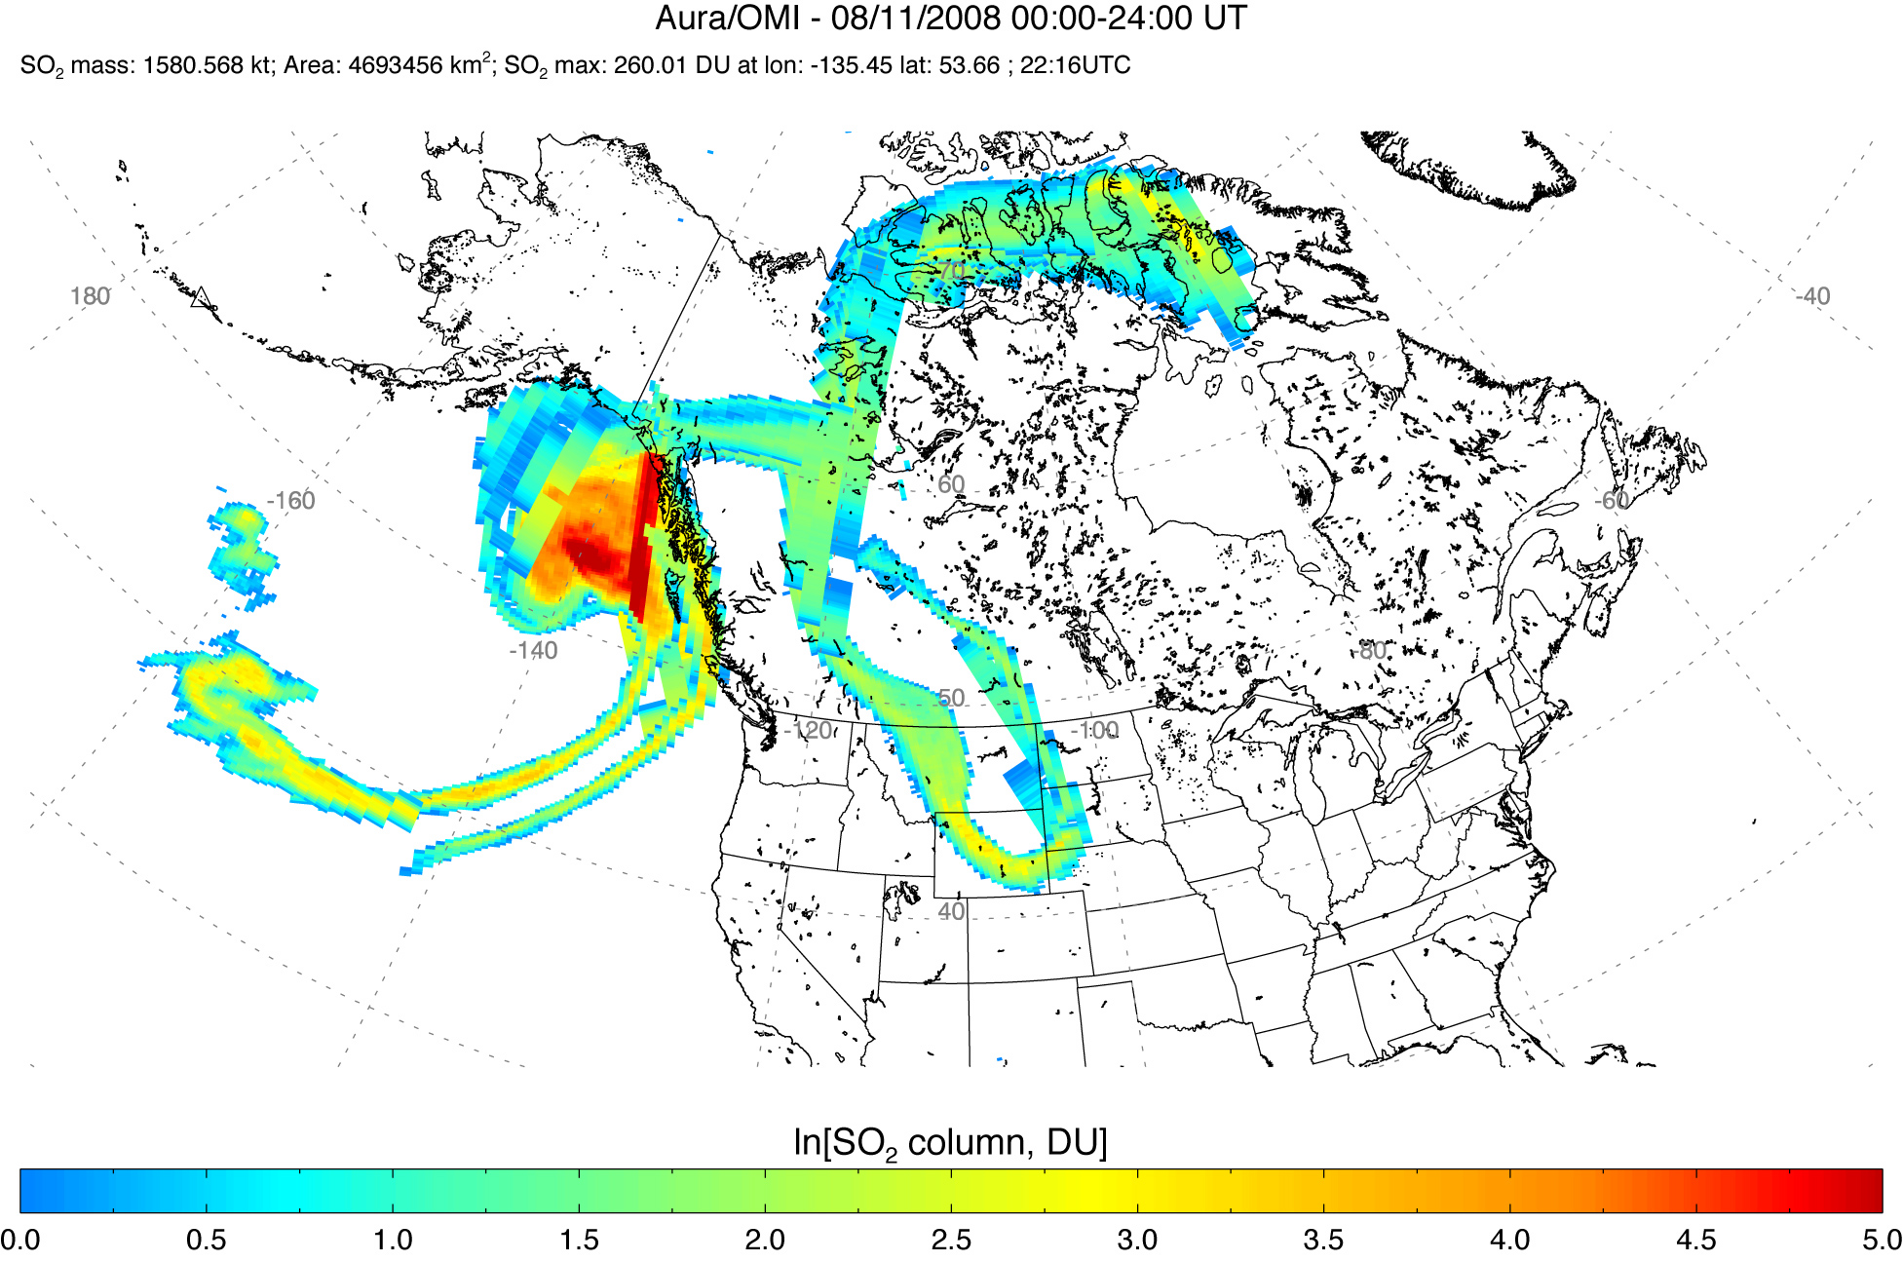
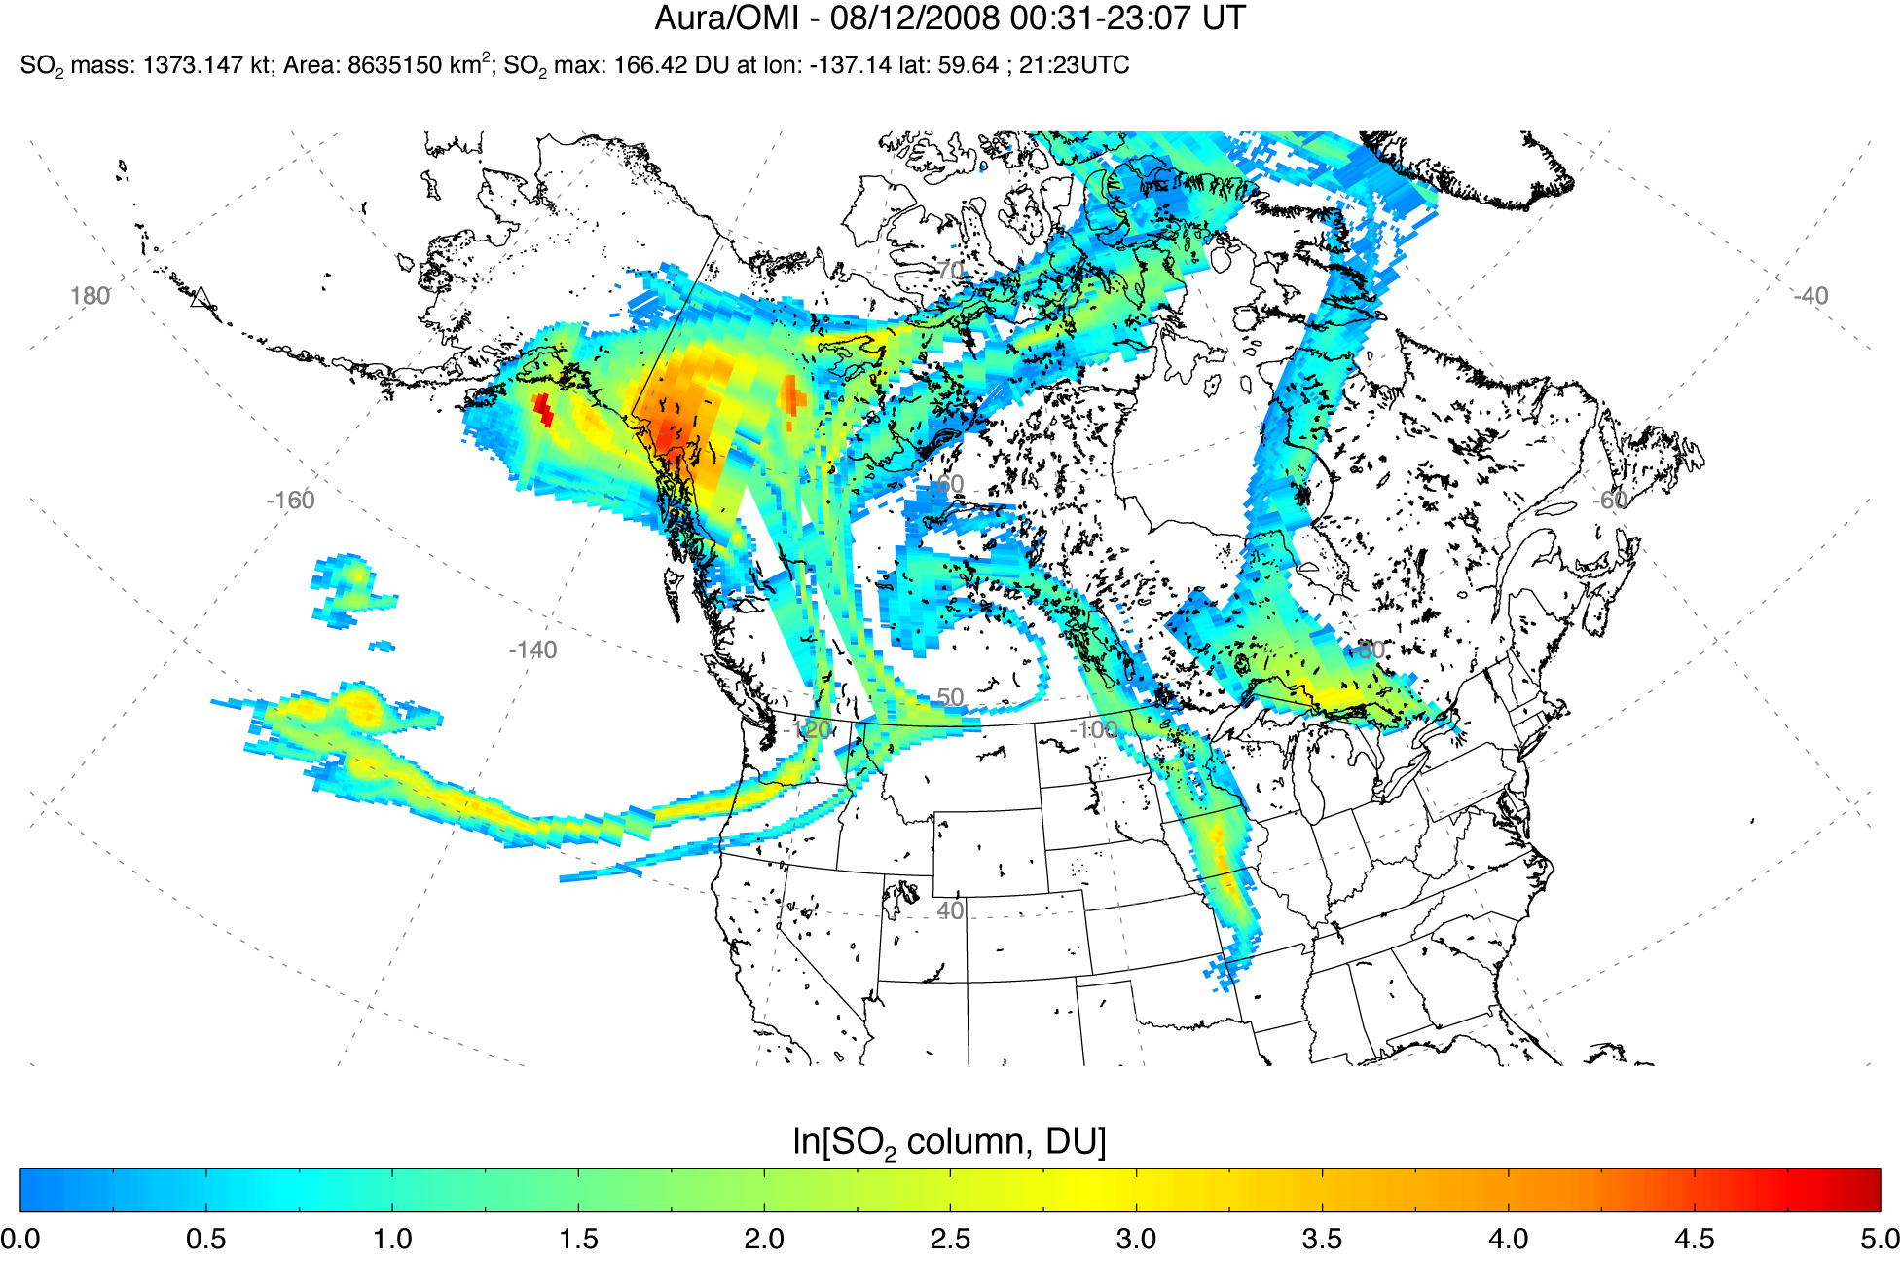
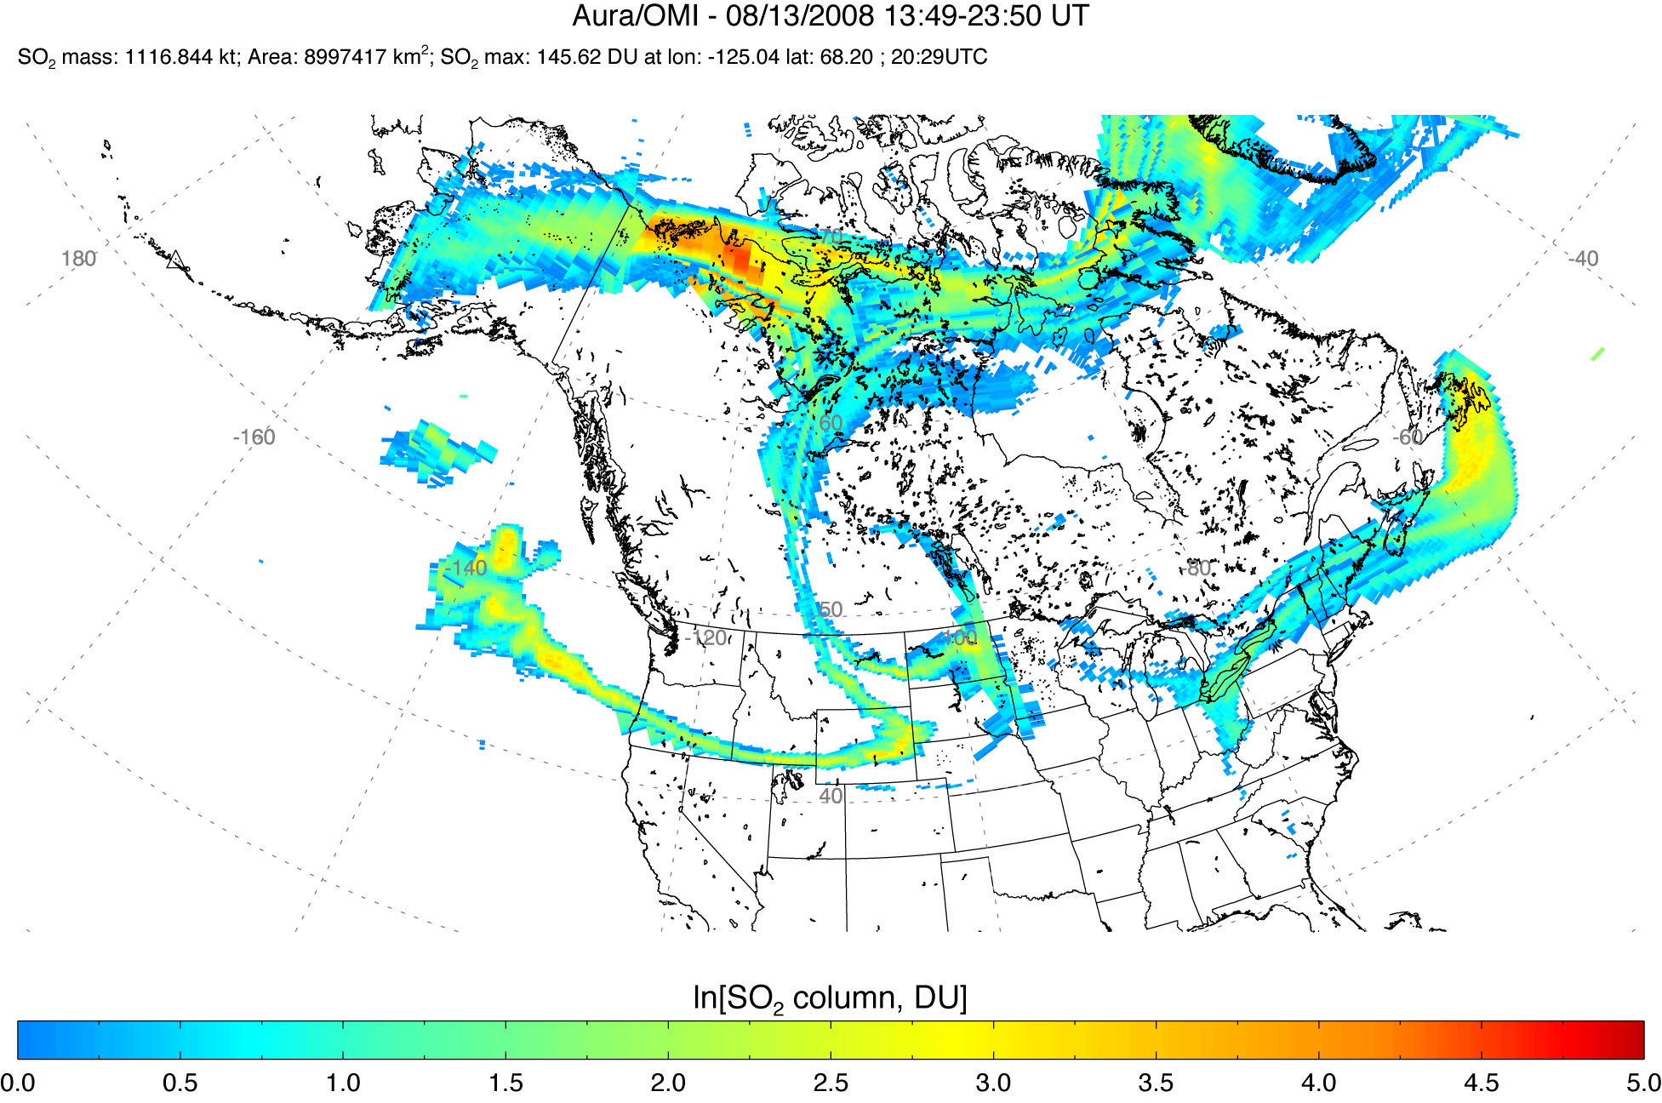
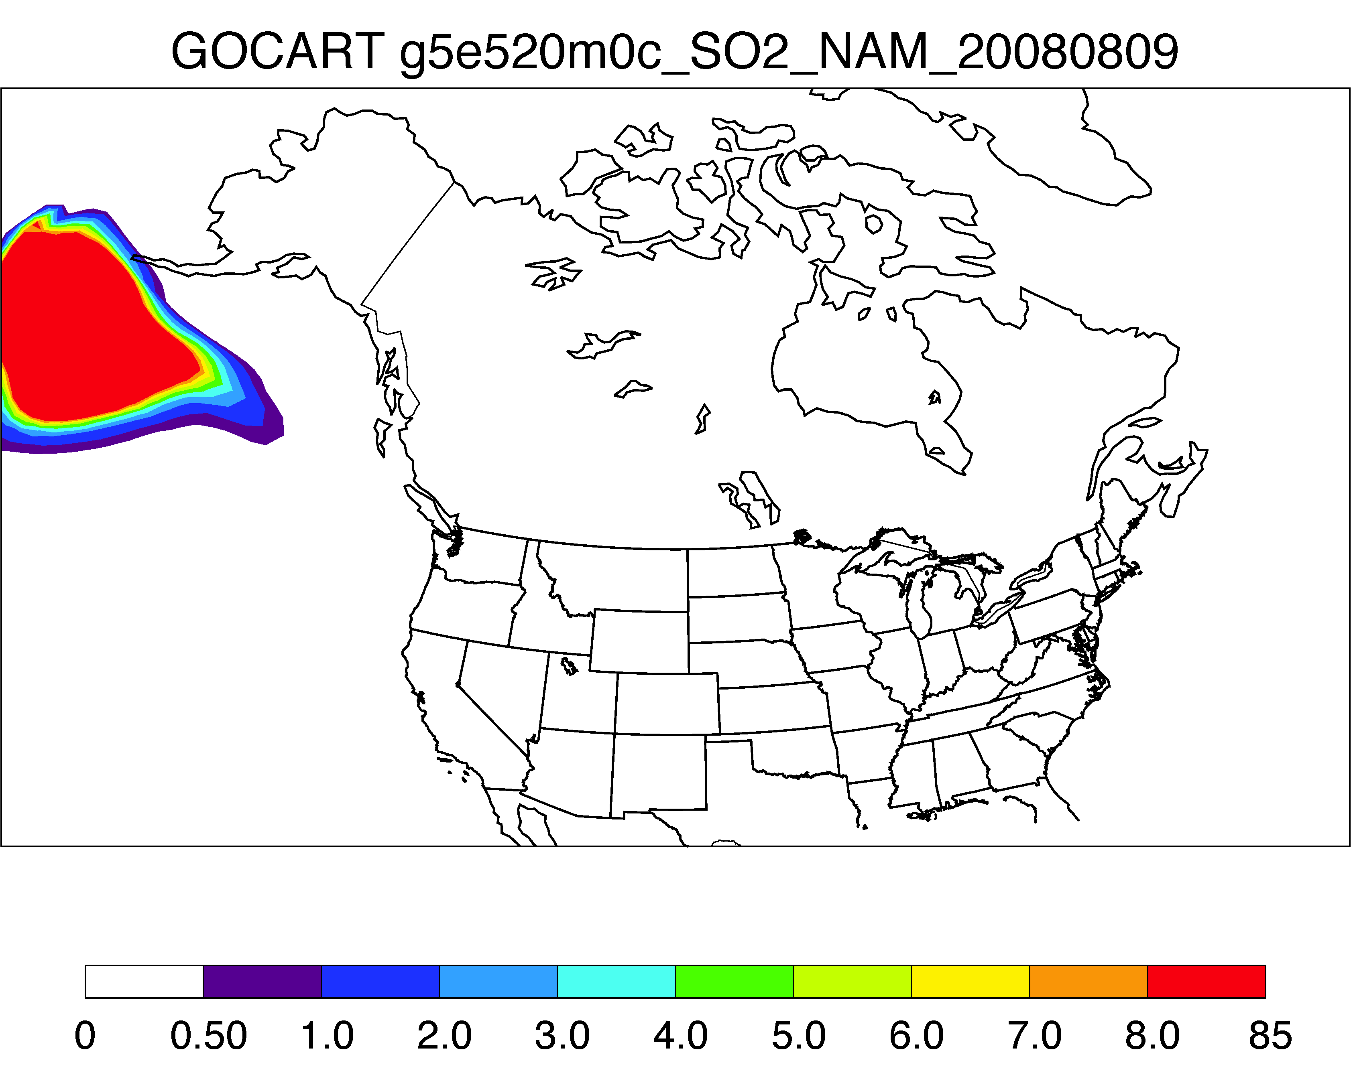
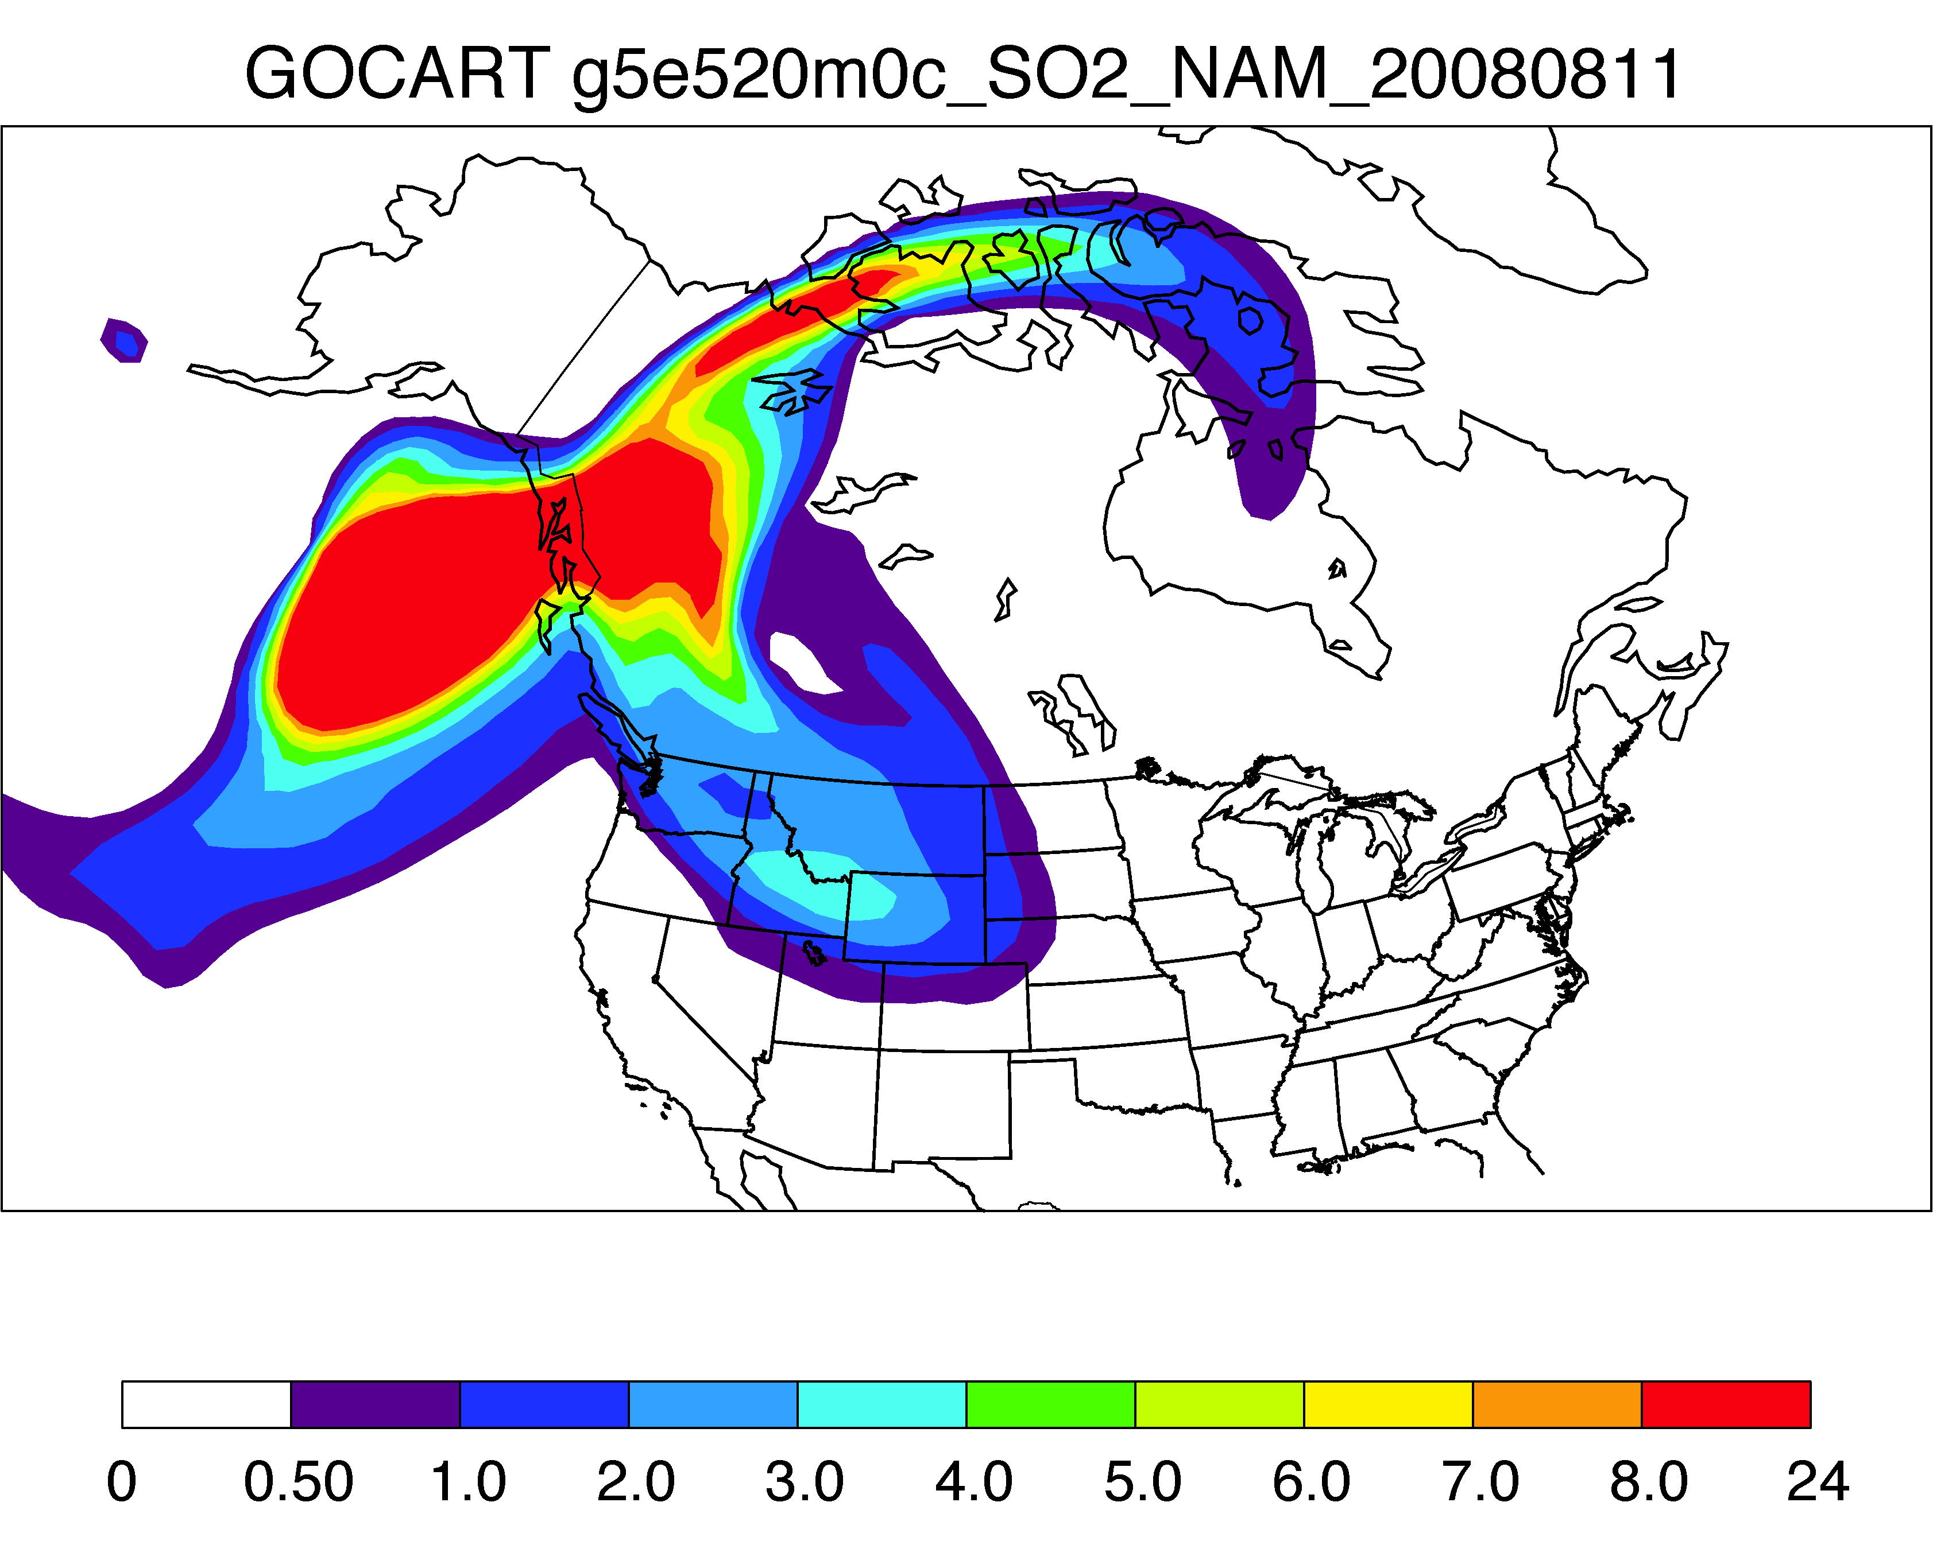
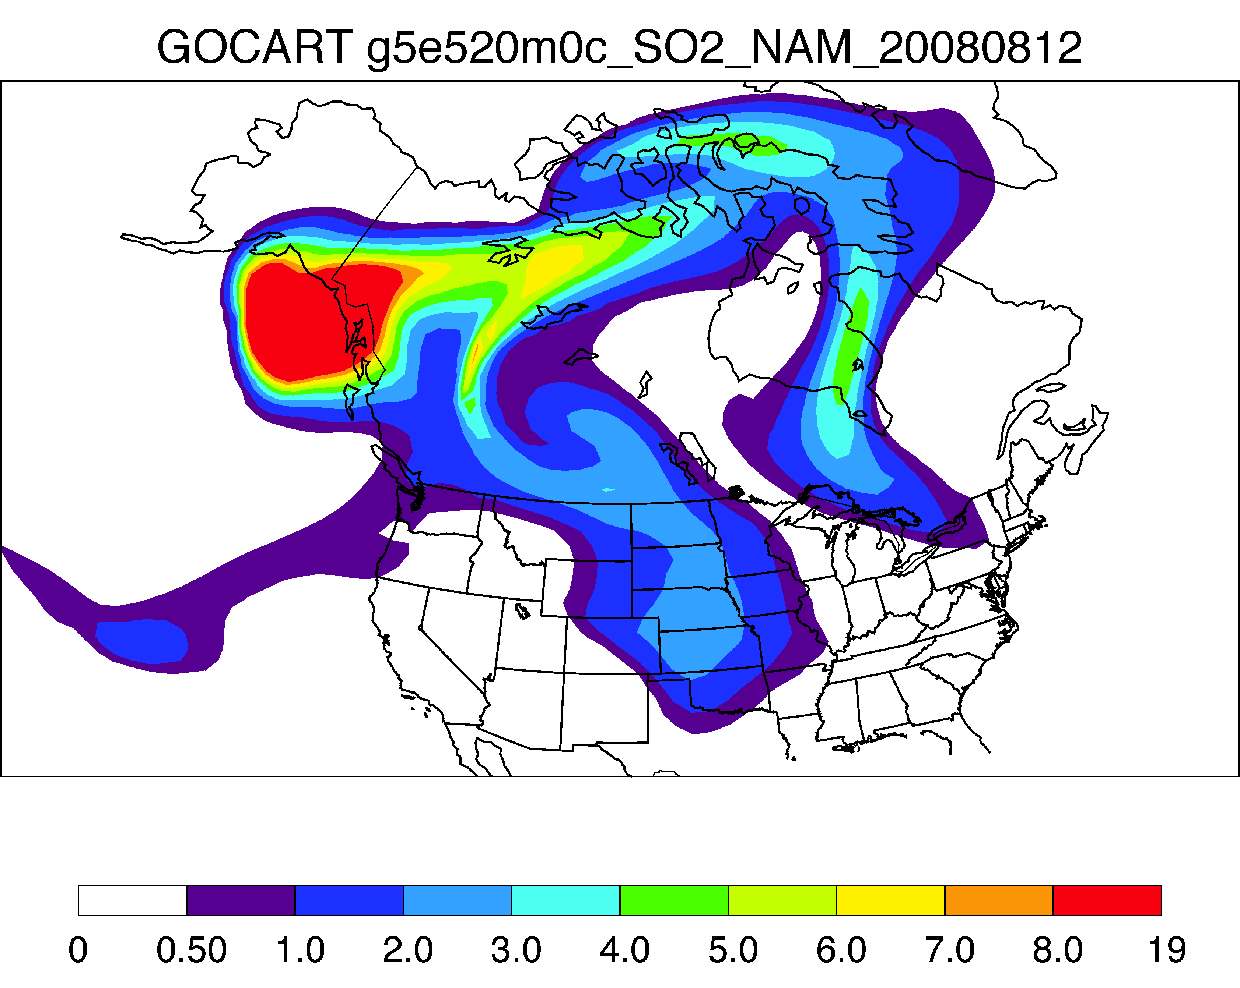
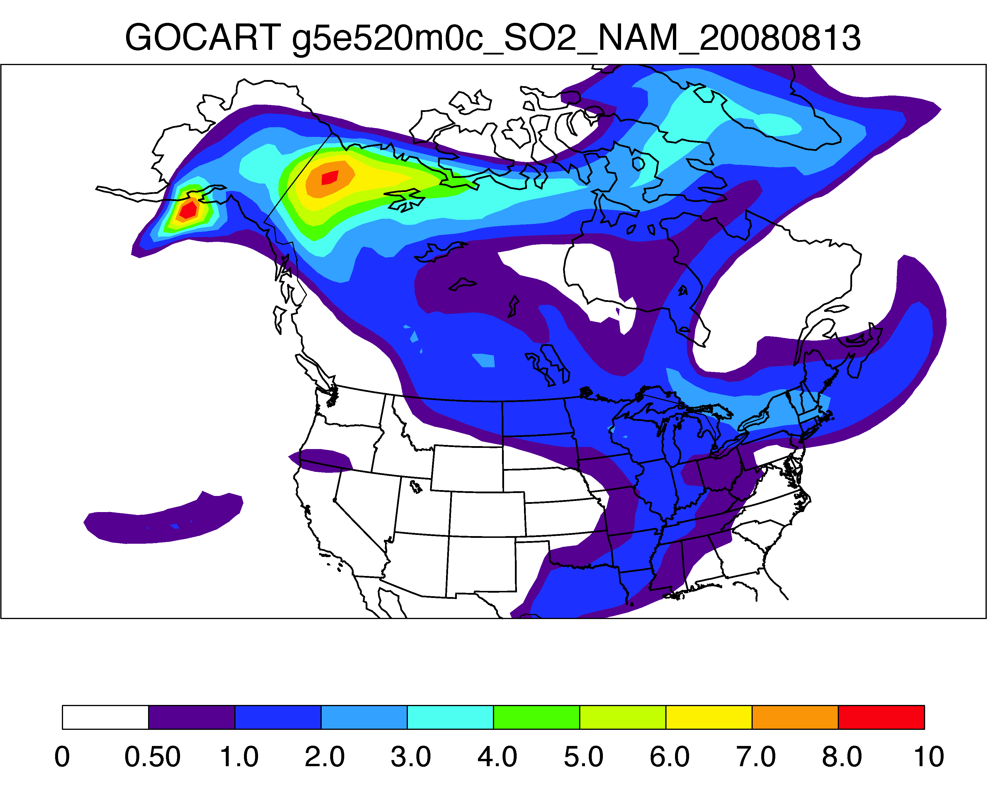
Volcanic SO₂ – Kasatochi, Aug 2008
OMI column SO₂
2008-08-09
2008-08-11
2008-08-12
2008-08-13
GOCART column SO₂
2008-08-09
2008-08-11
2008-08-12
2008-08-13
OMI: snapshot at ~1:40 pm local time GOCART: daily average
(note: unit and color scales are different between OMI and GOCART)

Slide 10
Volcanic SO₂ - Soufrière Hills, May 2006
OMI column SO₂
GOCART column SO₂
GOCART seems to capture the volcanic plume movement, although it is a little more diffusive

Slide 11
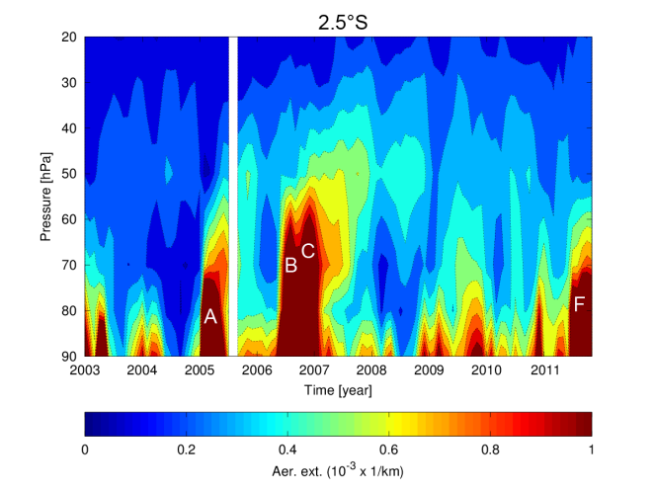
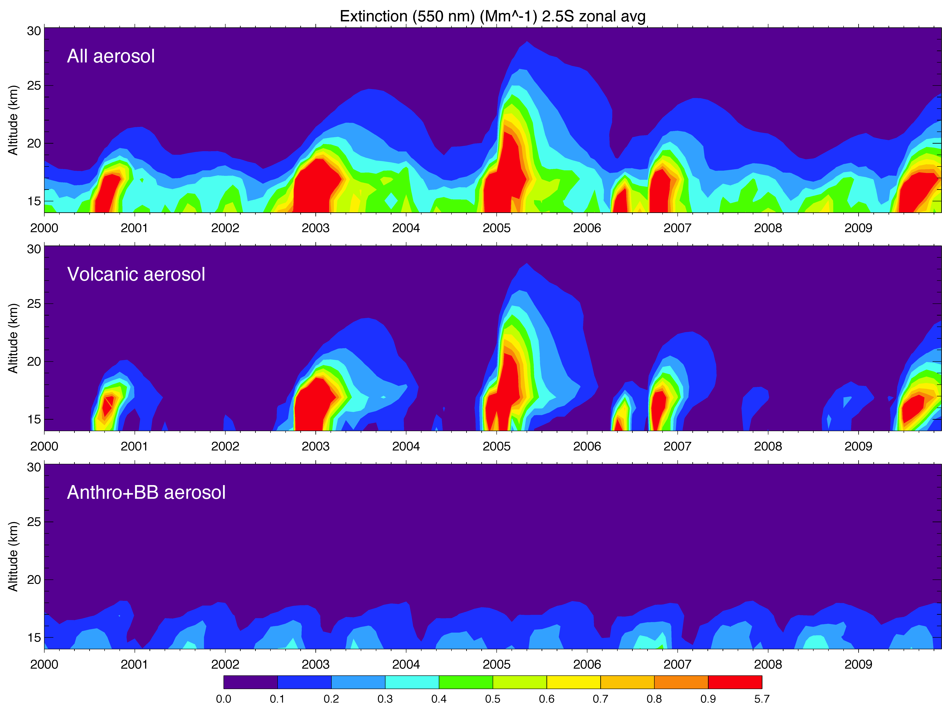
Comparisons with SCIAMACHY profiles
25
SCIAMACHY
2.5S
20
18
(Figure from John Burrows)
Km 16
GOCART total
Volcanic eruptions:
A) Manam (Jan 2005, 4°S)
B) Soufriere Hills (May 2006, 16°N)
C) Tavurvur (Oct 2006, 4°S)
D) Kasatochi (Aug 2008, 52°N)
E) Sarychev Peak (July 2009, 48°N)
F) Nabro (June 2011, 13°N)
GOCART Volcanic
GOCART Anthro+BB

Slide 12
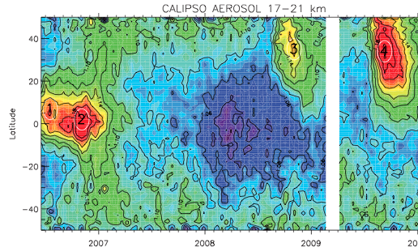
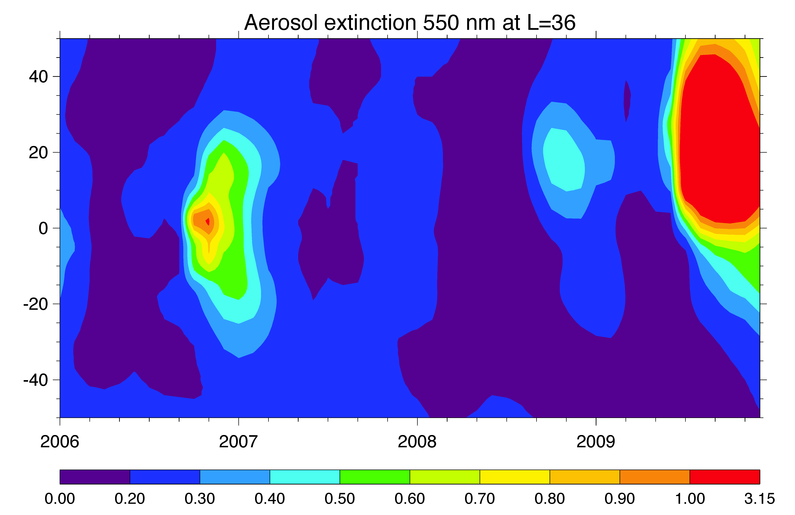
Comparison with CALIPSO
CALIPSO aerosol 17-21 km (SR)
Volcanic eruptions:
Soufriere Hills (May 2006, 16°N)
Tavurvur (Oct 2006, 4°S)
Kasatochi (Aug 2008, 52°N)
Sarychev Peak (July 2009, 48°N)
(Figure from Solomon et al., 2011)
GOCART aerosol ~18-20 km (extinction Mm⁻¹)
Injection height of some volcanoes could be inaccurate

Slide 13
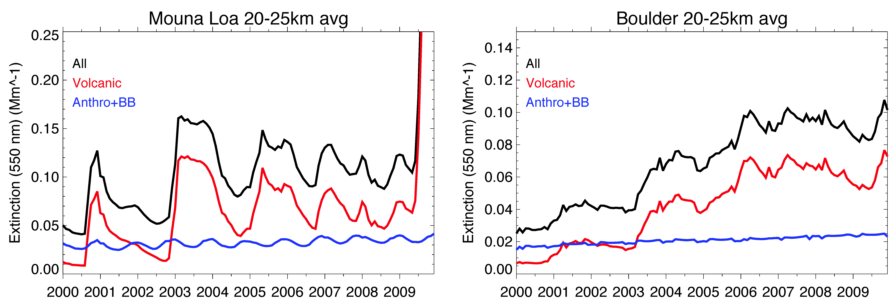
Attribution of “trends” (GOCART)
19.5N 155.6W
40.0N 105.3W
Clearly, variations and trends are different in different locations
The anthropogenic sources impose an organized, smooth change in the lower stratosphere
The numerous volcanic eruptions frequently perturb the “background”, or even showing an increase trends over certain locations
On average, volcanic aerosol is nearly 2x as much as anthropogenic aerosols in the stratosphere (> 16 km, 50S-50N) from 2000 to 2009

Slide 14
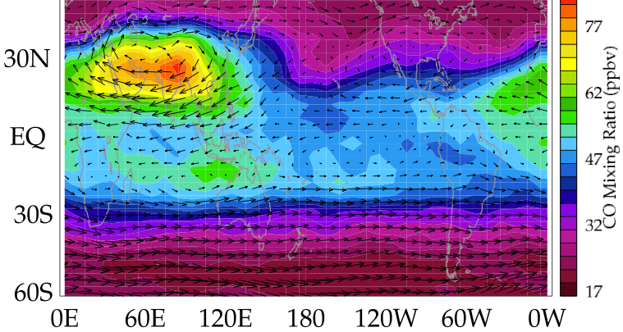
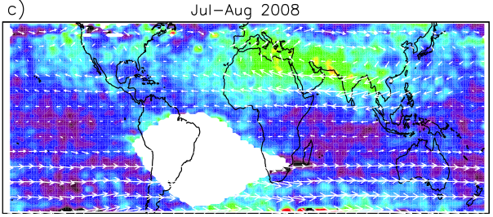
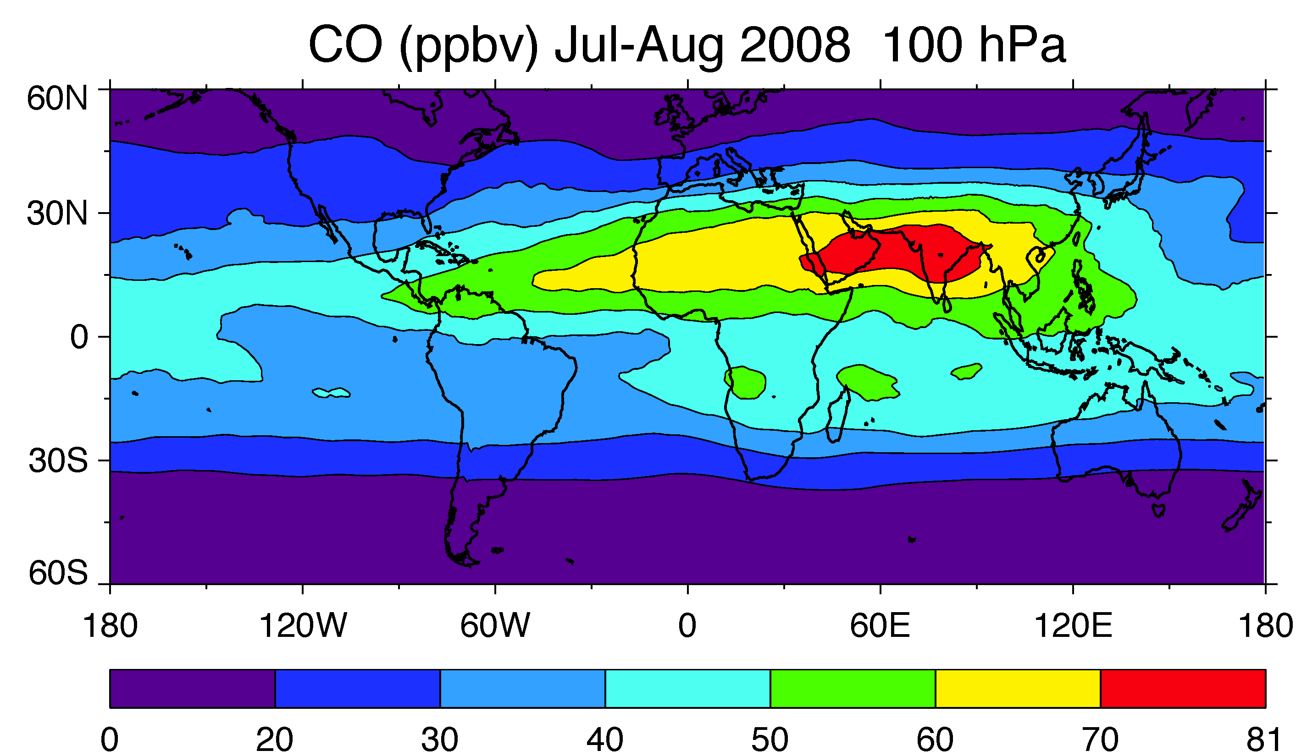
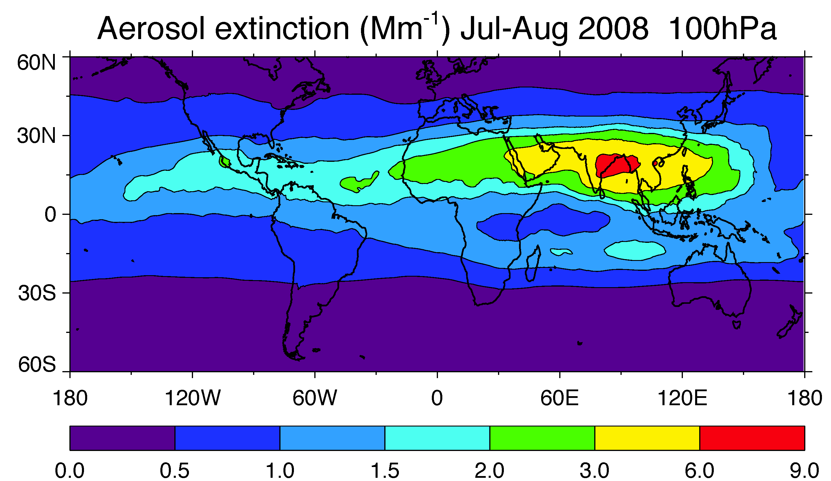
Transport of pollution to the UTLS
MLS CO (ppbv) Jul-Aug 2005 100 hPa
CALIOP aerosol SR (532 nm) Jul-Aug 2008 15-17 km
Vernier et al., 2011
Park et al., 2007
GEOS-5/GOCART simulations

Slide 15
Conclusions
Both satellite data and model have shown that even without major explosive volcanic eruptions, volcanic emissions frequently perturb the stratospheric “background” aerosols, making it difficult to define non-volcanic background aerosol values in the stratosphere
Although the ratio of volcanic/anthropogenic SO₂ emission is only 1:4 on decadal average (2000-2009), the ratio of corresponding stratospheric amount is disproportionally 2:1, due to the high altitude emissions from volcanoes
The increase of anthropogenic emissions in Asia does seem to contribute to the increasing trend of stratospheric aerosol with well organized seasonal variations, but the most influence is confined in the UT
The model suggests that the volcanic sources could be more responsible than the anthropogenic sources for the apparent increasing trend of stratospheric aerosol in the past decade

Slide 16
Next action items:
Extend simulation to 2013 (with updated volcanic SO2 emission source)
Incorporate OCS sources
Systematic compare model results with OMI, MLS, SCIAMACHY, OSIRIS, CALIOP, OMPS data of gas and aerosol tracers
Compare ground-based lidar measurements (e.g., Mauna Loa, Boulder,…)
Investigate other aerosol contributions (e.g., biomass burning)
Address climate effects

