Slide 1
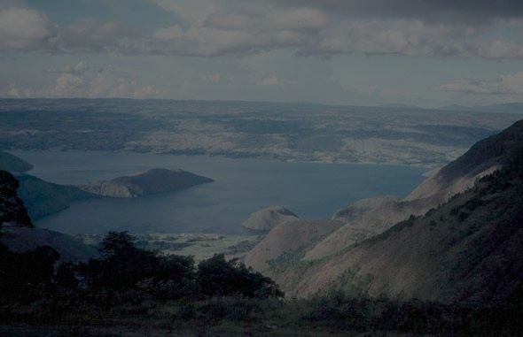
Microphysical simulations of large volcanic eruptions: Pinatubo and Toba
Jason M. English
National Center for Atmospheric Research
(LASP/University of Colorado starting Jan 1, 2014)
Thanks to collaborators
Brian Toon and Michael Mills

Slide 2
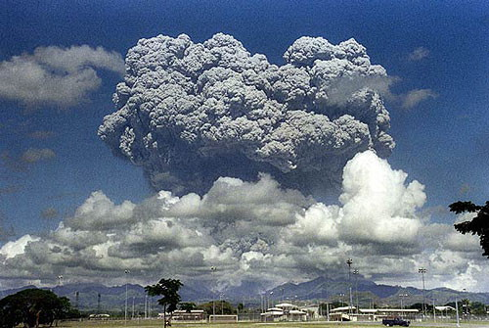
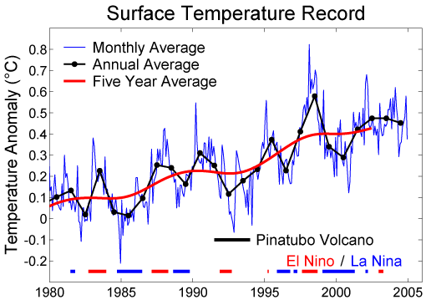
The 1991 eruption of Mt. Pinatubo
20 Tg SO₂ (10 Tg S) into stratosphere
1992: Temperature dropped 0.5°C; coolest year in the past 25 years
We also saw ozone loss, hydrological changes

Slide 3
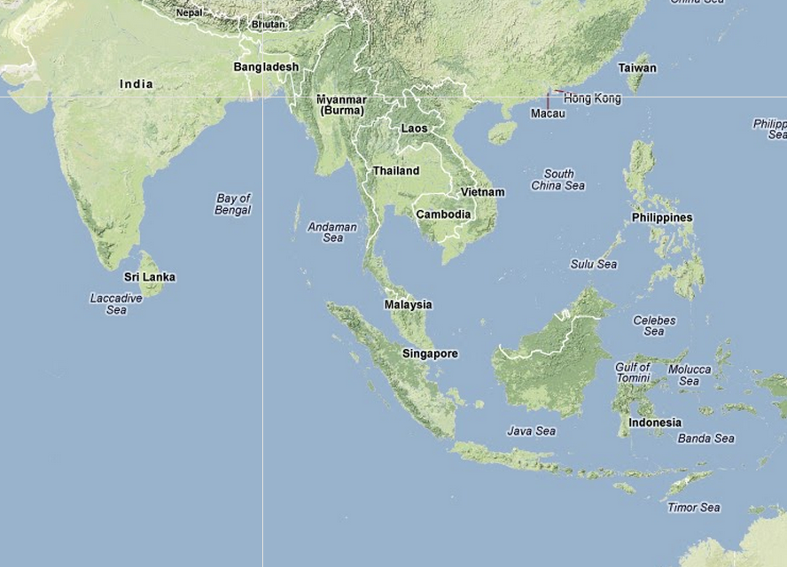
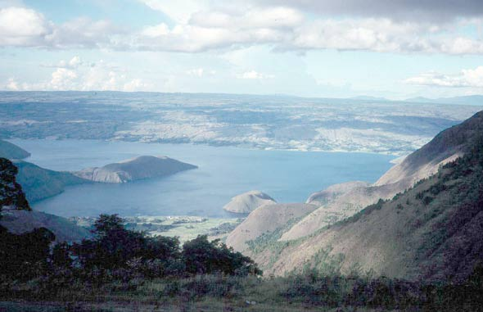
The Toba super-eruption 74,000 years ago
Largest eruption in past 20 million years
Up to 100x larger than Pinatubo
Disagreement re: climate impact
  May have caused a bottleneck in human evolution (Ambrose, 1998)
  10K cooling; 20-yr impact (Robock et al. 2009)
  3.5K cooling; 10-yr impact (Timmreck et al. 2010).

Slide 4
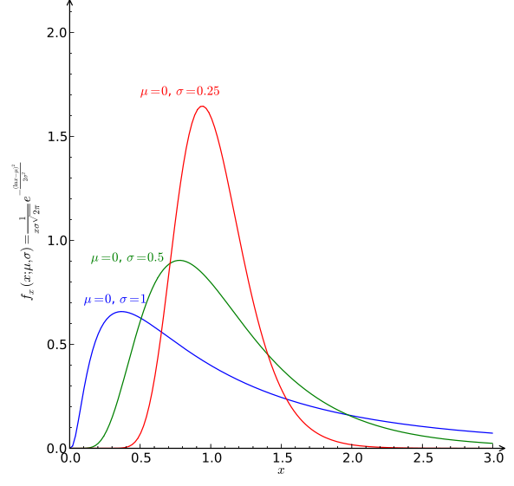
The importance of getting aerosol size right
Sectional aerosol model (CARMA)
Modal aerosol model (prescribed lognormal)
GCMs (with bulk aerosols) underestimate aerosol size; overestimate volcanic forcing
Notes:
Getting the tails of the dist right is important.

Slide 5

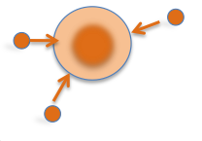
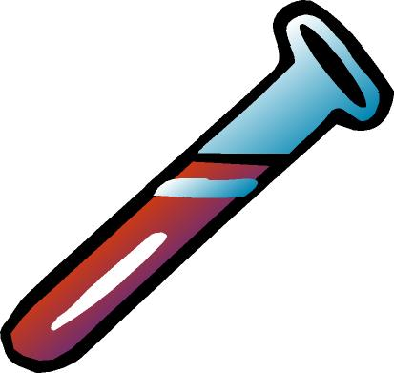

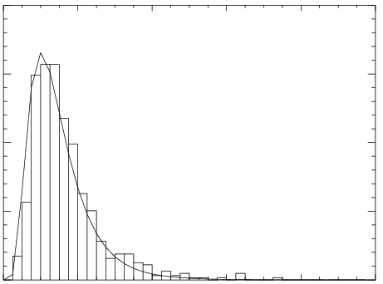


WACCM/CARMA Model
CARMA
CARMA
3. Nucleation
4. Condensational growth
Nuc: Zhao and Turco 1995
H₂O vp: Lin & Tabazadeh 2001
H₂SO₄ vp: Giauque/Ayers/Kulmala
H₂SO₄ vp: Giauque/Ayers/Kulmala
Wt %: Tabazadeh 1997
4°x5° resolution
WACCM
Dynamics/Radiation
CARMA
2. Chemistry
WACCM 3.1.9
5. Coagulation
H₂SO₄ formed
Oxidants OH, O,
O₃ ,NO₃
Brownian, convective, gravitational, and
van der Waals forces
CARMA
42 bins
0.2 nm-2.6 μm dry radius
WACCM
Aerosol Heating not linked to radiation
WACCM
CARMA
1. Emissions
6. Deposition, Sedimentation
SO₂ (prescribed UT source)
OCS (510 pptv boundary condition)

Slide 6
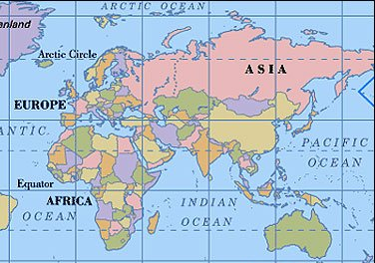
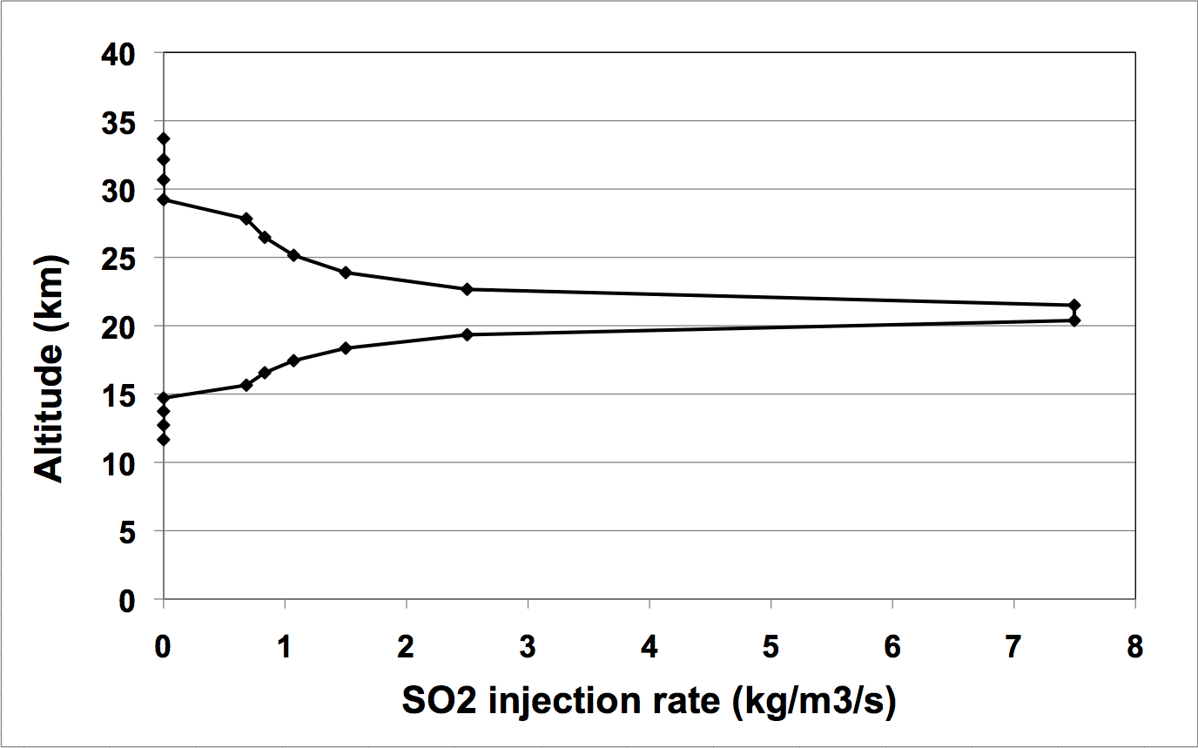
Three eruptions; with and without van der Waals
Simulated SO₂ cloud 2°S – 14°N 95 – 115°E
Three eruptions simulated
Pinatubo | 10 Tg S
Pinatubo x 10 | 100 Tg S
Toba | 1000 Tg S
10-year simulations
SO₂ gas injected continuously over 48 hours on June 14-15 of first year

Slide 7
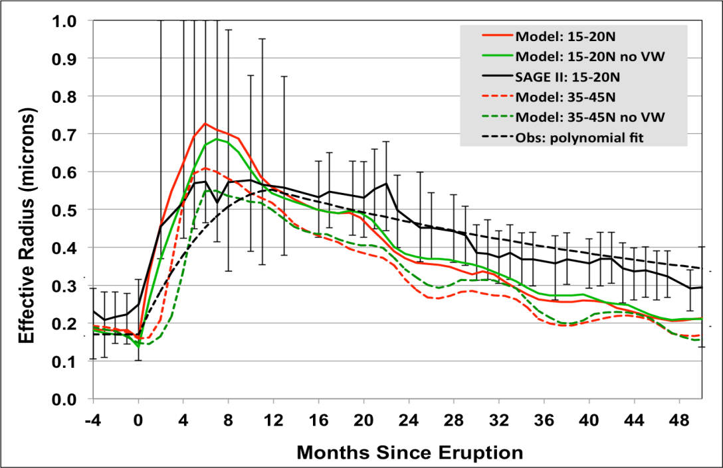
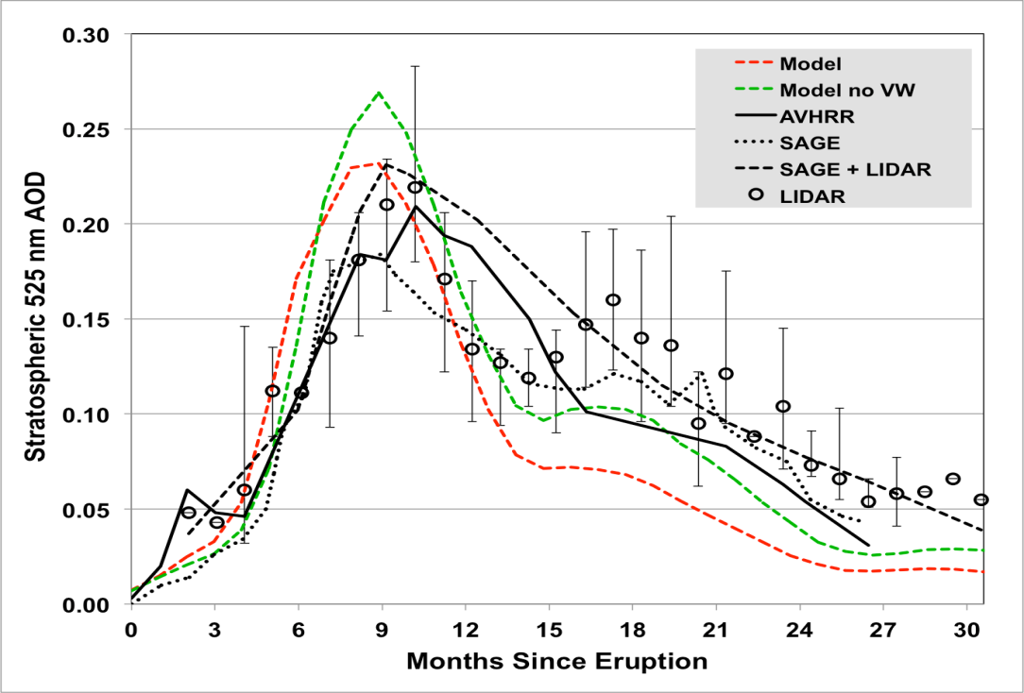
Pinatubo: Model captures peak but declines too quickly
Model is mostly within error bars but declines too quickly (no aerosol heating, no QBO)
Including van der Waals forces increases effective radius and reduces AOD
15 to 27 km
Data from Russell et al., 1996
50 to 55 °N;
1-300 hPa
Data from Ansmann et al., 1996

Slide 8
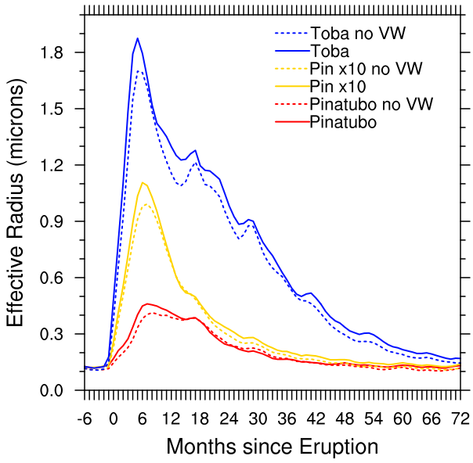
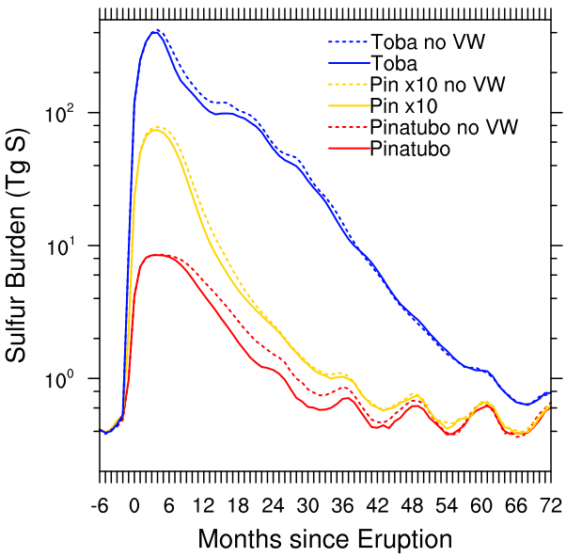
Larger Eruptions have larger particles, limited burdens
Van der Waals forces increases R_{eff,} decreases length of climate effect
Comparing Toba Studies R_{eff} Mode width
Robock et al., 2009 (Bulk) | ~0.6 μm (0.45 dry) | 1.25
Timmreck et al., 2010 (Modal) | 0.8 – 1.1 μm | 1.2
English et al., 2013 (Sectional) | 1.1 – 2.2 μm | 1.2 - 2.1

Slide 9
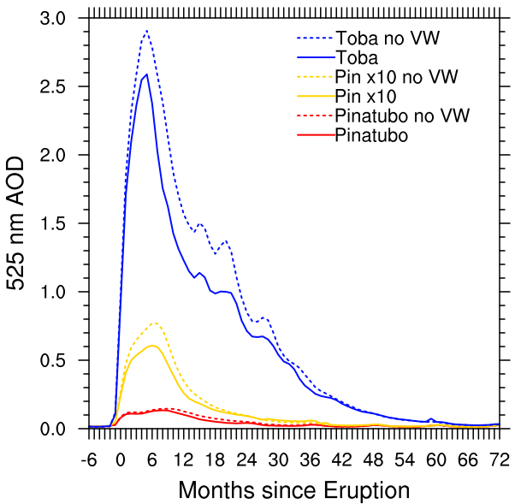
AOD is limited in larger eruptions, esp. when van der Waals forces are included (100x emissions = 20x AOD)

Slide 10
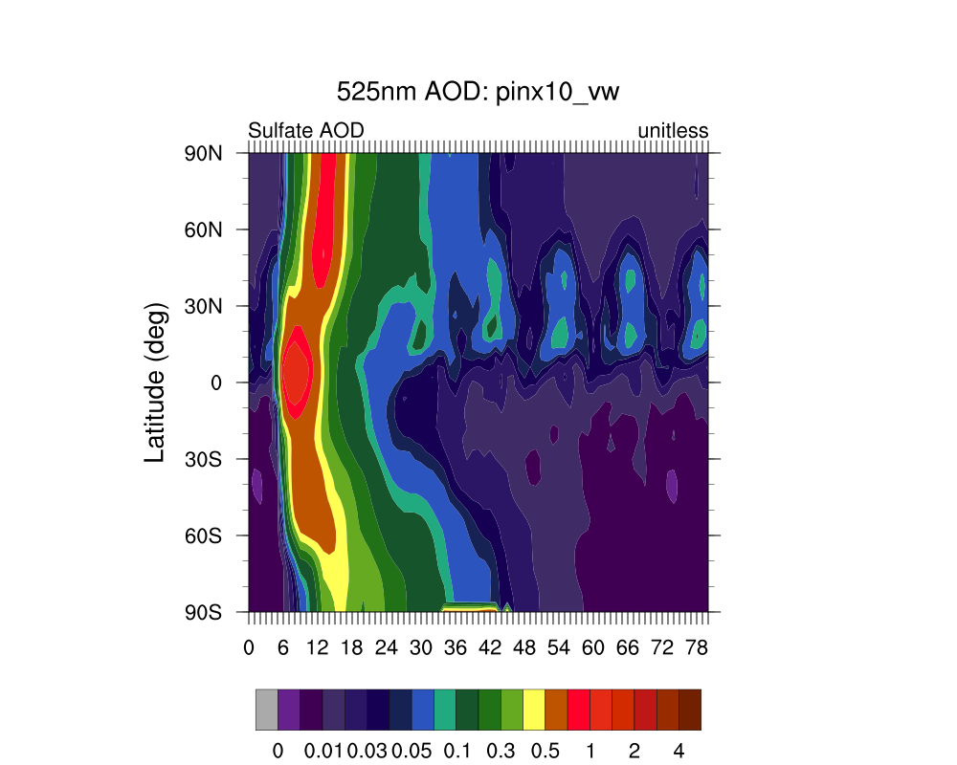
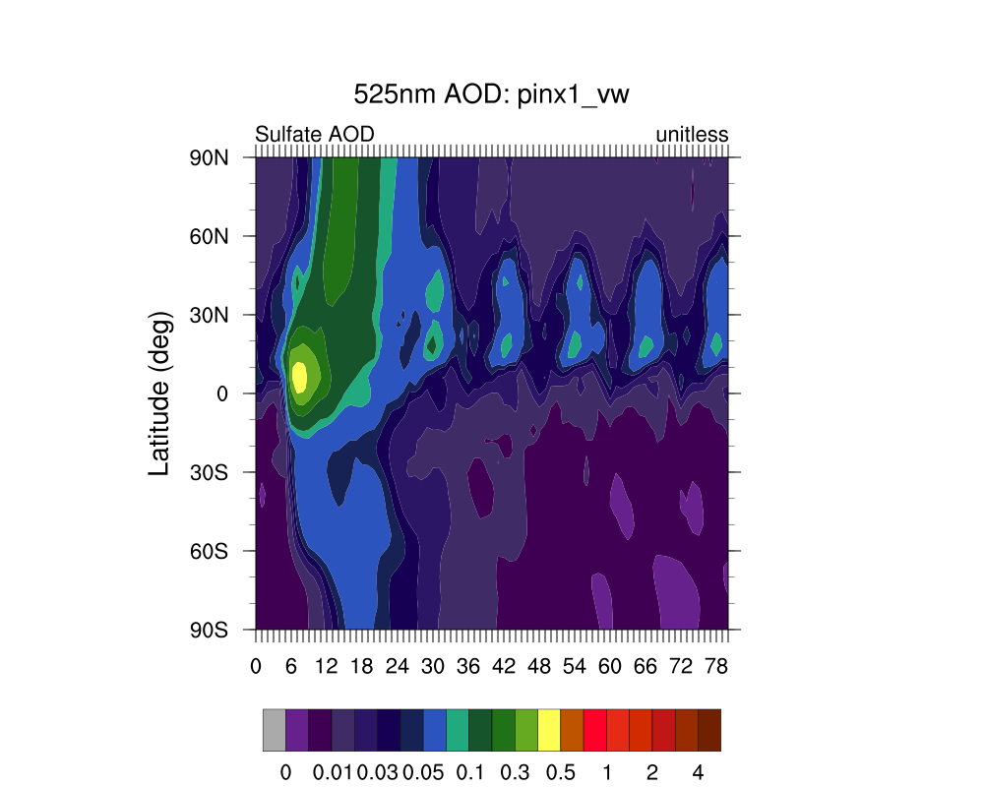
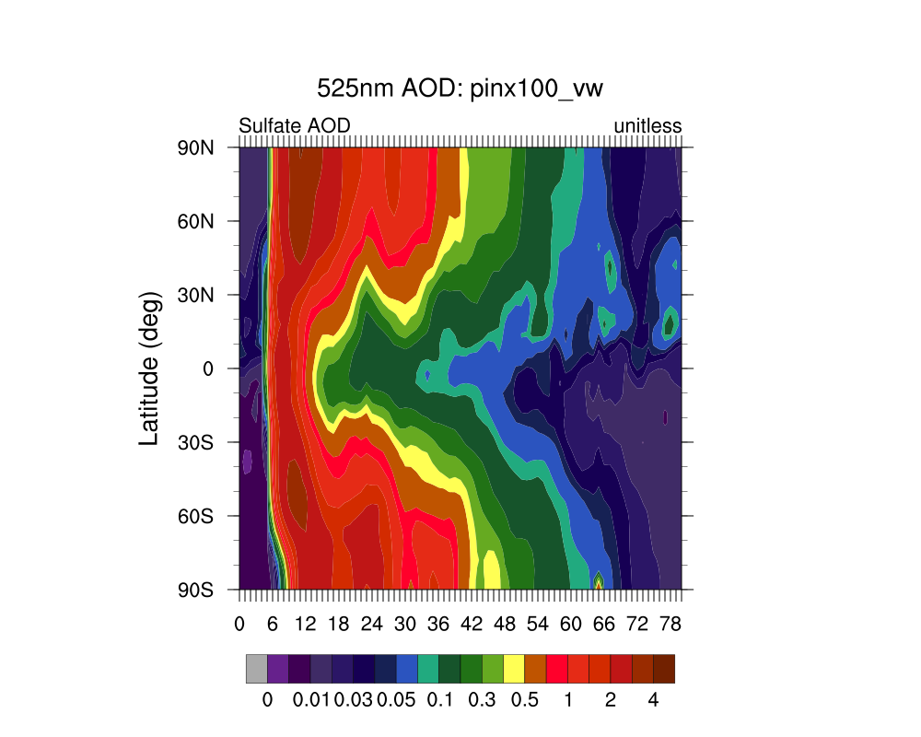

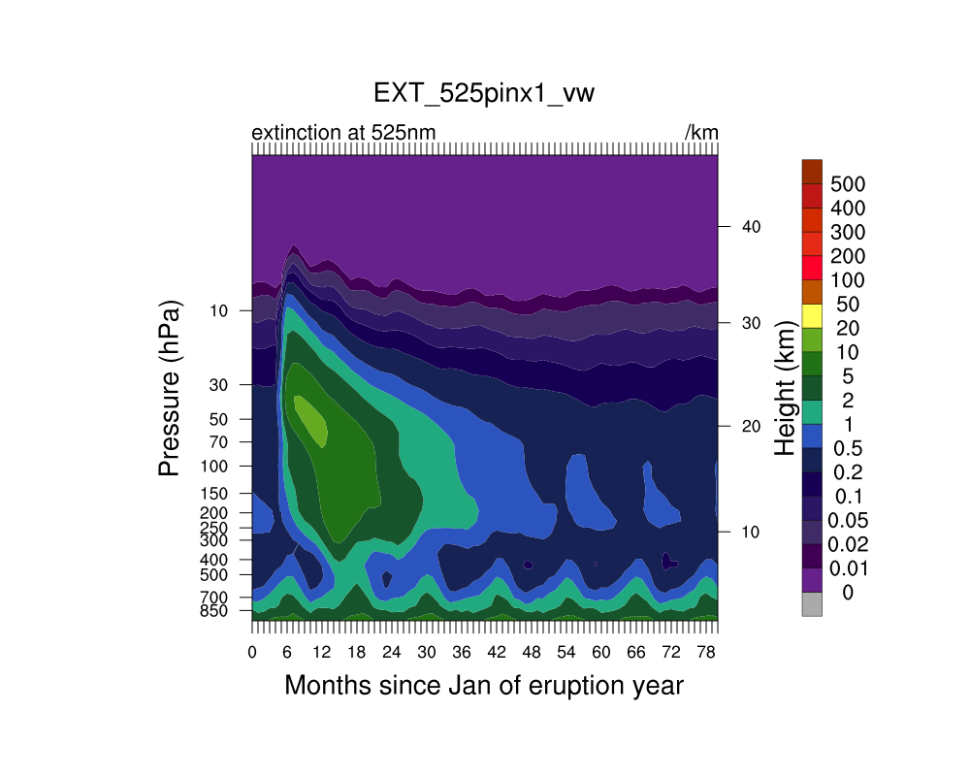
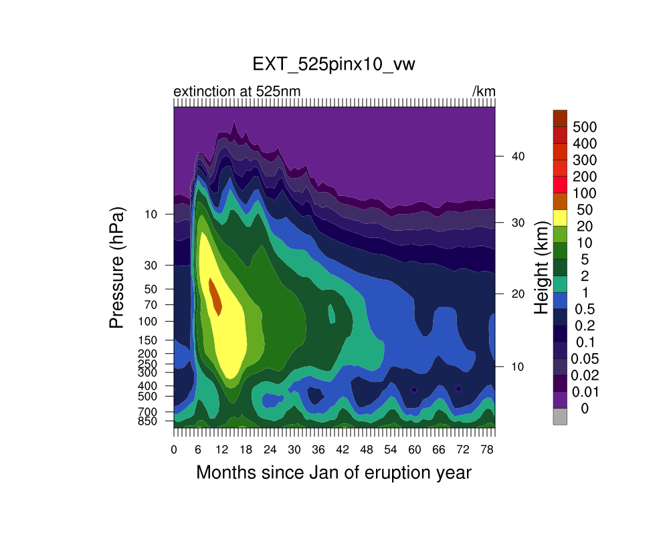
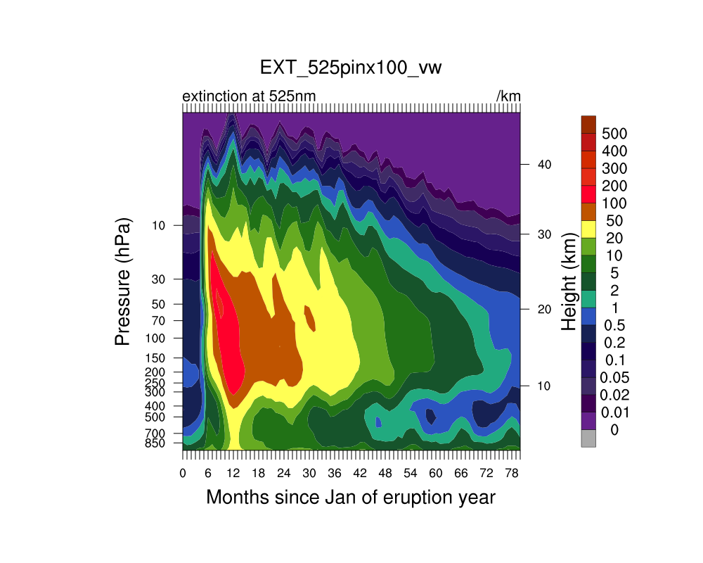
Extinctions peak in lower stratosphere and poles
AOD (525 nm)
Extinction (10³ km⁻¹)
Pinatubo
Pin x10
Toba

Slide 11
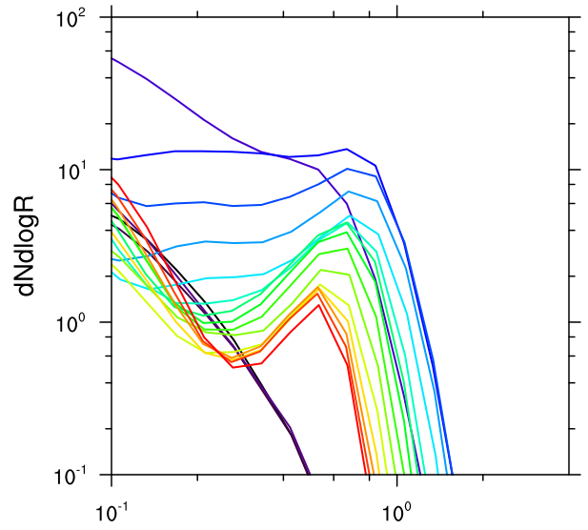
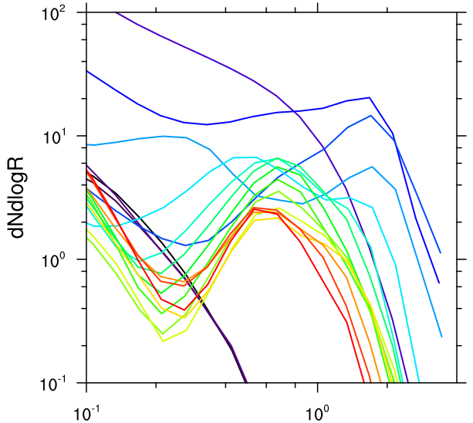
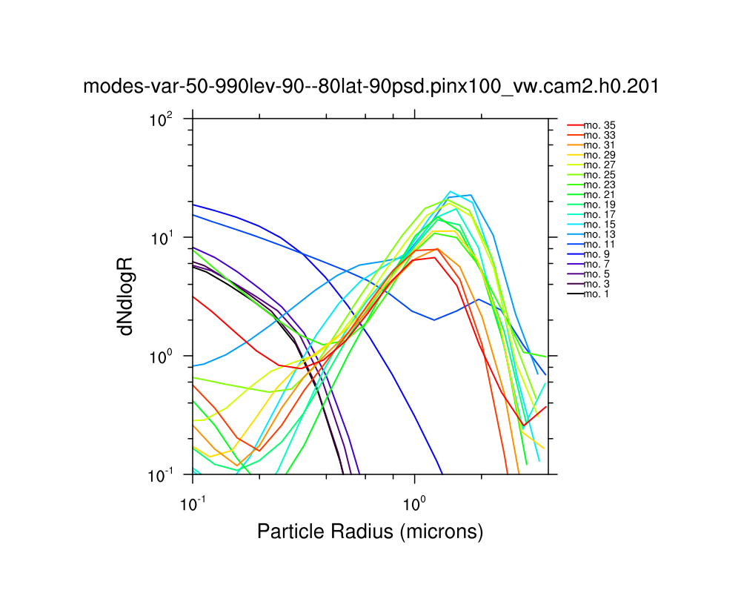
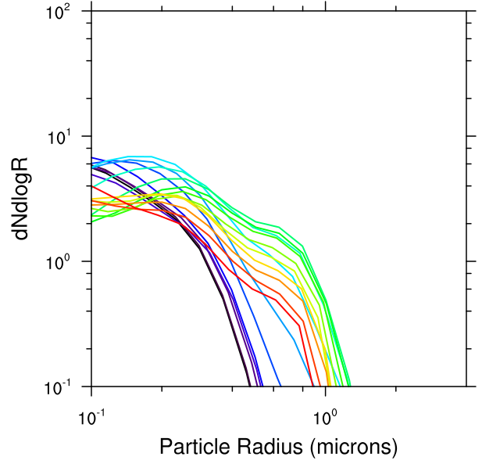
Accumulation modes perturbed in tropics and at poles
Pinatubo
Toba
20-200 hPa; Equator
Pinatubo
Toba
50-990 hPa; 80-90°S

Slide 12
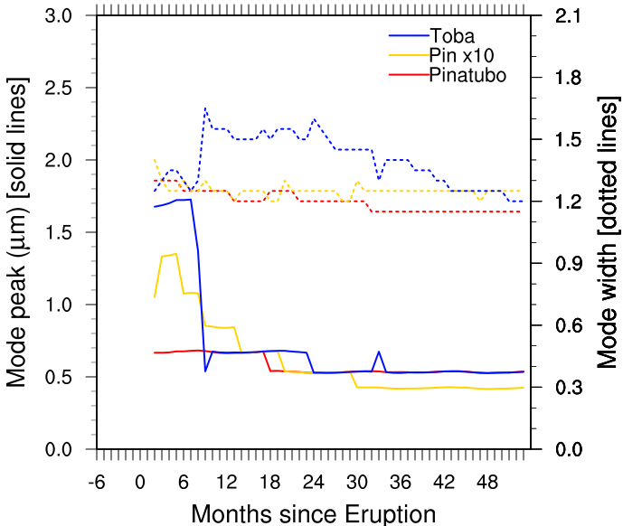
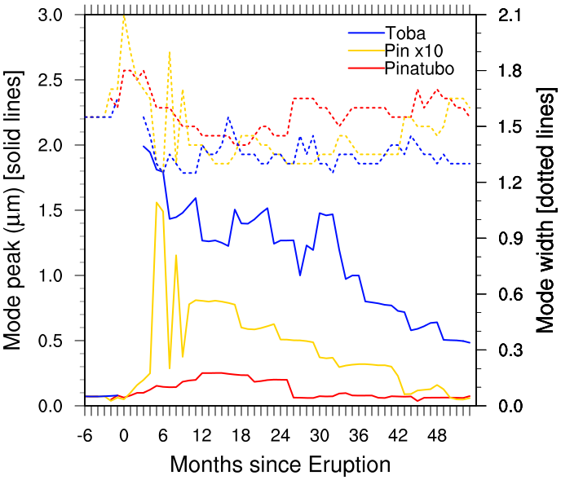
Mode peak size and widths vary
20-200 hPa; Equator
50-990 hPa; 80-90°S
Comparing Toba Studies R_{eff} Mode width
Robock et al., 2009 (Bulk) | ~0.6 μm (0.45 dry) | 1.25
Timmreck et al., 2010 (Modal) | 0.8 – 1.1 μm | 1.2
English et al., 2013 (Sectional) | 1.1 – 2.2 μm | 1.2 - 2.1

Slide 13
Summary
Our Pinatubo simulations capture the observed peaks in the NH but decline too quickly and are too low in the SH
  Need to add QBO, aerosol heating, Cerro Hudson to the model
Large eruptions have self-limiting radiative effects due to increased particle size
  Toba (100x Pinatubo) has only 50x burden; 20x AOD; 5-yr AOD and 2.0 μm r_{eff}
  Van der Waals forces increases r_{eff} and decreases AOD
Accumulation mode peak and widths evolve in a complex manner; 2-moment modal models may not be accurate
  Mode widths vary from 1.2 to 2.1
  High latitude mode peak size varies from 2 um to 0.5 um over 4 years
English, J. M., O. B. Toon, and M. J. Mills (2013), Microphysical simulations of large volcanic eruptions: Pinatubo and Toba, JGR.

Slide 14
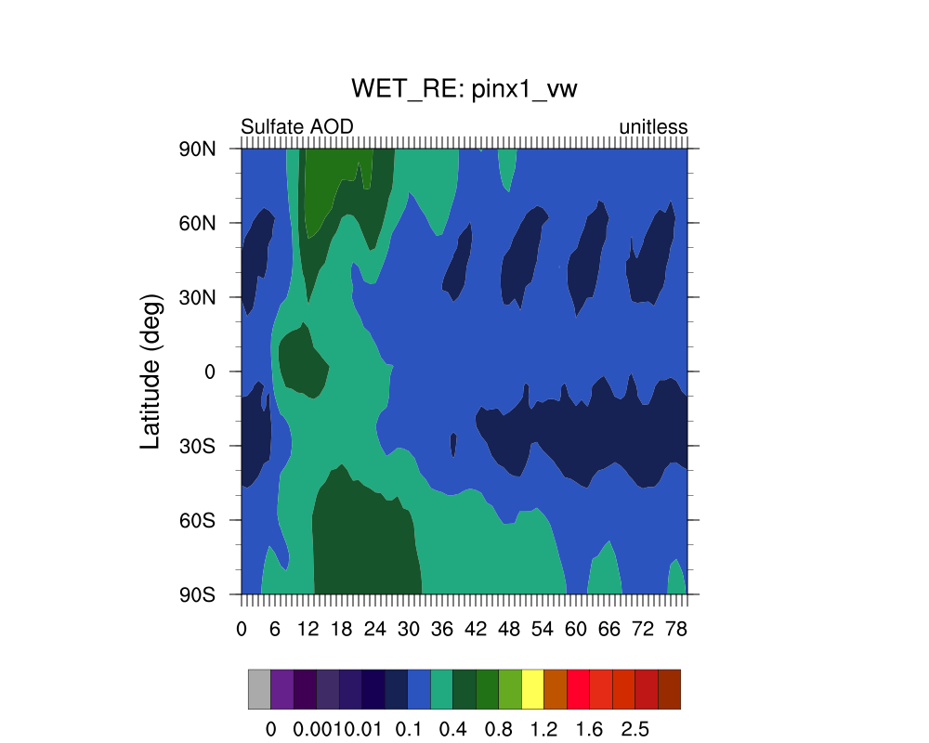
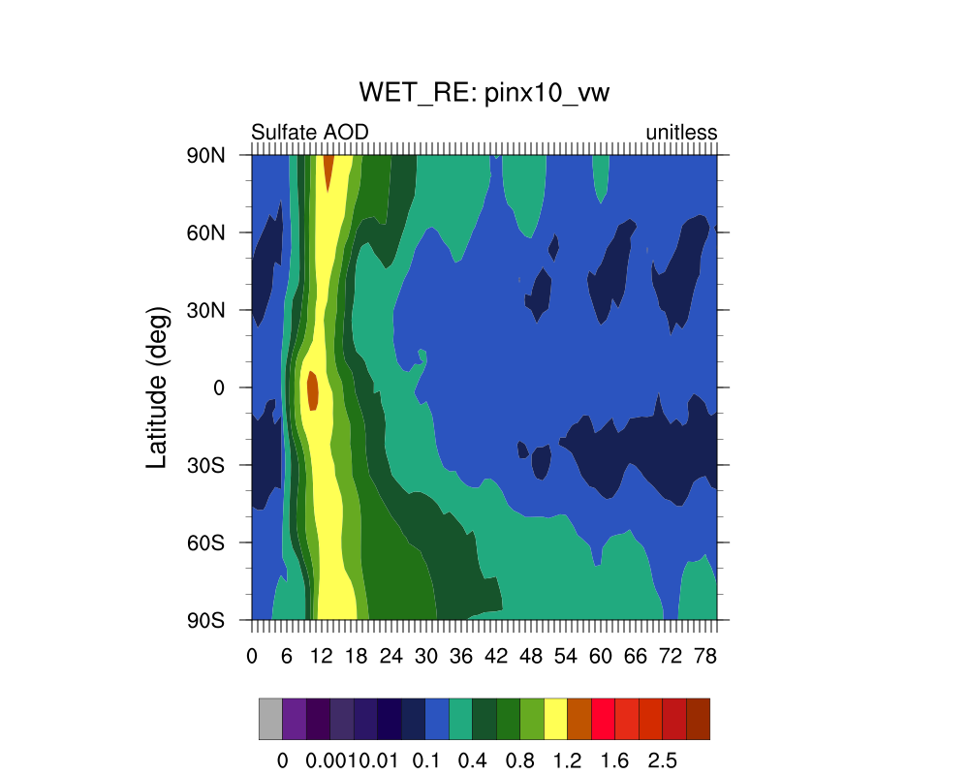
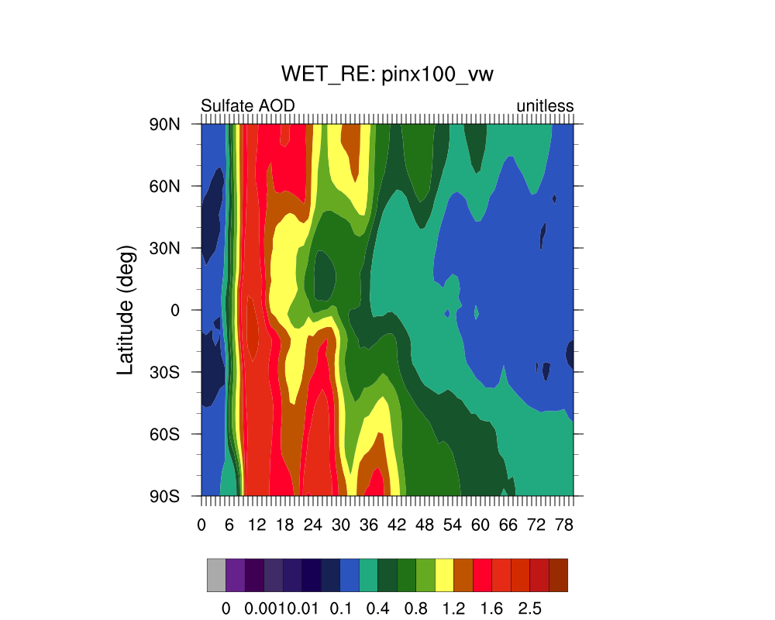
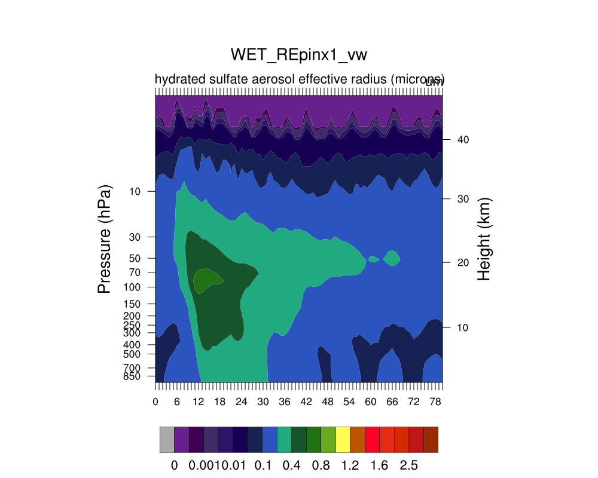
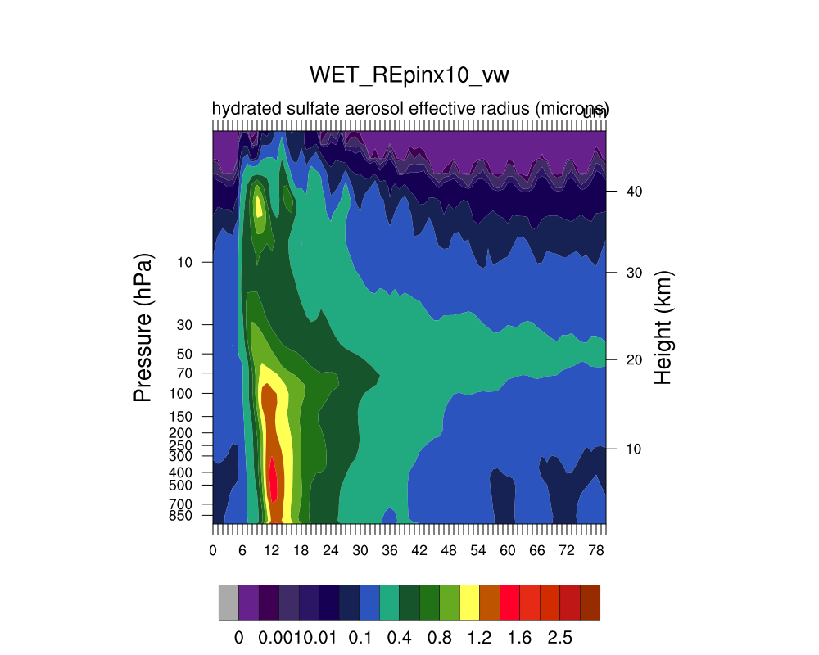
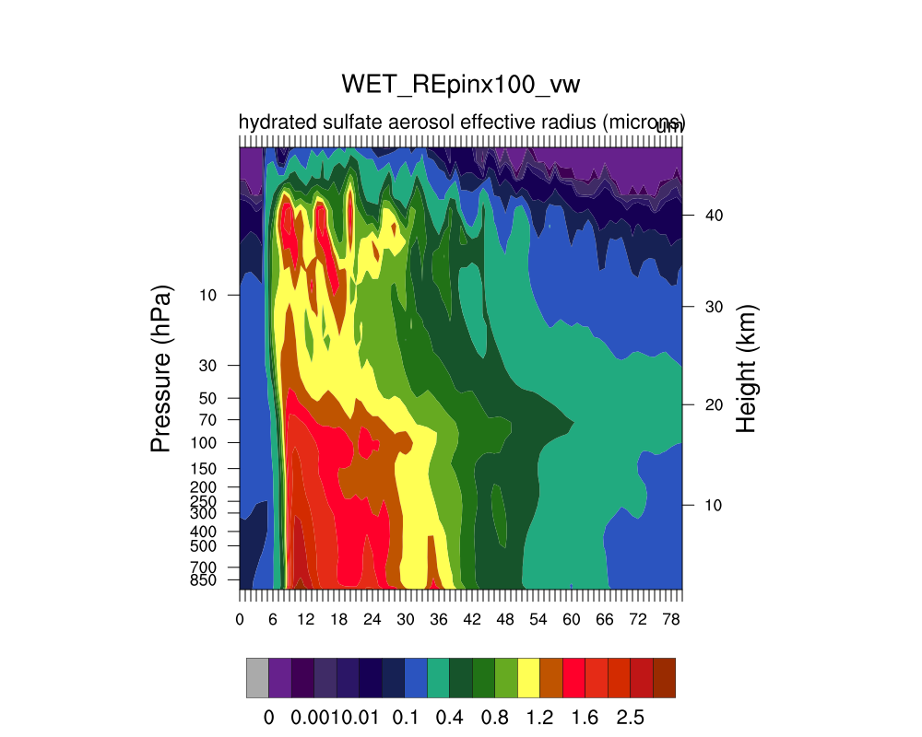
Effective radius peaks in high latitudes and below 150 hPa
Pinatubo
Pin x10
Toba
Effective radius (μm)

