Slide 1
OH in the tropical upper troposphere and its relationships to solar radiation and reactive nitrogen
Ru-Shan Gao, Karen Rosenlof, David Fahey, Paul Wennberg, Eric Hintsa, and Tom Hanisco
and
the STRAT team

Slide 2
OH in the tropical upper troposphere (TUT)
• Low concentration but important for pollutant degradation
• Direct source: O₃ + hν → O₂ + O(¹D) (R1)
O(¹D) + H₂O → 2OH (R2)
• Low O₃, low H₂O conditions in the TUT → Low OH?
- Kley et al., Science 1996
• Recent work by Markus Rex – Effect of low OH in TUT
• Tightly coupled to HO₂
- Easier to model HO₂/OH than OH

Slide 3
Box model results, Jaeglé et al., AE 2000
Notes:
Dashed lines: ±40%, instrument accuracy

Slide 4
Box model results, Jaeglé et al., AE 2000
Notes:
Dashed lines: ±20%, instrument accuracy for the HO2/OH ratio

Slide 5
OH in the lower stratosphere correlates with SZA
Hanisco et al., JPC, 2001
Notes:
Stratospheric data

Slide 6
OH in the lower troposphere correlates with J(¹D)
Rohrer and Berresheim, Nature, 2006

Slide 7
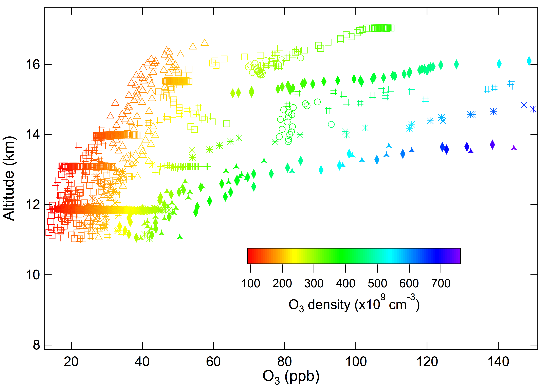
Measurements in TUT during STRAT

Slide 8
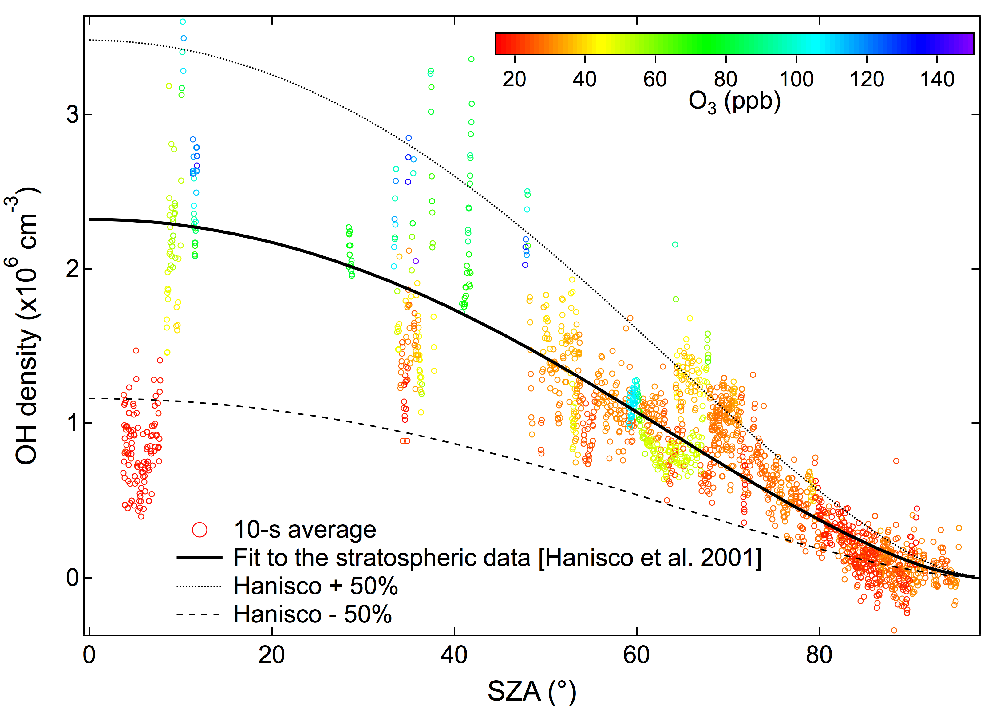
OH measurements in TUT

Slide 9
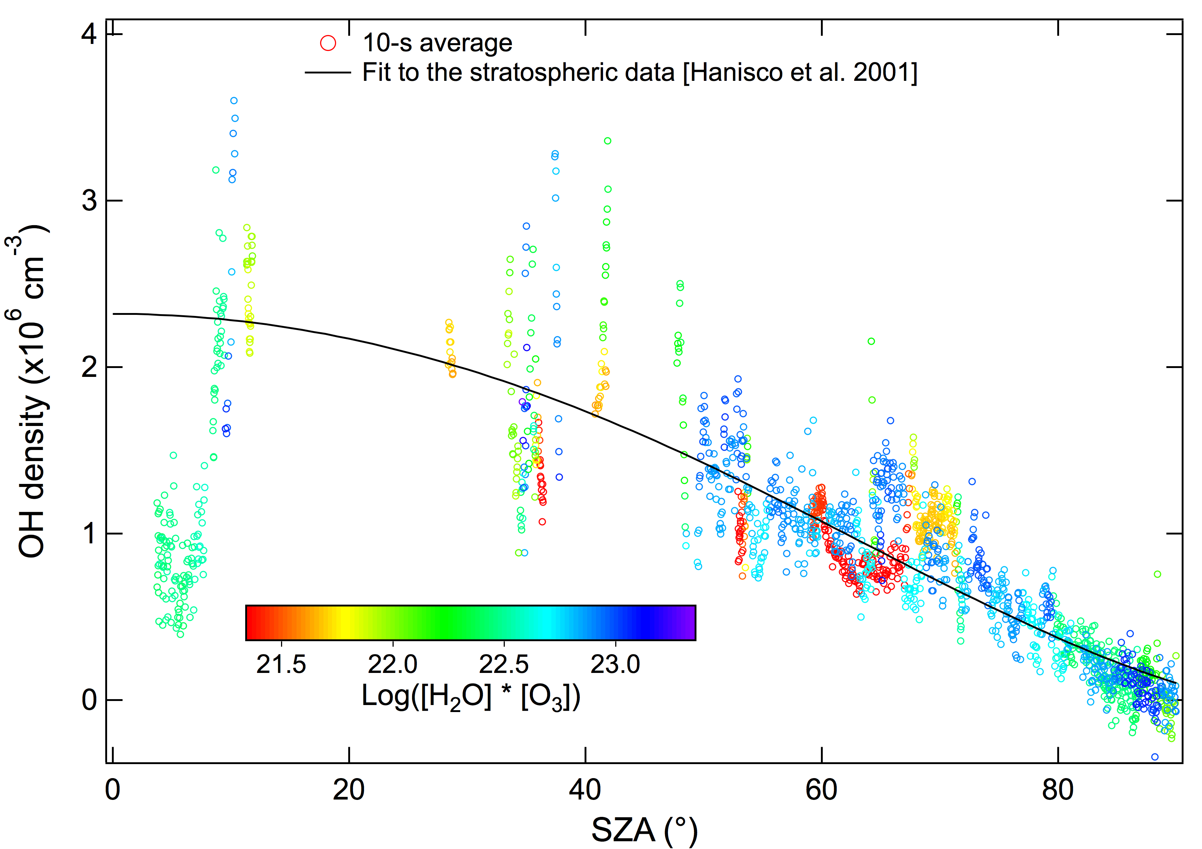
O₃ + hν → O₂ + O(¹D), O(¹D) + H₂O → 2OH

Slide 10
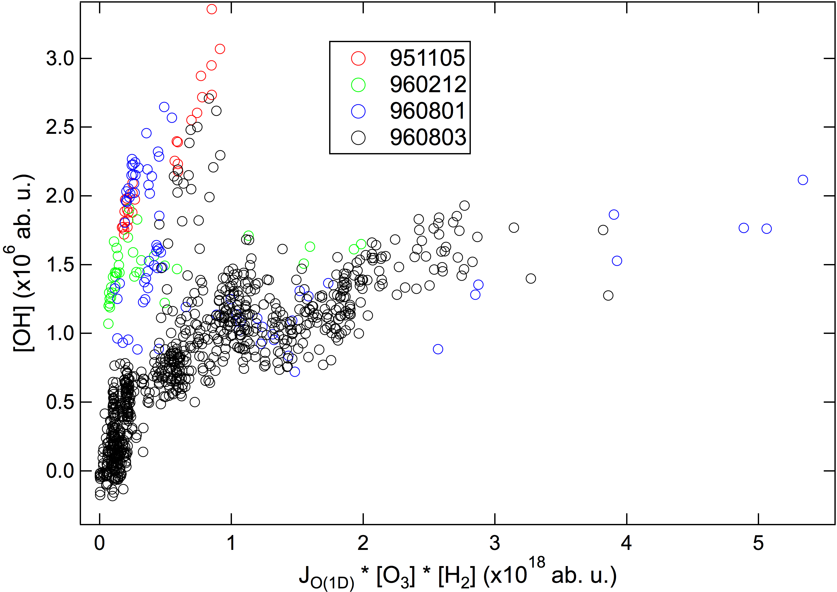
[OH] vs. JO(¹D) * [O₃] * [H₂O]

Slide 11
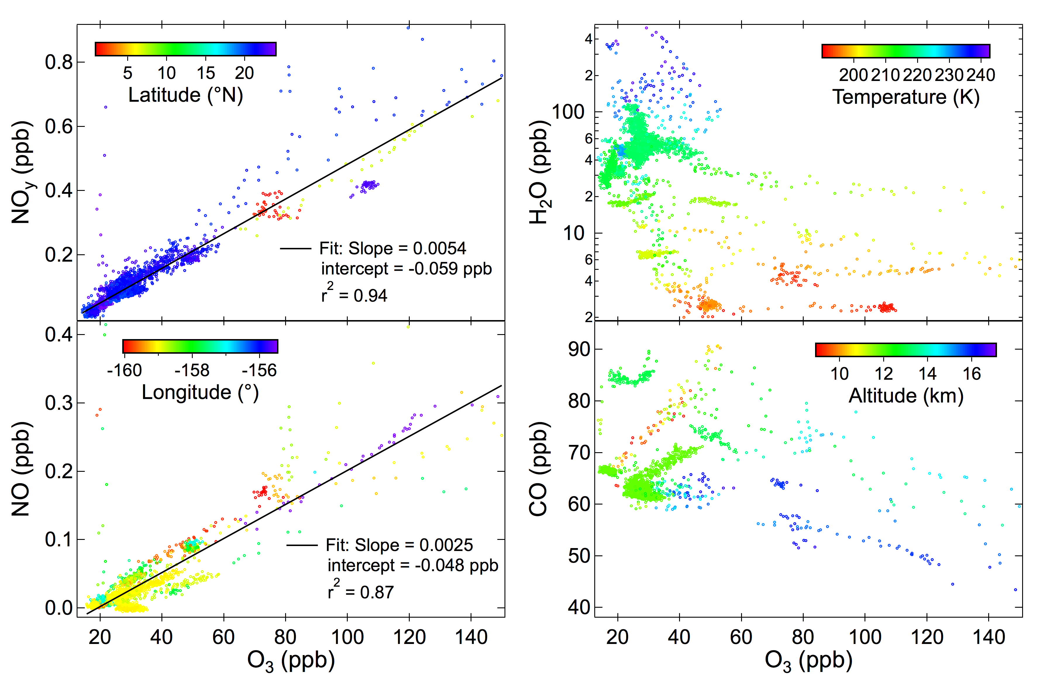
Measurements in TUT during STRAT

Slide 12
• The cycling time between OH and HO₂ is much shorter than the lifetime of HO_{x}
• OH <-> HO₂:
OH + CO (+ O₂) → HO₂ + CO₂ (R3)
HO₂ + NO → OH + NO₂ (R4)
• OH is controlled by R3, R4, and HO_{x} sources and sinks
• O₃+H₂O is not the dominant HO_{x} source
• Main HO_{x} sink:
NO_{y} (high NO_{y}) or HO_{x} self reactions (low NO_{y})
• When NO_{y} is low, NO determines [OH]

Slide 13
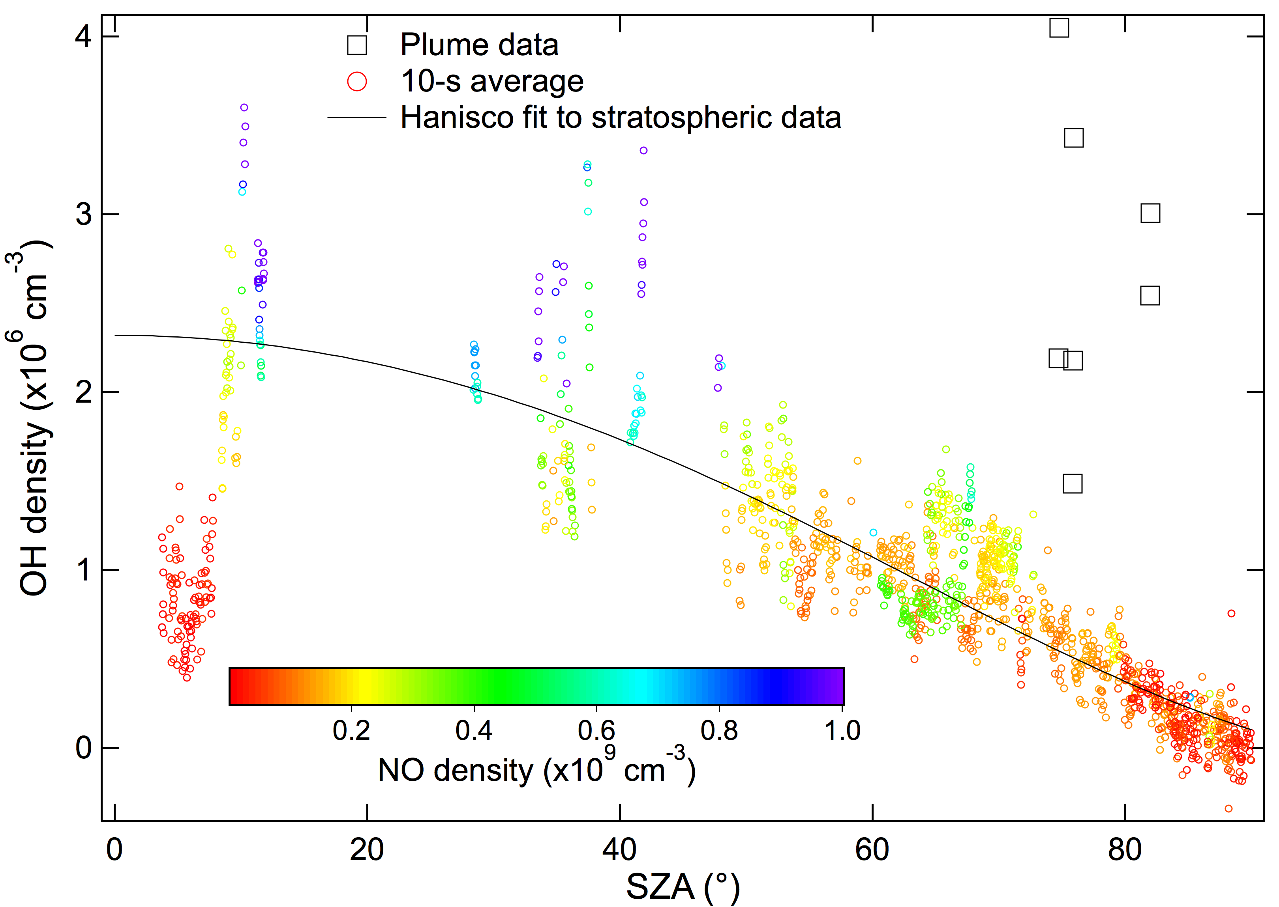
Notes:
This figure suggests that perhaps NO has influence on OH, but only at low SZAs – doesn’t make much sense. Recall that NO correlates with O3 and NOy, the pattern shown here also applies to O3 and NOy (except in plumes, where O3 is not high). HOx partitioning strongly depends on NO. When NO is low, OH is low and HO2 is high (see next figure)

Slide 14
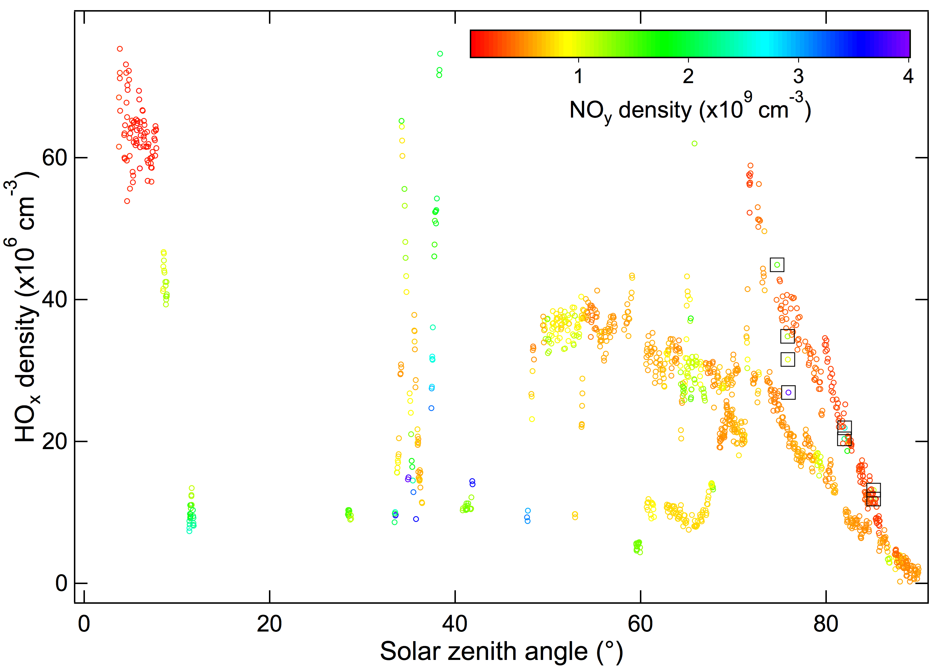

Slide 15
Concluding remarks:
1) A simple functional description for [OH] in the tropical upper troposhpere (TUT) is accurate to ±50%
- It appears that the TUT OH has no dependence on O₃ and H₂O
- Spread in [OH] at a given SZA needs further examination
2) Low [OH] air parcels do exist in TUT
- O₃, NO, and NO_{y} are very low in these air parcels
- Low NO appears to be the main cause
3) Where to find low [OH] air parcels:
• Source: aged marine boundary air (low O₃, NO, and NO_{y})
• Strong convection without lightning – marine convection
• Most likely place – the west Pacific warm pool
• Low O₃ can be an indicator of low NO and low OH!

Slide 17
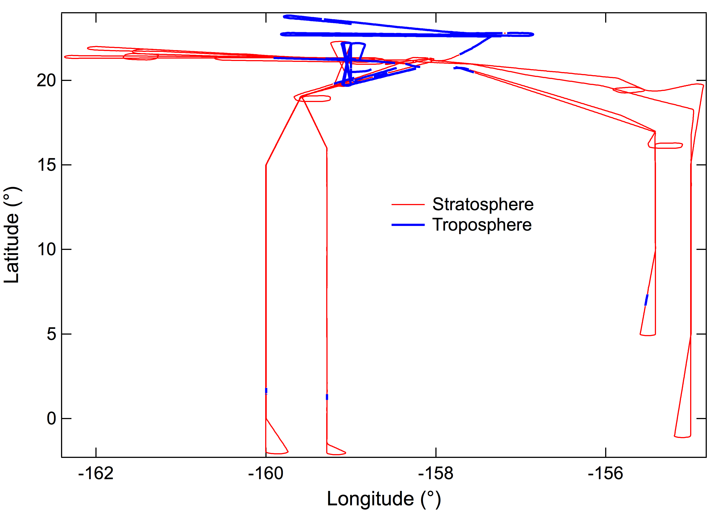
Measurements in TUT during STRAT
Notes:
Data are from the NASA STRAT mission. Only flights based in Hawaii were used in this work. Most tropospheric data are between 19° and 24° latitude, but there are a few short segments of data taken between 0° and 7°. In the next figure we will show that OH in these regions (0°-7° and 19°-24°) behave pretty much the same.

Slide 18
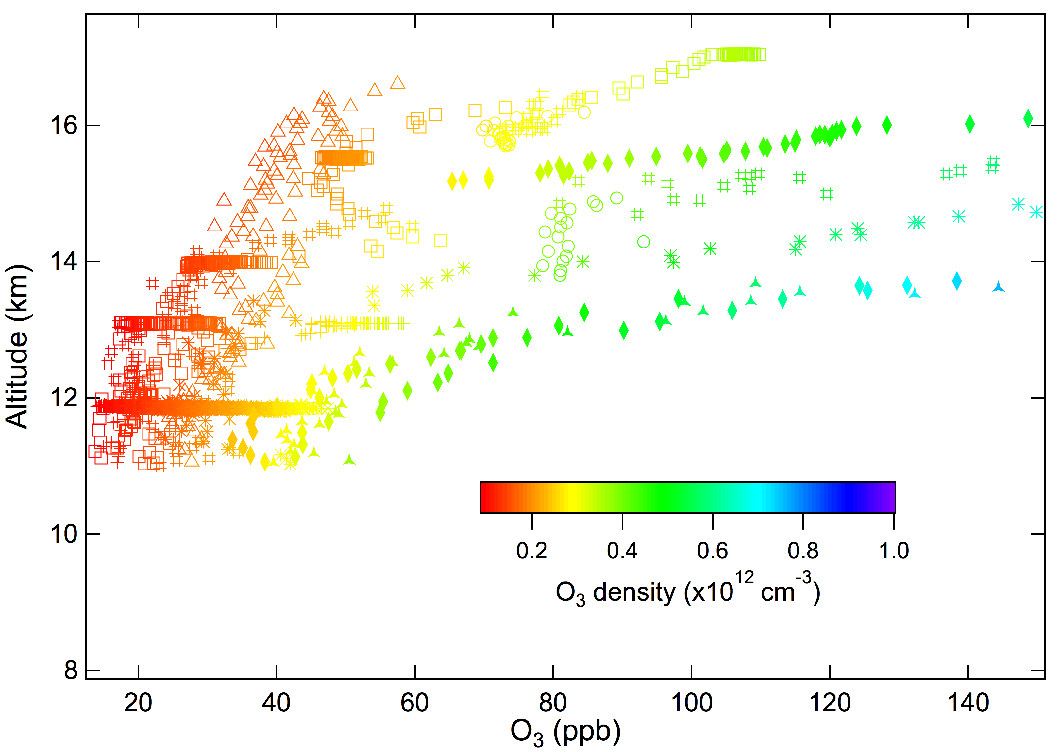
Notes:
During the STRAT mission, OH, HO2, O3, H2O, NO, and other species have been measured in the tropical UT/LS. Low-O3 air in the topical parcels have been sampled. These air parcels may be used to test the theory of low O3 leading to low OH.

Slide 19
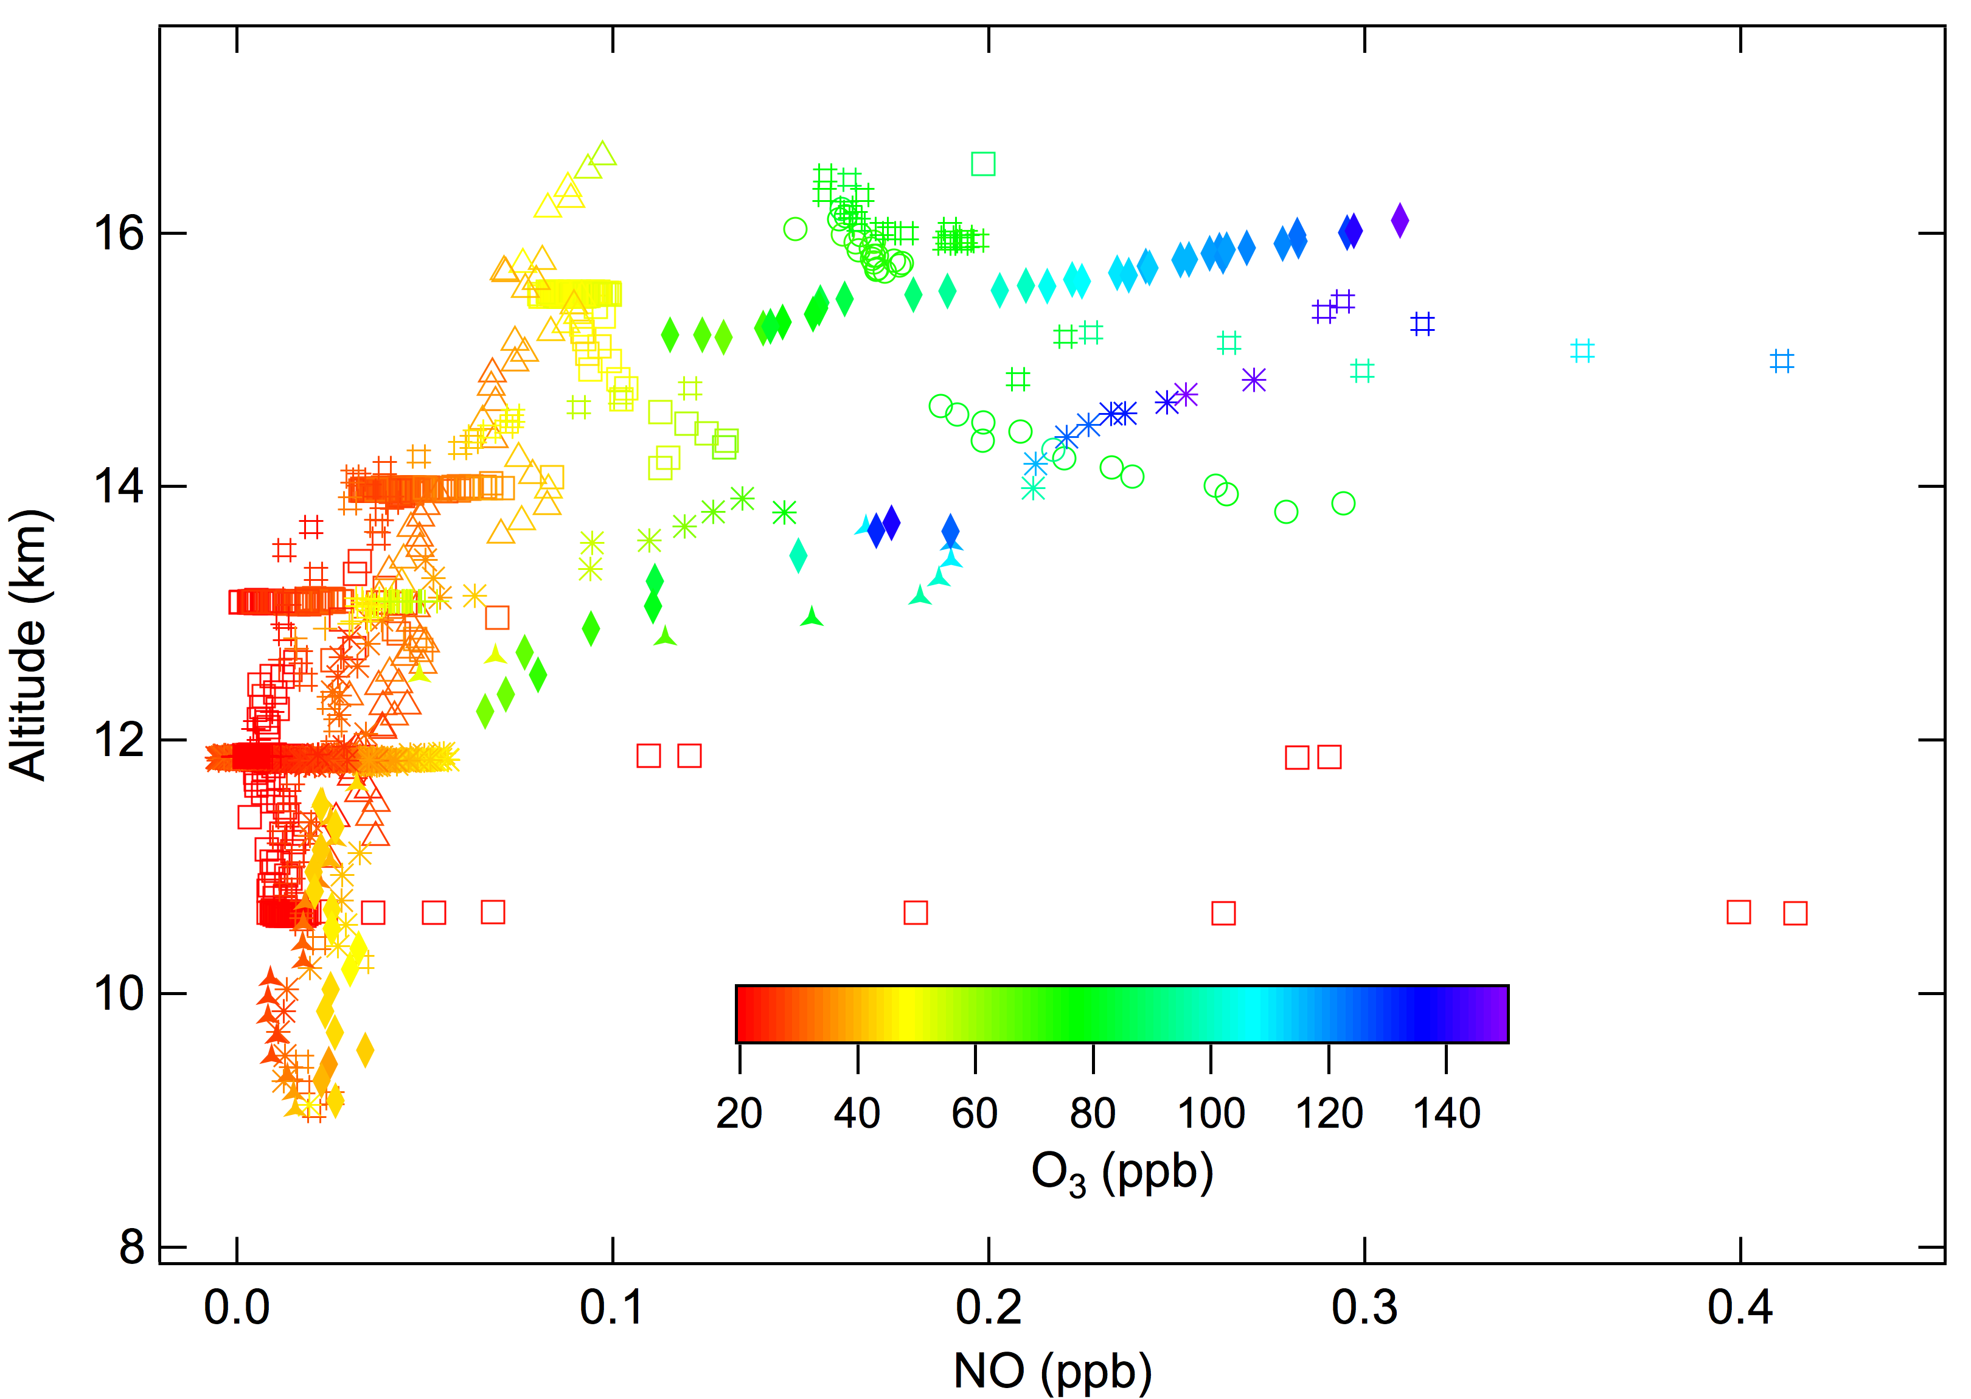
Notes:
Low-NO (and low-NOy) air parcels were also observed, and these air parcels were generally low in O3 as well.

Slide 20
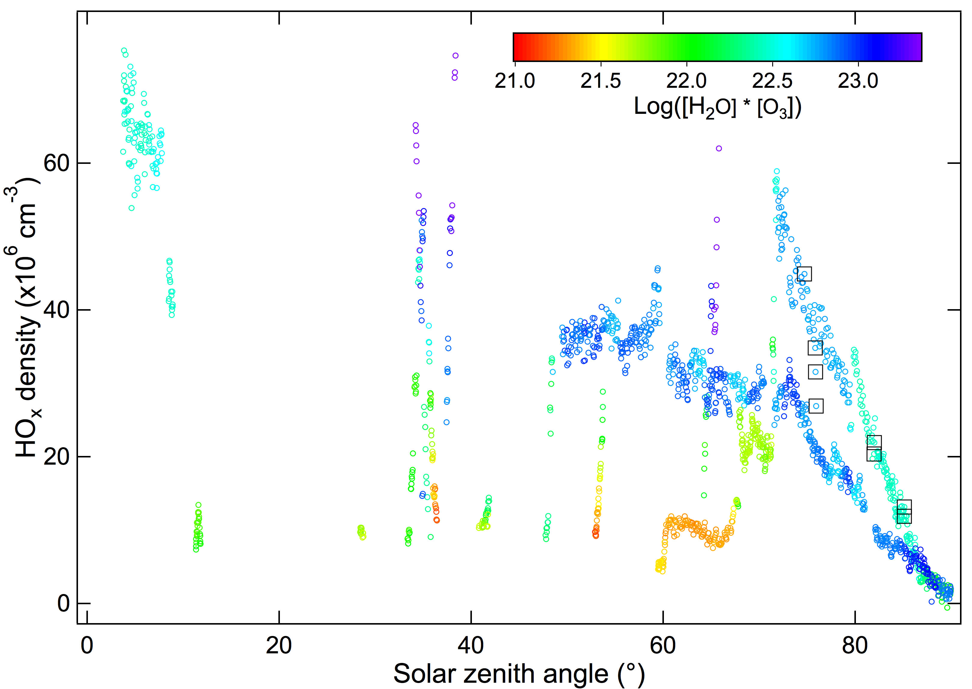
Notes:
There is really no dependence on [H2O] * [O3] – O3 and H2O do not control OH! Note that O3 alone is insufficient for OH production. H2O must also be taken into account (O3 + hv -> O(1D) + O2 and O(1D) + H2O -> 2OH)

Slide 21
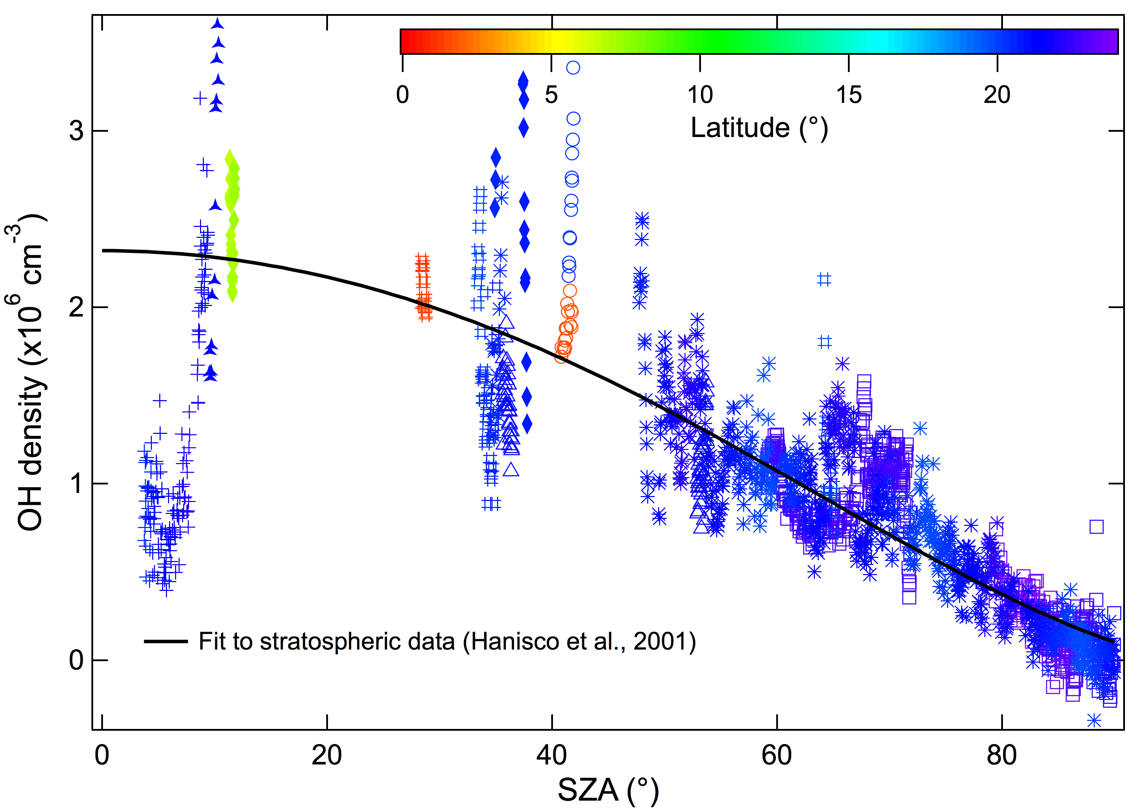
Notes:
OH is shown as function of solar zenith angle. Data are color coded according to the latitudes where they were taken. As shown, There is not significant latitudinal dependence. The black curve is a fit to the ASHOE/MESA and POLARIS OH data taken in the lower stratosphere. Clearly, these tropospheric data don’t look very much different from the stratospheric data. One important exception is the data at SZA < 10°. These data points are associated with very low O3, but we will later show that low [O3][H2O] is not the reason for low OH

Slide 22
