Slide 1
MIPAS observations of SO₂ and COS
M. Höpfner¹, N. Glatthor¹, U. Grabowski¹, S. Kellmann¹, MKiefer¹, A. Leyser¹, A. Linden¹, J. Orphal¹, G. Stiller¹, T. v. Clarmann¹, C. Brühl², J. Lelieveld²,
C. Boone³
¹Institute for Meteorology and Climate Research, Karlsruhe Institute of Technology, Karlsruhe, Germany
²Atmospheric Chemistry Department, Max-Planck-Institute for Chemistry, Mainz, Germany
³Department of Chemistry, University of Waterloo, Waterloo, Ontario, Canada

Slide 2
Thomason and Peter, 2006

Slide 3
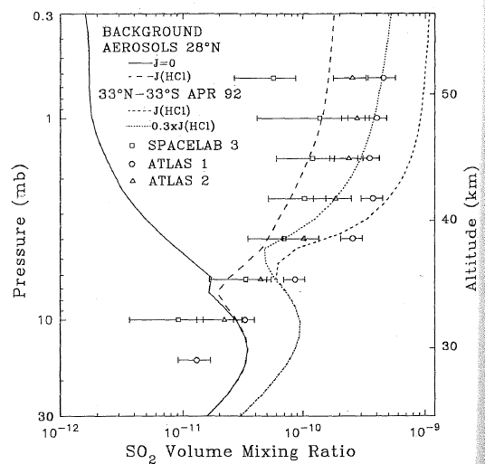
Observations of SO₂ by FTIR limb solar occultation spectroscopy
ATMOS: Rinsland et al., 1995
ACE-FTS: Doeringer et al., 2012
July 2009

Slide 4
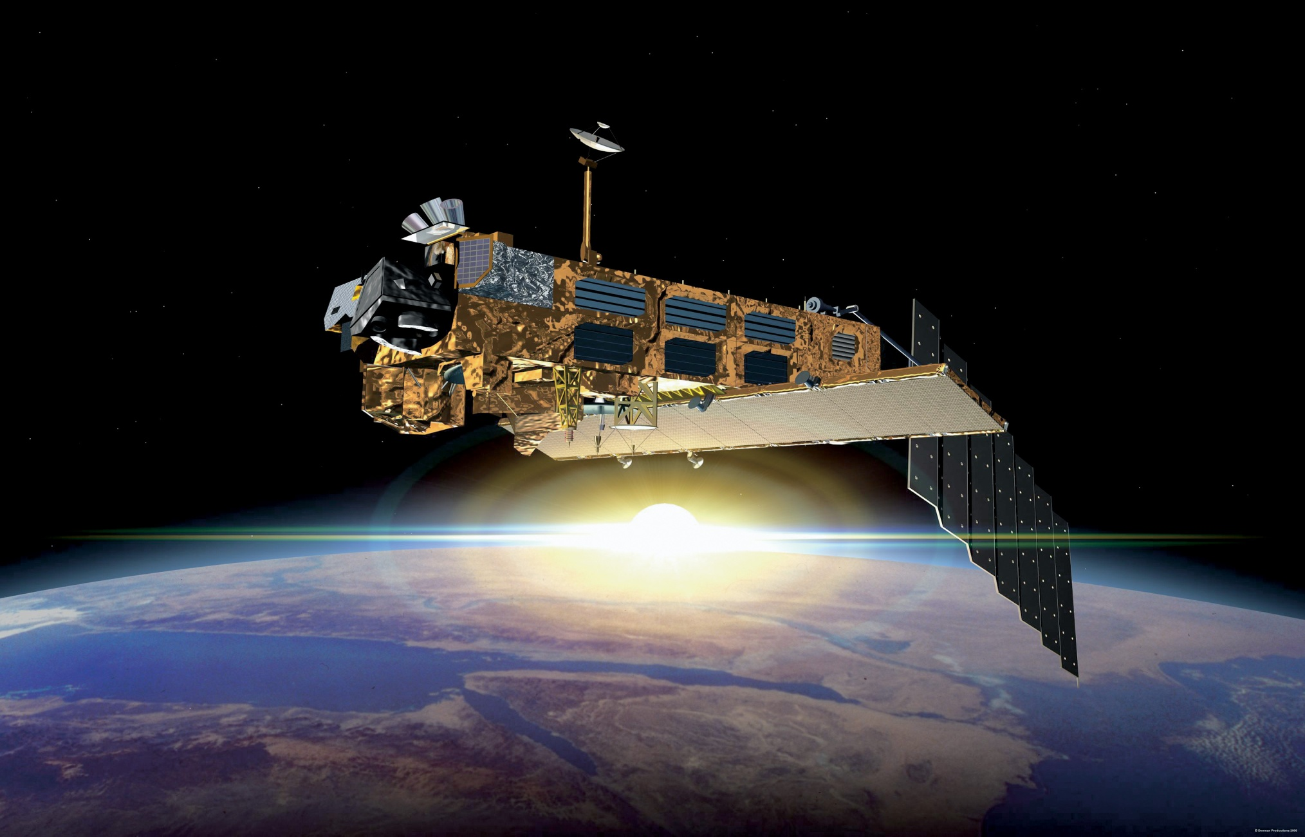
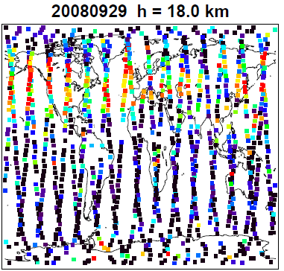
The Michelson Interferometer for Passive Atmospheric Sounding on Envisat
MIPAS

Slide 5

Sulfur aerosol precursors from MIPAS:
General retrieval strategies
SO₂
Retrieval from mean spectra (averages over 1 month and 10° latitude bins) (altitude range: ~13-45 km) (Höpfner et al., ACP, in press)
from single limb-scans (altitude range: ~8-20 km)
COS
from single limb-scans (altitude range: ~8-30 km)

Slide 6
SO₂ from mean MIPAS spectra

Slide 7
Retrieval of SO₂ from MIPAS mean spectra
Observations | Monthly mean 10° zonal average spectra
Spectral windows for retrieval | 4 at 1366-1376 cm⁻¹
Retrieval method | Global fit
Regularization | Tikhonov 1st order
A-priori vertical profile | Zero
Retrieval grid | 1 km
Jointly fitted species | H₂O, HDO, H₂¹⁸O, CO₂, O₃, CH₄, HCN, HO₂
Limit of aerosol volume density for retrieval | 1-2 µm³cm⁻³

Slide 8
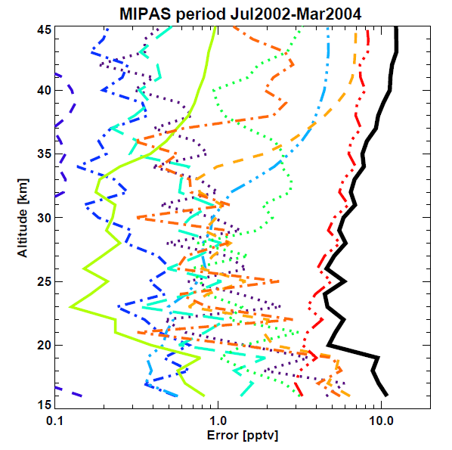
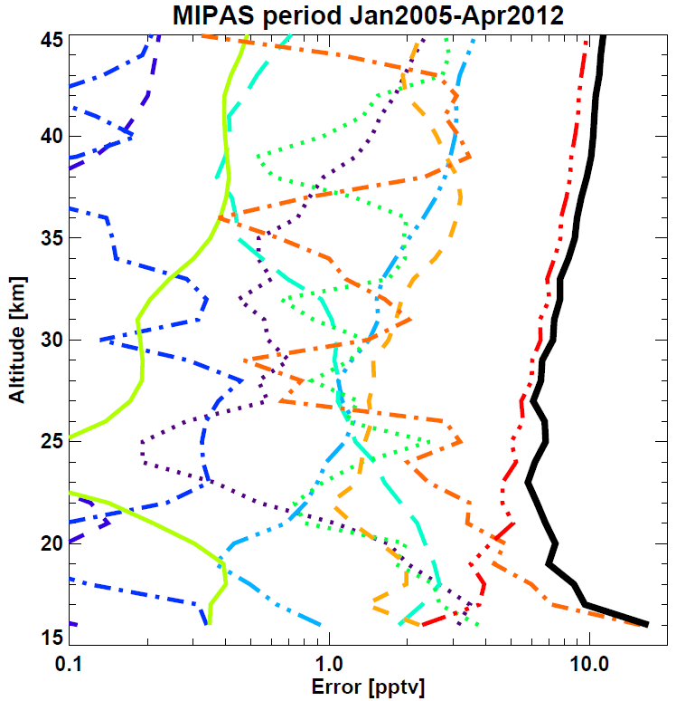
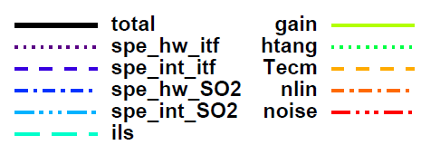
Error estimation

Slide 9
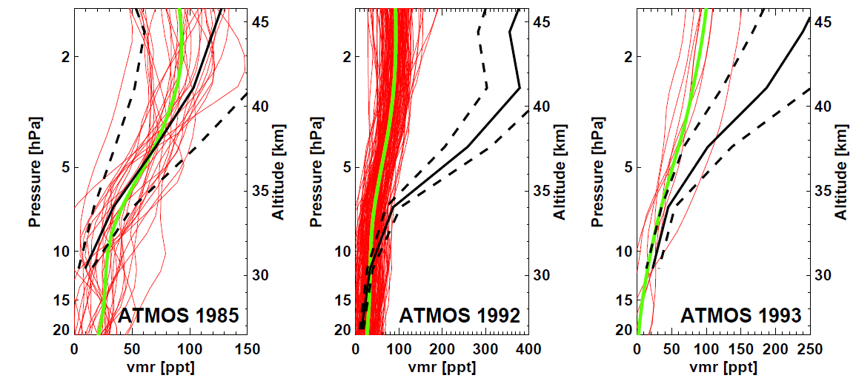
Comparison with ATMOS (Rinsland et al.,1995)
Pinatubo
MIPAS single monthly mean profiles
MIPAS mean

Slide 10
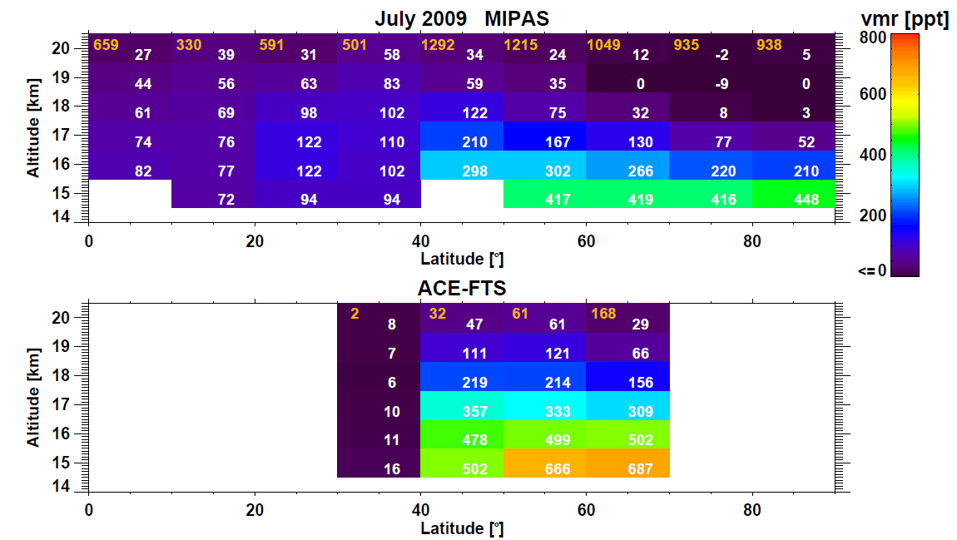
Comparison with ACE-FTS (Doeringer et al., 2012)
Number of limb-scans averaged
White numbers: SO₂ vmr [ppt]

Slide 11
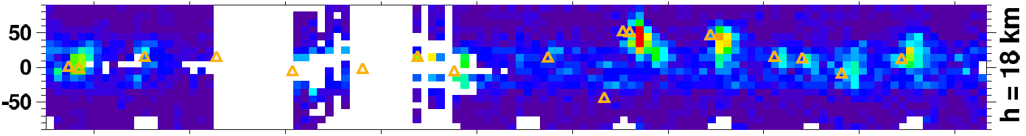
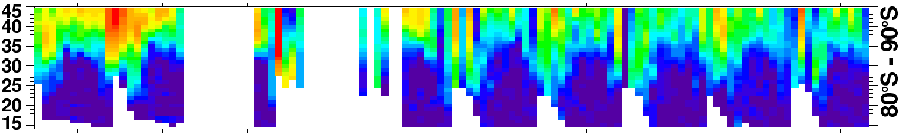
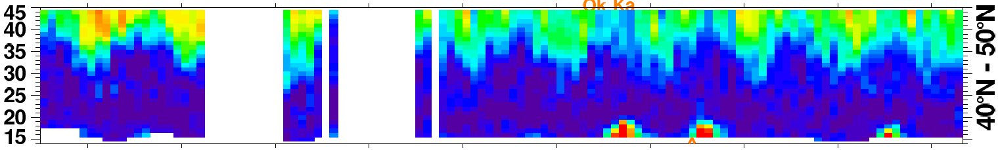
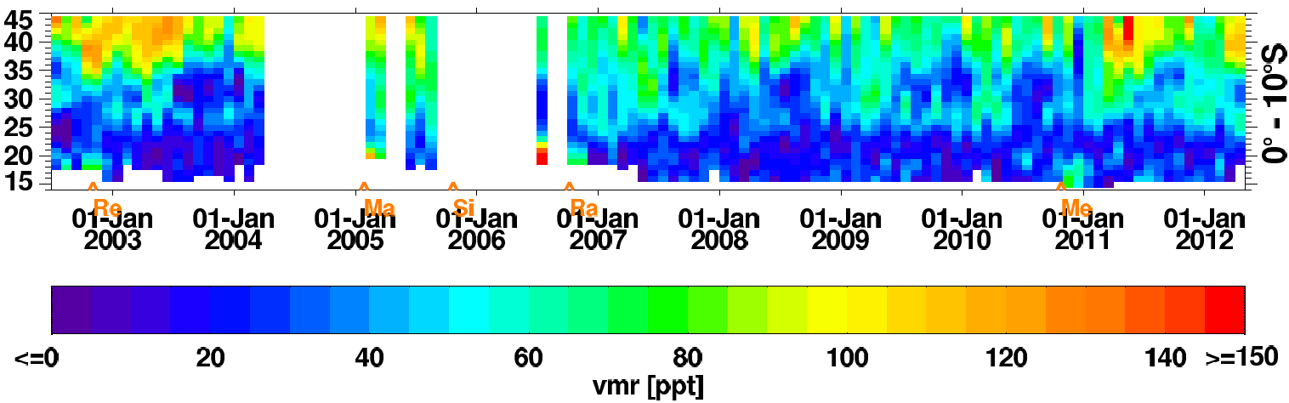
Time series of SO₂ from MIPAS mean spectra
Latitude
Volcanic eruptions
Downwelling of high SO₂ during polar winter: reason for CN-bursts in spring
High levels from photolysis of H₂SO₄
Production from COS
Altitude [km]

Slide 12
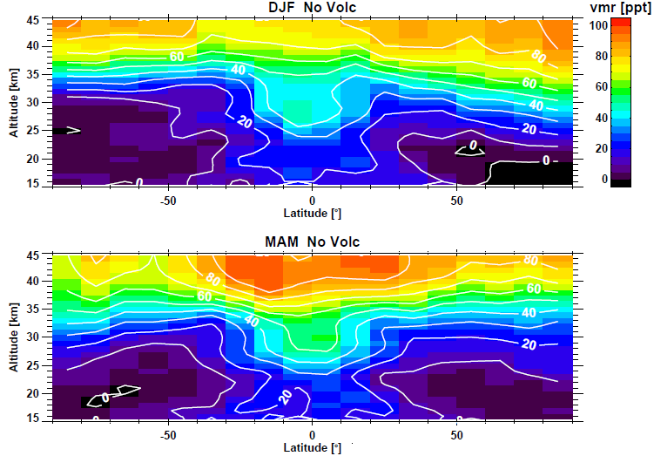
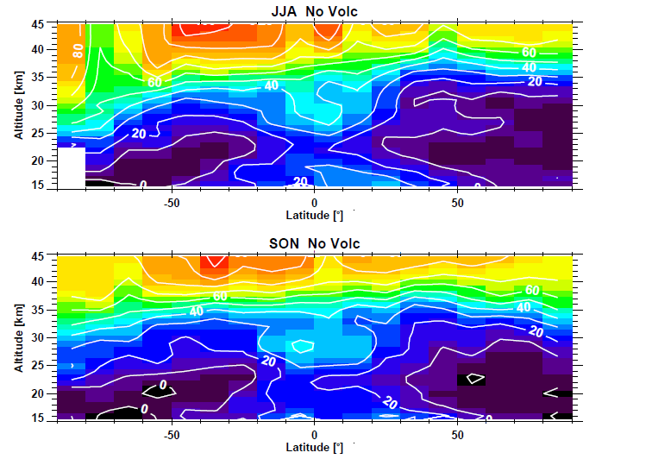
Seasonal distributions of background SO₂

Slide 13
Production from COS at 25-30 km
MIPAS

Slide 14

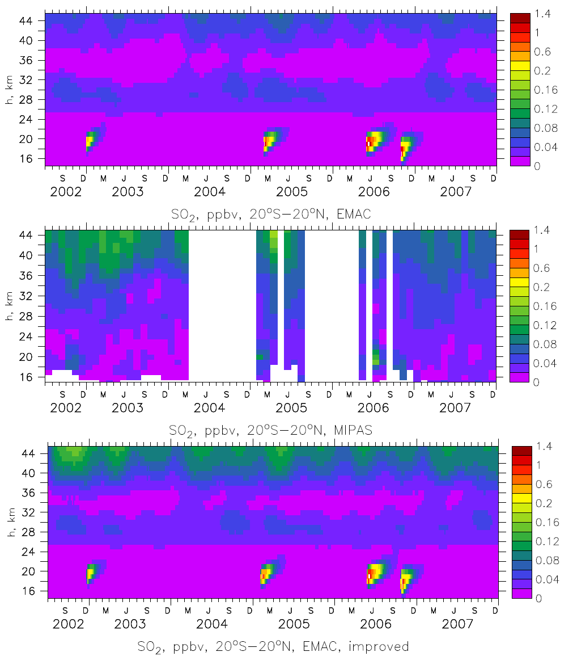
Production of SO₂ from H₂SO₄ in the upper stratosphere
Model (ECHAM5-MESSy with aerosl module GMXe)
without H₂SO₄ NIR photolysis
MIPAS
Measurements
Model with
H₂SO₄ NIR photolysis +
sulfur sink on meteoric dust
Vaida et al., 2003
Mills et al., 2005
Brühl et al., ACPD, 2013

Slide 15
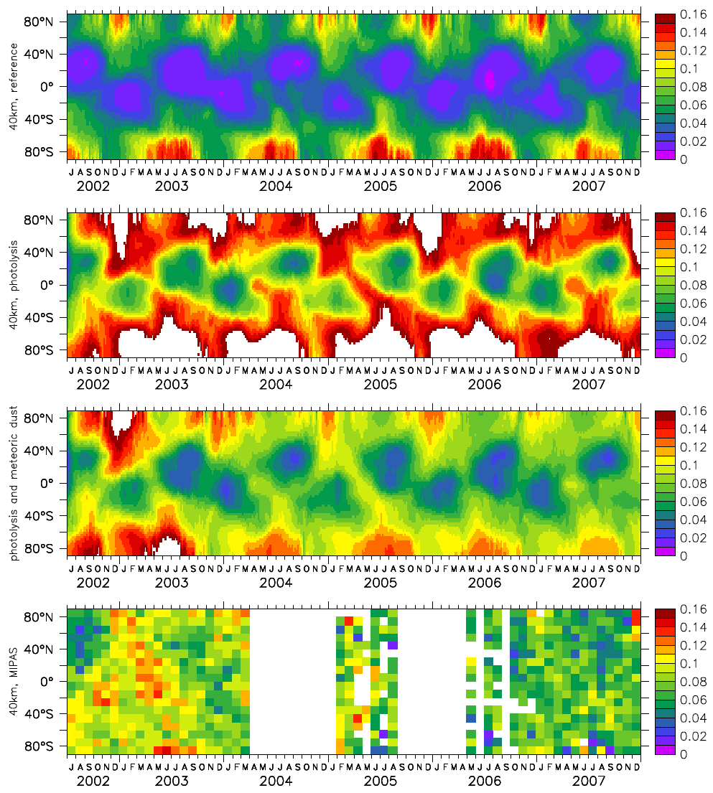
H₂SO₄ photolysis and meteoric dust sink
40 km
Model without
H₂SO₄ NIR photolysis
Model with
H₂SO₄ NIR photolysis
Model with
H₂SO₄ NIR photolysis +
sulfur sink on meteoric dust
MIPAS

Slide 16
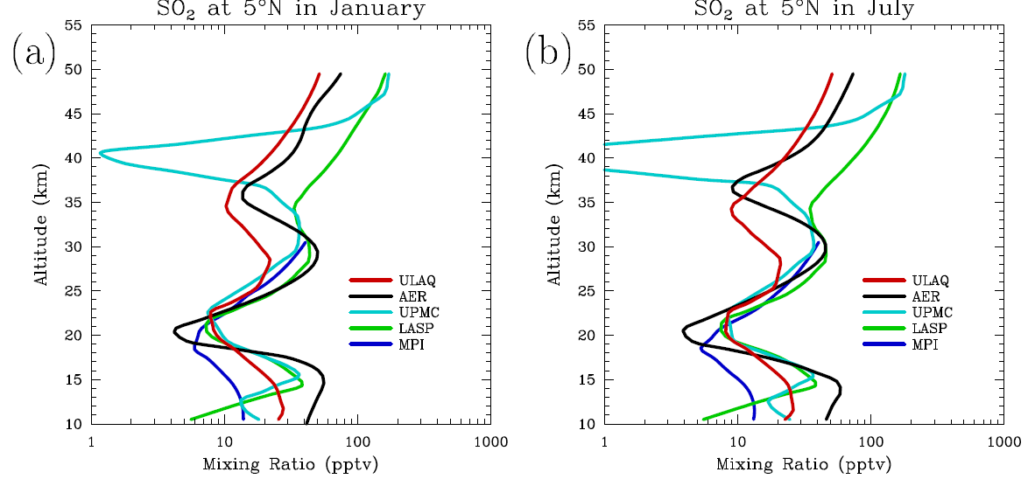
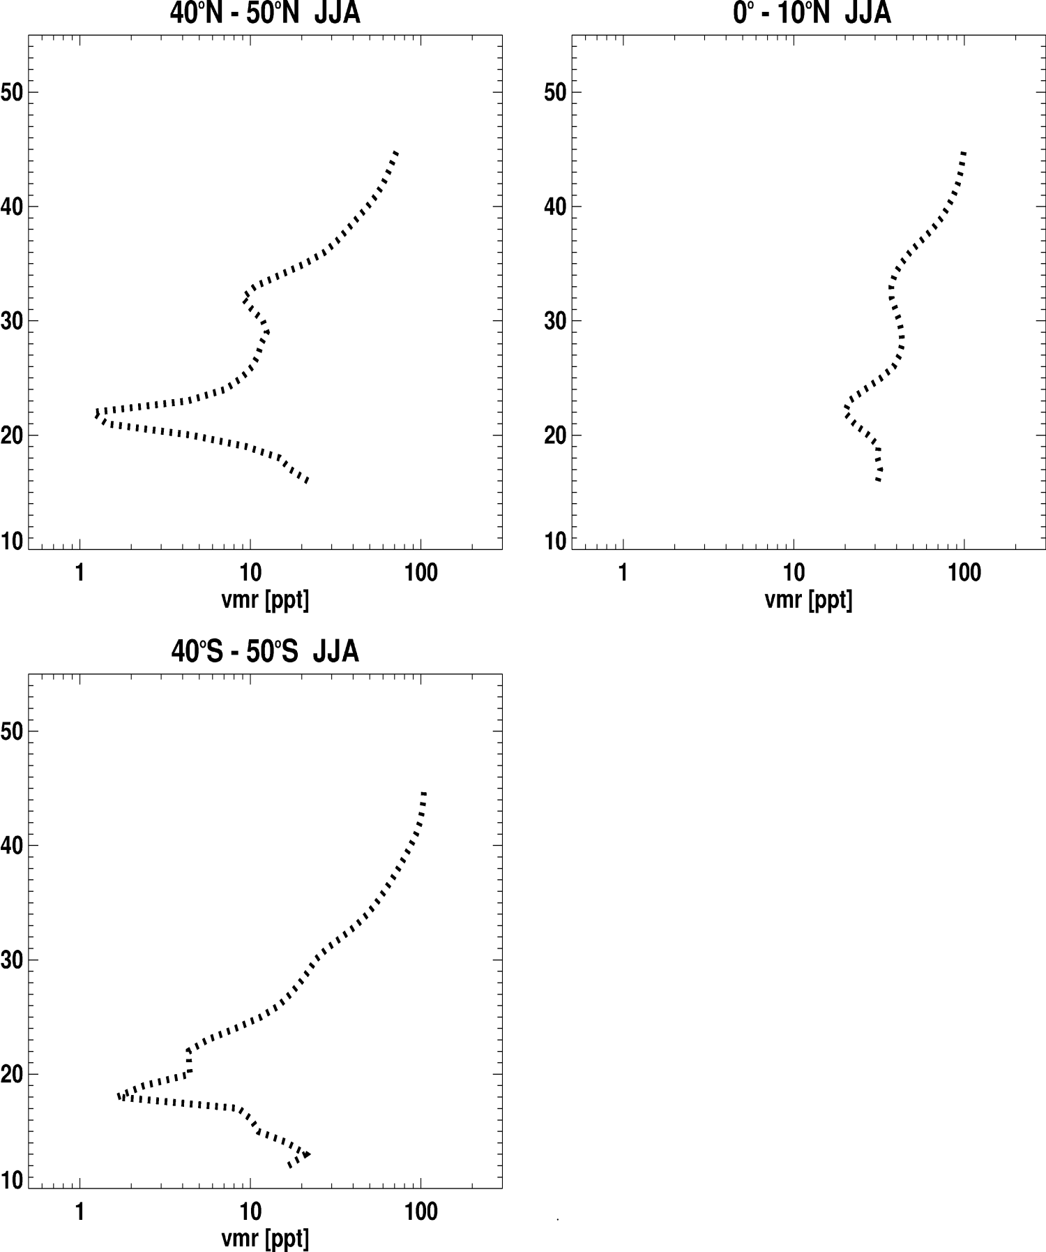
Comparison of SO2 ‘background’ with SPARC06 models
MIPAS

Slide 17
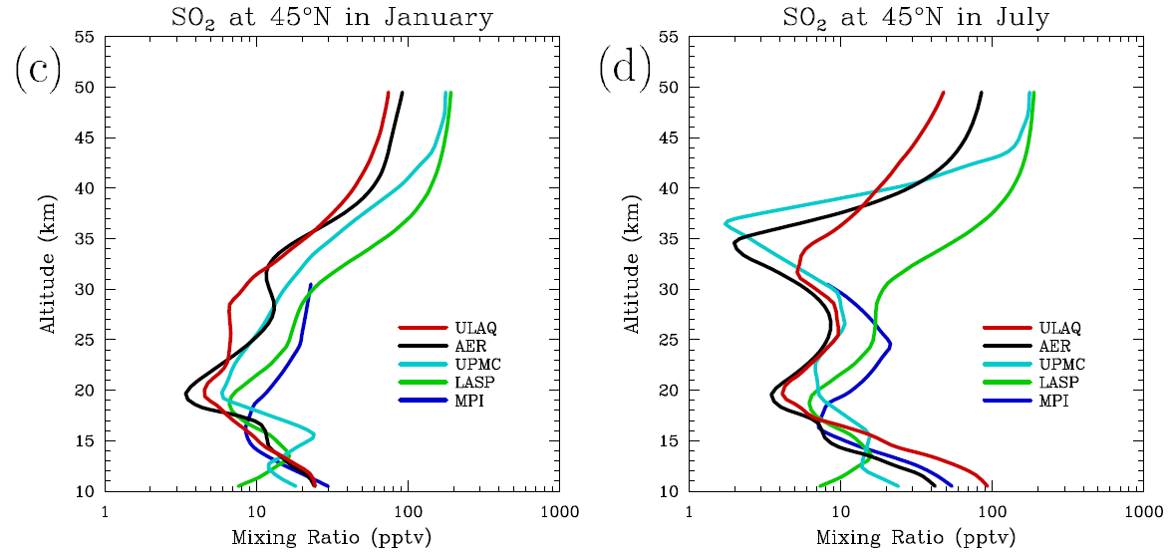
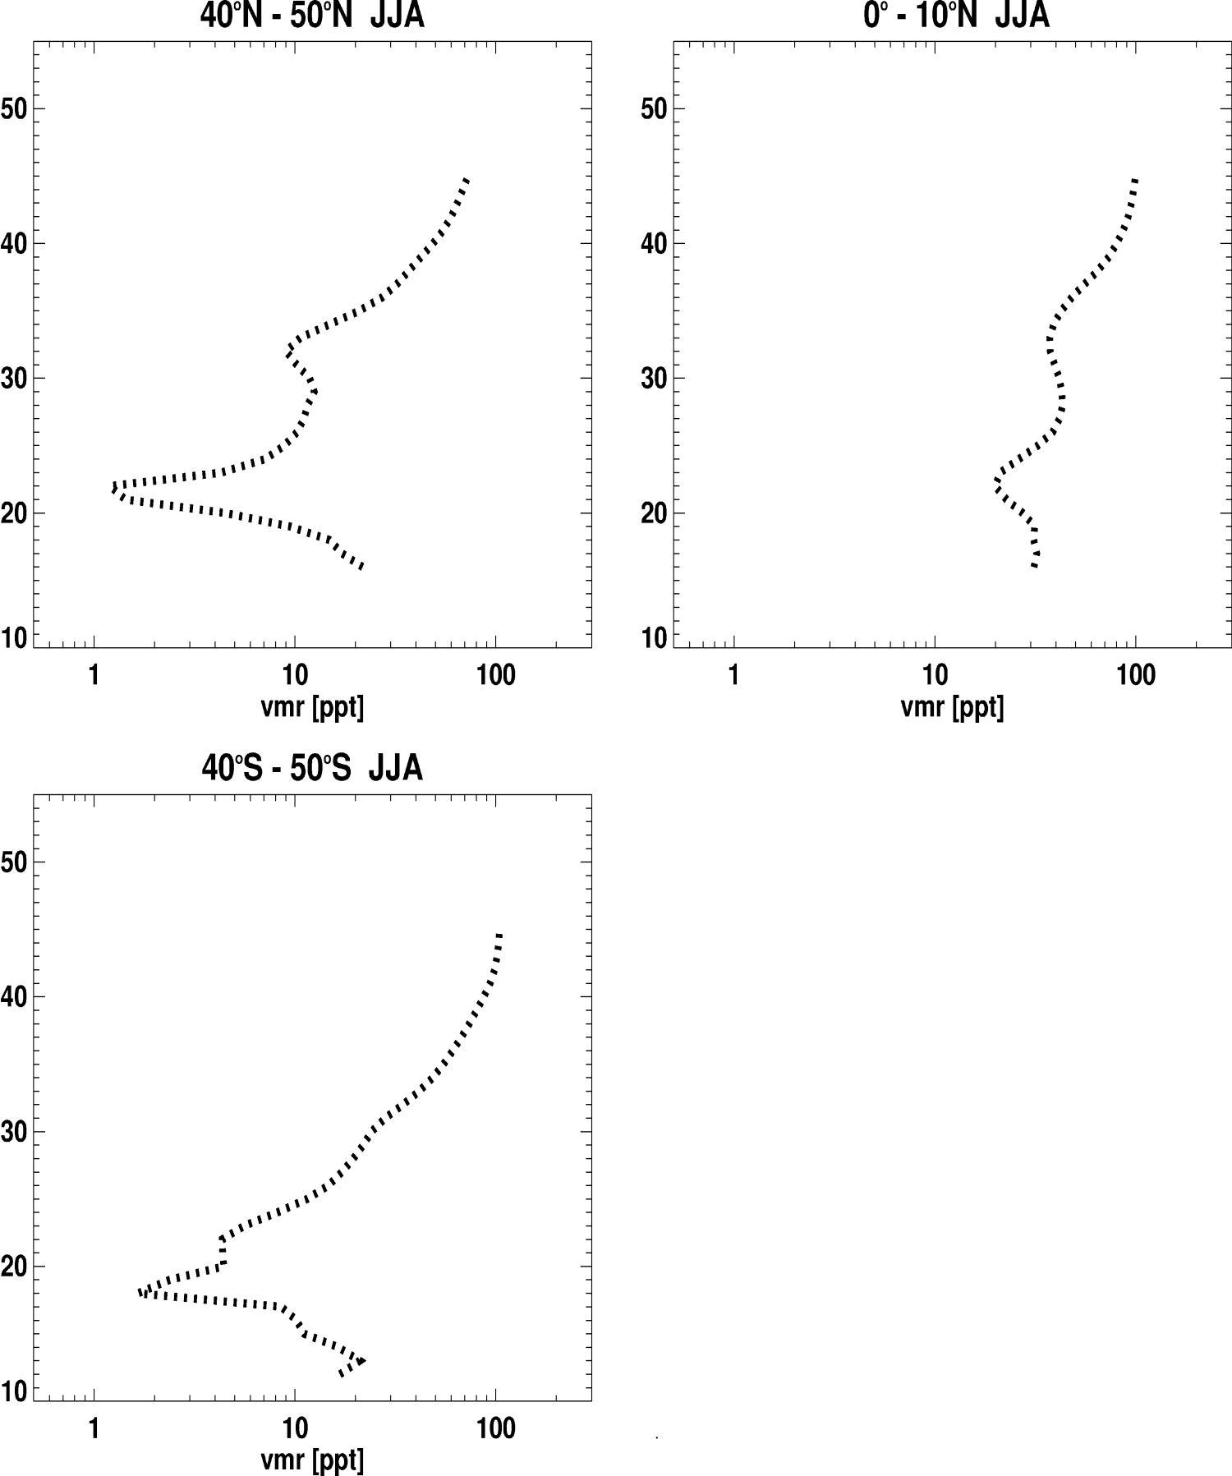
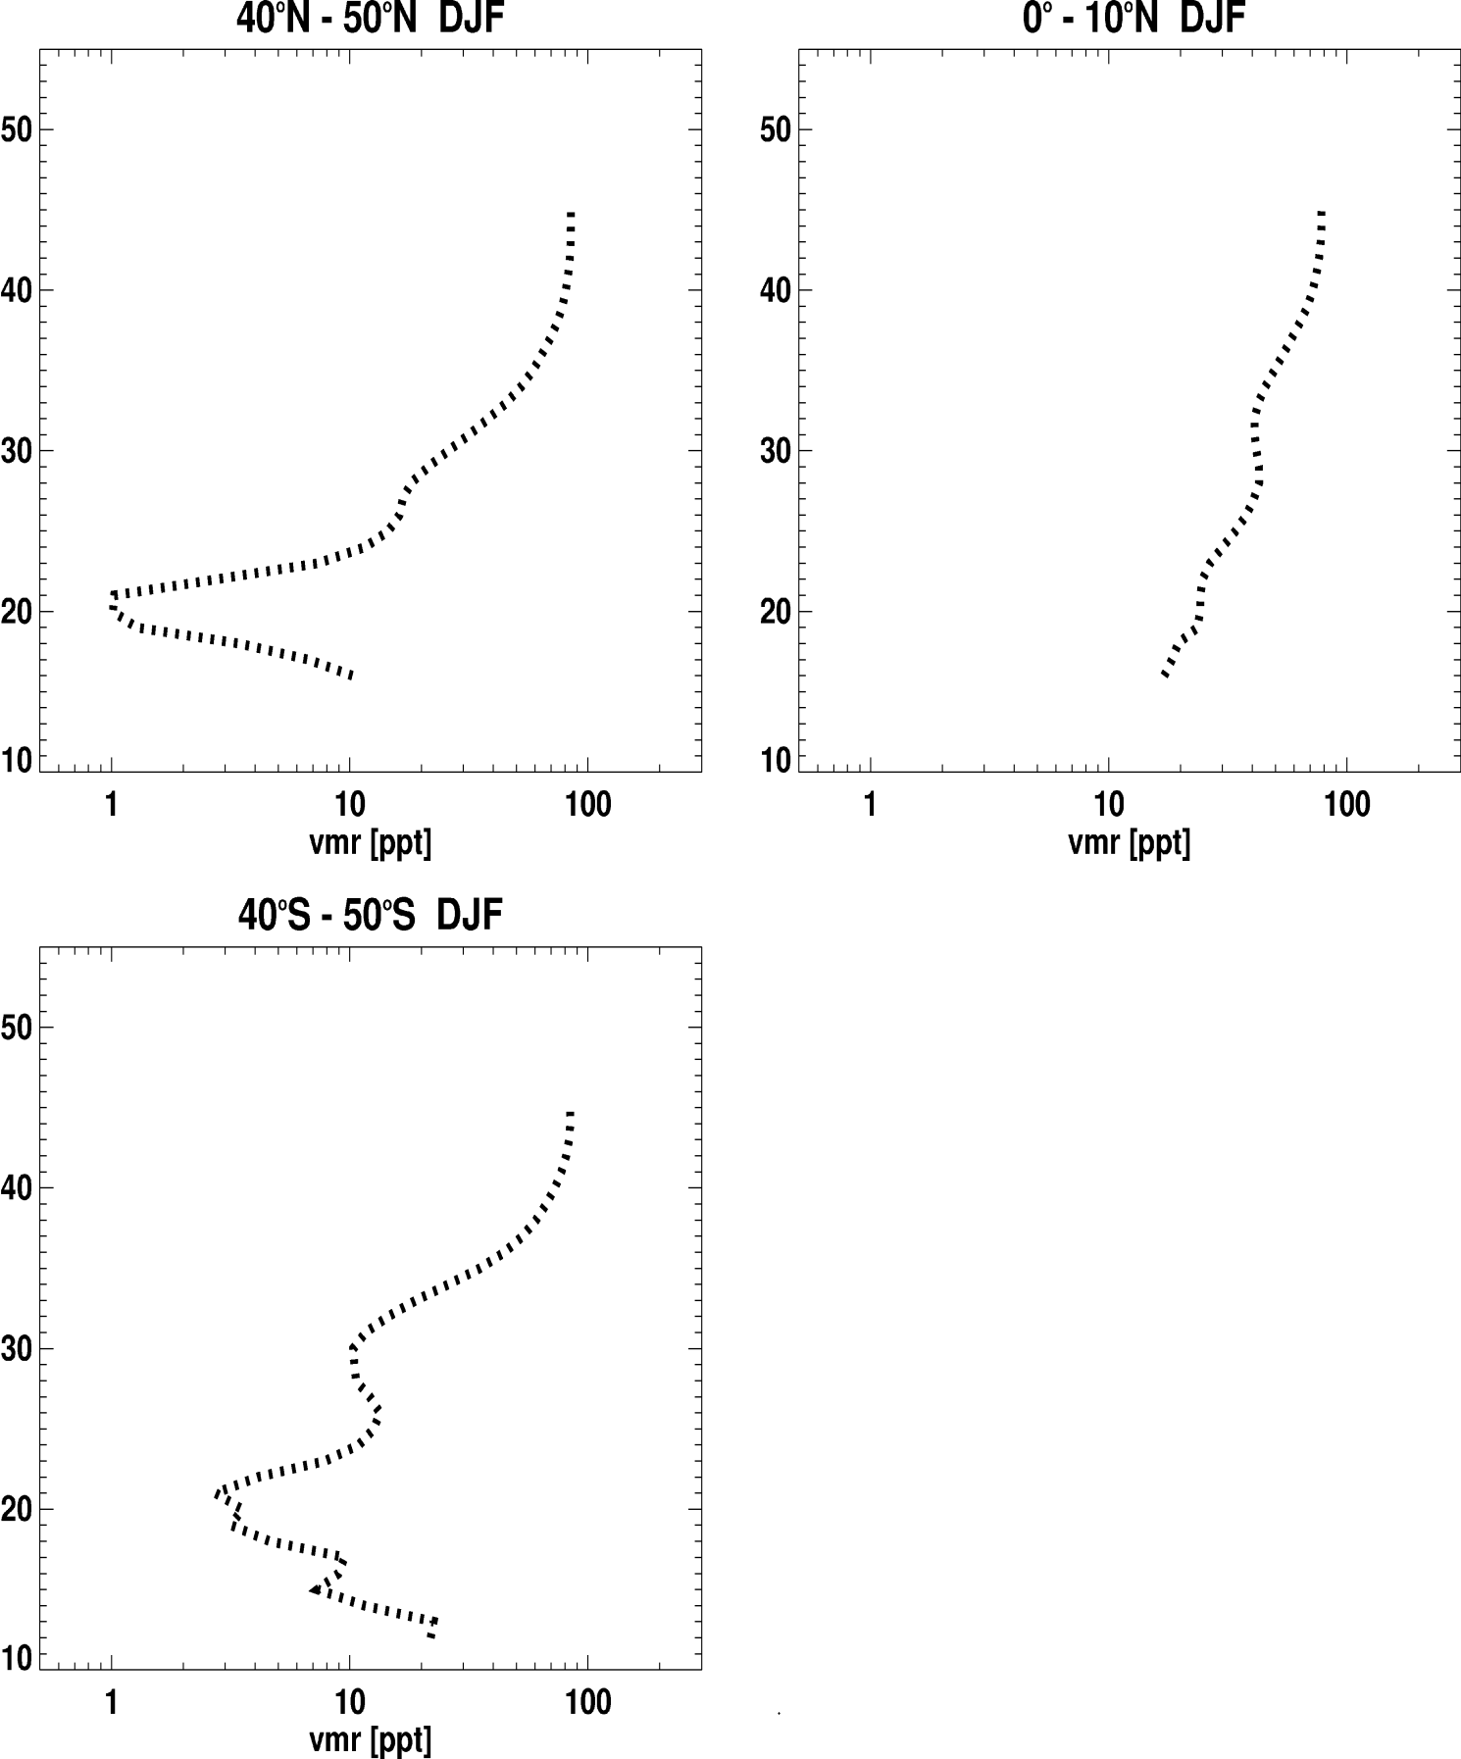
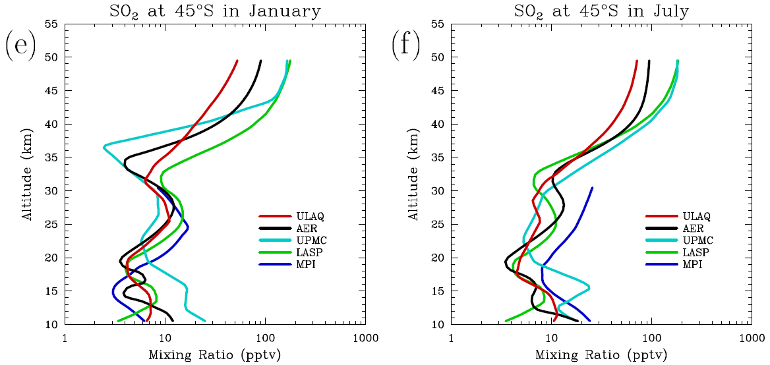
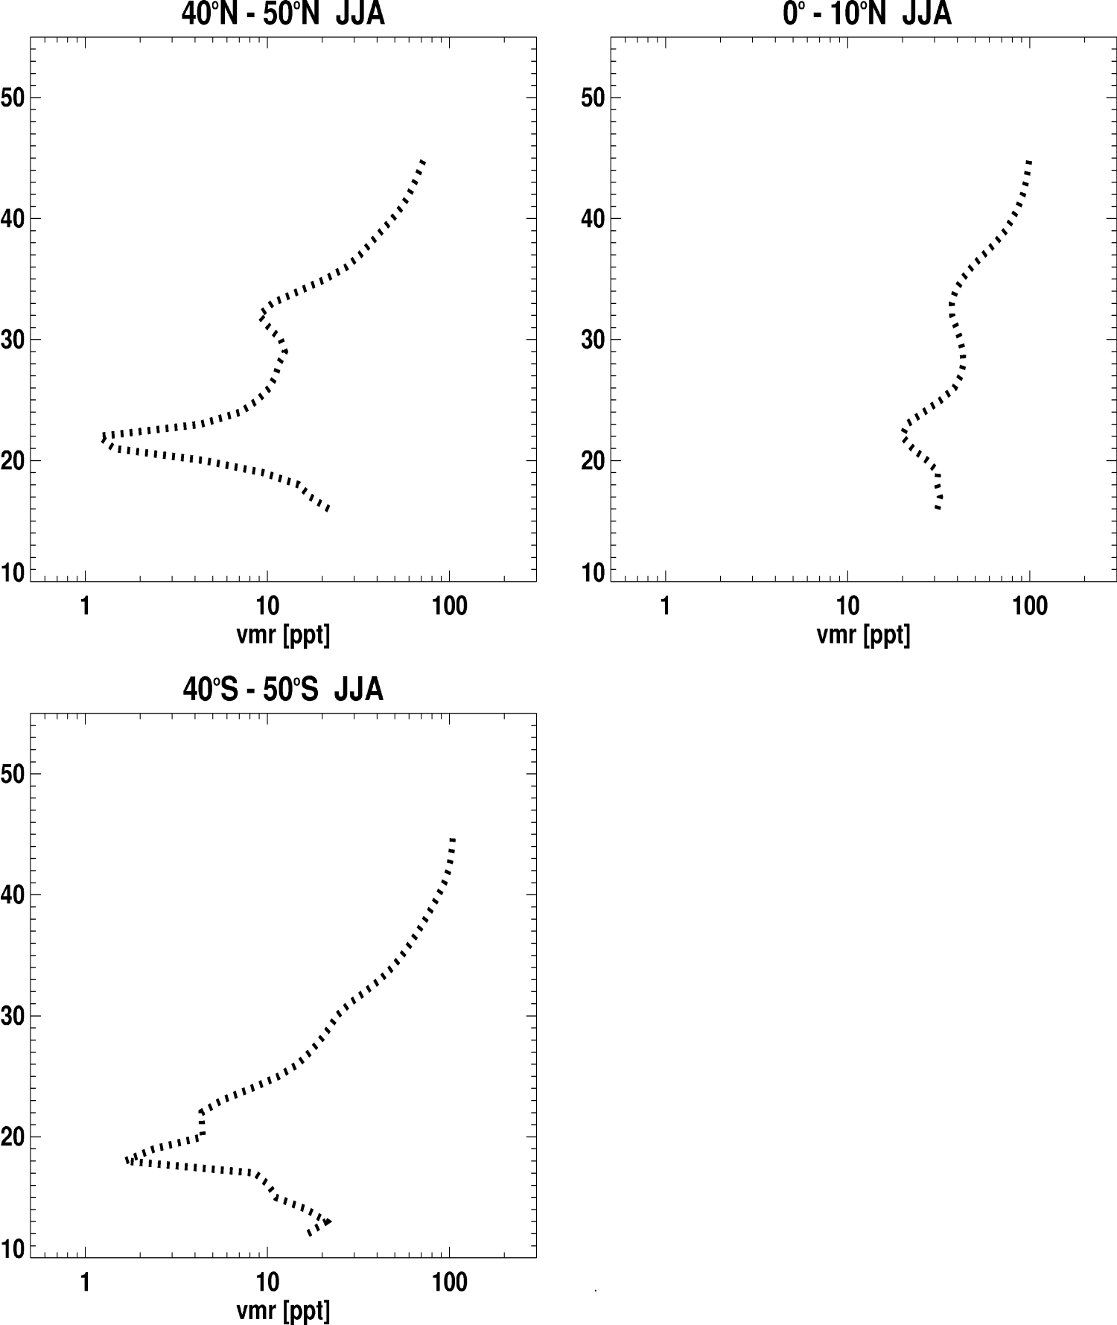
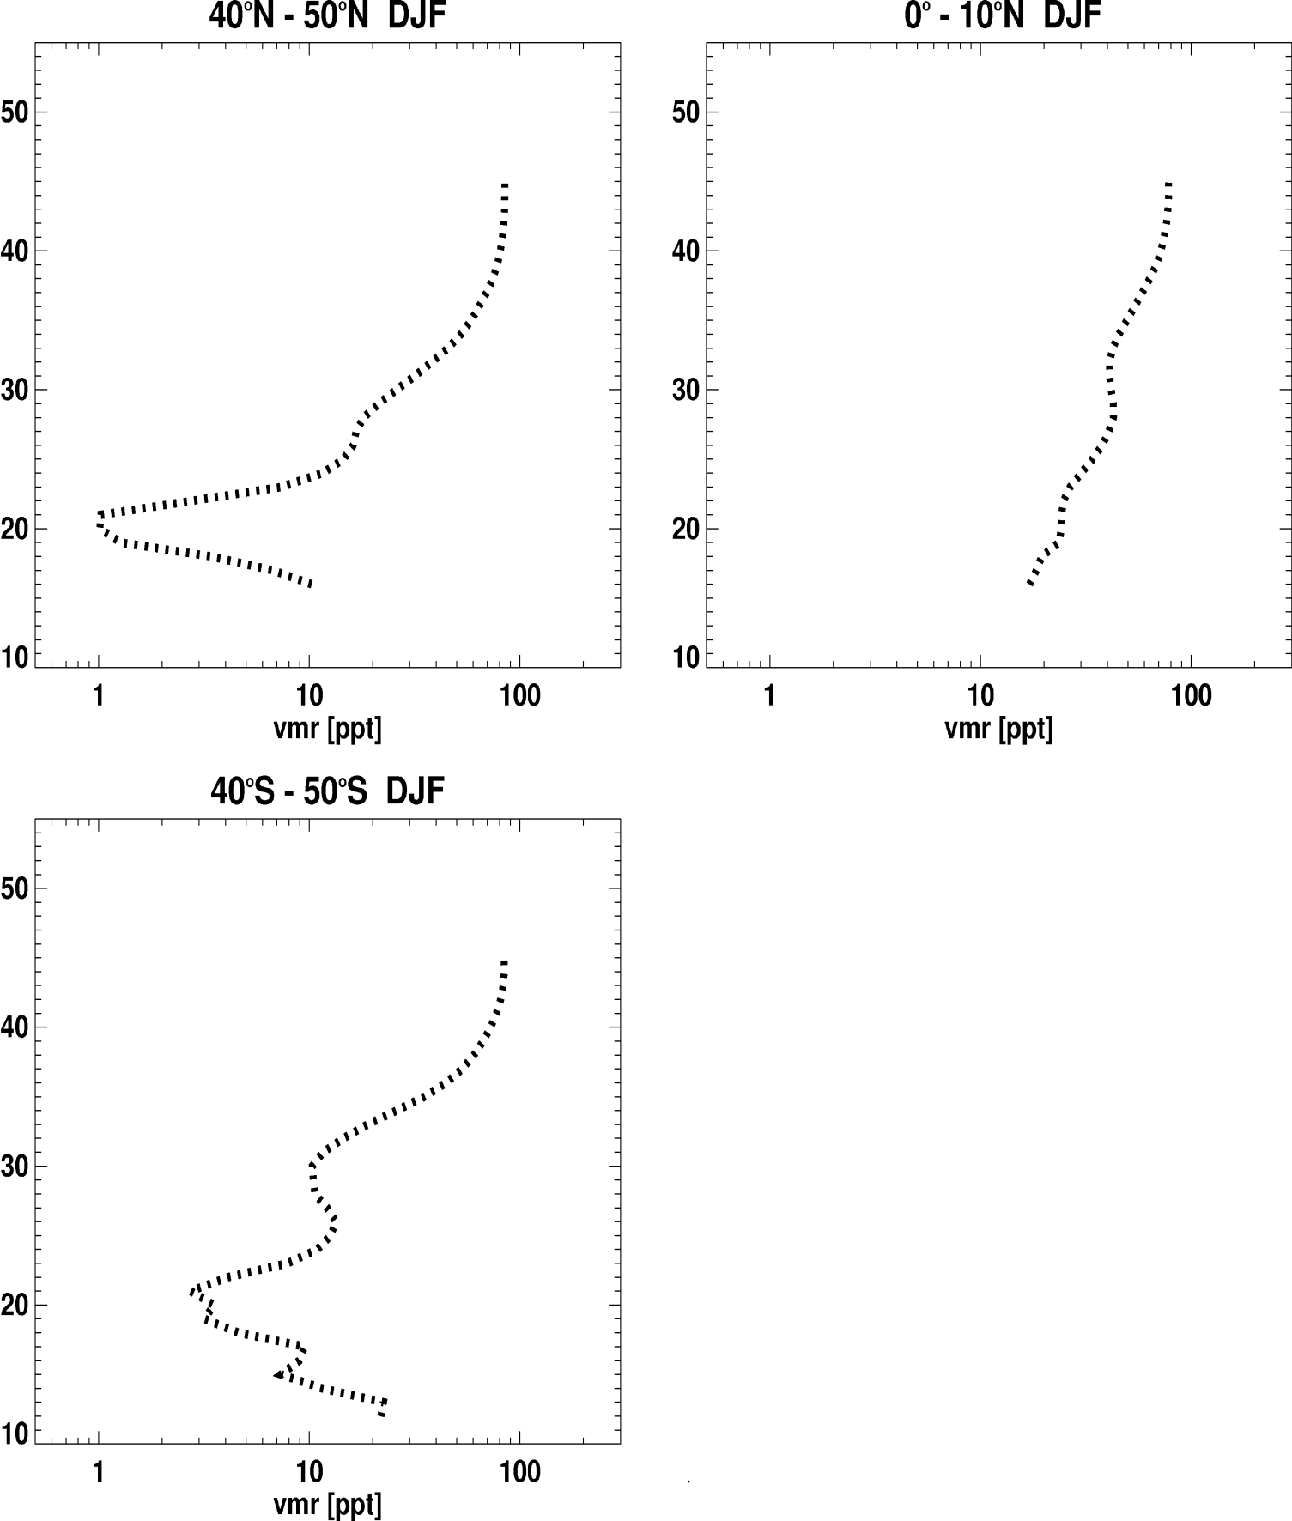
MIPAS

Slide 18
Downwelling of SO₂ in winter and depletion in spring:
Reason for burst of condensation nuclei

Slide 19
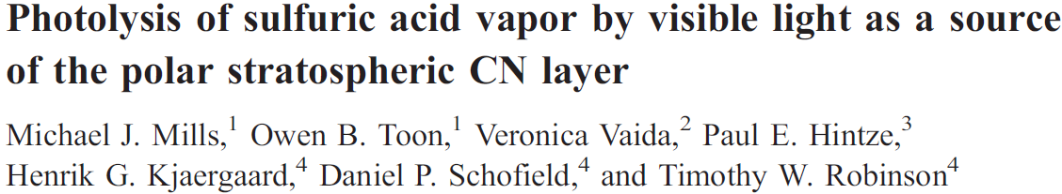
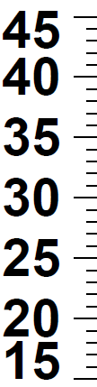
Downwelling in winter and depletion in spring:
Reason for burst of condensation nuclei
Model simulation
[pptv]
SO₂
MIPAS
[pptv]
H₂SO₄
[K]
Temp
Nucl. rate
[cm⁻¹ s⁻¹]

Slide 20
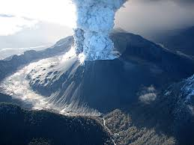
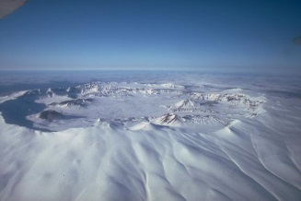
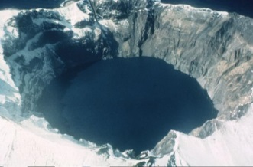
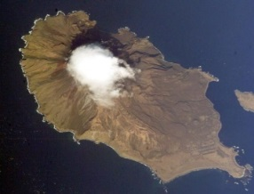
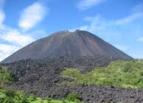
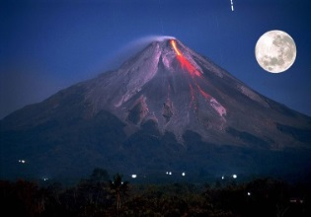
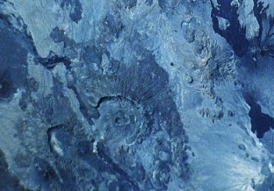
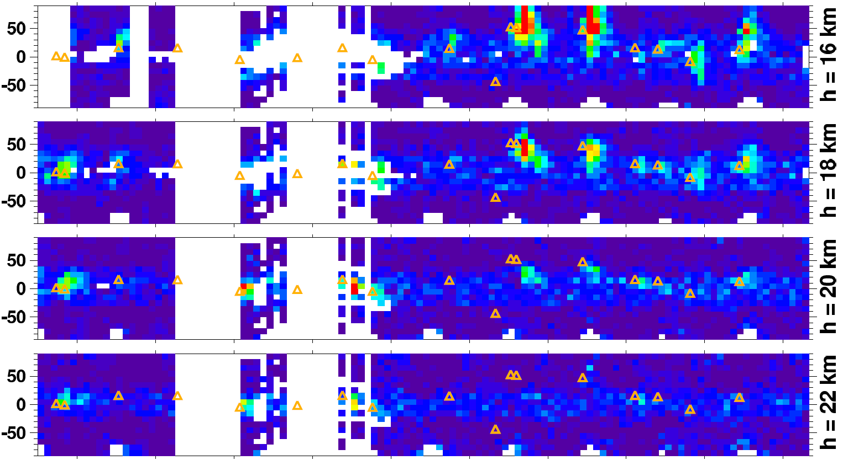

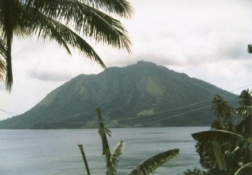
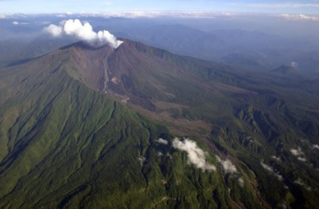
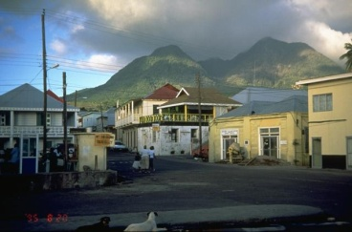
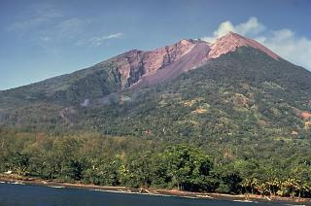
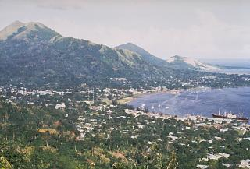
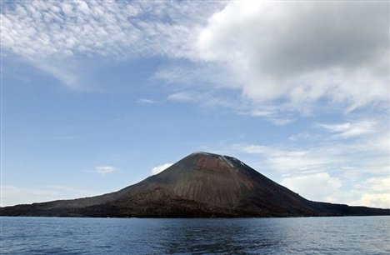
Okmok
Kasatochi
Nabro
Volcanic eruptions
Chaiten
Sarychev
Pacaya
Merapi
Ruang
Reventador
Soufrière Hills
Manam
Rabaul
Jebel al Tair

Slide 21
SO₂ from single MIPAS limb-scans

Slide 22
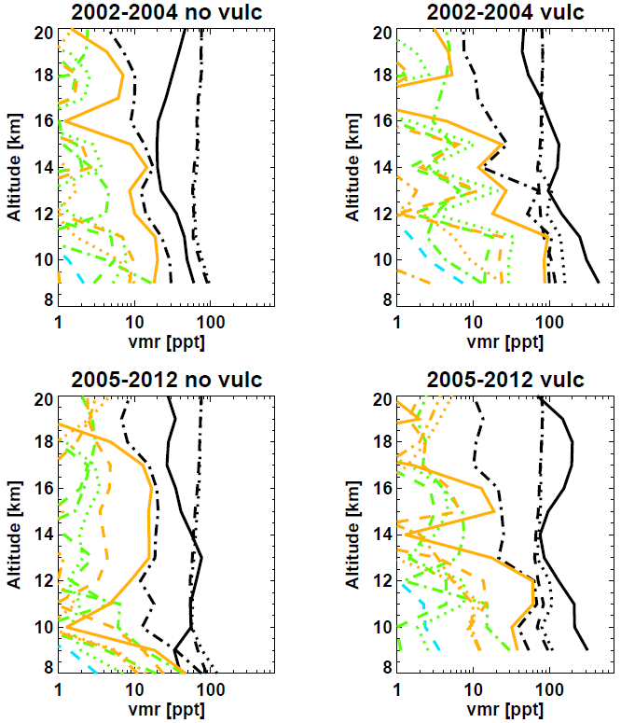
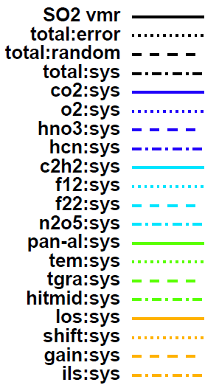
Error estimation: SO₂ from single limb-scans

Slide 23
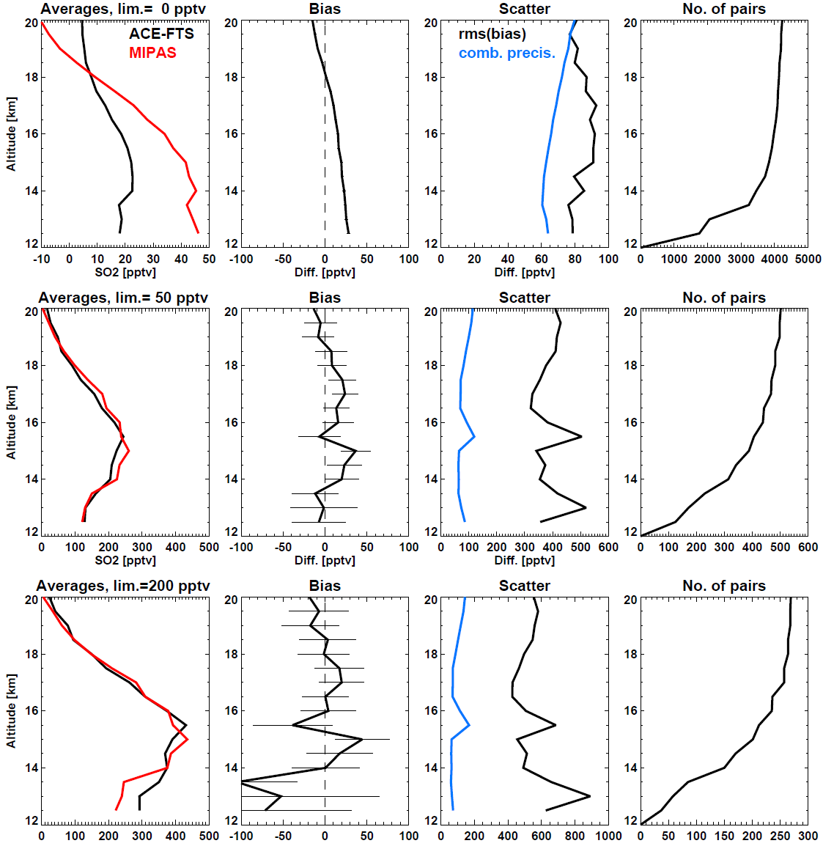
Comparison with ACE-FTS (500 km, 5 h)
Background
Volc. enhanced (>50 pptv)
Volc. enhanced (>200 pptv)

Slide 24
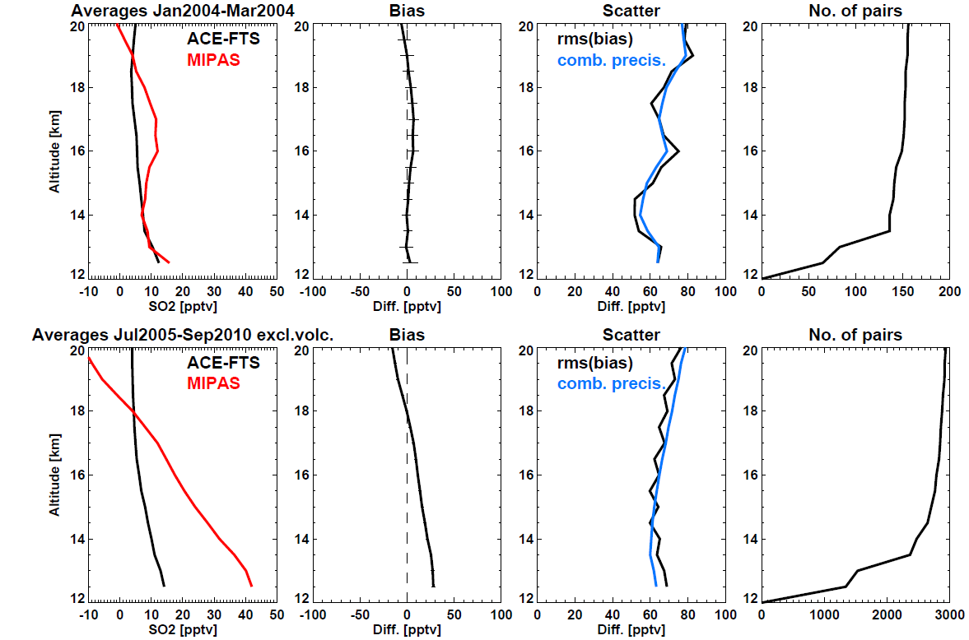
Comparison with ACE-FTS (500 km, 5 h):
Background before and after Jan 2005

Slide 25
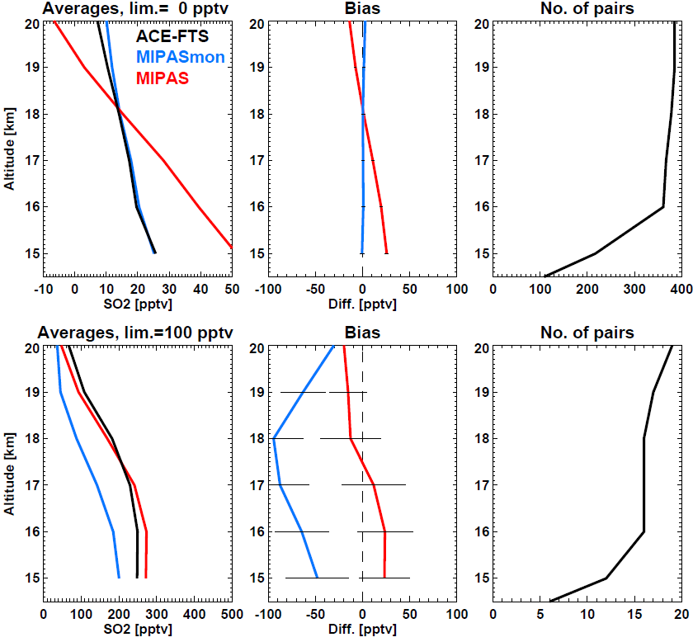
Comparison with ACE-FTS and MIPAS from monthly mean spectra:
Background
Volc. enhanced (>50 pptv)

Slide 26
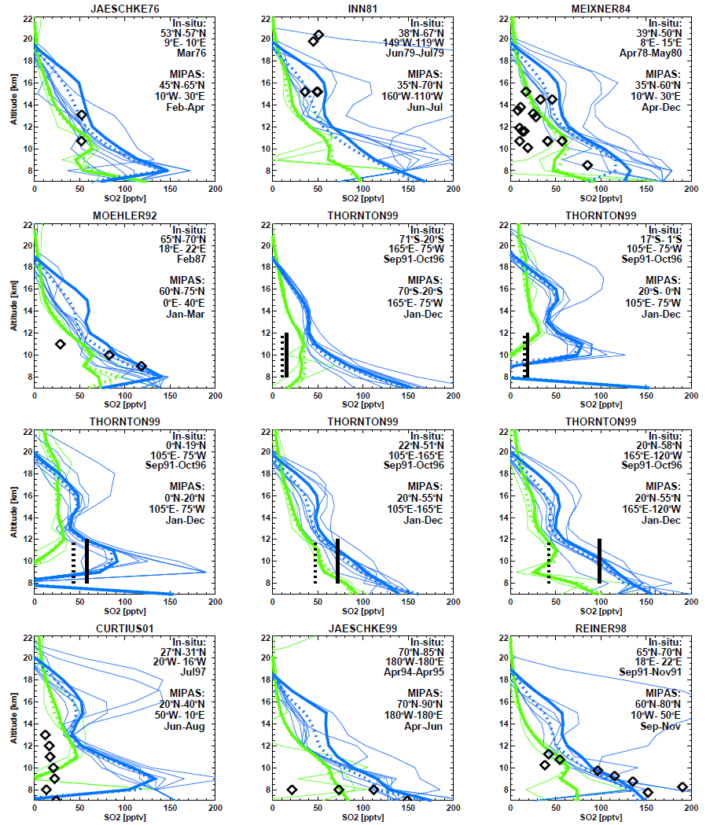
Comparison with in-situ observations
In-situ
MIPAS before Mar 2004
MPAS after Jan 2005

Slide 27
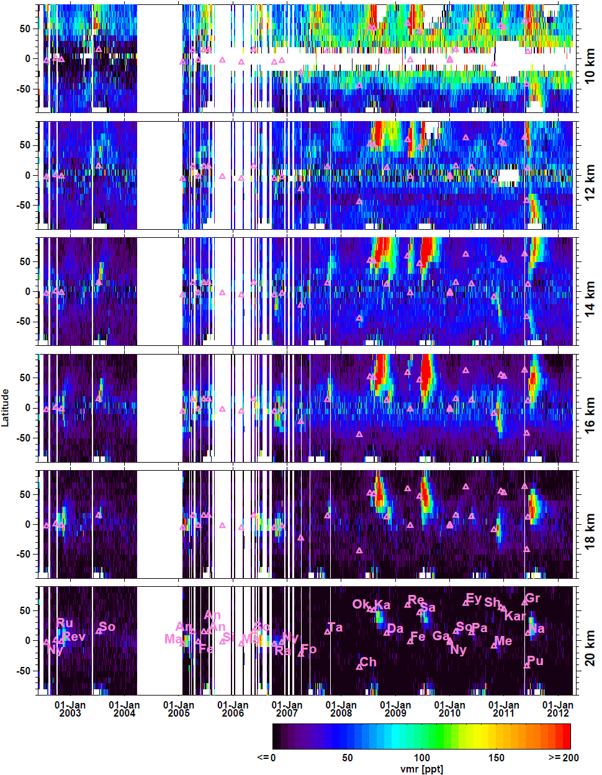
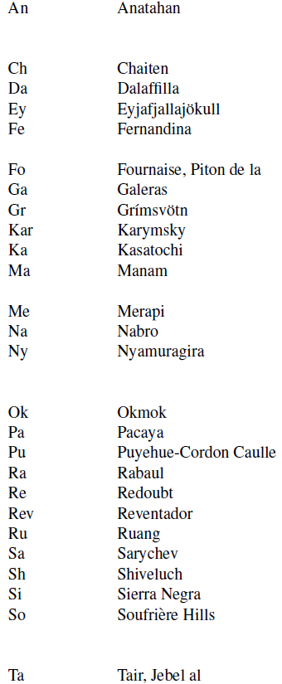

Slide 28
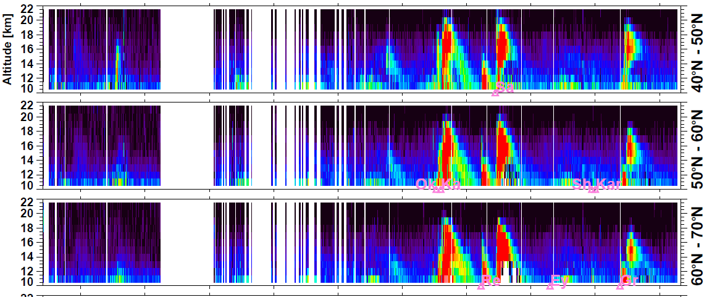
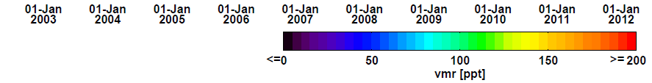

Slide 29



Slide 30
COS from single MIPAS limb-scans

Slide 31

Burgess et al., 2005

Slide 32


OCS: comparison with ACE-FTS
Spectroscopy?
MIPAS-Karlsruhe retrievals use other
IR band than ACE
No Problem: due to tropical profiles
Barkley et al., 2008

Slide 33




OCS: comparison with SPARC06 models
MIPAS

Slide 34

OCS: monthly meridional mean distribution

Slide 35


OCS: time series

Slide 36


OCS: global distribution @ 9 km
OCS: global distribution

Slide 37
Summary
Monthly 10° zonal mean SO₂ profiles from MIPAS 2002-2012
First observations of:
  Stratospheric maximum @26-30 km
  Downwelling and springtime depletion of SO₂-rich air during polar winter as explanation for the springtime CN bursts
Confirmation of need for:
  Visible and near-IR photolysis of H₂SO₄
  Irreversible sink of sulfur (meteoric dust?)
SO₂ variability:
  Lower stratosphere: volcanic eruptions (no indication for any larger anthropogenic influence)
  1-year: downwelling at high latitudes
  ~30 km: QBO at tropics
  35-45 km: SAO at tropics+sub-tropics
  Upper stratosphere: indications for solar cycle

Slide 38
Summary cont.
Single SO₂ profiles from MIPAS 2002-2012
Very good comparison with ACE-FTS during volcanic episodes
Signs for positive bias in background profiles (>2005)
Detailed distribution of SO2 in the lower stratosphere after volcanic eruptions
Single COS profiles from MIPAS 2002-2012
Positive offset compared to ACE-FTS (spectroscopy?)
Good comparison with SPARC06 models

