Slide 1
Global stratospheric aerosol distribution as measured by the OMPS/LP
Didier Rault, GESTAR / Morgan State University
Pawan Bhartia, NASA Goddard Space Flight Center
SSAI processing team, Science Systems & Applications Inc, Lanham, MD 20706, USA
Stratospheric Sulfur and Its Role in Climate (SSiRC)
28-30 October 2013, Atlanta, Georgia

Slide 2
OUTLINE
Ozone Mapper Profiler Suite (OMPS) Limb Profiler
Stratospheric aerosol product description
Orbital curtain files
Vertical profiles of aerosol extinction
Vertical profiles of Angstrom coefficient (particle size)
Quality assessment / comparison with CALIPSO, GOMOS
Observations
Chelyabinsk meteor aftermath
Aerosol “bubbles”
Time evolution of aerosol layer (over 1.5 year of operation)
Brewer Dobson Circulation signature
Conclusion

Slide 3
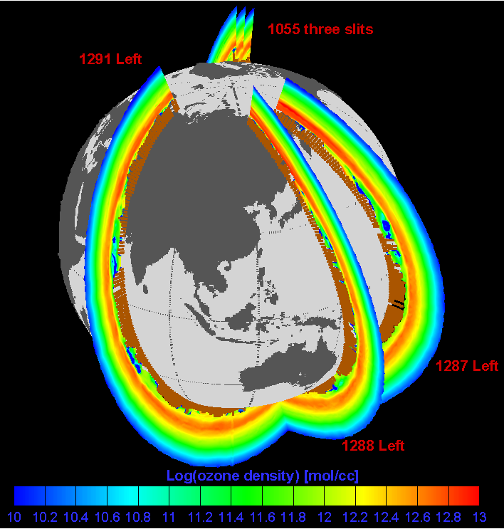
OMPS Limb Profiler
NPP/Suomi launched on October 28, 2011. Sun-synchronous orbit (1:30 PM ascending node and 833 km altitude)
OMPS/LP images the whole vertical extent of the Earth limb (110 km)
Wavelength range: 290 nm – 900 nm
OMPS
Courtesy: BATC
3 measurements every 19 s (1° lat sampling)
7000 measurements per day
4-5 days revisit time
I km vertical sampling
2 km vertical resolution

Slide 4
Stratospheric aerosol product (1)
Retrieval algorithm
Based on Rodgers’ Optimal Estimation, with Tikhonov regularization
Retrieve extinction vertical
profiles at several wavelengths
from 470 to 870 nm
Evaluate mean Angstrom
coefficient in whole aerosol layer
Convert Angstrom coefficient
into particle size (phase function)
Retrieve extinction vertical
profiles with updated particle size
Ref: D. Rault, R. Loughman, IEEE Trans. on Geoscience and Remote Sensing, Issue 99, 1 (2013)

Slide 5
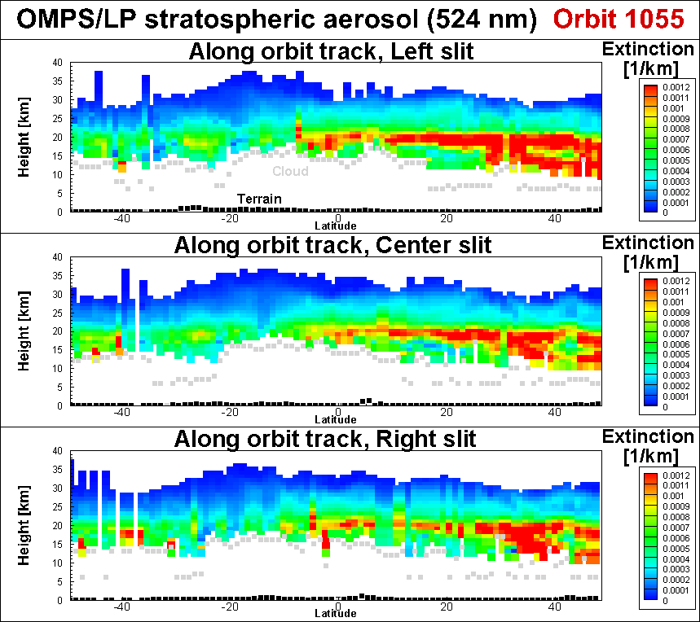
Stratospheric aerosol product (2)
Aerosol curtains
Orbit 1055
OMPS at 524 nm (orbit #1055, January 10, 2012)
CALIPSO at 532 nm (averaged over first two weeks in Jan 2012,
result by J.-P. Vernier)
2 week Zonal Mean
5

Slide 6
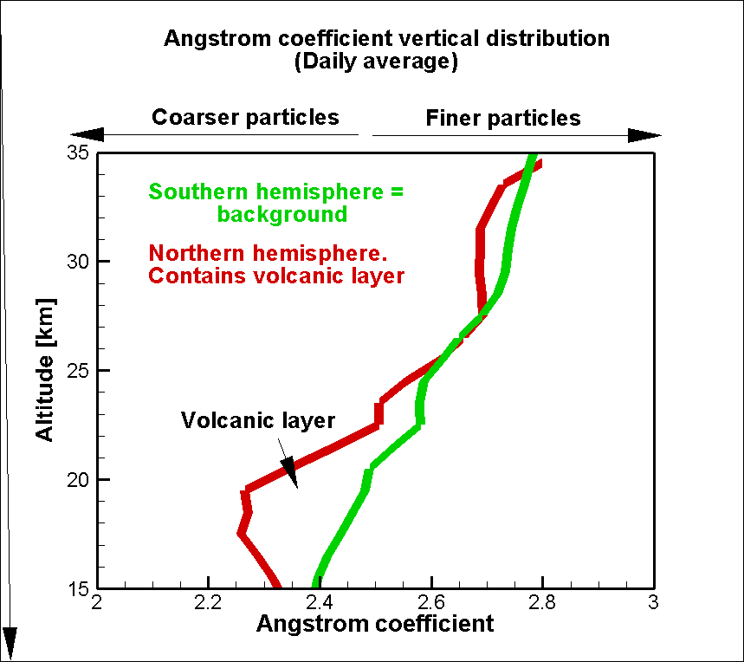
Stratospheric aerosol product (2)
Aerosol curtains
Orbit 1055
OMPS at 524 nm (orbit #1055, January 10, 2012)
OMPS at 524 nm (orbit #1055, January 10, 2012)
Aerosol Angstrom vertical profile
(Daily mean)
CALIPSO at 532 nm (averaged over first two weeks in Jan 2012,
result by J.-P. Vernier)
2 week Zonal Mean
6

Slide 7
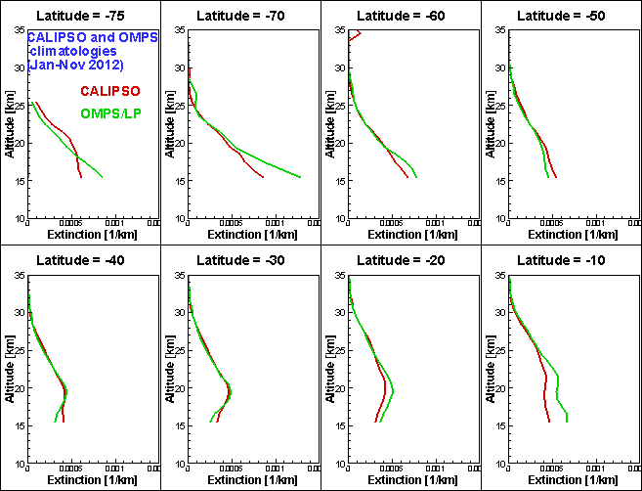
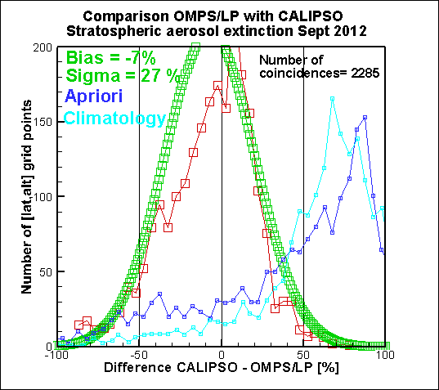
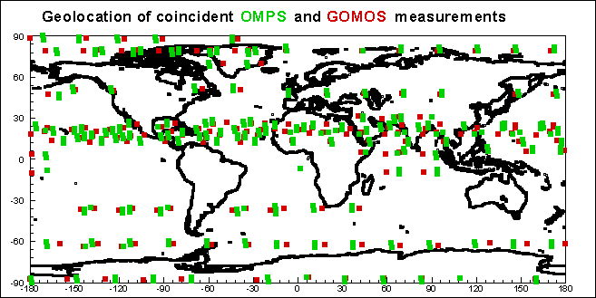
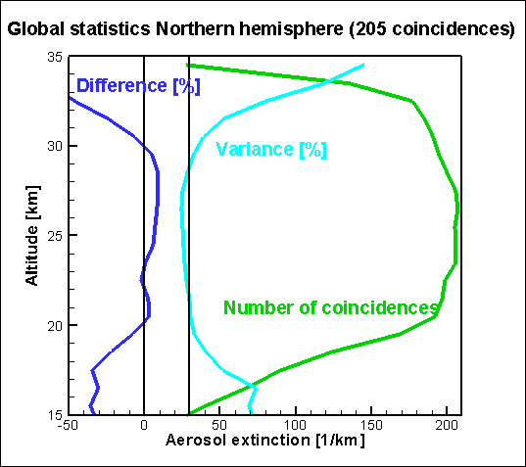
Comparison with CALIPSO and GOMOS
Stratospheric aerosol product (3)
Monthly
statistics
Comparison with CALIPSO
Bias < 7%, Variance = 27 %
Comparison with GOMOS
Bias < 10%, Variance = 30 %
7

Slide 8
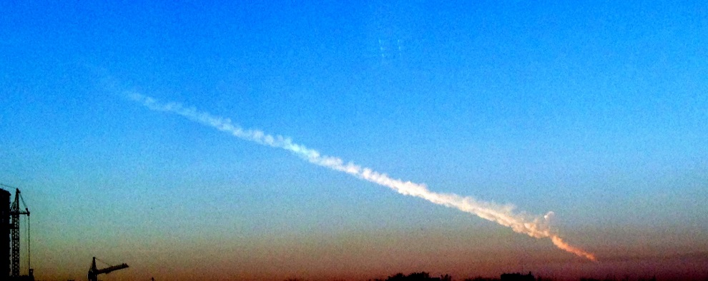
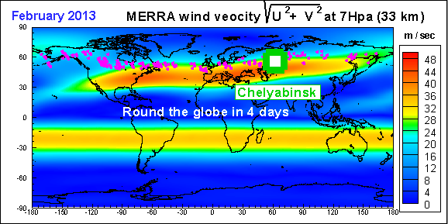
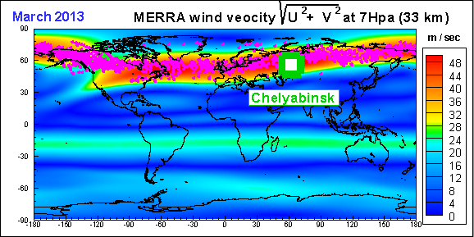
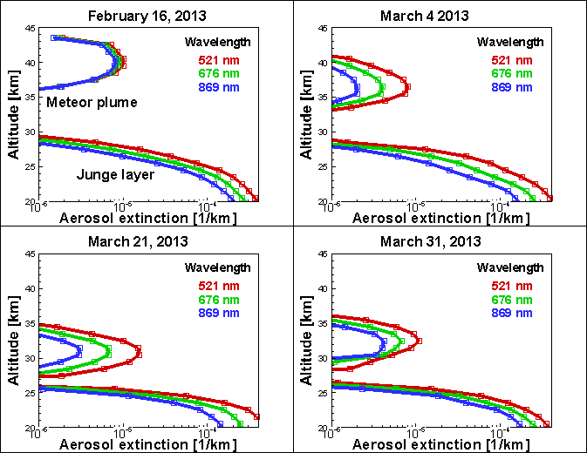
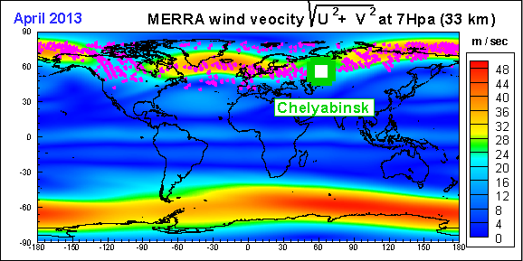
Observation of Chelyabinsk
meteor aftermath (1)
20m diameter, 10,000 metric tons, 18.6 km/s
Explosion at 23.3 km with energy release = 30 x
Hiroshima pulverized meteor
Mushroom cloud to > 55km
“New stratospheric dust belt due to the Chelyabinsk bolide”, Gorkavyi, Rault, Newman, da Silva, Dudorov, GRL, DOI: 10.1002/grl.50788 (5 Sep 2013)

Slide 9
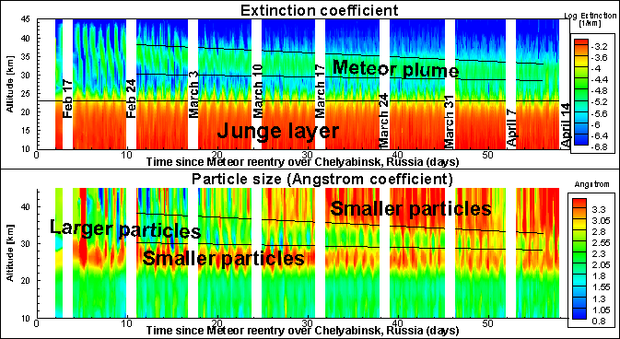
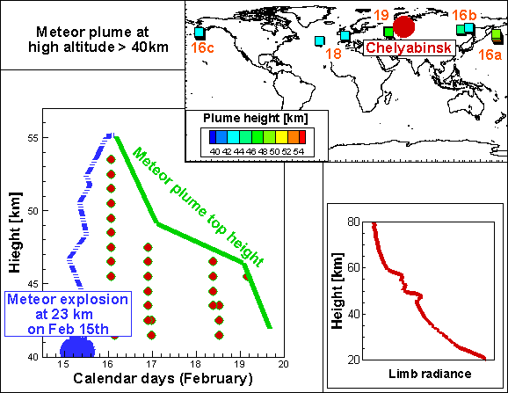
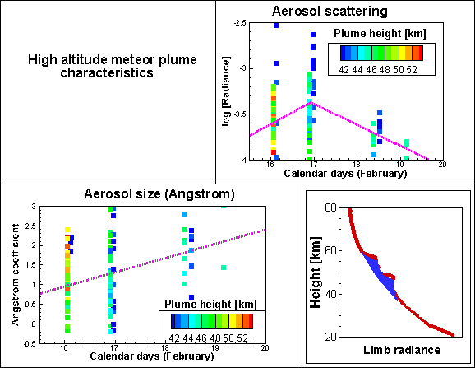
Observation of Chelyabinsk
meteor aftermath (2)
Meteor plume descent = -90 m / day
-1 mm /sec
Aerosol scattering ratior
Aerosol size (Angstrom)

Slide 10
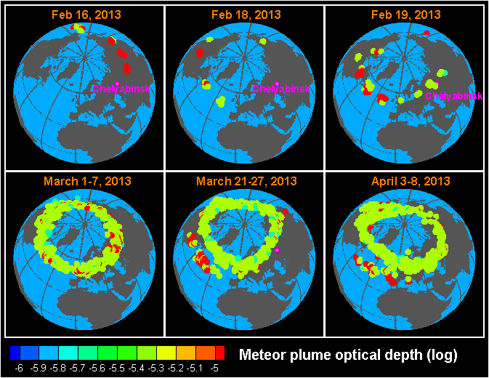
Additional features:
Aerosol bubbles (1)
Red circle = meteor dust
White circle = aerosol bubble
OMPS/LP aerosol curtain
Height [km]
Monthly median Junge layer
10^{-4.5}
Event number along orbit

Slide 11
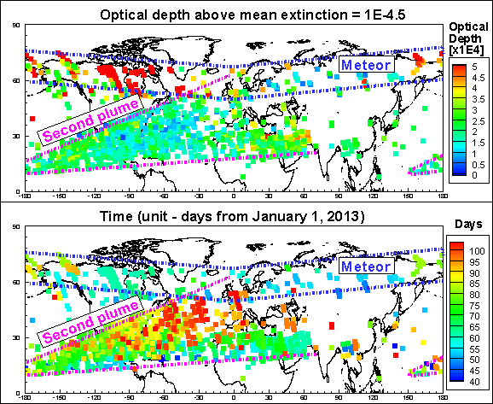
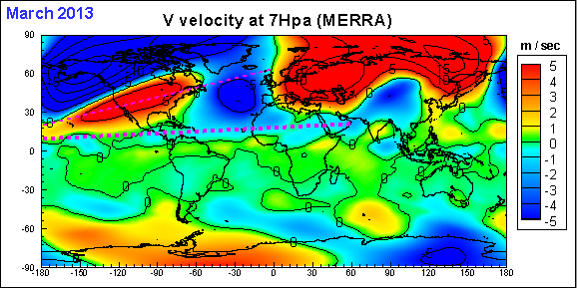
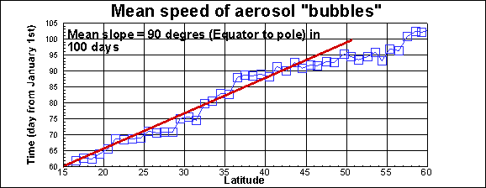
Observation of
Aerosol bubbles (2)
Meridional velocity at 7hpa (MERRA)
Mean speed: 35 deg lat in 32 days = 1.4 m /s
Bubble flight time vs latitude

Slide 12
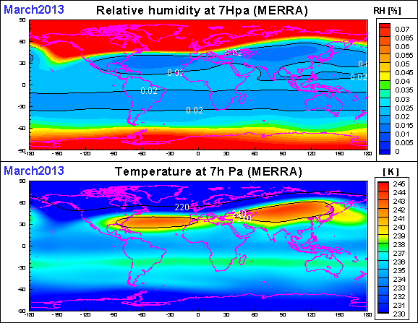
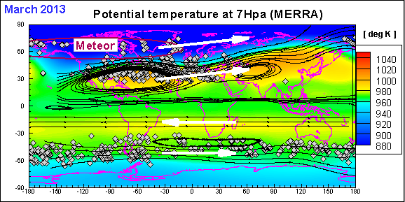
Observation of
Aerosol bubbles (3)

Slide 13
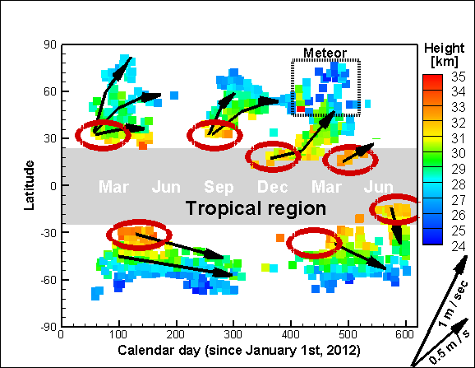
Observation of
Aerosol bubbles (4)
Meridional evolution

Slide 14
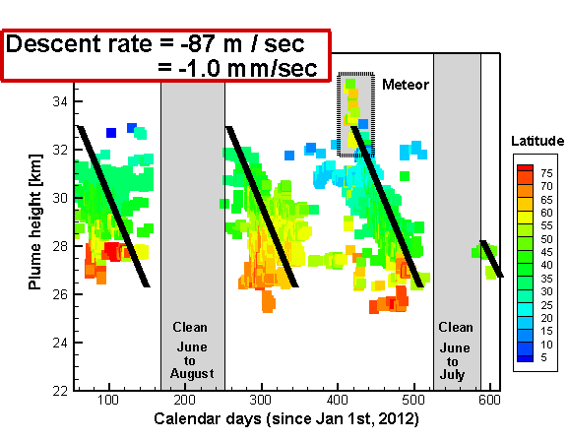
Observation of
Aerosol bubbles (5)
Vertical descent in NH
day

Slide 15
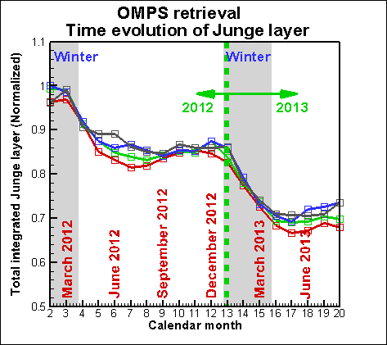
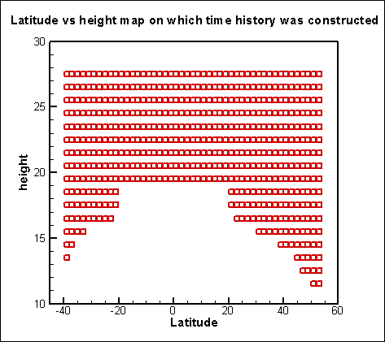
Time evolution of stratospheric
aerosol over OMPS/LP mission (1)
The time evolution was
computed on same grid points
(latitude, height)at all dates

Slide 16
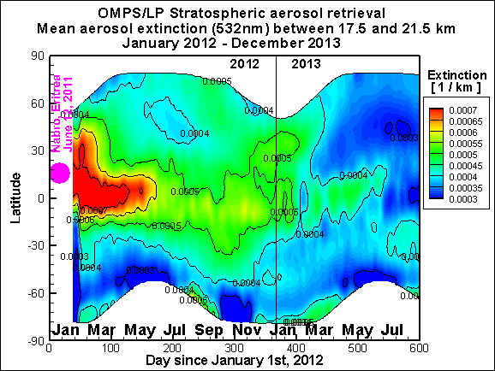
Evolution of stratospheric aerosol
over OMPS/LP mission (2)
February 2012 – August 2013
Fen

Slide 17
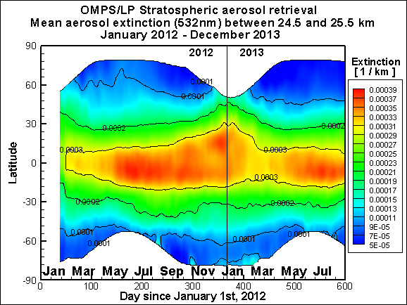
Evolution of stratospheric aerosol
over OMPS/LP mission (3)
February 2012 – August 2013
Fen
Annual
variation
Polewards
In NH winter
Polewards
In SH winter

Slide 18
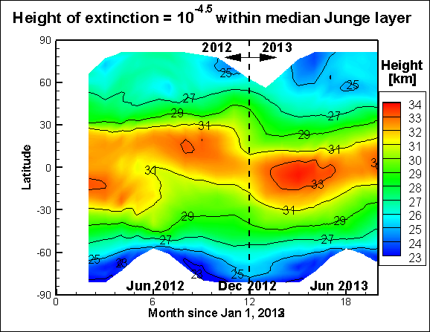
Brewer Dobson circulation (1)

Slide 19
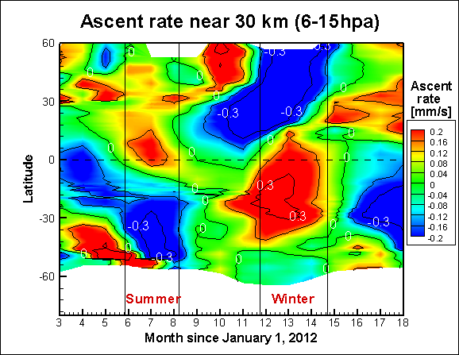
Brewer Dobson circulation (2)
Ascent rates compiled by J. Urban

Slide 20
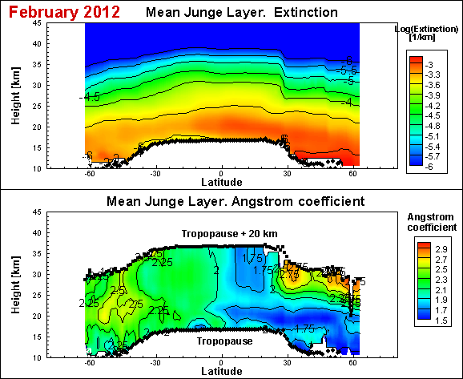
Brewer Dobson circulation (4)
Aerosol particle size (Angstrom coefficient)
Median Junge layer. Extinction
Median Junge layer. Angstrom coefficient
NH BDC

Slide 21
Brewer Dobson circulation (4)
Aerosol particle size (Angstrom coefficient)
Median Junge layer. Extinction
Median Junge layer. Angstrom coefficient
NH BDC
Larger particles in NH, finer in SH

Slide 22
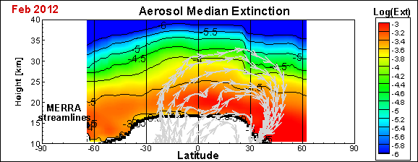
Brewer Dobson circulation (4)
Aerosol particle size (Angstrom coefficient)
Median Junge layer. Extinction
Median Junge layer. Angstrom coefficient
Maximal altitude for R>0.1μm particles:
V_{terminal} = V_{updraft} = 0.3mm/sec
NH BDC
NH BDC

Slide 23
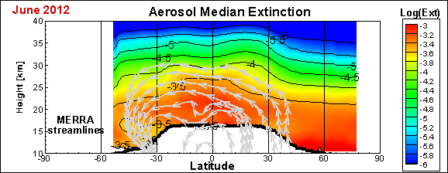
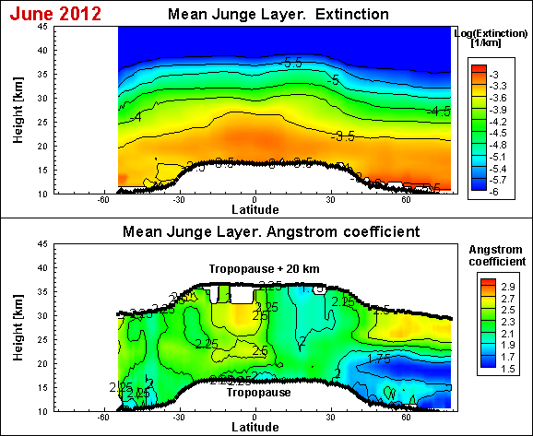
Brewer Dobson circulation (5)
Aerosol particle size (Angstrom coefficient)
Median Junge layer. Extinction
Median Junge layer. Angstrom coefficient
Maximal altitude for R>0.1μm particles:
V_{terminal} = V_{updraft} = 0.2mm/sec
NH BDC
SH BDC
No NH BDC

Slide 24
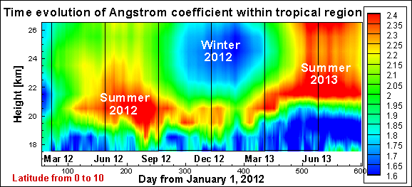
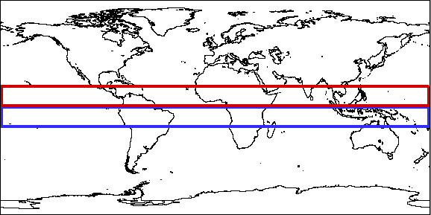
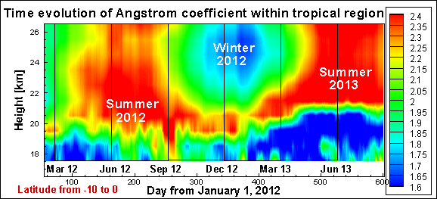
Brewer Dobson circulation (6)

Slide 25
Conclusion
Lessons learnt from OMPS/LP stratospheric aerosol assessment:
-Quantitative: Within 10% bias, 30% variance wrt CALIPSO, GOMOS
-Qualitative: Contains signature of volcano, meteor, BDC (bubbles, extinction profiles, Angstrom). QBO effect TBD(<2 years of data)
-Observations:
30% Decrease of stratospheric aerosol from Feb 2012 to Aug 2013
Tropical pipe Vortex
Surf zone
35 km
30 km
25 km
20 km
15km
1
BDC downdraft
2
BDC
updraft
3
Tropopause
Equator Winter pole

Slide 26
Backup slides

Slide 27
0.3 mm/sec = 0.8 km/month
Altitude [km]
Maximum altitude for 0.1 μm in tropical pipe
Maximum altitude for 0.5 μm in tropical pipe
Falling speed [cm/s]
Falling speed of spherical 1 g/cc particles in 1962 US Standard atmosphere
Ref: F. Kasten, “Falling speed of aerosol particles”, J. Applied Meteorology, Vol 7, pp 944-947, Oct 1968

Slide 28
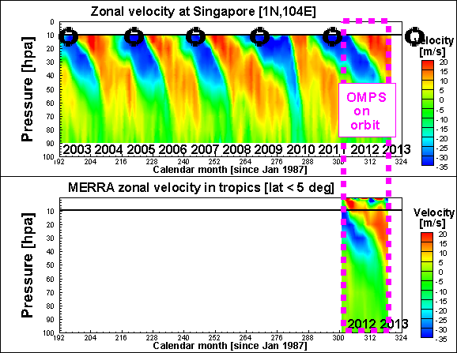
QBO feature within
OMPS/LP data?
Black circles
Indicate largest easterlies (at 10hpa), which should correspond to larger vertical updraft
No QBO signature yet in OMPS/LP dataset

Slide 29
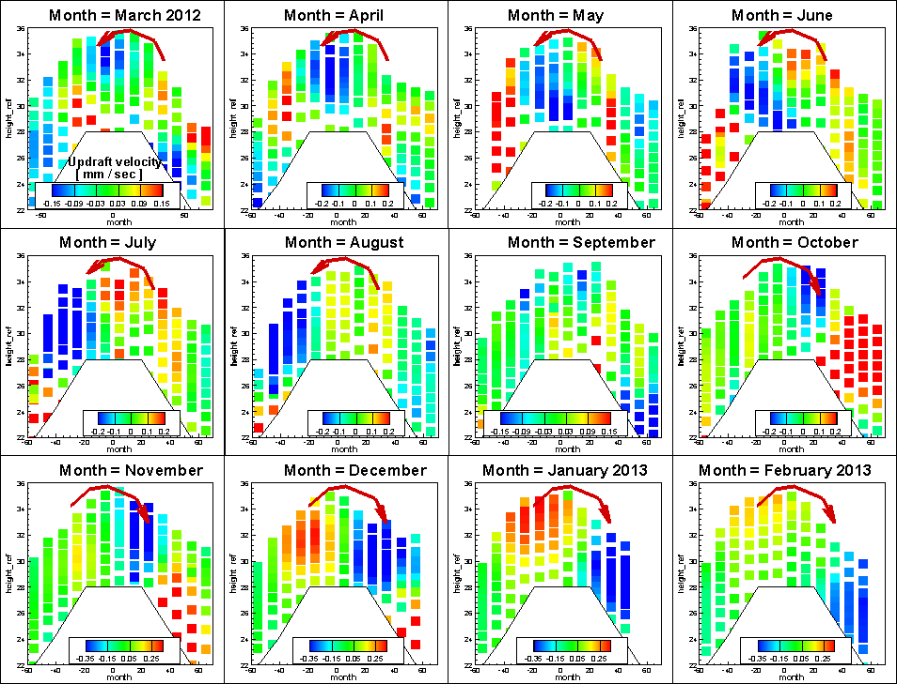

Slide 30
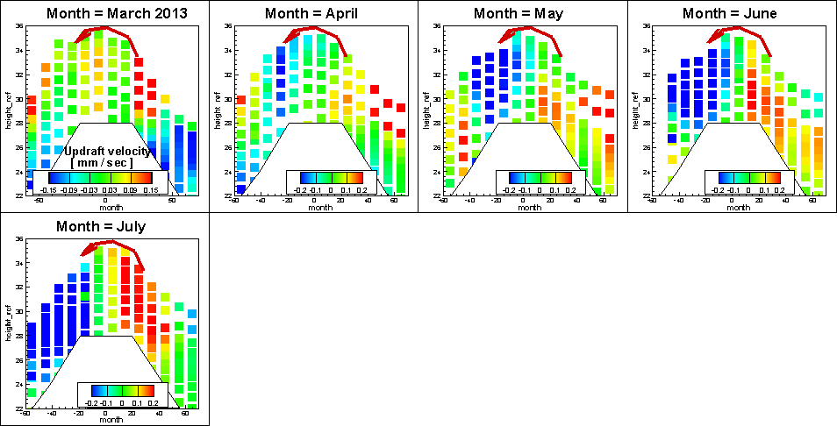

Slide 31
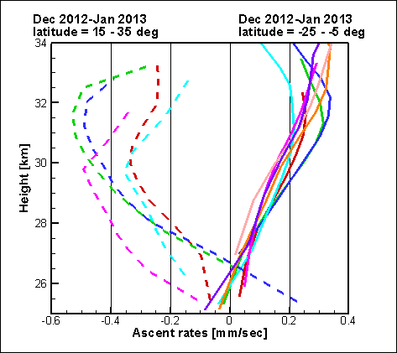
Brewer Dobson circulation

Slide 32
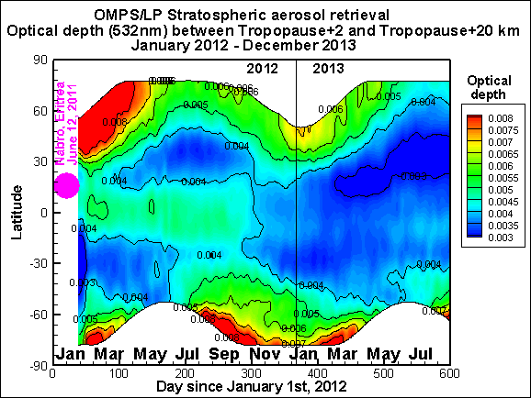
Evolution of stratospheric aerosol
over OMPS/LP mission (1)
February 2012 – August 2013
Fen

Slide 33
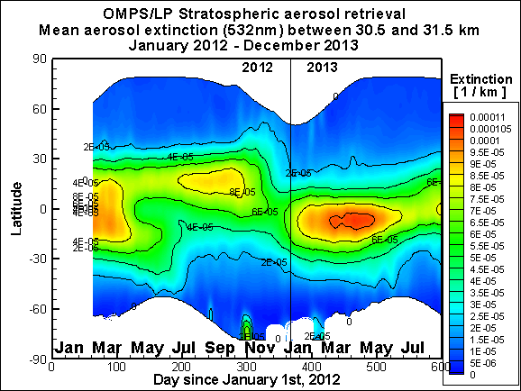
Evolution of stratospheric aerosol
over OMPS/LP mission (5)
February 2012 – August 2013
Fen
Annual
Variation
and
QBO?

Slide 34
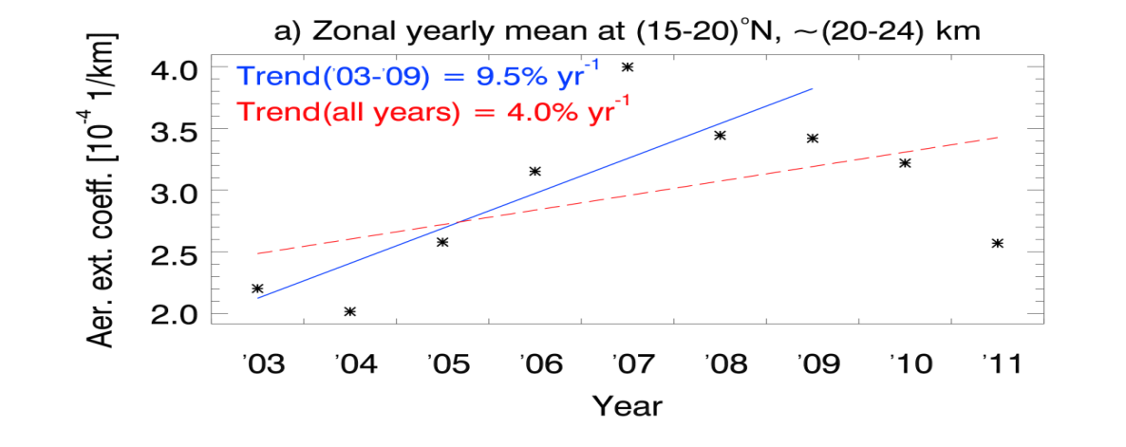
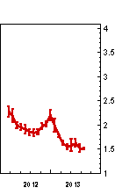
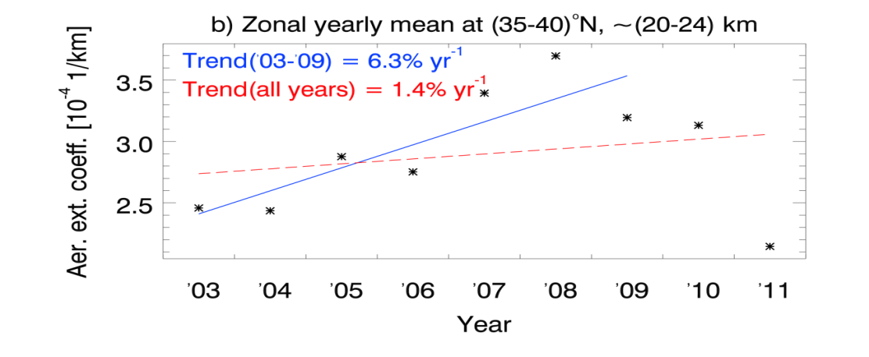
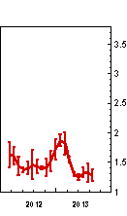
Time evolution of stratospheric
aerosol over OMPS/LP mission (2)
Ref: Brinkhoff, SCIAMACHY group OMPS/LP
Zonal yearly mean
15-20 N
20-24km
Zonal yearly mean
35-40 N
20-24km

Slide 35
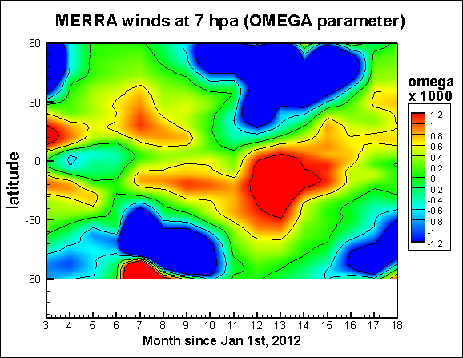
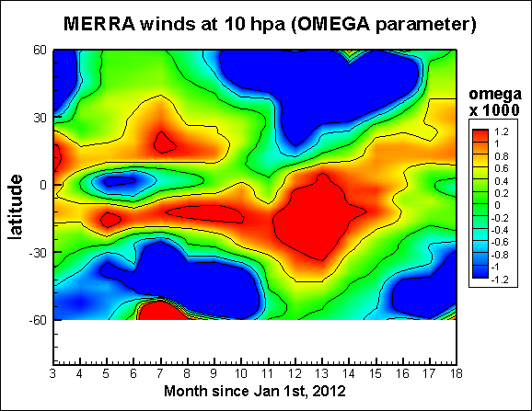
Brewer Dobson circulation (3)
Comparison with MERRA
Summer Winter
Summer Winter

Slide 36
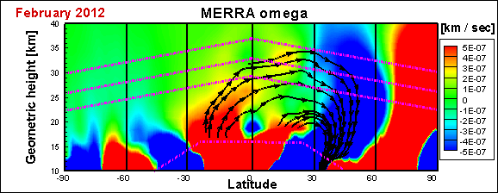
Brewer Dobson circulation (4)
Aerosol particle size (Angstrom coefficient)
Median Junge layer. Extinction
Median Junge layer. Angstrom coefficient
Maximal altitude for R>0.1μm particles:
V_{terminal} = V_{updraft} = 0.3mm/sec
NH BDC
NH BDC

