Slide 1
Aircraft measurements of the SO₂ distribution in the upper troposphere and lower stratosphere
A. Roiger, H. Schlager, K. Wissmüller, H. Aufmhoff, F. Arnold
DLR, Institute of Atmospheric Physics
SSRiC Workshop
28 – 30 Oct 2013
Atlanta, GA, USA

Slide 2
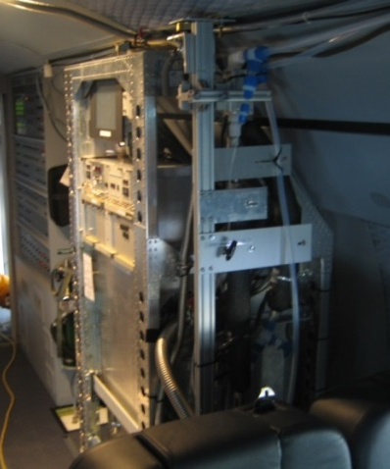
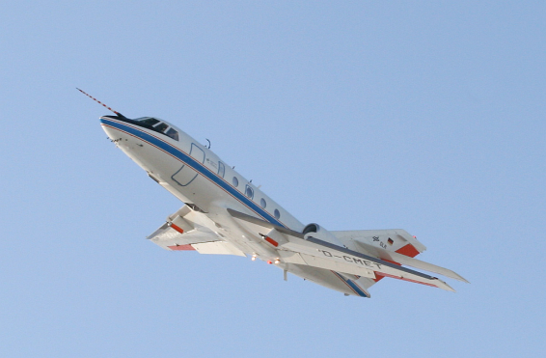
SO₂ measurements using CI - ITMS
CI-ITMS (Chemical Ionization – Ion Trap Mass Spectrometry)
CO₃⁻ ion chemistry (e.g. Speidel et al., 2007)
time resolution ~ 1-2 s
detection limit ~ 10 pptv (10s)
online isotopic calibration using ³⁴SO₂
Falcon: max. altitude ~12 km
HALO: max. altitude ~15 km
→ 10 aircraft campaigns (2004 - 2012)
→ 3 aircraft campaigns (2010, 2012)

Slide 3
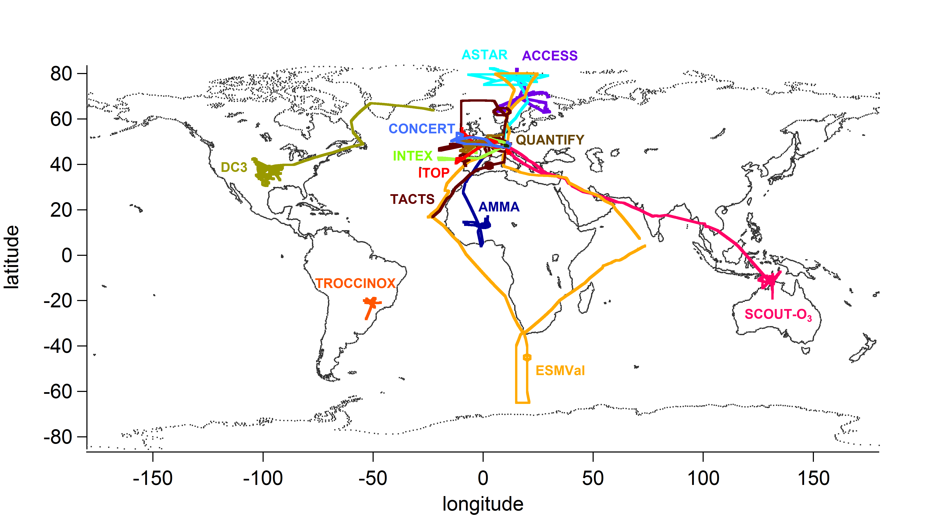
Overview: SO₂ measurements (2004 – 2012)
In total: 13 field campaigns ~ 480 flight hours

Slide 4
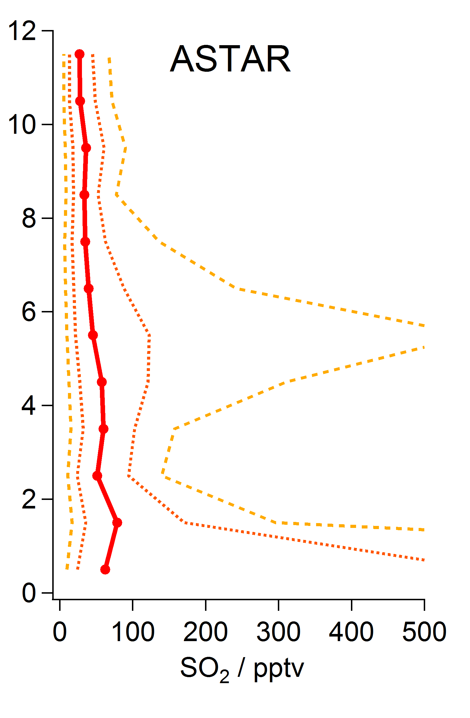
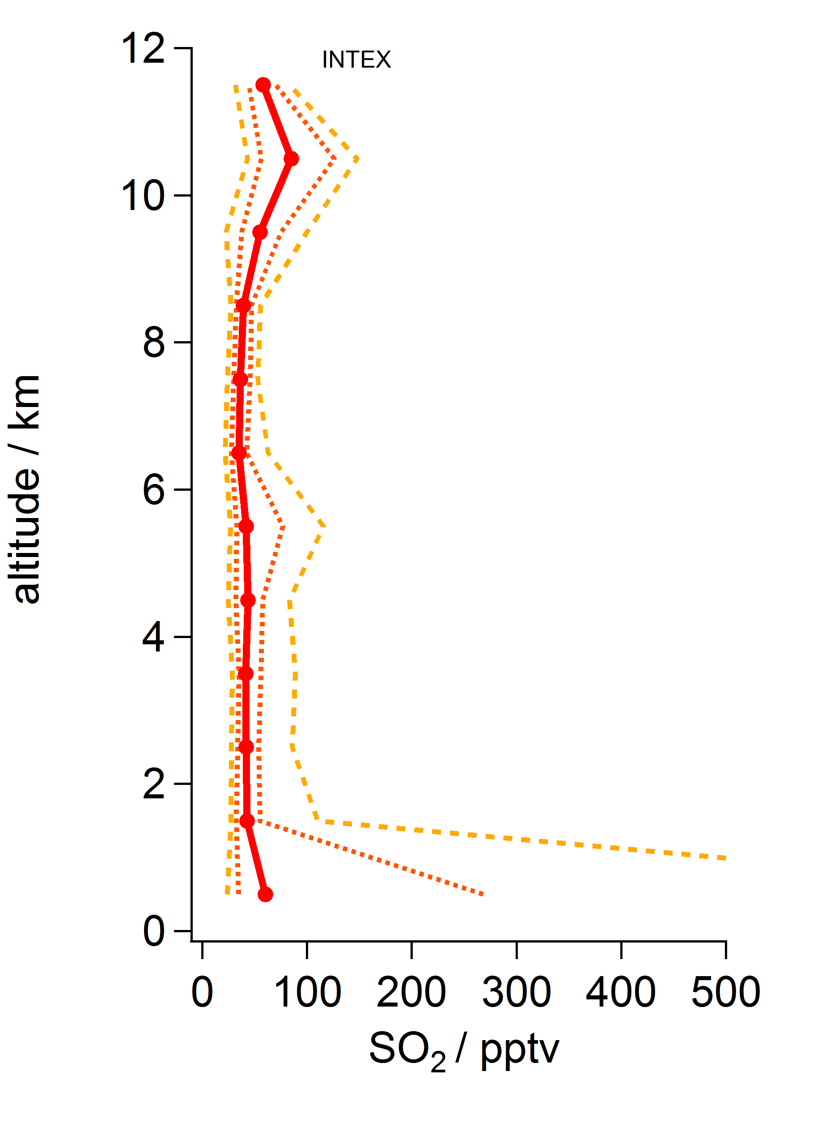
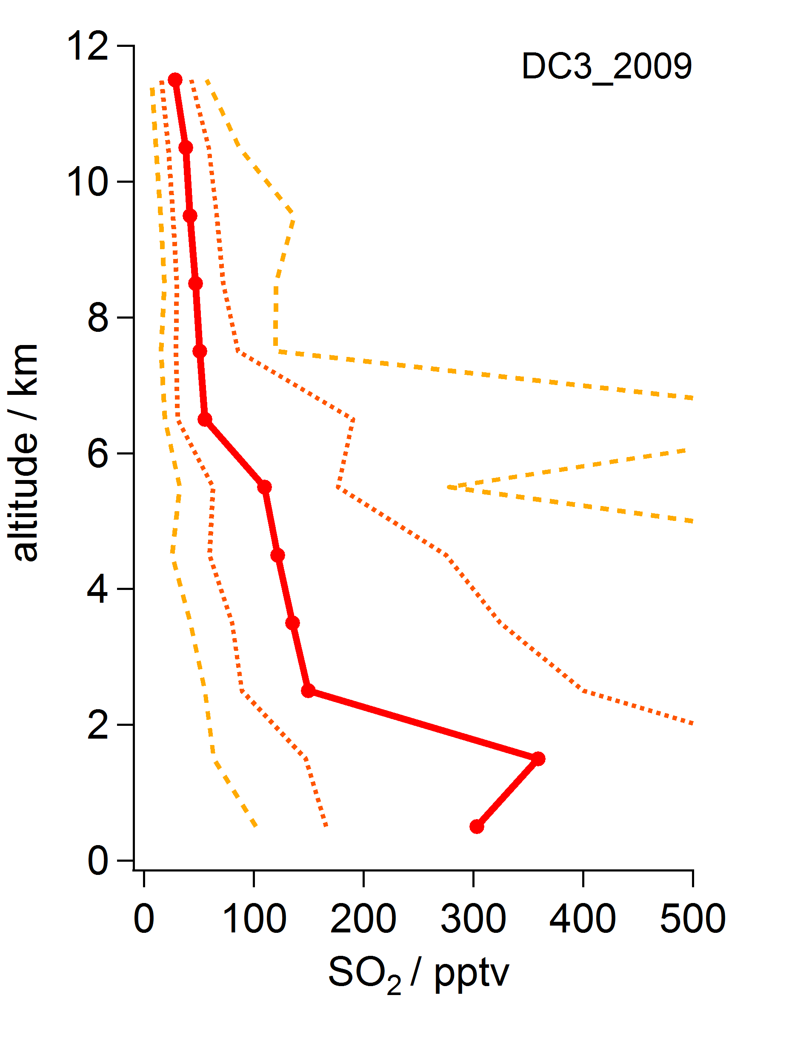
In-situ SO₂ vertical profiles: polar region & mid-latitudes
ASTAR
Spitsbergen, April 2007
INTEX
W Europe, May-June 2006
DC3
Kansas (USA), May 2012
Norilsk smelter
~2500 kT/y
(Fioletov et al., 2013)
Norilsk smelter *
WCB outflow
(NA, Asia)
BB (New Mexico)
Asian emissions - WCB outflow
* ~2500 kT/y, Fioletov et al., 2013

Slide 5
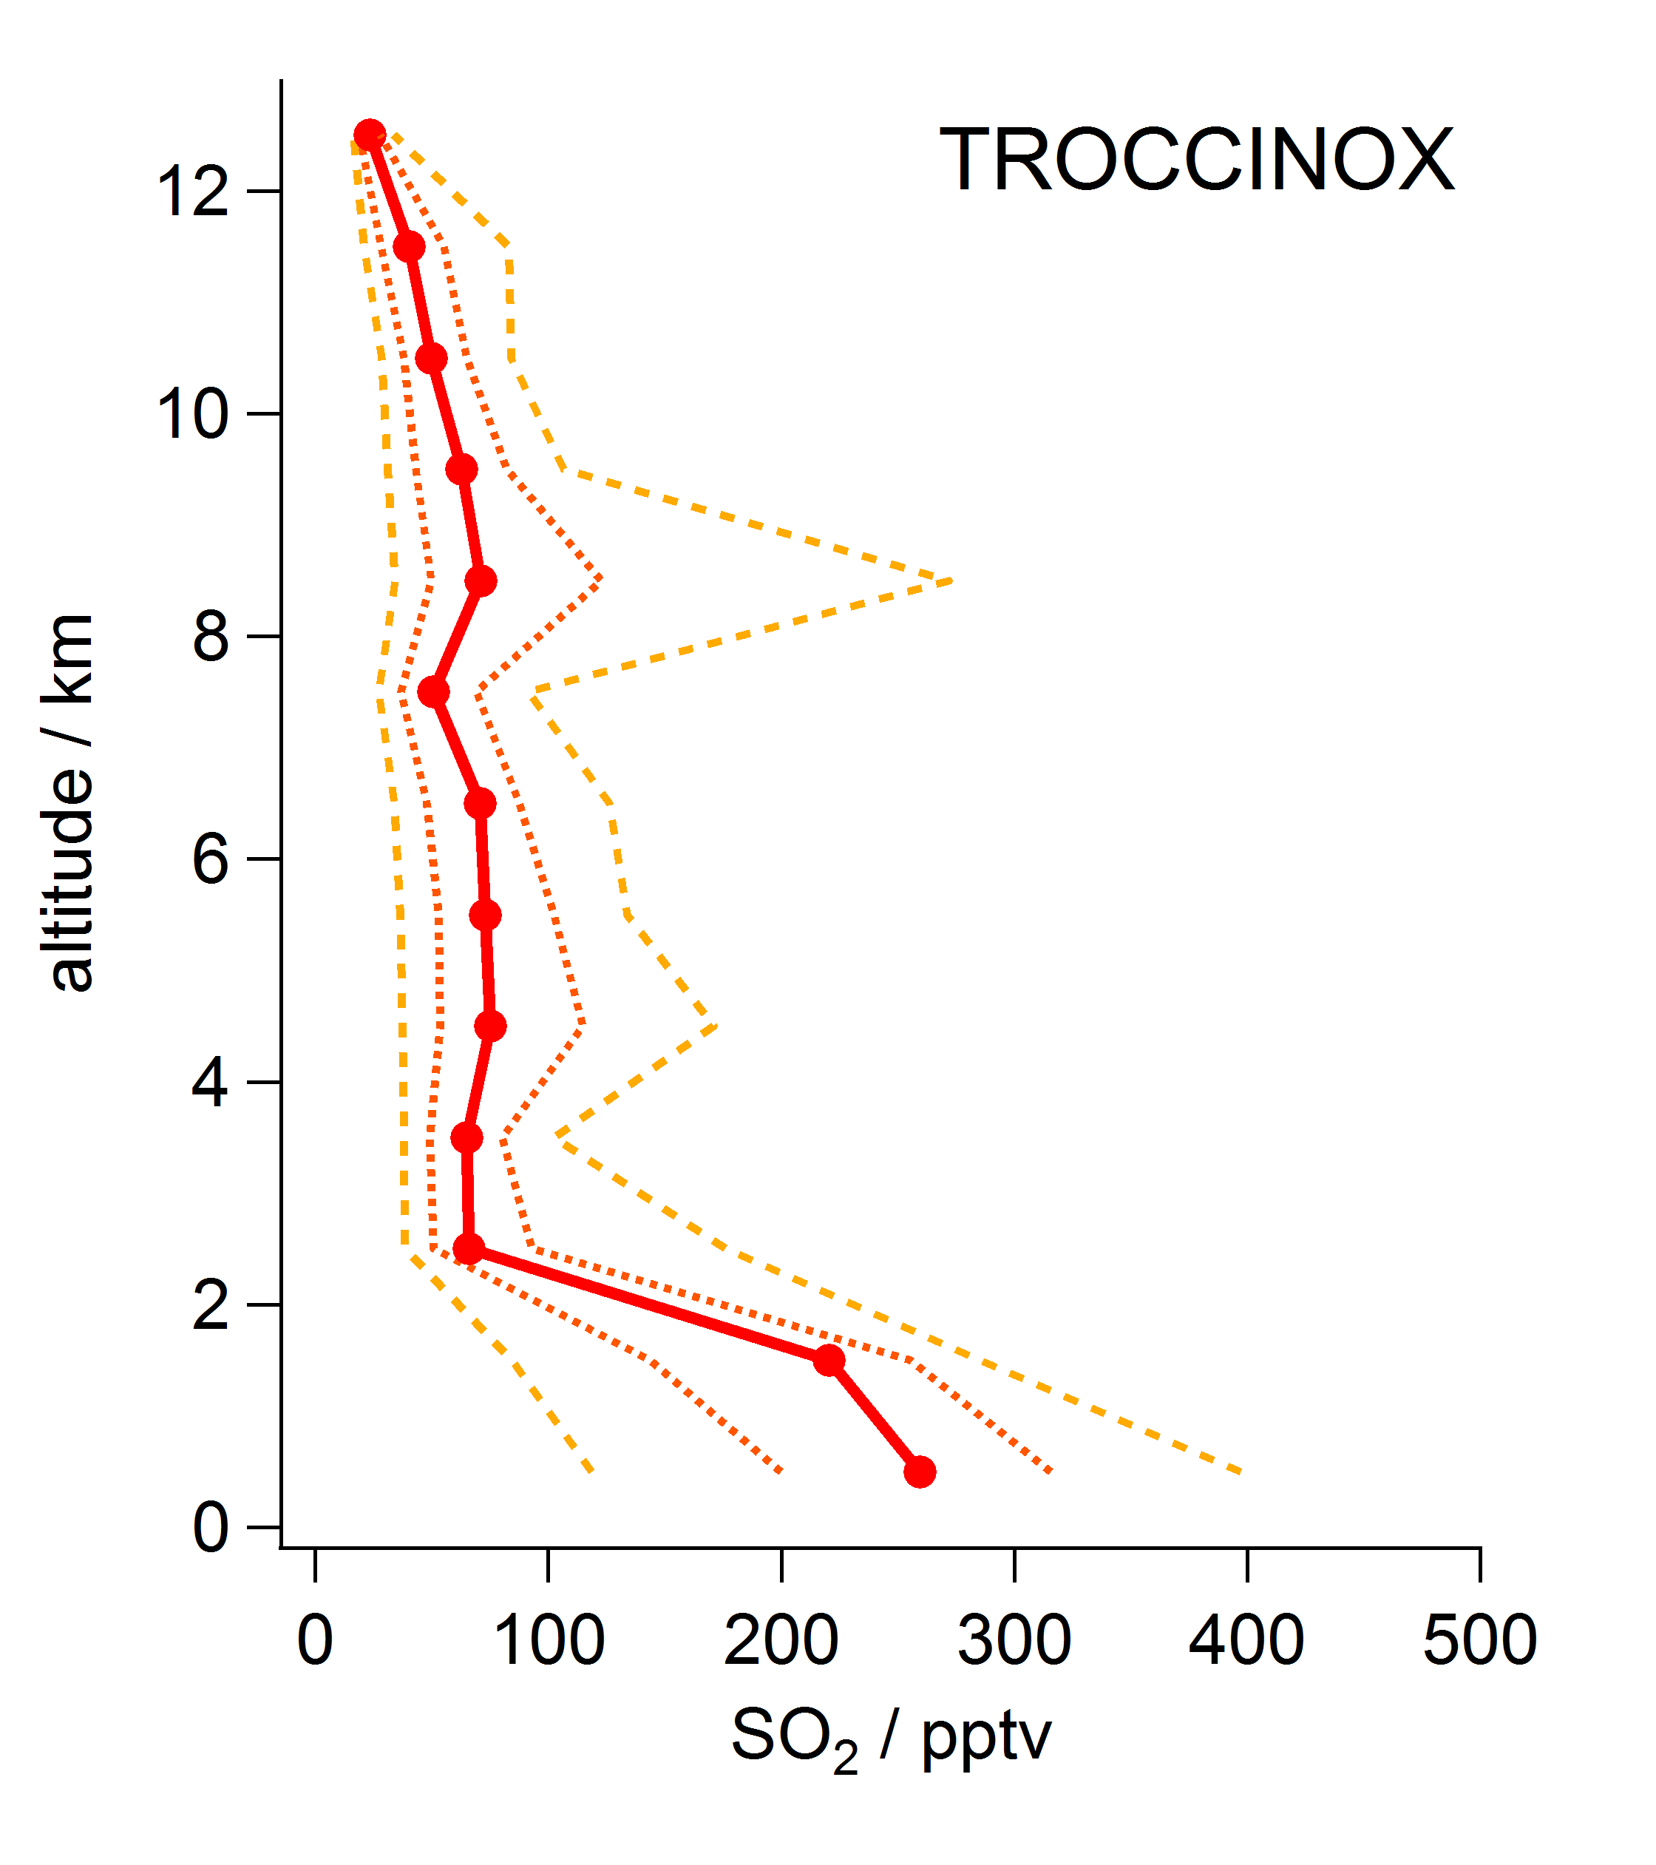
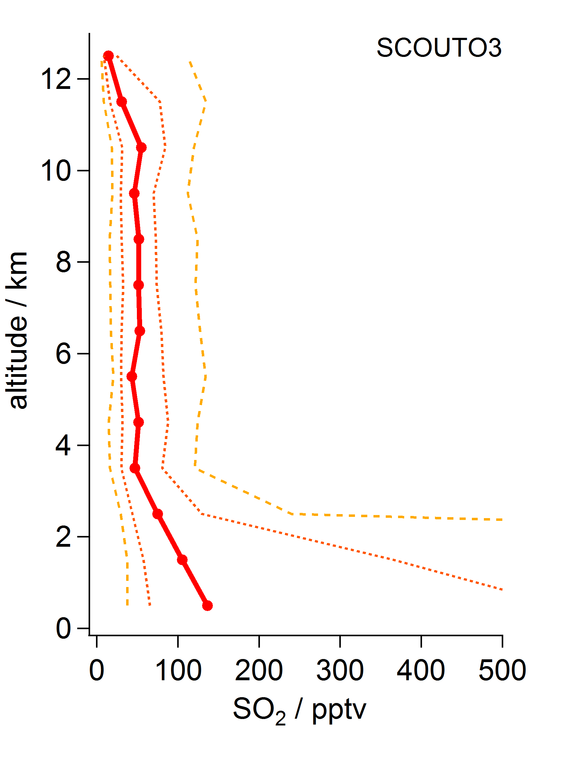
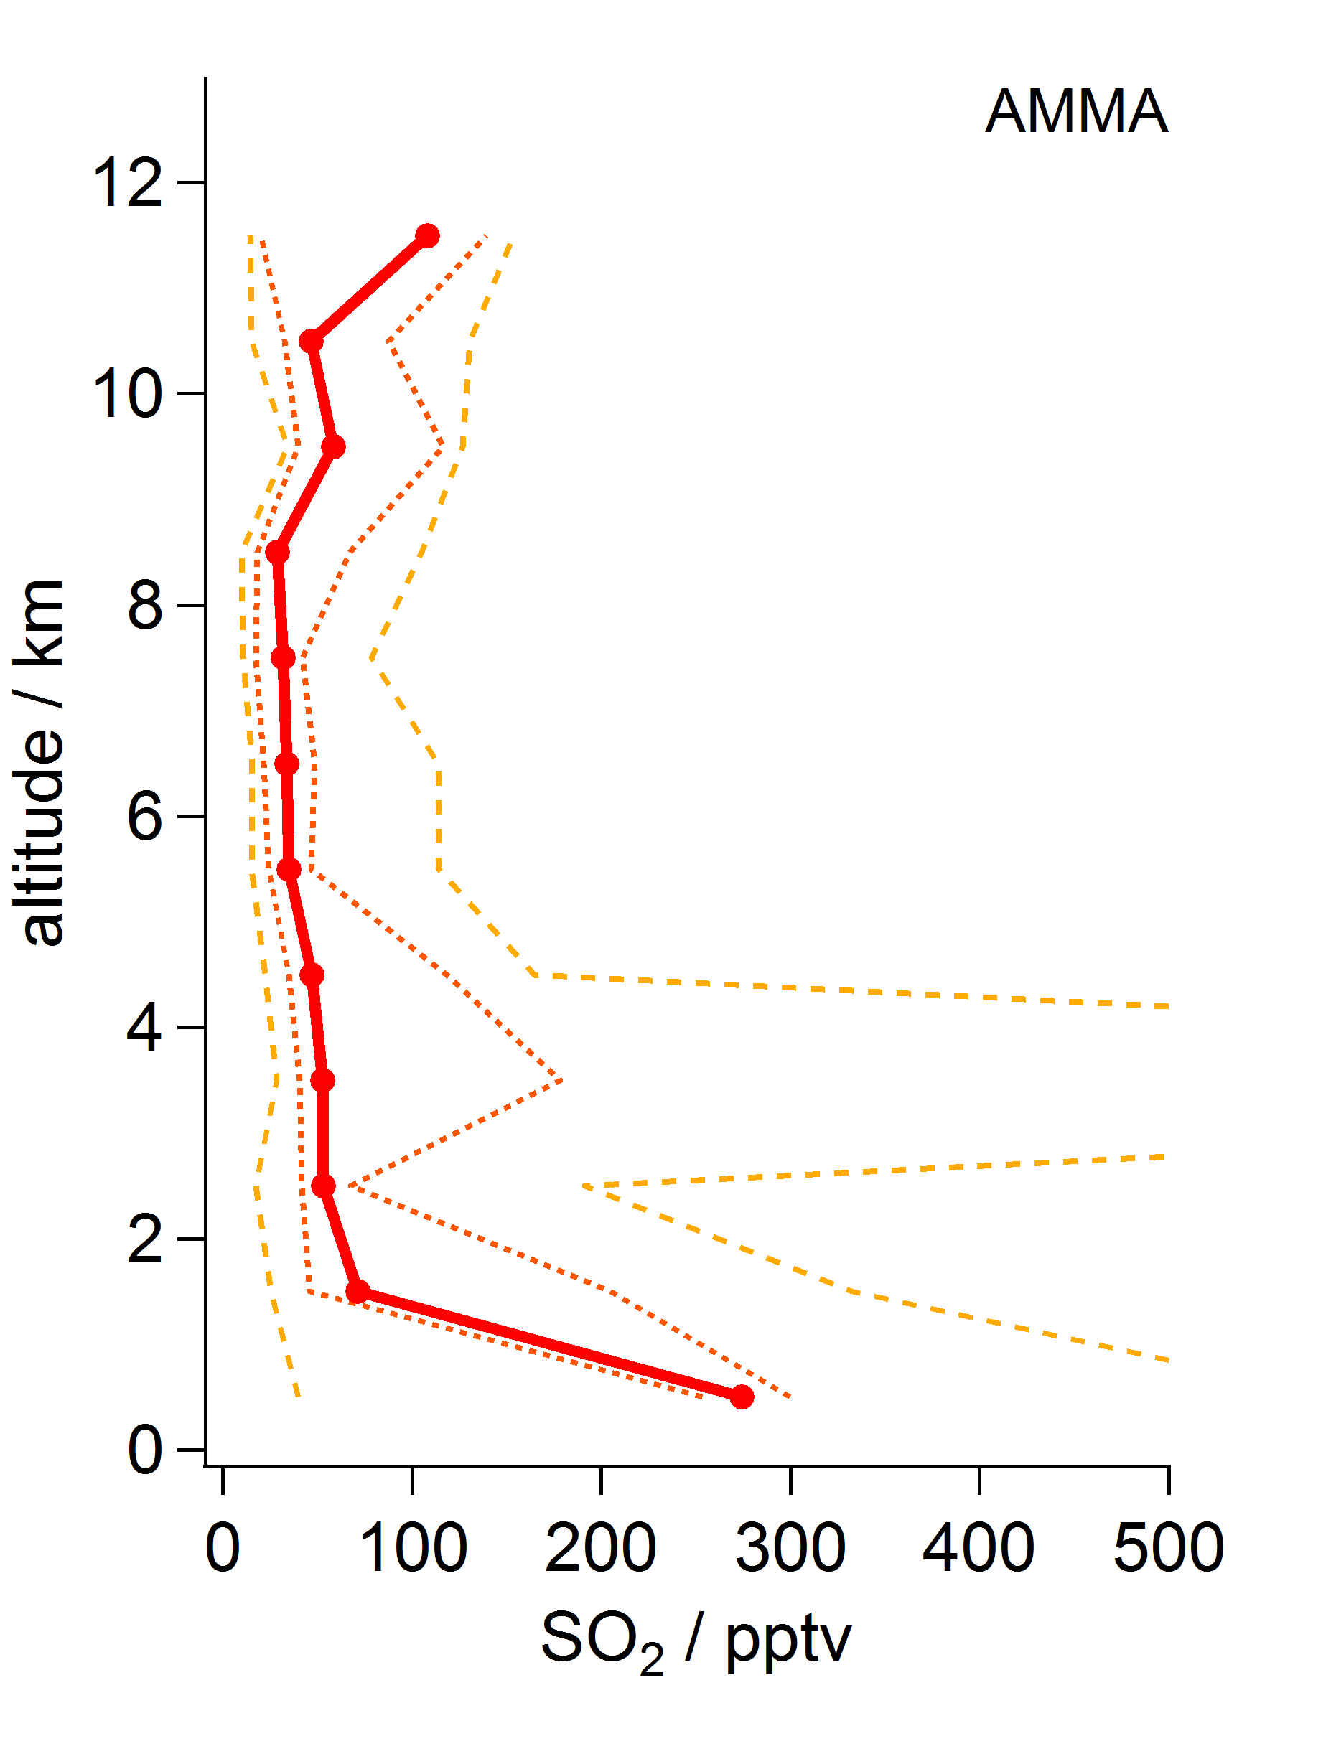
In-situ SO₂ vertical profiles: tropics
TROCCINOX
Brasil, Feb-Mar 2005
SCOUT
N Australia, Nov-Dec 2005
AMMA
West Africa, July 2006
copper smelters &
deg. volcanoes*
* ~4000 kT/y, Fioletov et al., 2013

Slide 6
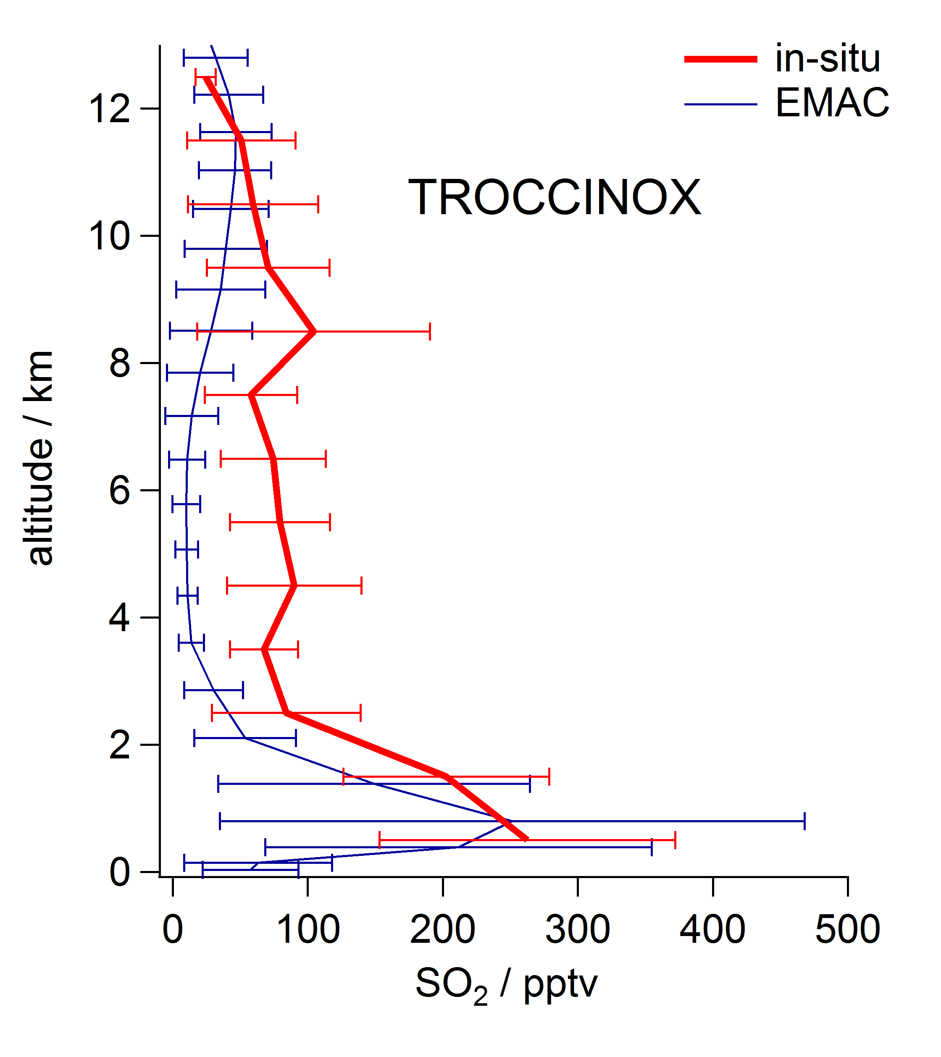
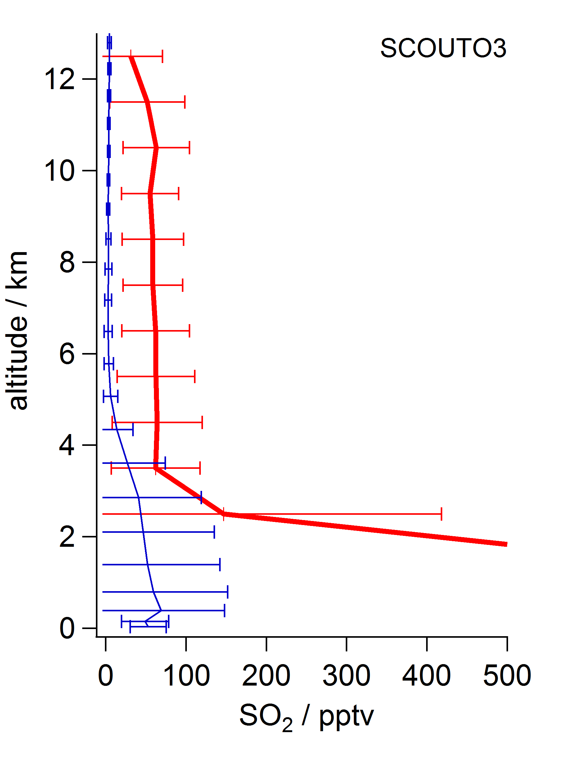
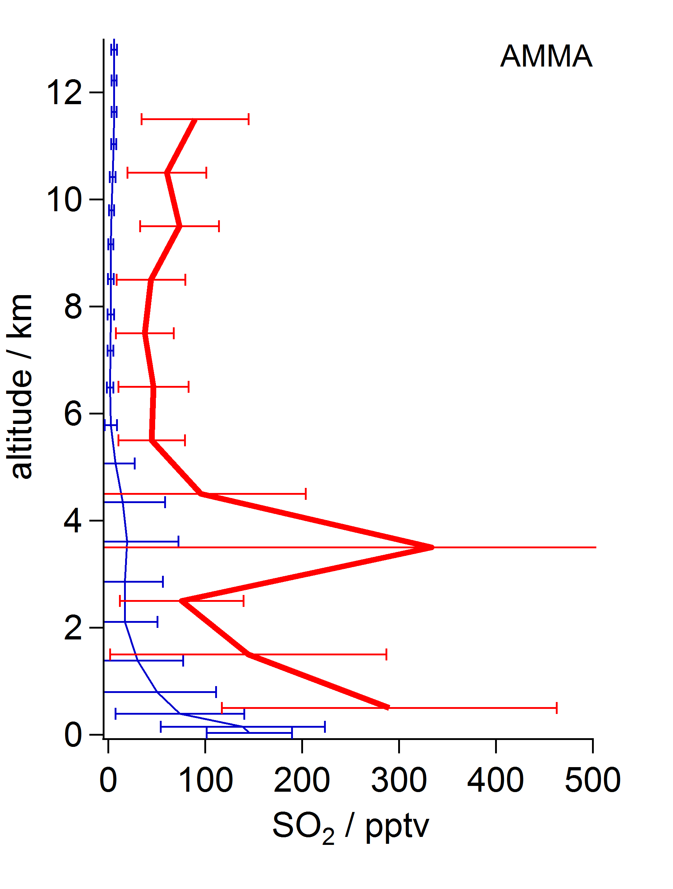
SO₂ vertical profiles: in-situ measurements & EMAC model
TROCCINOX
Brasil, Feb-Mar 2005
SCOUT
N Australia, Nov-Dec 2005
AMMA
West Africa, July 2006
EMAC: Jöckel et al., GMD, 2010

Slide 7
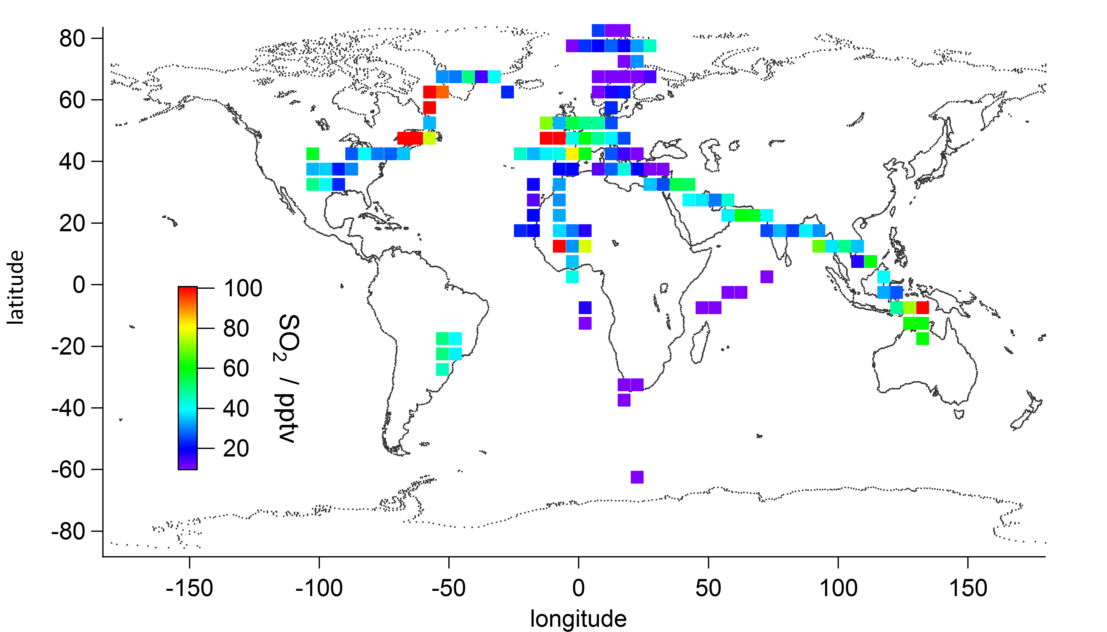
SO₂ distribution at altitudes between 8 – 12 km
5°x5° bins

Slide 8
SO₂ distribution at altitudes between 8 – 12 km
volcano „Kasatochi“
(Jurkat et al., 2010)
+
Asian emissions
(Fiedler, 2008)
5°x5° bins
Canadian
biomass
burning
Indonesian
biomass burning
MCS outflow
(Fiedler, 2008)

Slide 9
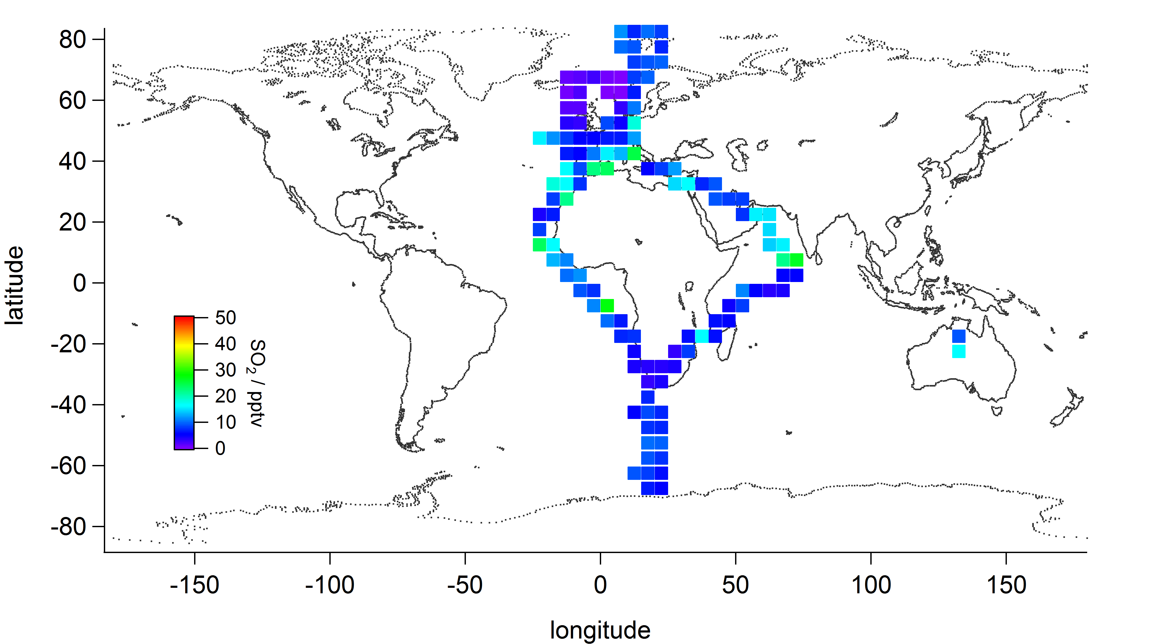
SO₂ distribution at altitudes between 12 – 15km
5°x5° bins
SO₂ typically ~10-30 pptv
→ In good agreement with
MIPAS observations
(Höpfner et al., ACPD, 2013)
Asian Monsoon outflow
in Tropical Easterly Jet
Asian Monsoon outflow
in Tropical Easterly Jet

Slide 10
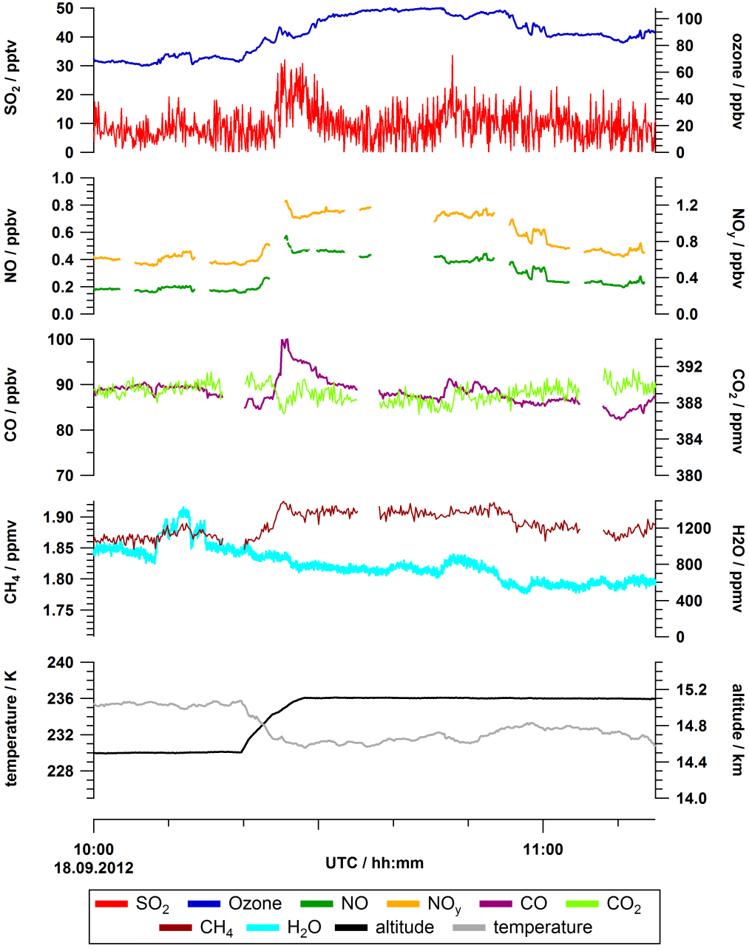
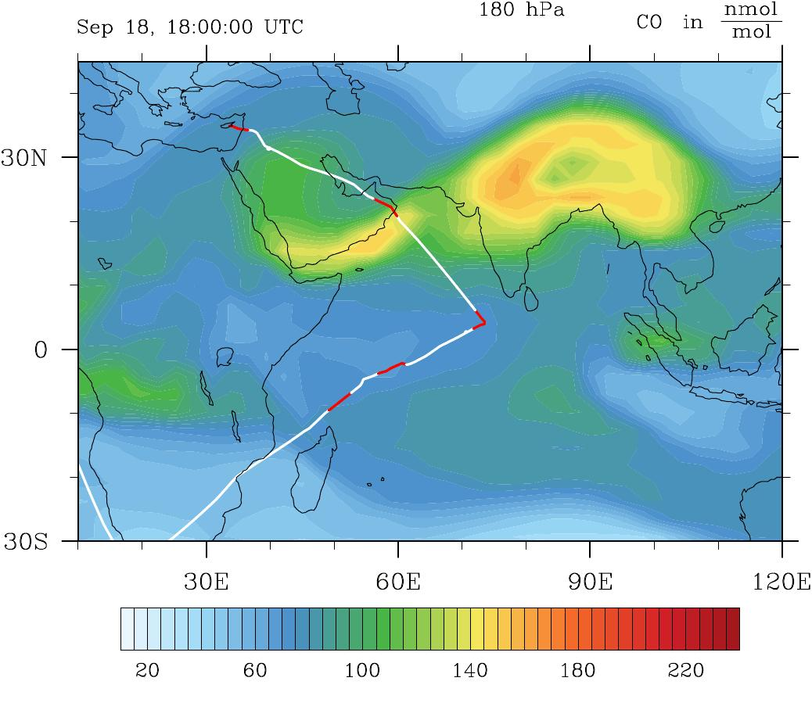
SO₂ in-situ observations in Asian Monsoon outflow
O3
EMAC analysis
SO₂
CO

Slide 11
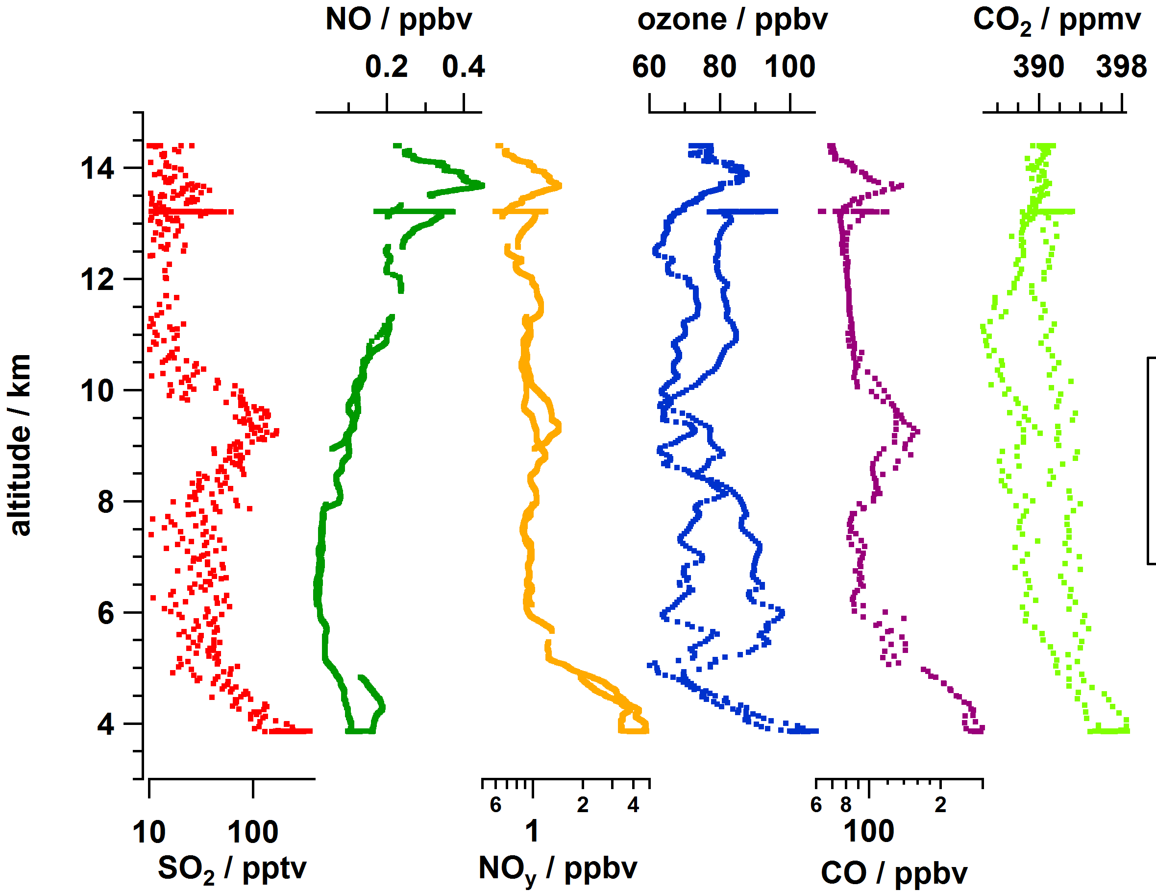
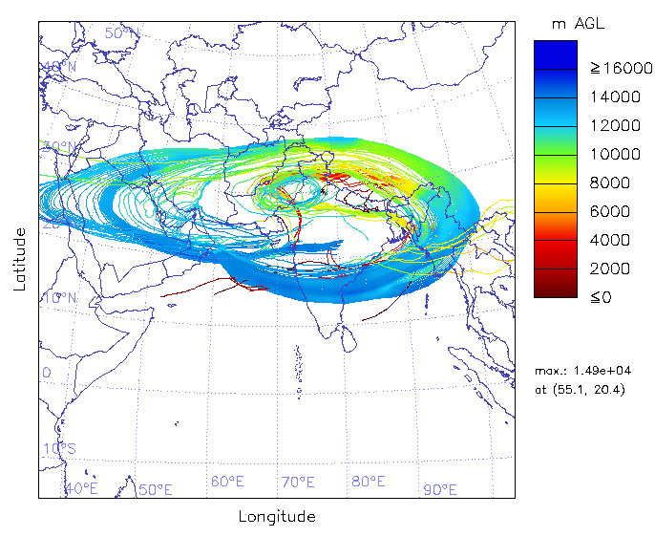
SO₂ in-situ observations in Asian Monsoon outflow
ESMVal flight 18 Sep 2012: Male – Larnaca
Hysplit backward trajectories

Slide 12
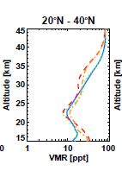
Outlook: Future SO₂ measurements
SO₂ measurements onboard HALO
(ACCRIDON, OMO – Asia)
SO₂ measurements onboard Geophysica M55
(StratoCLIM, summer 2015/2016)
→ Expected SO₂ mixing ratios: ~10-15 pptv
→ CIMS instrument to be integrated in MIPAS dome
Höpfner et al., ACPD, 2013

Slide 13
Outlook: Future SO₂ measurements onboard Geophysica
Challenges
low detection limit needed (to be improved by a factor of 2 – 5)
→ zero baseline determination important
low pressure, automatization
Achievements
First detailed in-situ SO₂ measurements above 15km
(between 15 - 20km only one single observation reporting SO₂ estimates)
Horizontal and vertical variability of SO₂ → indications of fresh injections?
In combination with simultaneous H₂SO₄ measurements estimates of OH
possible

