Slide 1
Gas-phase sulfuric acid in the stratosphere: measurement technique, previous and future observations Hans Schlager¹ & Frank Arnold^{1,2} ¹DLR-Institut für Physik der Atmosphäre Oberpfaffenhofen ²Max-Planck-Institut für Kernphysik, Heidelberg
SSiRC Workshop
28-30 Oct 2013
Atlanta, GA, USA

Slide 2
Background
Gasphase H₂SO₄ is an important compound of the stratospheric sulfur budget, however, data is sparse
Main H₂SO₄ sources gases are COS and SO₂
H₂SO₄ abundance in the stratosphere is variable mainly due to seasonal temperature changes and variable SO₂ input from volcanic eruptions
In-situ measurements of H₂SO₄ in the stratosphere are difficult to perform due low mixing ratios (sub-pptv) and sampling issues.
No in-situ H₂SO₄ data collected since late 80s.

Slide 3
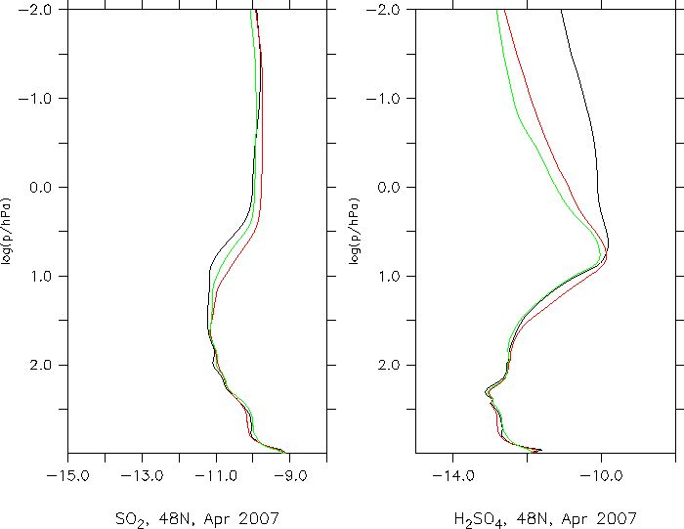
H₂SO₄ Profile (volcanic quiescent period)
km
Main controlling factors of
gasphase H₂SO₄
70
stronger
H₂SO₄
photolysis
60
H₂SO₄ production by COS photolysis
and reaction with O(³P) and loss by
photolysis and heterogeneous
removal due to meteor smoke
50
Log(p/hPa)
removal
by meteor
smoke
40
30
Equilibrium saturation pressure of
H₂SO₄ vapor over H₂SO₄ – H₂O
aerosol solution droplets
20
Photochemical H₂SO₄ production by
COS and SO₂ oxidation initiated by
reaction with OH and heterogeneous
removal
10
-14 -12 -10 -8
VMR (48°N, Apr 2007)
(H₂SO₄ profiles: Christoph Brühl, MPI Mainz)

Slide 4
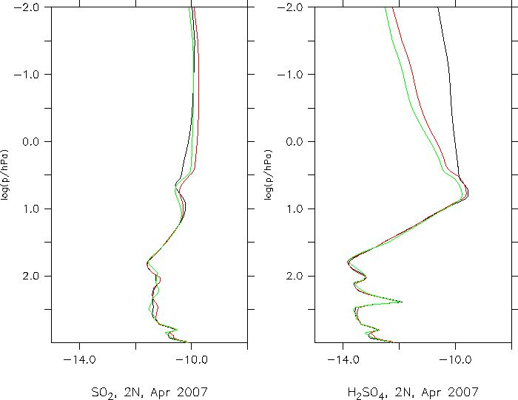
H₂SO₄ Profiles (mid-latitudes and tropics)
km
70
60
50
Lower VMR
due to lower
temperatues
Log(p/hPa)
40
30
20
10
-14 -12 -10 -8
-14 -12 -10 -8
VMR (48°N, Apr 2007)
VMR (2°N, Apr 2007)
(Courtesy: Christoph Brühl, MPI Mainz)

Slide 5
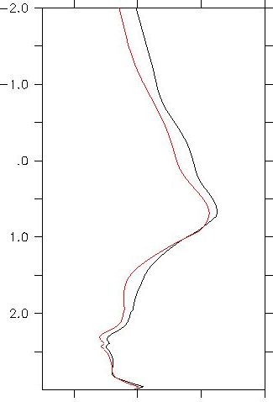
H₂SO₄ Profiles (volcanic quiescent & unrest periods)
km
70
60
50
Log(p/hPa)
40
30
20
10
-14 -12 -10 -8
-14 -12 -10 -8
VMR (48°N, Apr 2007)
VMR (48°N, Apr 1992/93)
(Courtesy: Christoph Brühl, MPI Mainz)

Slide 6
In-situ H₂SO₄ Measurement Technique: Active and Passive CIMS
CIMS reaction:
NO₃⁻(HNO₃)_{h}(H₂O)_{n} + H₂SO₄ -> HSO₄⁻(HNO₃)_{l}(H₂O)_{m}
+ (h-l+1) HNO₃ + (n-m) H₂O
[H₂SO₄] = (1/ k t_{r} ) ln(1-R), R= HSO₄⁻/NO₃⁻ cluster ions
ACIMS: NO₃⁻ ions produced by an ion source
PACIMS: NO₃⁻ produced in ambient air by cosmic rays
k(h=0-2) measured by Viggiano et al (1997): 2.3 – 1.7
x 10⁻⁹ cm³/s
tr: drift time in reaction cell (ACIMS) or
ion-ion recombination lifetime (PACIMS)

Slide 7
H₂SO₄ CIMS measurements:
PBL (ACIMS): Eisele & Tanner (1993), Berresheim et al. (2000), Fiedler et al. (2005), Petäjä et al. (2009), Aufmhoff et al. (2010), Zheng et al. (2011)
TP layer (PACIMS) Möhler & Arnold (1992)
STR (PACIMS): Arnold & Fabian (1980), Arnold & Bührke 1983), Viggiano et al. (1983), Schlager et al. (1987)

Slide 8
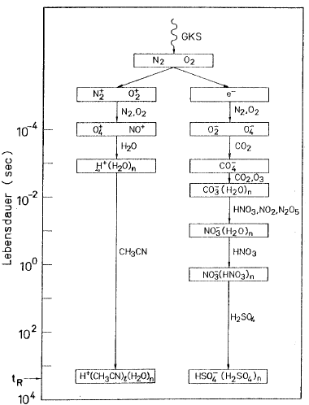
Passive CIMS: Negative Ion Chemistry
Life time / s

Slide 9
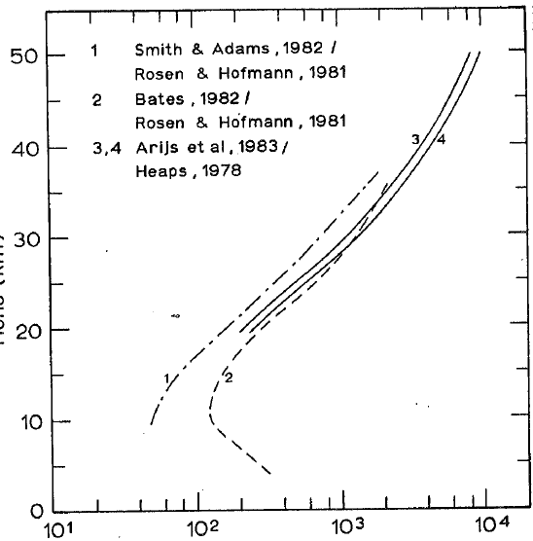
Passive CIMS: Ion-Ion-Recombination Lifetime
Altitude / km
from ion density
measurements
and calculated
recommbination
coefficients
Lifetime / s

Slide 10
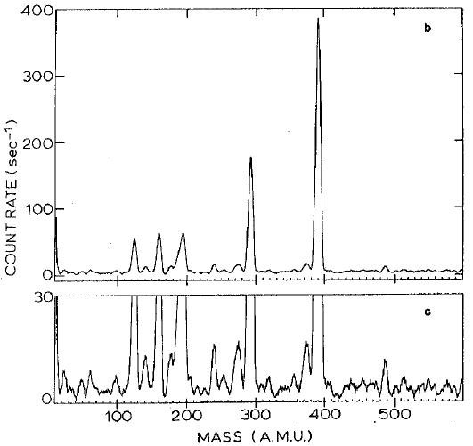
Passive CIMS: Negative Ion Mass Spectrum
HSO₄⁻⁽H₂SO₄)₃
HSO₄⁻⁽H₂SO₄)₂
HSO₄⁻⁽H₂SO₄)
NO₃⁻⁽HNO₃)
HSO₄⁻⁽H₂SO₄)₄

Slide 11
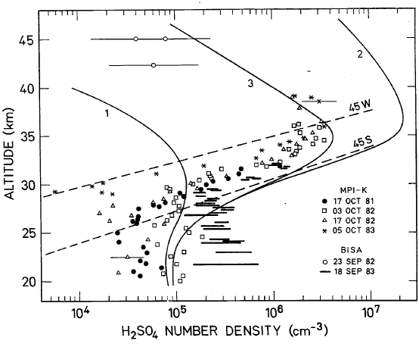
Passive CIMS: Measured H₂SO₄ Profiles
re-evaporation,
photolysis,
re-evaporation,
photolysis,
removal by
Meteor smoke
no re-evaporation
no photolysis
B
M
M
B
(Schlager et al., 1987)

Slide 12
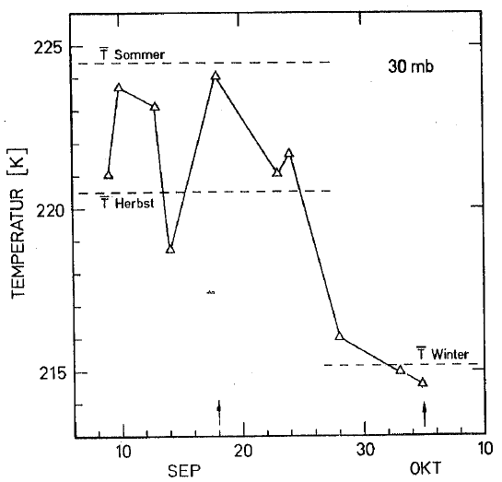
Temperatures 30 hPa (Radiosonde data)
B
M

Slide 13
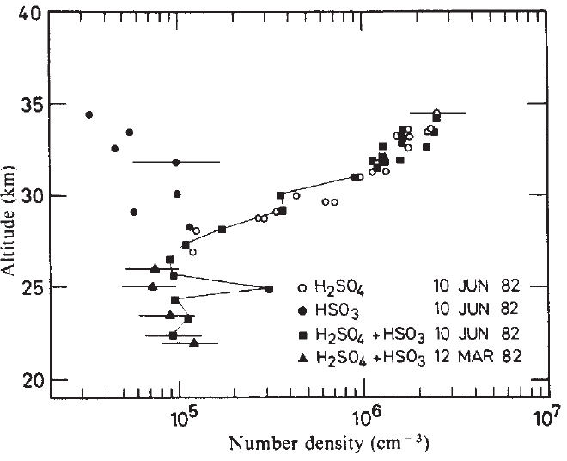
Signature of El Chichon Eruption
(Arnold & Bührke, Nature 1983)

Slide 14
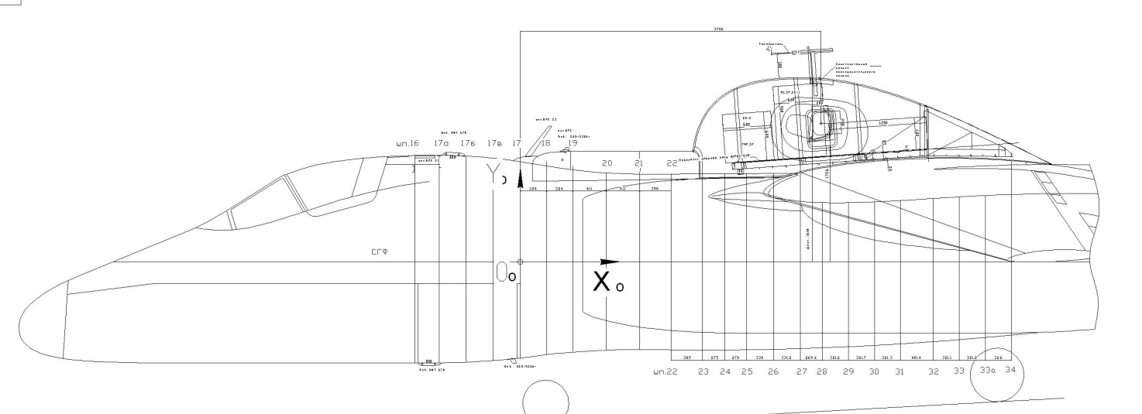
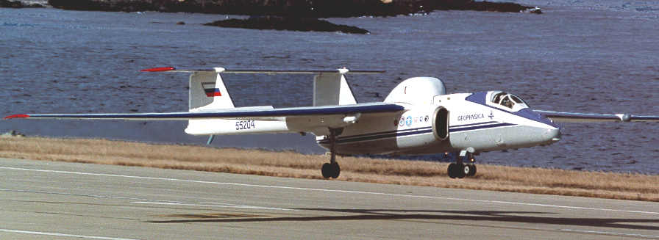
StratoClim: H₂SO₄ measurements on board the Geophysica
Tentative schedule:
Test campaign 2015
South-East Asia campaign 2016

Slide 15
Challenges of H₂SO₄ measurements on board Geophysica
To achieve a detection limit of 10 ppqv (use of LNe cryopump)
To calibration H₂SO₄ wall losses in the instrument sampling line
To avoid aerosol evaporation in the sampling line
To prepare automatic operation and in-flight calibration
StratoClim measurements will provide first H₂SO₄ data in
the stratosphere since more than 25 years!

