Slide 1
Transport of aerosols into the UTLS and their impact on the Asian monsoon region as seen in a global model simulation
S. Fadnavis, K. Semeniuk, L. Pozzoli, M. G. Schultz, S. D. Ghude, S. Das
ACP, 2013

Slide 2
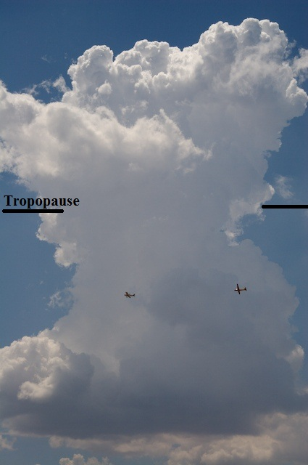

Transport of boundary layer pollutants into the UTLS region via monsoon convection
SO2
The Asian Summer monsoon is one of the most powerful atmospheric circulation system.
Deep monsoon circulation provides an entry of tropospheric polluted air into the stratosphere.
Motivation:
India is experiencing decreasing trend in monsoon precipitation.
To understand effects of increase in aerosols , its transport into UTLS and feedback on ASM precipitation
H2O
PAN
OC
CH4
HCN
BC
CO
CO2
NOX
Emission: Biomass burning, fossil fuel, industrial, urban, agricultural
CO2, CO, VOCs, BC, SO2,NOX ……..

Slide 3
ECHAM5-HAMMOZ : Aerosol-chemistry-climate model
Resolution: 2.8 x 2.8 degrees in the horizontal and 31 vertical hybrid σ-p levels from the surface up to 10 hPa.
Simulations : An eight member ensemble runs for Asian summer season (June-September) starting from initial conditions of 24–31 March 2003.
Sets of Experiments (1) Control run (2) Simulations without aerosol mixing ratios on-line calculations (NOAER).
The NOAER simulation includes the standard ECHAM5 cloud scheme (Roeckner et al., 2003).
Emissions: Surface CO, NO_{x} and hydrocarbon from anthropogenic and biomass burning →RETRO 2000; the anthropogenic and fire aerosol emissions →AEROCOM; Stratospheric NO_{x}, HNO₃, and CO → MOZART -3

Slide 4
Satellite observations
Aerosol extinction
SAGE II at 0.525 μm wavelength
(2) HALOE at 5.26 μm wavelength

Slide 5
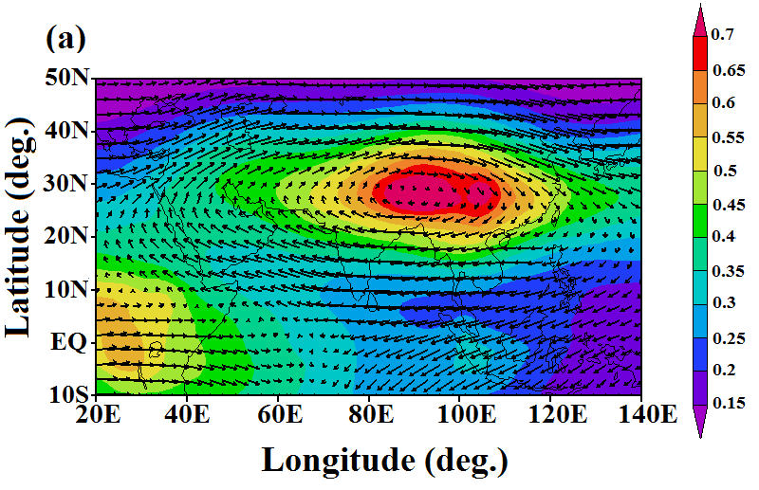
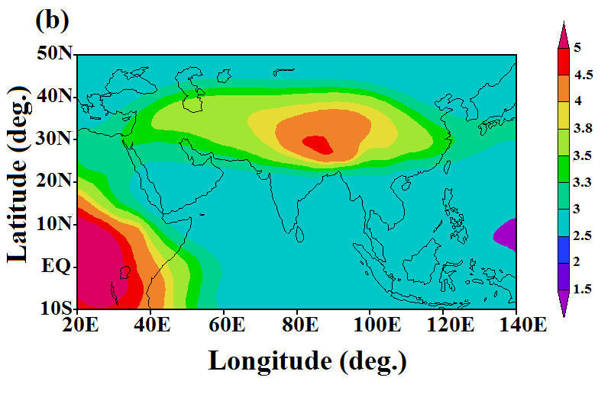
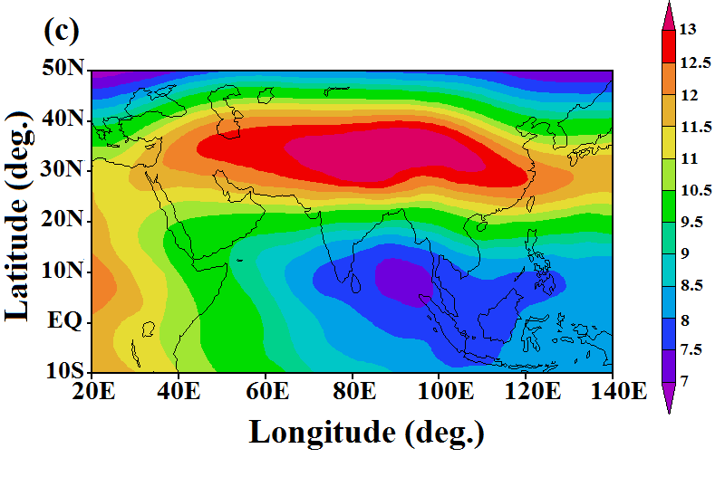
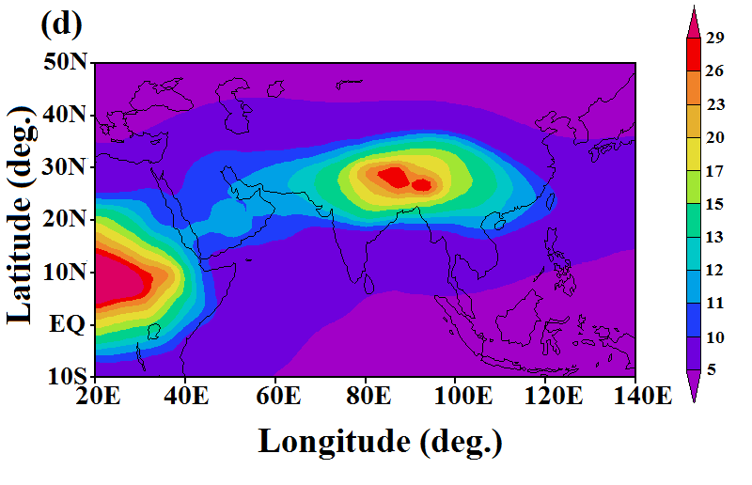
Distribution of Aerosols in the UTLS
Maximum within anticyclone
ngm⁻³
BC
OC
Sulfate
Dust

Slide 6
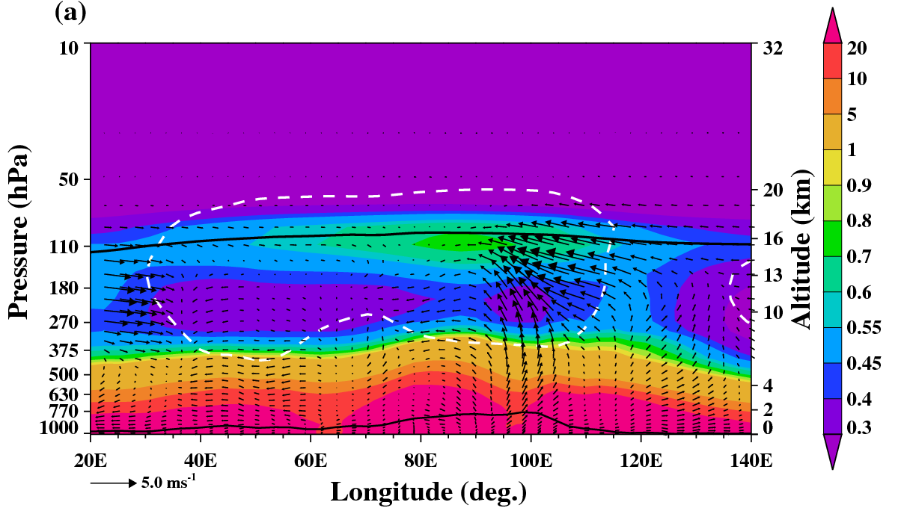
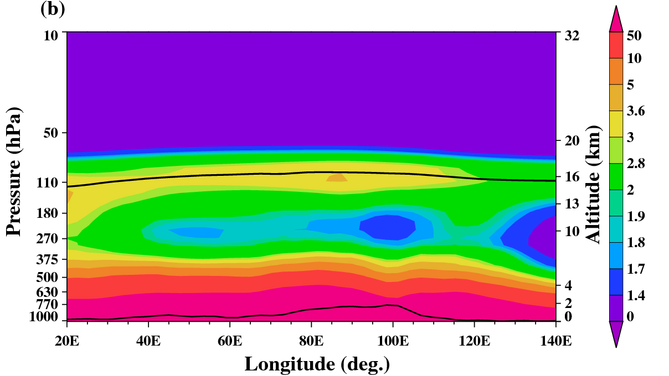
Vertical transport into the UTLS
BC
Ave: 15–35N
The eastern end of the anticyclone (around 85 E)
OC
Ave: 15–35N
South China Sea around 120E

Slide 7
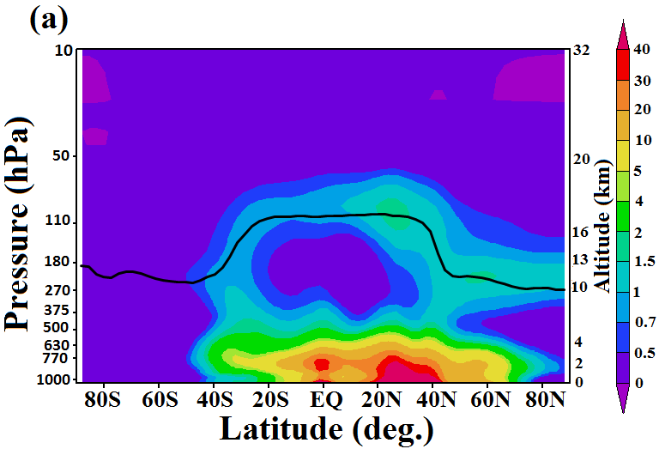
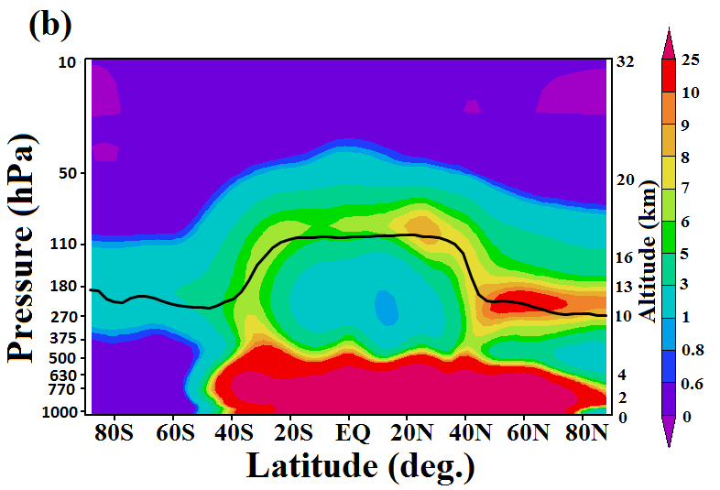
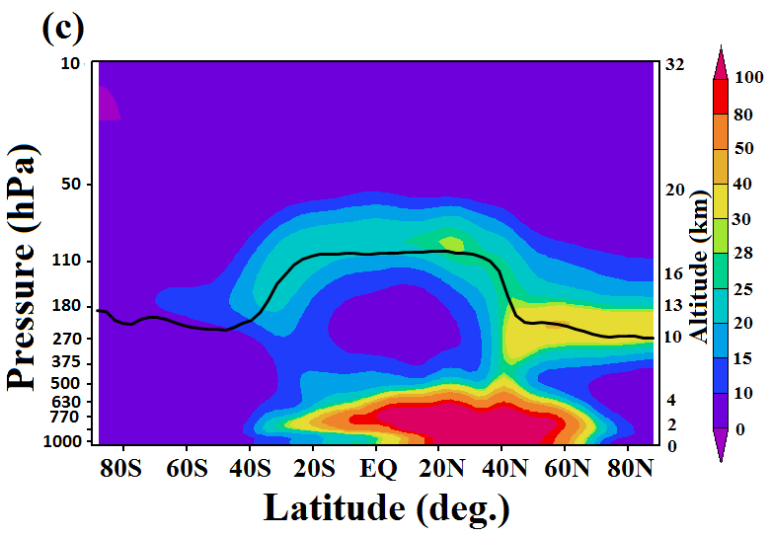
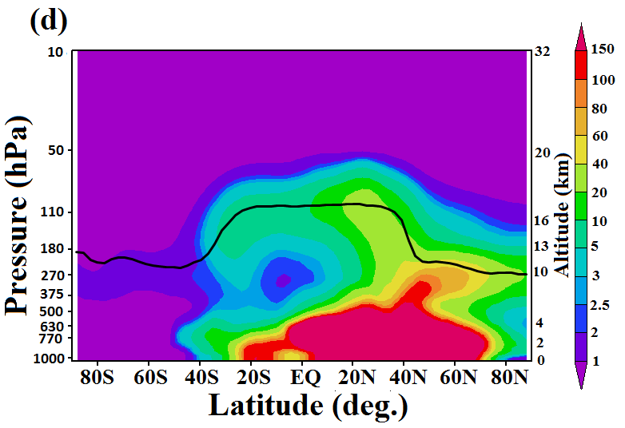
Vertical transport into the UTLS
BC
(avg:60-120E)
OC
SO₄²⁻
Dust

Slide 8
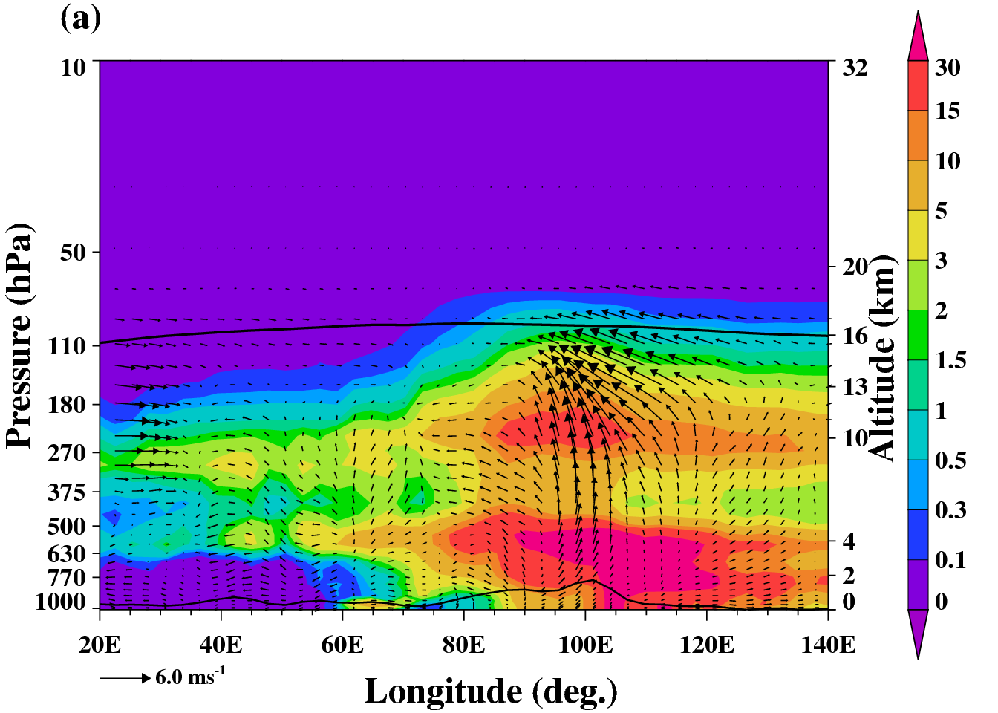
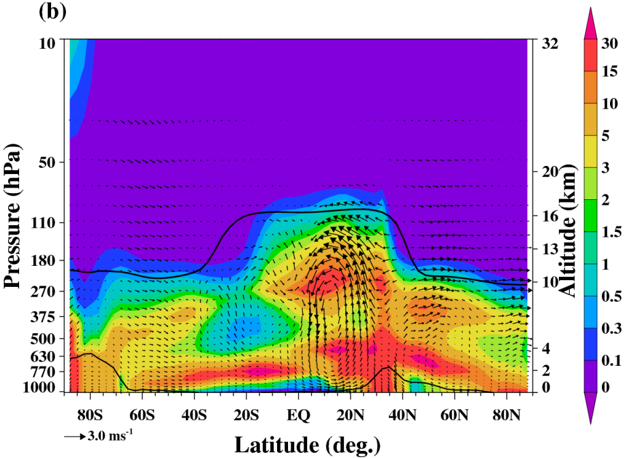
Distribution of CDNC and ICNC
mg⁻¹
mg⁻¹
(avg: 15-35N)
(avg:60-120E)
Transport due to deep convection from the southern flank of Himalayas (15-30N, ~100 E)

Slide 9
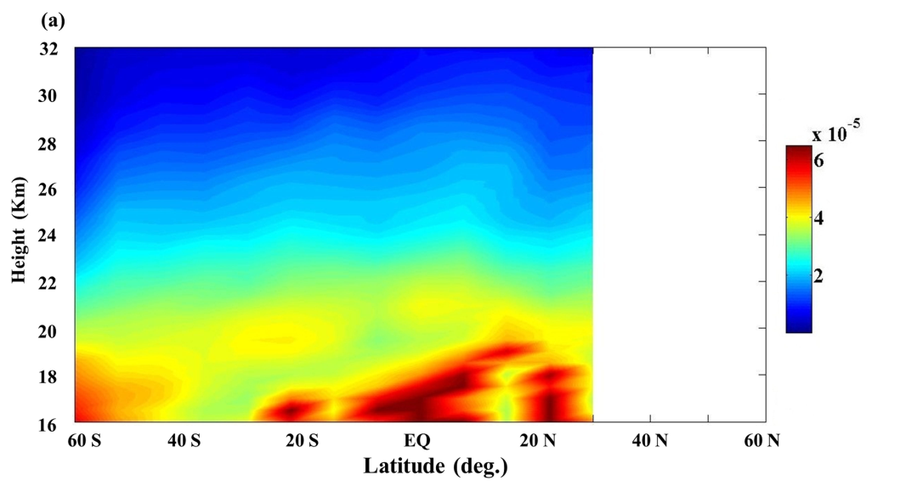
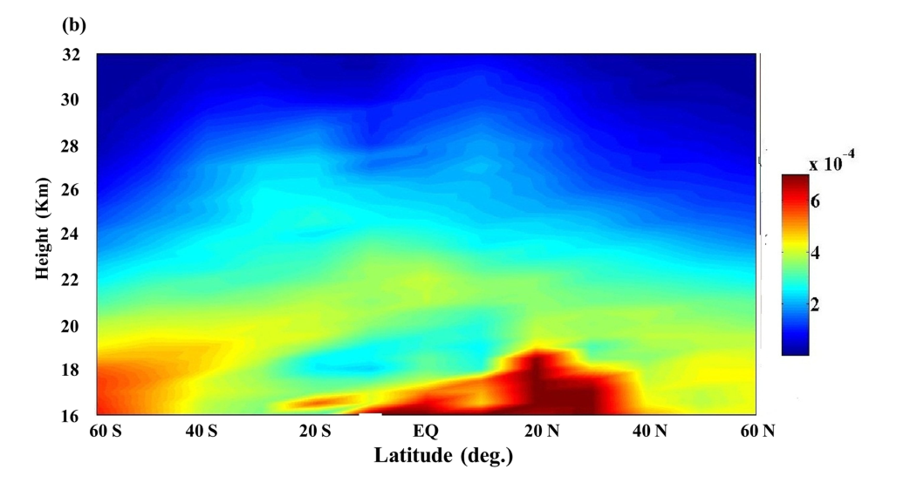
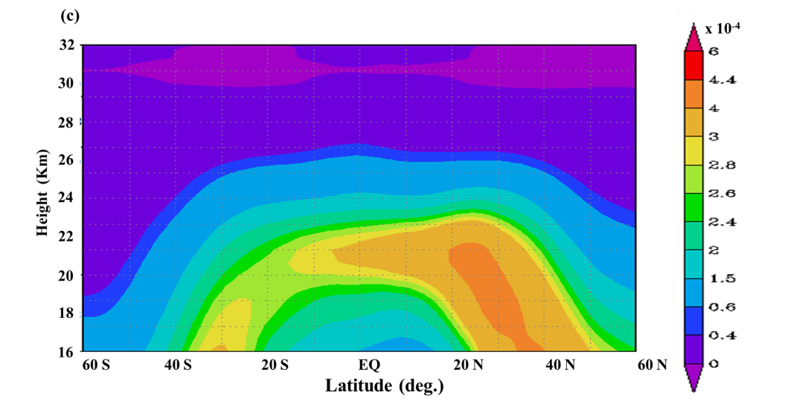
Aerosol Extinction from HAOE, SAGE II and ECHAM5-HAMMOZ
HALOE (5.26 μm)
(avg:60-120E)
SAGEII (0.525 μm)
ECHAM5-HAMMOZ (0.550 μm)
Aerosol arch feature is observed in HALOE and SAGE II satellite data. ECHAM5-HAMMOZ simulations also show this feature indicating transport of aerosols by Brewer Dobson circulation.

Slide 10
Correlation between aerosol fields in the UTLS and OLR
A 10–20 day periodicity in convection is evident in the aerosols.
Time series of BC, OC, and Sulfate aerosols mixing ratio show statistically significant (at 95% confidence level) anti-correlation greater than 0.5 with OLR, indicating aerosols vary coherently with OLR.

Slide 11
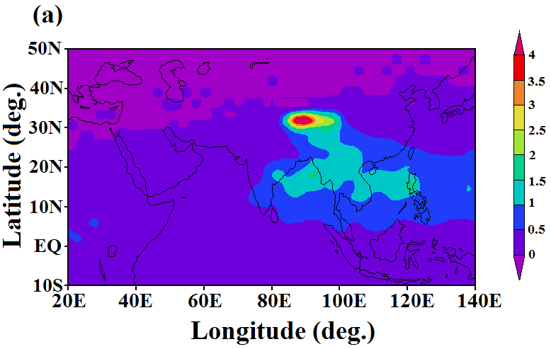
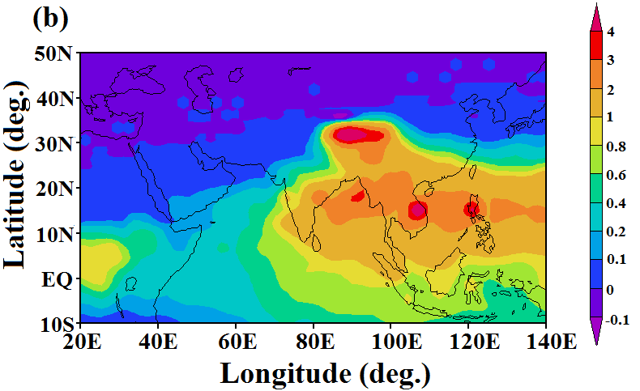
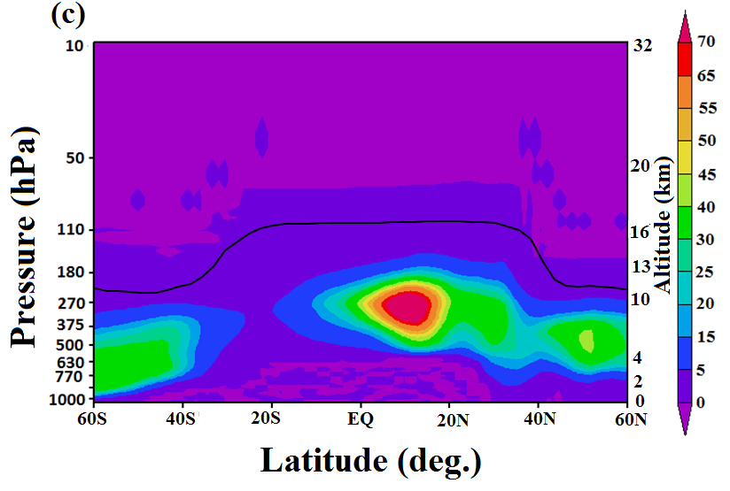
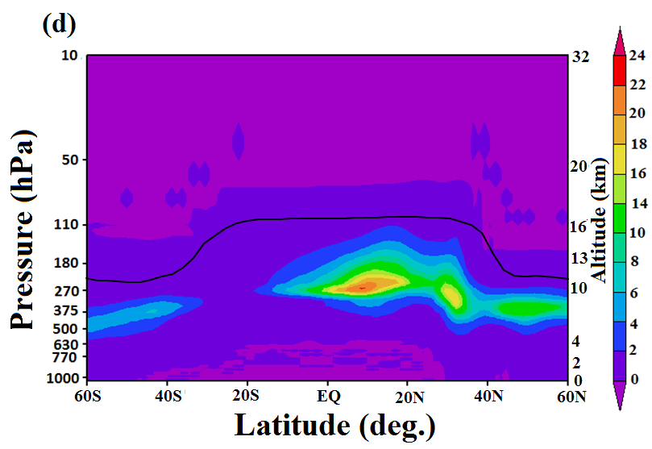
Distribution of cloud ice water and ice crystal number concentration in the UTLS
cloud ice water
(110 hPa)
ice crystal number concentration
decigramm⁻²
mg⁻¹
cloud ice water
ice crystal number concentration
Maxima in ICW and ICNC collocated with aerosol maxima indicate that transport of aerosol and water-vapour-rich air by deep convection may enhance high-level cloud ice formation in the Northern Hemisphere subtropics. Changes in cloud properties have an impact on the hydrological cycle and climate.

Slide 12
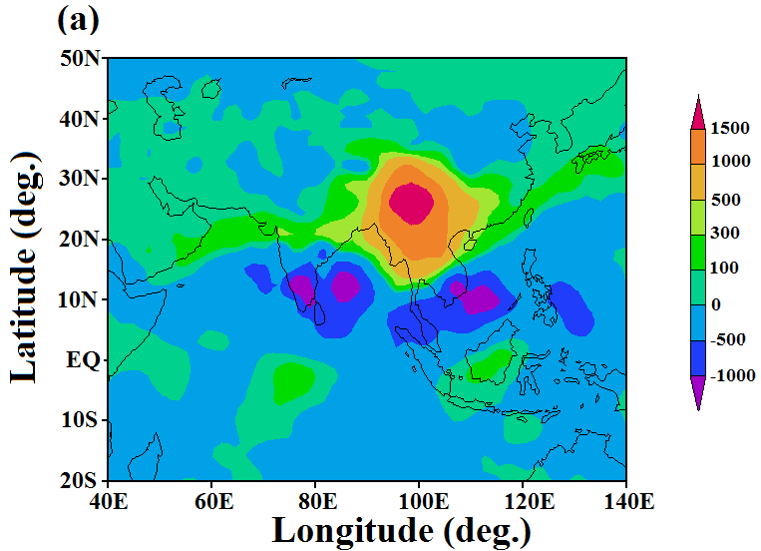
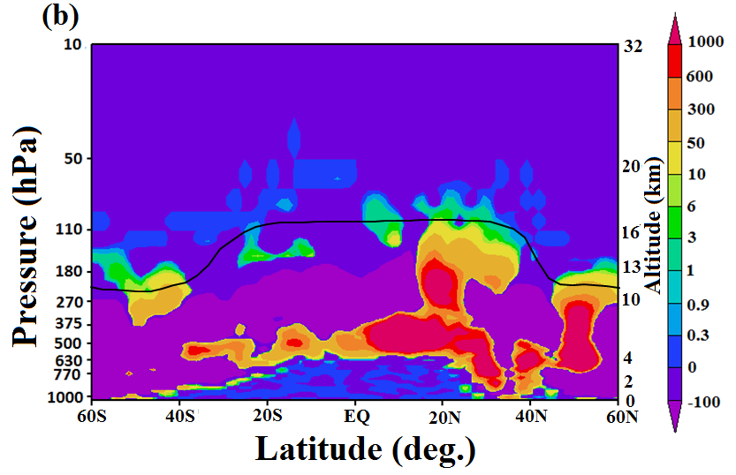
Aerosol induced cloud ice
180hPa
(CTL-NOAER)
cloud ice
Figure (a) --> A prominent feature at the eastern end of the anticyclone region, where the cloud ice anomaly has a maximum (15 mgm−3).
Figure (b) --> Increase in cloud ice up to 10 μgm−3 near the tropical tropopause due to aerosol loading.

Slide 13
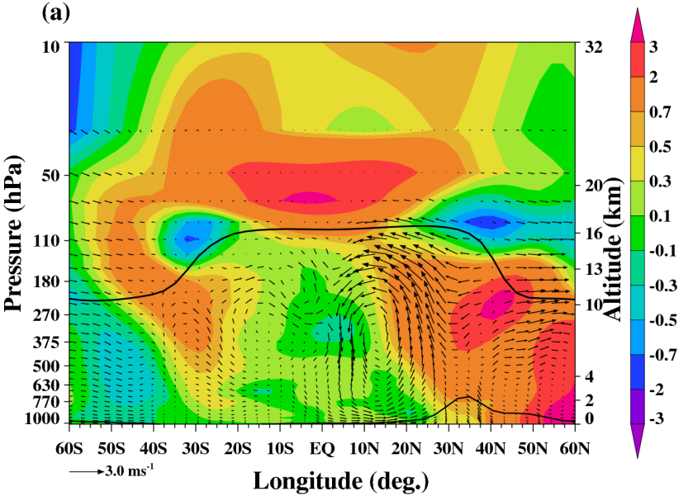
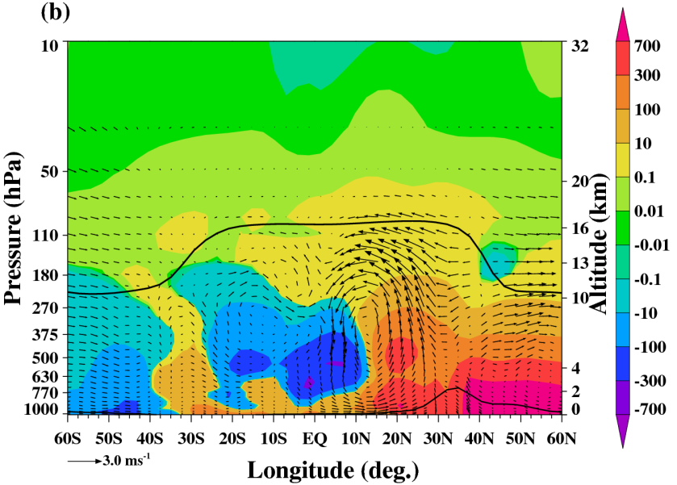
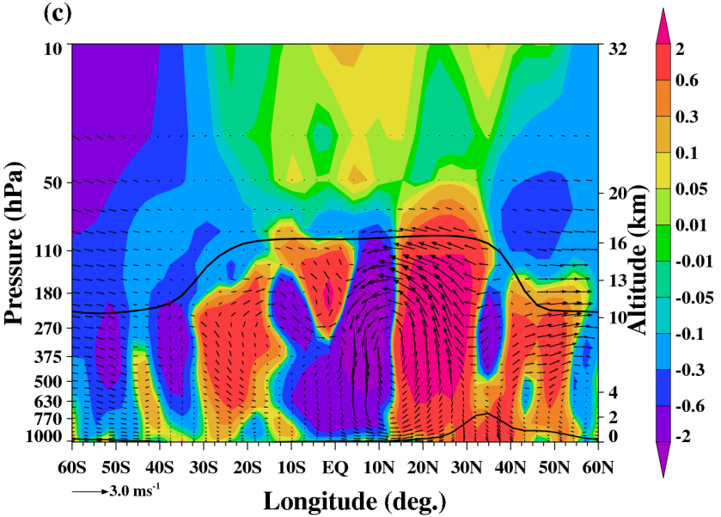
Impact of aerosols on temperature, water vapour, and circulation
Temperature
Water vapor
Circulation
Temperature increases by 1–5K near the tropical tropopause. Tibetan Plateau experiences a significant warming.
Increase in vertical transport over the southern flanks of the Himalayas.
A weakening of the Hadley circulation due to aerosol forcing.

Slide 14
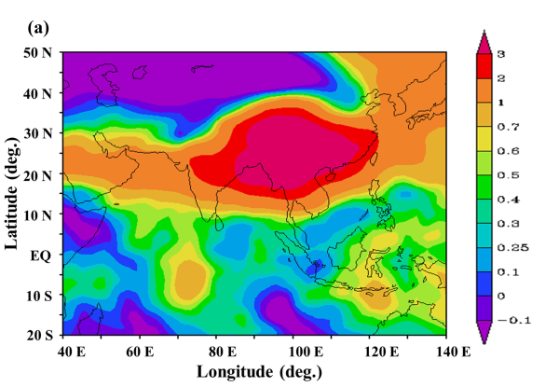
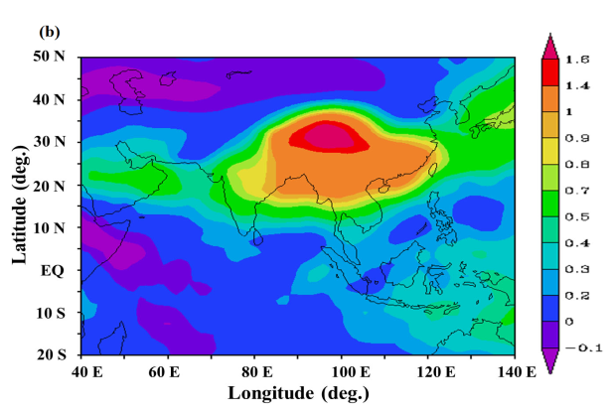
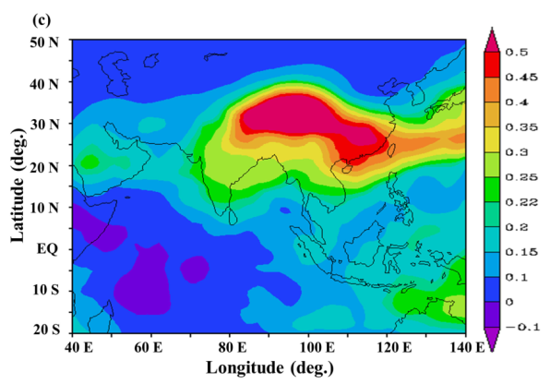
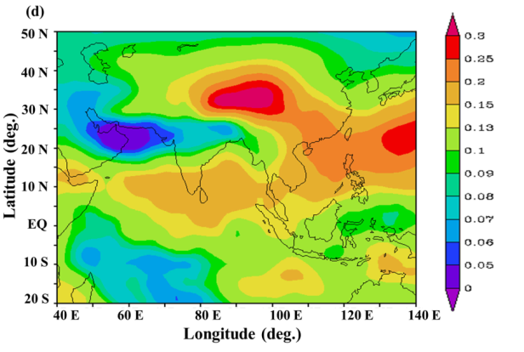
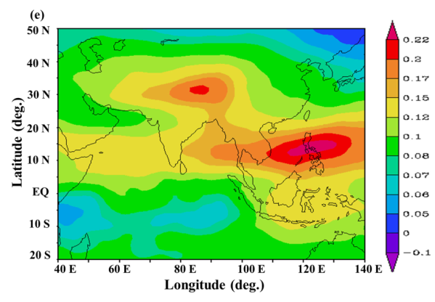
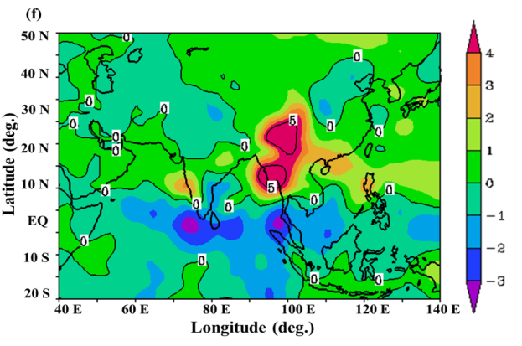
Aerosol induced changes in water vapor and precipitation
155 hPa,
132 hPa
Positive water vapour anomalies (0.2 – 3 ppmv) in the ASM anticyclone
Decrease in precipitation ~-1 to -3mm/day over southern India .
Positive precipitation anomalies (0–3 mm/day) over western India.
At the eastern end of anticyclone there is significant increase in precipitation ~ 5–7 mm/day.
110 hPa
90 hPa
70 hPa
Precipitation

Slide 15
Conclusions
Simulations show persistent maxima in BC, OC, sulfate and mineral dust aerosols within the anticyclone throughout the Asian summer monsoon.
The transport of aerosols into the TTL and the lower tropical stratosphere during ASM is observed in HALOE and SAGE II aerosol extinction.
Aerosols are transported across the equator, pole ward and downward in the Southern Hemisphere to 30 S.
Variations in all four types of aerosols in the anticyclone are closely related to deep convection.
Transport from Southern flank of Himalayas is the primary transport pathway into the UTLS.
However, the convective region from the Bay of Bengal to the South China Sea is also a source of UTLS aerosols.

Slide 16
Conclusions
Aerosol induces a significant increase in cross-tropopause transport between 15 and 35 N.
Aerosols induce a weakening of the Hadley circulation.
Aerosols induces increased vertical transports at Southern Flank of Himalayas, which reaches into the tropical lower stratosphere.
Intensification of a secondary thermally direct circulation associated with the southern flanks of the Himalayas (15 and 30 N and around 100 E).
Aerosols induces decrease in precipitation ~ -1 to -3mm/day over southern India and increase 0–3 mm/day over west coast of India.
At the eastern end of anticyclone there is significant increase in precipitation ~5–7mm/day.

Slide 17
Transport of PAN into UTLS due to ASM and North American Monsoon
Michelson Interferometer for Passive Atmospheric Sounding (MIPAS) : 2002-2011.
ECHAM5-HAMMOZ simulations: 1995-2004

Slide 18
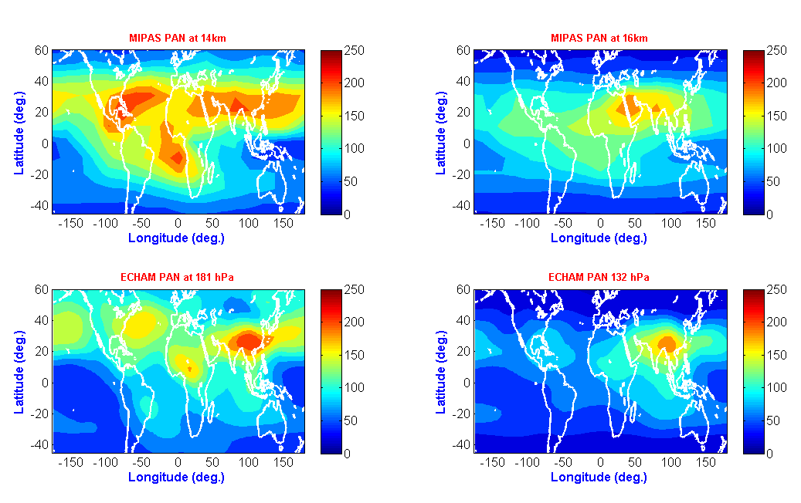
Distribution of Peroxyacetyl Nitrate (PAN) in the UTLS
JJAS:(2002-2011)
JJAS:(2002-2011)
JJAS:(1994-2004)
JJAS:(1994-2004)

Slide 19
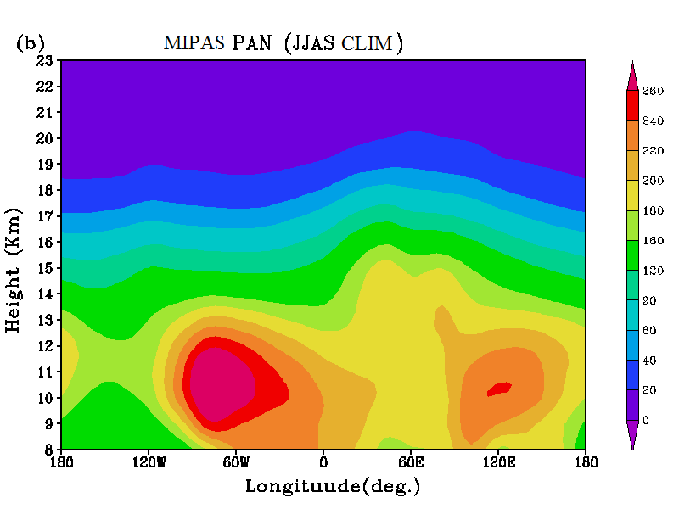
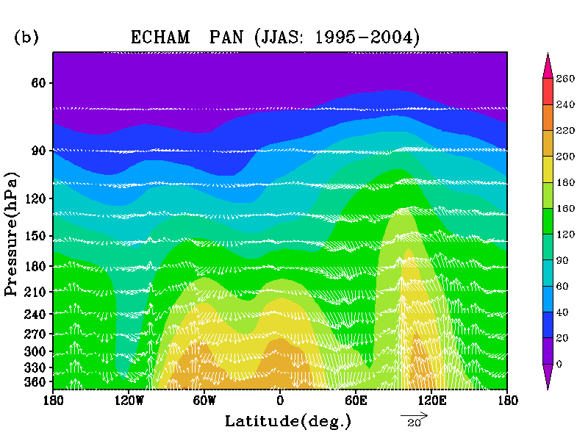
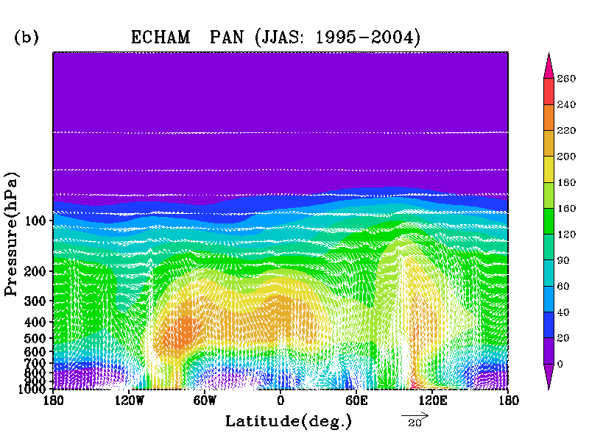
Transport of PAN over the ASM region
Avg:10-40N
Transport of PAN from Asian summer monsoon region and North America including Gulf of Mexico.

Slide 20
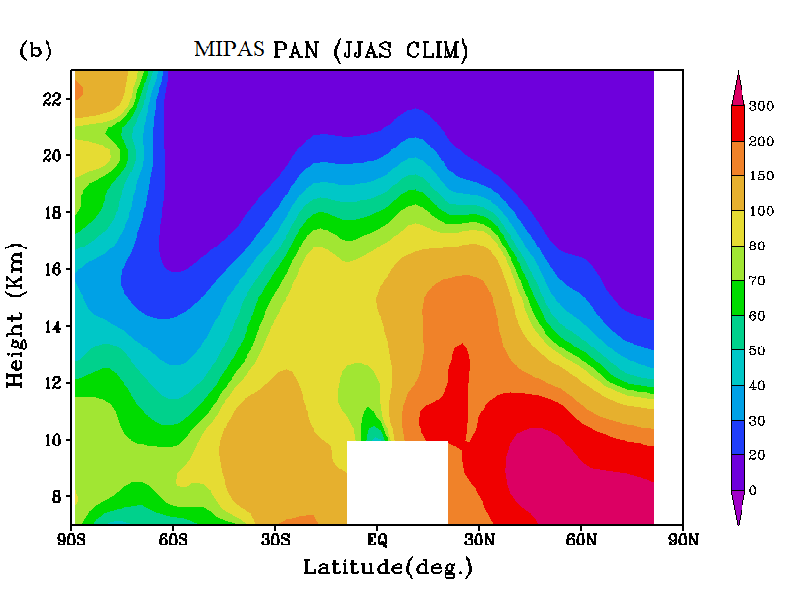
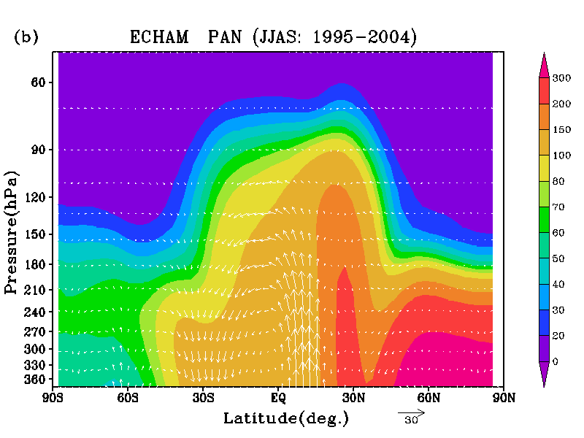
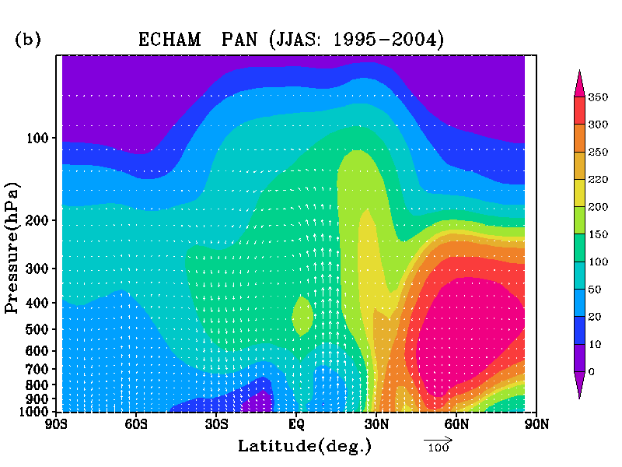
Transport of PAN over the ASM region
Avg:60-120E
Avg:60-120E
Cross tropopause transport from southern flank of Himalayas and Tibetan plateau is quite evident.

Slide 21
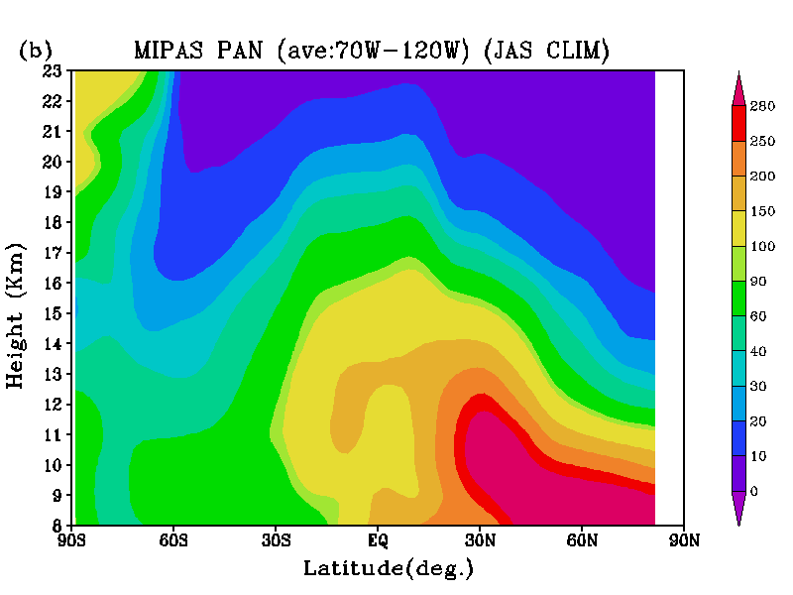
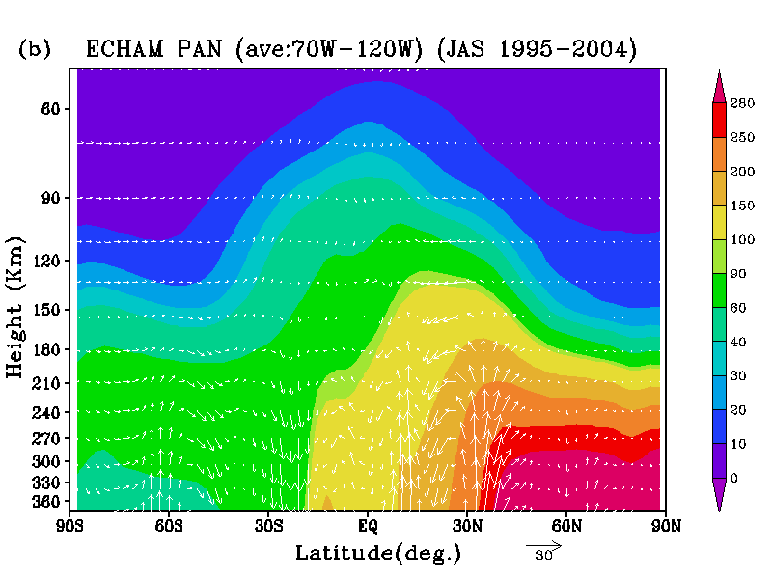
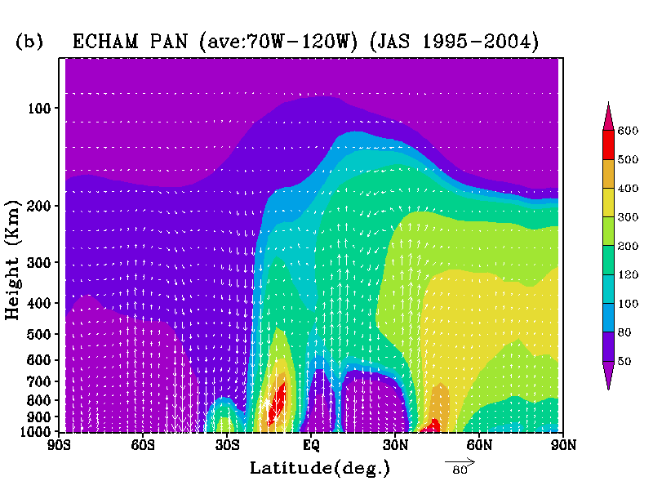
Transport of PAN over the America
MIPAS and ECHAM5-HAMMOZ simulations
Show transport of PAN in the lower stratosphere due to North American monsoon.
PAN from ~10N and 30N -45N is lofted up in the UTLS.

Slide 22
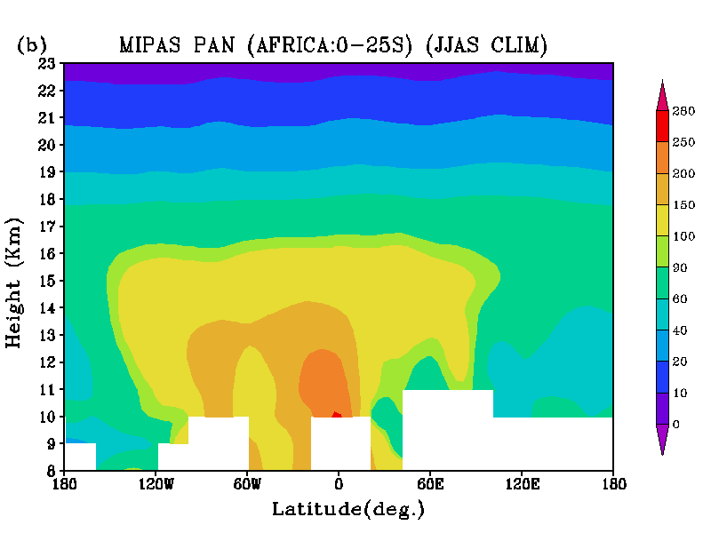
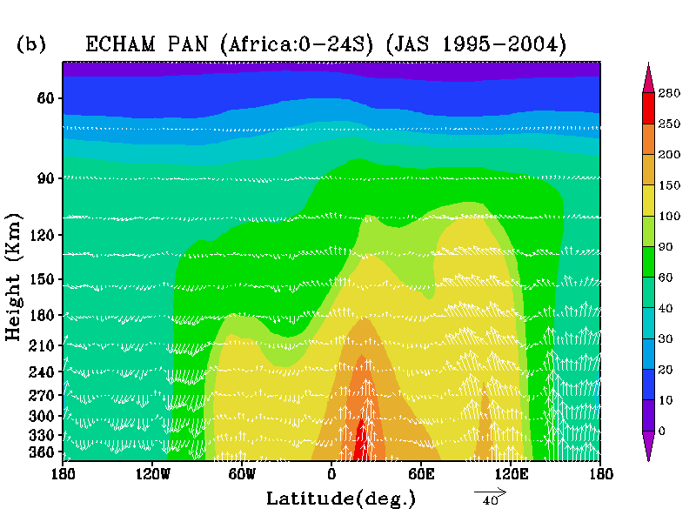
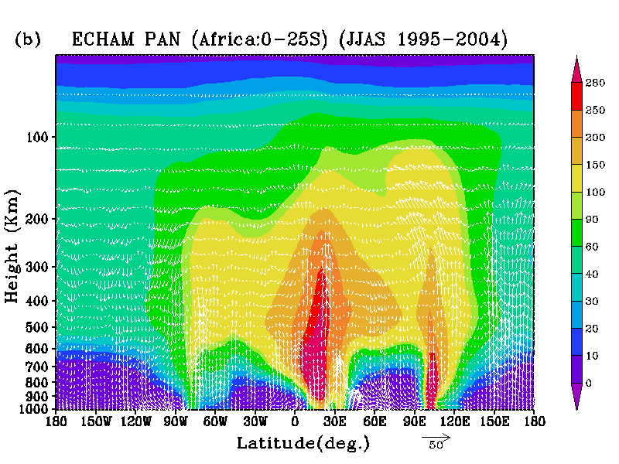
Transport of PAN over the Africa
MIPAS observations indicate elevated levels of PAN in the UTLS. ECHAM5-HAMMOZ simulations show transport from South Africa, Indianesia, Brazil .

Slide 23
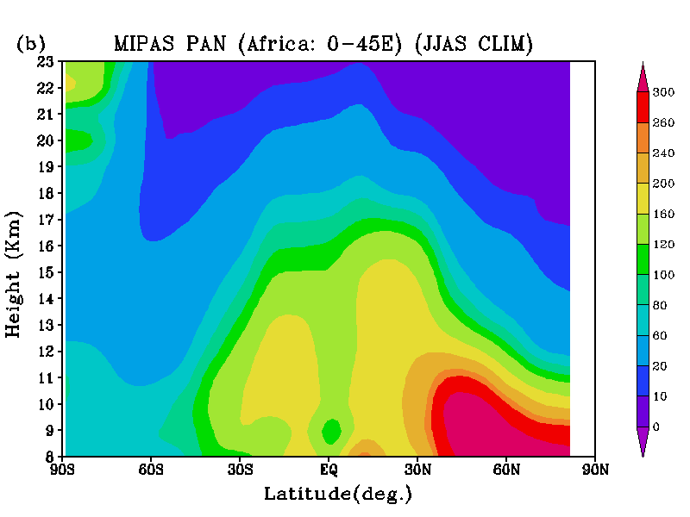
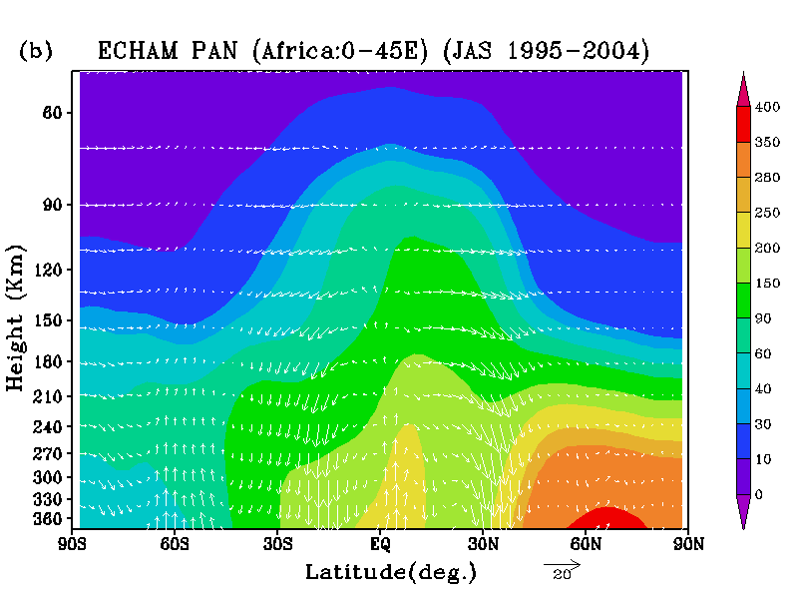
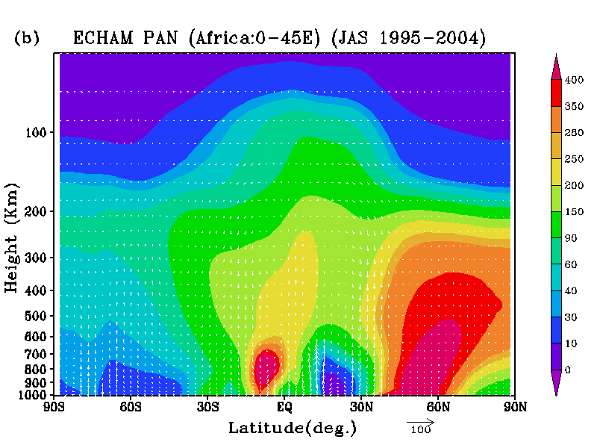
Transport of PAN over the Africa
PAN from South Africa is transported north ward and upward over the equator.
PAN from Europe is transported ward and pole ward.

Slide 24
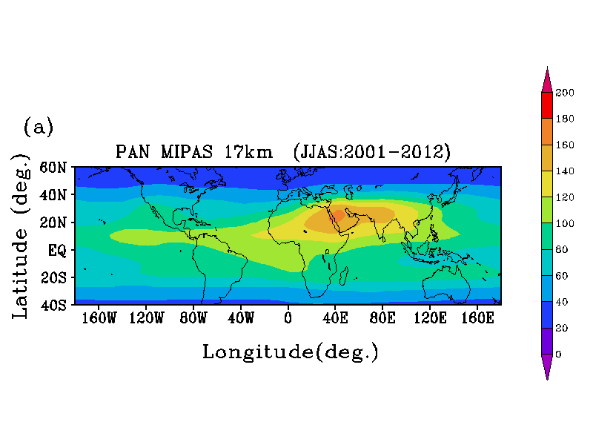
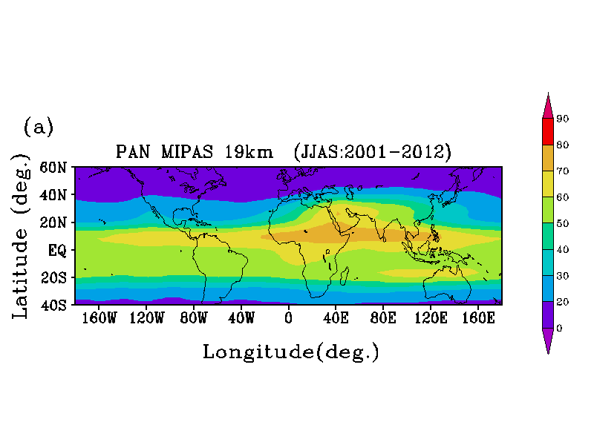
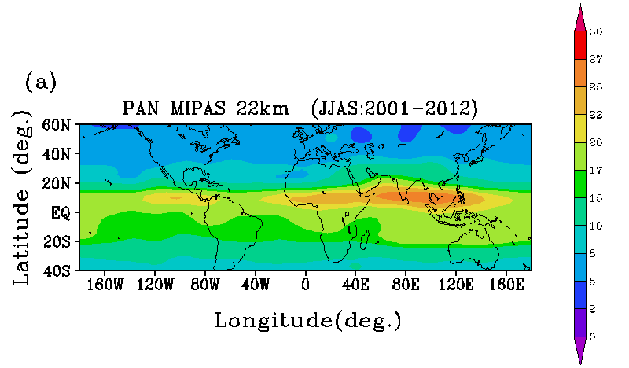

Horizontal distribution in the lower stratosphere

Slide 25

“Coming Together is a Beginning
Keeping Together is Progress
Working Together is Success”
Thank You!
suvarna@tropmet.res.in

