Slide 1



Modeling Stratospheric Aerosols at Background Levels: New Results from SOCOL and GEOS-CHEM
Debra Weisenstein¹, Sebastian Eastham², Jianxiong Sheng³,
Steven Barrett², Thomas Peter³, David Keith¹
¹ Harvard University, Cambridge, MA, U.S.A.,
² Massachusetts Institute of Technology, Cambridge, MA,
³ ETH-Zurich, Zurich, Switzerland
SSiRC Meeting
28-30 October 2013

Slide 2
Why study background aerosols?
Background and perturbed conditions are two different regimes
Perturbed conditions decay to background conditions
Transport of sulfur gases and aerosol across the tropopause uncertain
Smaller background particles harder to measure
Calculated size distributions under background condition don’t match well to available observations

Slide 3
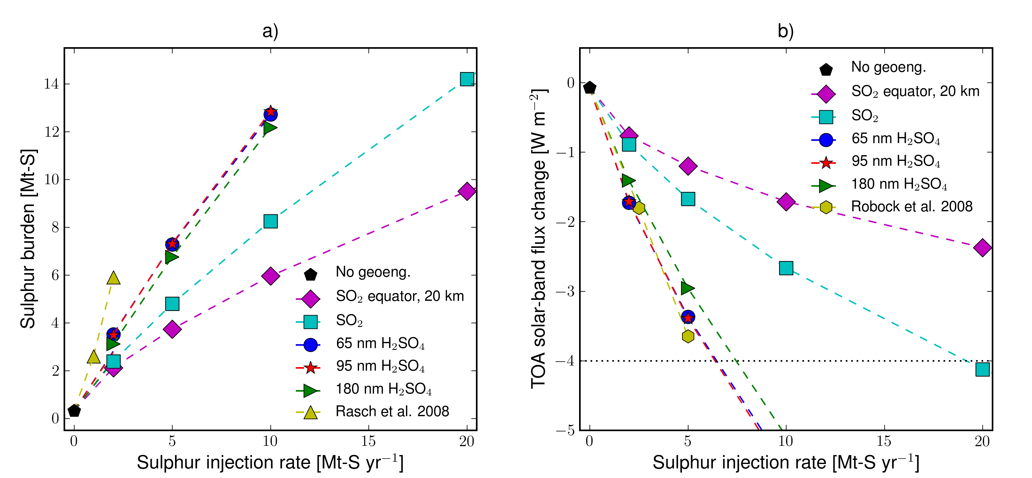
Motivation for Model Development
Aerosol-Climate Studies: Geoengineering, Volcanoes
Sulfur chemistry, aerosol microphysics
Ozone interactions
Strat-trop exchange: impact on tropospheric chem + clouds
Climate response

Slide 4
Models Used in This Study
SOCOL CCM: ETH – AER Collaboration
Chemistry-Climate model at ETH
Aerosol microphysics from AER 2-D
Add aerosol microphysics to SOCOL SOCOL/AER
Chemistry-Climate-Aerosol-Radiation interactions
GEOS-CHEM CTM: Harvard – MIT Collaboration
Comprehensive, validated tropospheric chemistry
Multi-component aerosol microphysics package APM
Extend chemistry into stratosphere UCX
Extend microphysics into stratosphere
Chemistry-Aerosol-Radiation interactions for trop + strat
No interactive climate response

Slide 5
SOCOL/AER
Chemistry-climate model from ETH-Zurich
MA-ECHAM GCM + MEZON chemistry
Aerosol microphysics:
Sulfate only scheme following AER 2-D model
Improved H₂SO₄ photolysis rate (Vaida et al. 2003)
40 sectional bins (wet radius 0.4 nm – 3.2 μm)
Size-dependent composition (H₂SO₄/H₂O): Kelvin Effect
Binary homogeneous nucleation (Vehkemaki et al. 2002)
Coagulation (standard efficiency)
Condensation and Evaporation
Sedimentation
Aerosol – Radiative feedback (chemical and dynamical)

Slide 6
GEOS-CHEM
Harvard’s 3-D tropospheric chemistry model
Assimilated winds from GEOS-5, GISS, etc.
Not a climate model, but off-line climate model interactions possible
Two versions of aerosol microphysics implemented:
Sulfate, sea salt, dust, OC, BC for troposphere
APM – Fangqun Yu, SUNY-Albany
Sectional microphysics, 88 aerosol tracers
TOMAS – Peter Adams, Carnegie Melon
Sectional 2-moment microphysics, 360 aerosol tracers

Slide 7
GEOS-CHEM with APM
Part of standard GEOS-CHEM distribution – optional compilation
Size-resolved aerosols:
40 sulfate bins (dry radius 0.6nm -5.8 μm)
20 sea salt bins, 15 dust bins,
8 modes for OC/BC
Aerosol type interactions: sulfate scavenging onto dust, sea salt, OC/BC
Equilibrium uptake of ammonium and nitrates via ISORROPIA II
Ion-mediated nucleation scheme
Coagulation and Condensation
Tested and validated for troposphere
APM microphysics to be extended into stratsphere model: add strat nucleation, radiative interactions

Slide 8
Stratospheric GEOS-CHEM (UCX)
Stratospheric chemistry extension developed by Steven Barrett’s group at MIT, Seb Eastham primary developer
72 vertical levels to 0.01 mb (chem to 60 km)
Sources gases added: OCS, N₂O, CFCs, HCFCs, etc.
Stratospheric photolysis via FastJX
Full ozone chemistry included from NO_{x}, ClO_{x}, BrO_{x}, HO_{x}
Bulk sulfate and PSCs in stratosphere
Submitted paper to Atmos. Env.
To become part of future GEOS-CHEM public release
APM microphysics to be integrated soon by D. Weisenstein (Harvard)

Slide 9
UCX Stratospheric Chemistry
Br
Cl
Catalytic 0₃ loss
BrNO₂
Cl₂O₂
H₂O
HBr
BrO_{x}
BrCl
HCl
ClO_{x}
PSC/LBS
N
BrONO₂
ClONO₂
HNO₃
NO_{x}
Gravitational settling
S
H₂SO₄
hν
Release of active species
SO₂
¹D
TROPOPAUSE
SOURCE
OCS
N₂O
Br_{org}
CH₄
Cl_{org}

Slide 10
UCX Aerosol domains
In troposphere:
ISORROPIA II does equilibrium condensation of ammonium and nitrates into sulfate particles
In stratosphere:
Ammonium ignored (advected normally)
Gas/liquid partitioning of H₂SO₄ applied:
Liquid H₂SO4 particles below ~35 km
Gas phase H₂SO₄ above ~35 km
Photolysis of gas-phase H₂SO₄ yields SO₂
Equilibrium condensation of H₂O/HNO₃/HCl/HBr into particles to form PSCs
PSC types: STS, NAT, Ice
Supersaturation of 3K for NAT formation

Slide 11
Aerosol/Gas Interactions
Photolysis rates impacted by aerosol scattering
Heterogeneous reactions on solid and liquid aerosols
Shifts in mid-latitude NOx/ClOx partitioning
chlorine activation during polar winter/spring

Slide 12
2006 Antarctic Ozone Hole GEOS-CHEM UCX Simulation

Slide 13
Comparison of 3 Models
 | GEOS-CHEM/UCX 2007 | GEOS-CHEM/APM 2005 | SOCOL/AER 2005
# Gas Species | 132 | 104 | 49
# Reactions | 342 | 240 | 283
Stratospheric Aerosol Types | Sulfate (LBS, STS), PSCs (NAT, Ice) |  | Sulfate (40 bins)
Tropospheric Aerosol Types | Sulfate, Dust (4), Sea Salt (2), BC/OC (4), SOA (optional) | Sulfate (40), Dust (15), Sea Salt (20), BC/OC (8), sulfate on dust/seasalt/OC/BC, SOA (optional) | Sulfate (40 bins)
Model Top | 0.01 hPa | 0.01 hPa | 0.01 hPa
Chemistry Top | 60 km + linearized chemistry above | 20 km + linearized chemistry above | 80 km (same as dynamics)
Model Grid | 4°x5°,72 Levels | 4°x5°, 47 Levels | 3.75°x3.7°, 39 Levels

Slide 14
Sulfur Gas Emissions and Boundary Conditions
 | GEOS-CHEM UCX | GEOS-CHEM APM | SOCOL/AER
SO₂ Emissions | Anthropogenic Shipping Aircraft Biofuel Volcanic | Anthropogenic Shipping Aircraft Biofuel Volcanic | Anthropogenic=46 Tg Shipping = 4.9 Tg Biomass burning = 1.9 Volcanic = 12.6 Total = 65 Tg/yr
DMS | Oceanic emission | Oceanic emission | Oceanic = 18 Tg/yr
CS₂ | None | None | 1 Tg/yr
H₂S | None | None | 8 Tg/yr
OCS | 500 pptv fixed mixing ratio | None | 500 pptv fixed mixing ratio

Slide 15
Modeled OCS + ATMOS Observation

Slide 16
Modeled SO₂ + ATMOS Observation

Slide 17
SOCOL/GEOS-CHEM Comparison
H₂SO₄ + hv ➔ SO₂
OCS removal in tropical mid-strat
as source of SO₂
CS₂, DMS, H₂S convective transport to tropical mid-trop as source of SO₂.
Scavenging removal efficiency?

Slide 18
SOCOL/GEOS-CHEM Sulfate Comparison
APM Aerosol Sulfate
Ion-mediated nucleation
in boundary layer

Slide 19
SOCOL/AER Sulfur Budget

Slide 20
Aerosol Size Distributions Equator, 20 km, October
SOCOL
GOES-CHEM APM
Effective nucleation near tropical tropopause. Mixing of aged particles
Less nucleation near tropical tropopause. No aged stratospheric particles above.

Slide 21
SOCOL Size Distributions in March
Equator
45°S
45°N

Slide 22
Comparisons of SOCOL and OPC
2000-2010 Laramie
SOCOL calculates too many particles above 20 km.

Slide 23
Extinctions from SOCOL and SAGE II
Equator, April and October
SOCOL overpredicts 1.02 μm extinction above 20 km.

Slide 24
Extinctions from SOCOL and SAGE II
45N, January and July

Slide 25
0.525 μm Extinction from SOCOL
at 20 km in September

Slide 26
Summary
SOCOL/AER CCM with microphysics
Robust results
OCS, SO₂ compare well with observations
Good representation of background stratospheric aerosol conditions
Too many particles above 20 km, 1.02 μm extinction overestimated
GEOS-CHEM extension into stratosphere
Promising results with bulk sulfate model
APM microphysics to be implemented
Future Testing and Validation
SO₂ comparisons with MIPAS and other observations
Aerosol extinction comparisons with satellite observations
Evaluation of tropospheric convection and scavenging as controls of stratospheric sulfur
Volcanic simulations (Nabro, etc)

